Slide 1
What’s New?
Russell Palmer
Assistant Director for Support Services
russell.palmer@usg.edu

Slide 2
Agenda
GALILEO overview
Navigation basics
Authentication with OpenAthens
New to TCSG: WestLaw
Resources you’ll want to use
Primary sources and the Digital Library of Georgia
Q&A Time: What do you and your students need?

Slide 3
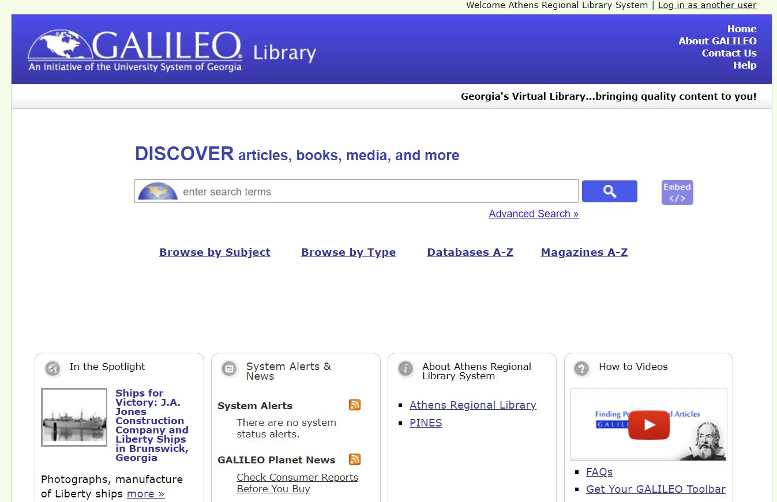
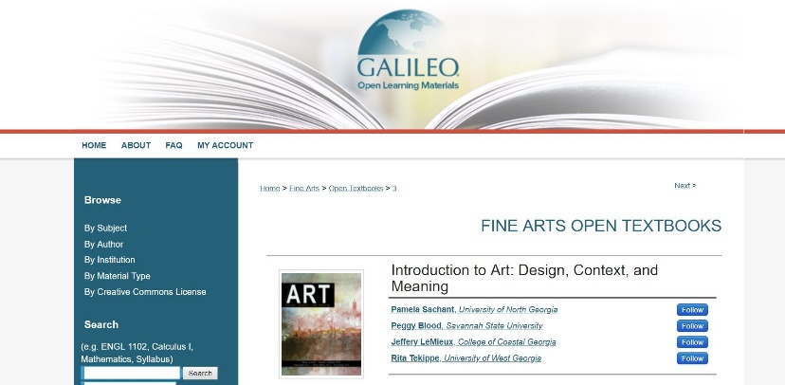
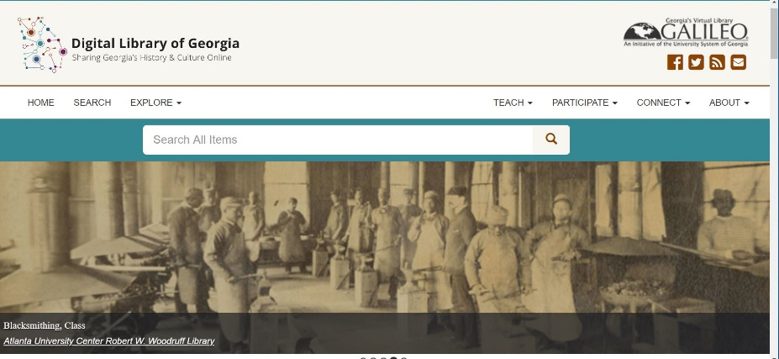
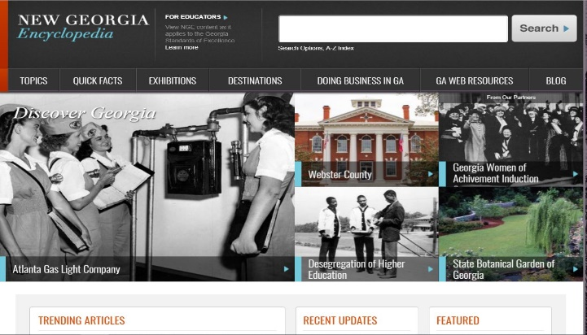
Notes:
GALILEO serves as part of the Board of Regents of the University System of Georgia.
GIL: 313 miles (503 KM) from Dalton State to Valdosta State, same day delivery via GIL Express
Illustrate the way that all the programs are interconnected and interoperable, up to a point beginning with “Mother GALILEO and her creation in 1995” through to the success of OER/ALG
Since ALG started in 2014-15, the program has saved USG students over 31 million us dollars in textbook costs

Slide 4
Discover Search, browsing options

Slide 5
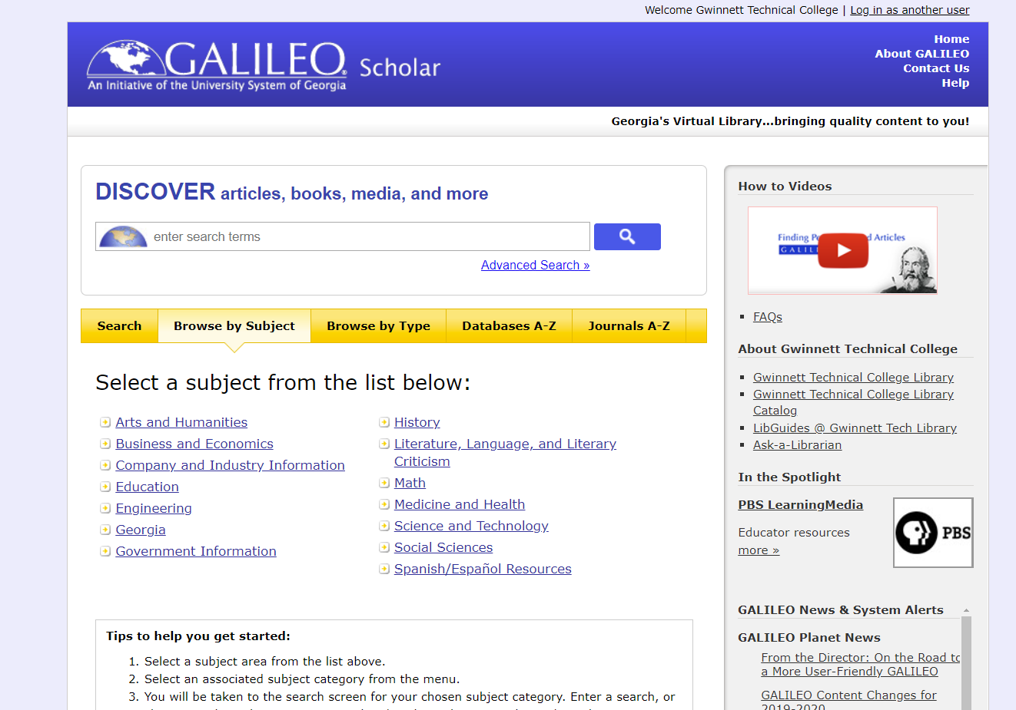

Slide 6
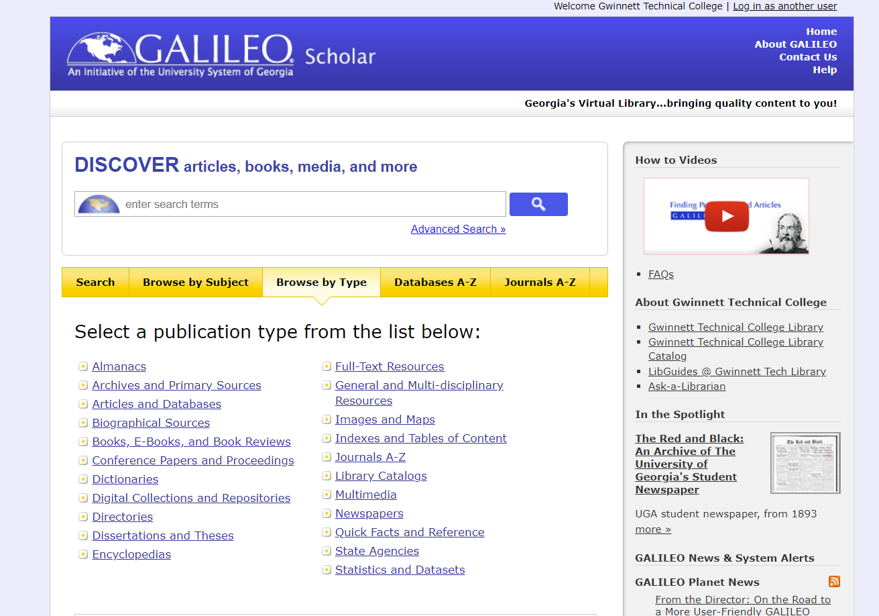

Slide 7
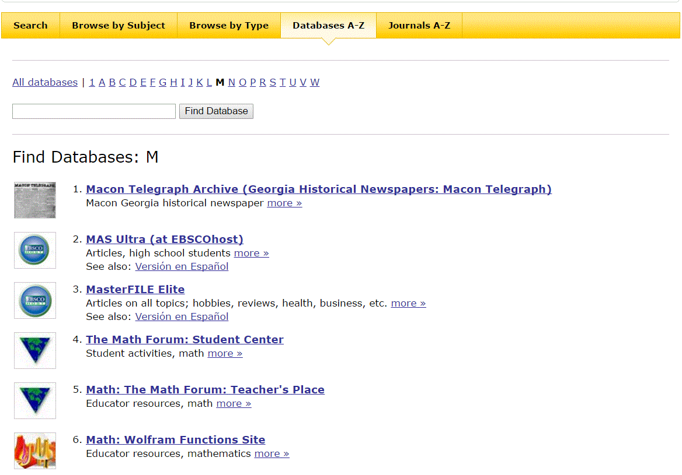
Databases A-Z

Slide 8
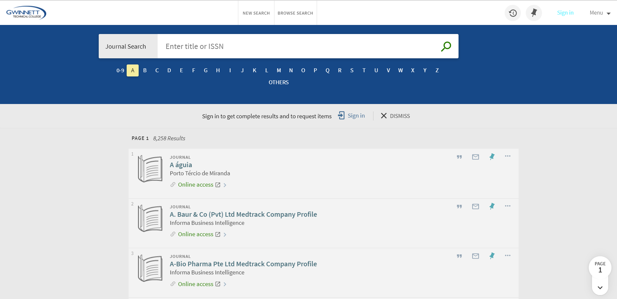
Journals A-Z

Slide 9
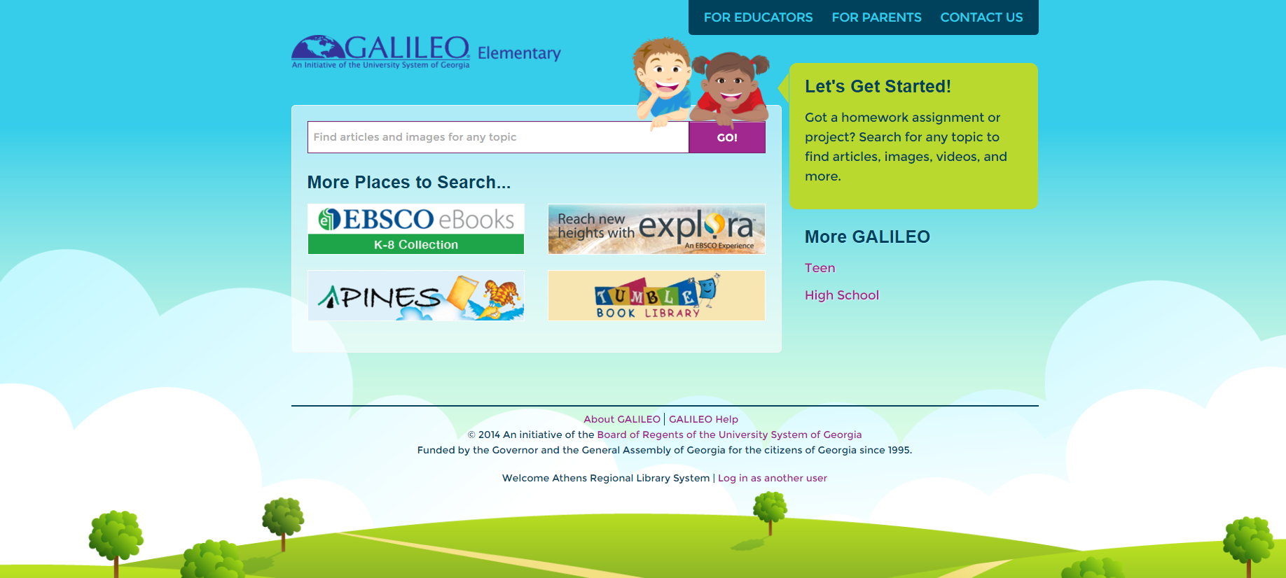
GALILEO Interfaces
Scholar
Kids
Book Collection: Nonfiction
Britannica School Elementary
Funk and Wagnall’s New World Encyclopedia
History Reference Center
Primary Search
High School
15 databases (ebooks, articles, encyclopedias and more)
Teen
20+ databases (ebooks, articles, encyclopedias, and more)

Slide 10
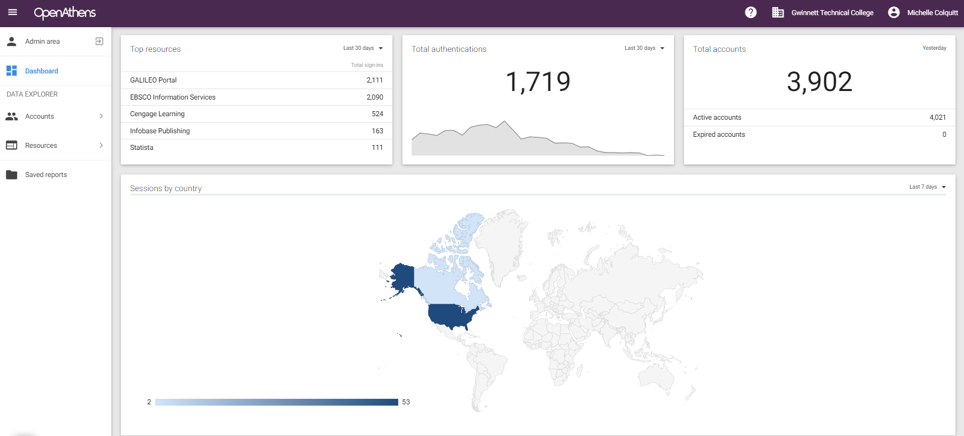
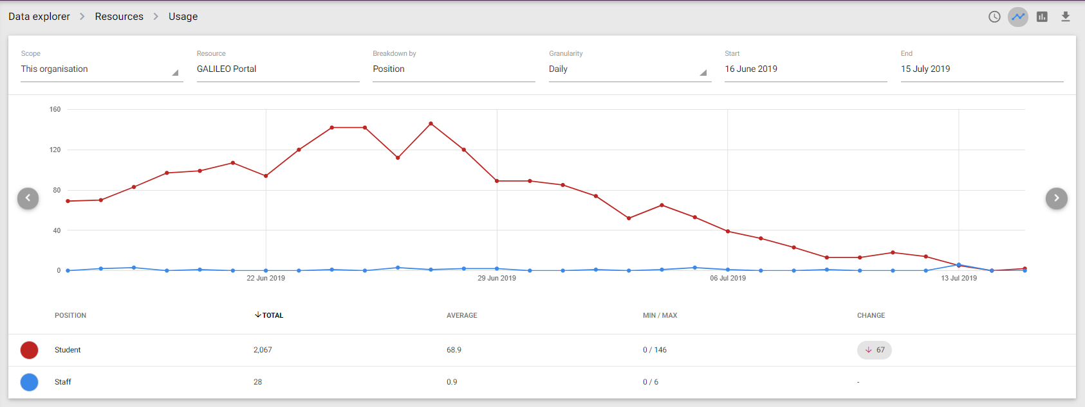
Authentication With OpenAthens

Slide 11
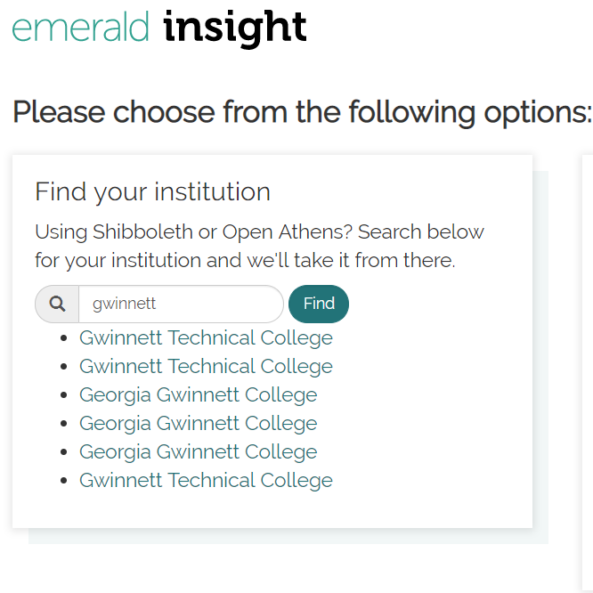
Goal: Make authentication as easy as possible

Slide 12
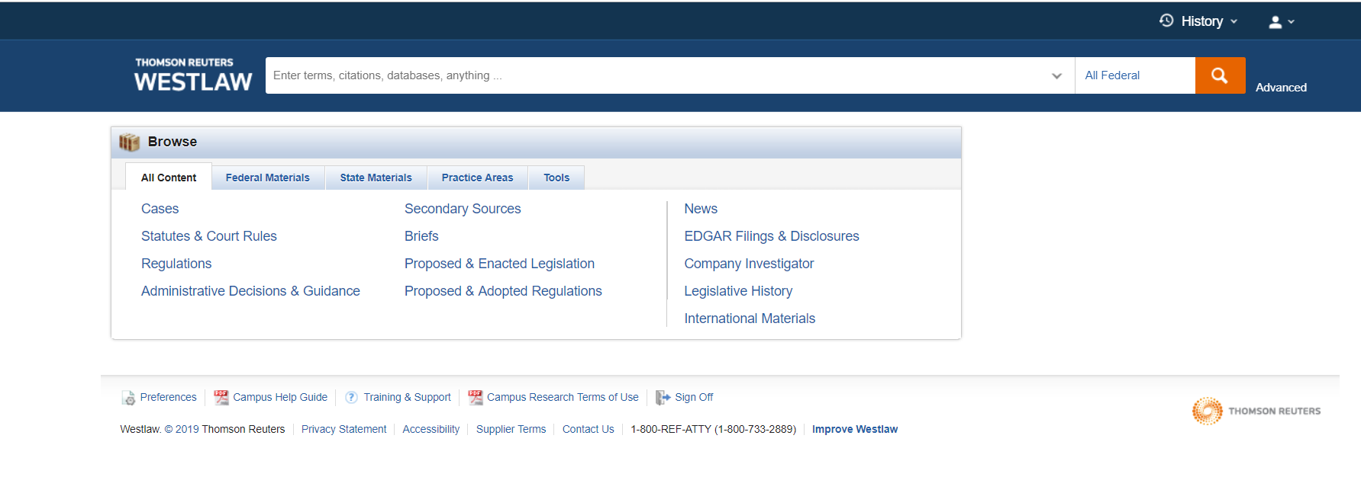
GALILEO Content
New!
WestLaw

Slide 13
Did you know…
Auto Repair Source
https://www.galileo.usg.edu/express?link=zbuu
Films on Demand
https://www.galileo.usg.edu/express?link=zfod
Nursing and Mental Health in Video
https://www.galileo.usg.edu/express?link=nurm-gwt1
Ancestry Library Edition
https://www.galileo.usg.edu/express?link=zual

Slide 14
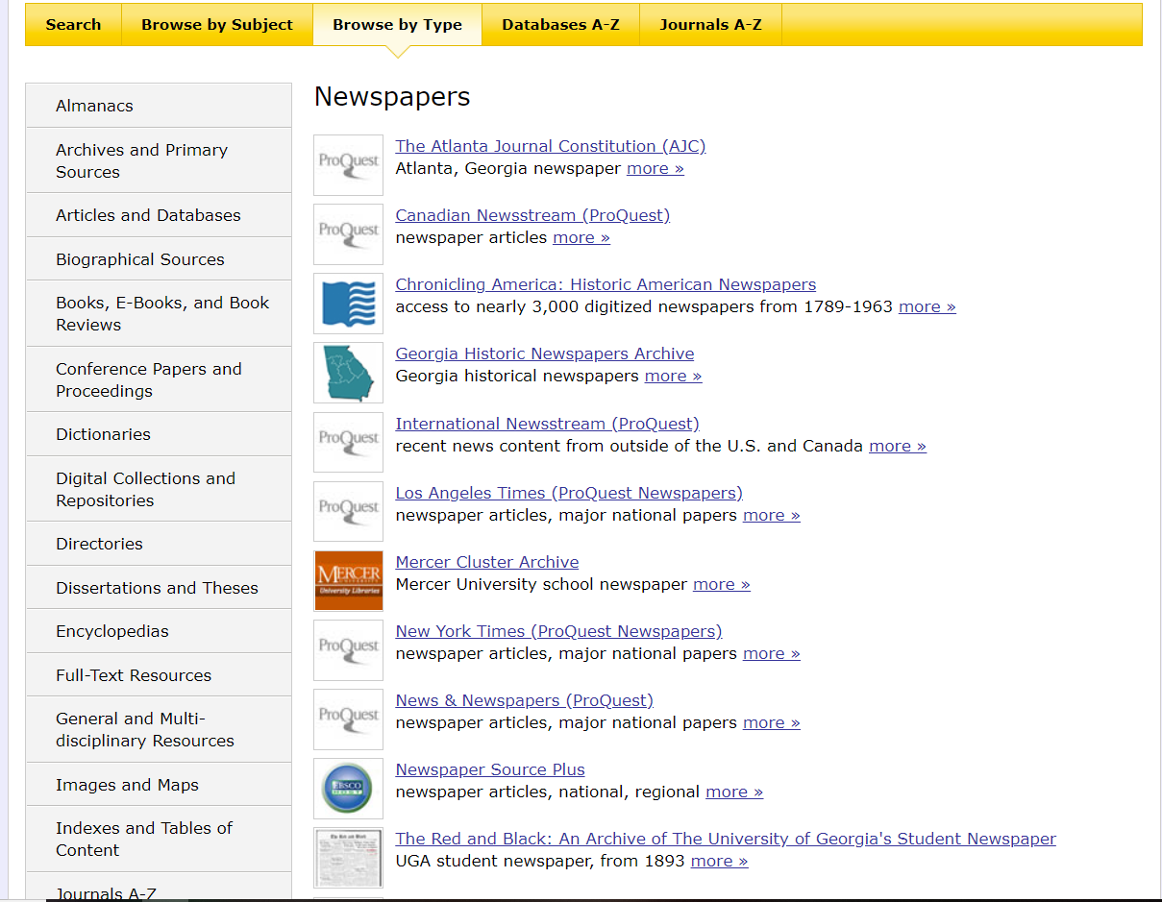
After Nexis Uni: Newspaper Access
Newspaper Source Plus (upgraded)
News and Newspapers (ProQuest)
New York Times
AJC
WSJ
Washington Post

Slide 15
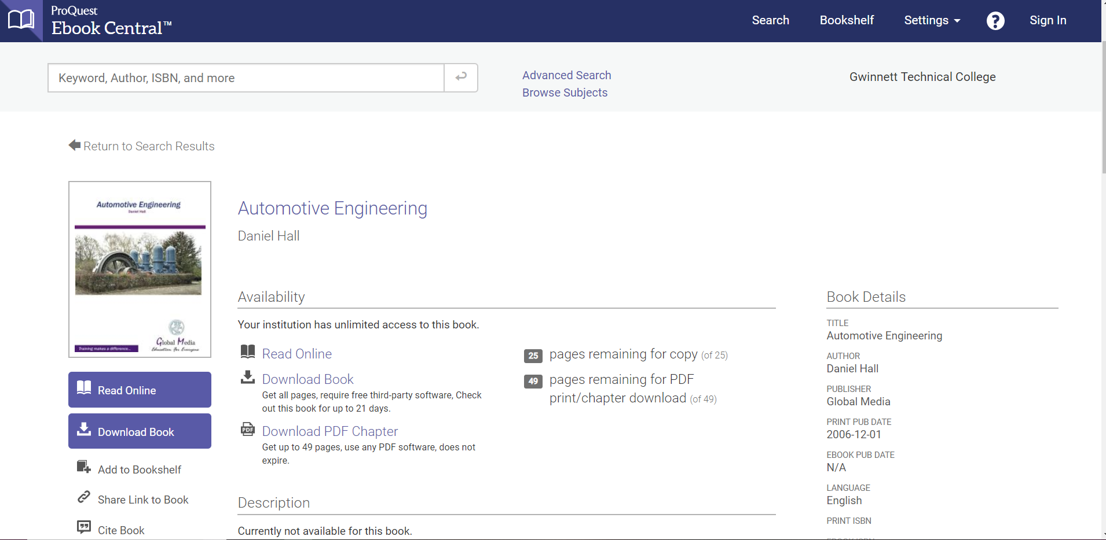
e-books
EBSCO eBook collections
Ebook Central
Books 24 x 7 (Gwinnett Tech)

Slide 16
Primary documents (Updated 2019)
Georgia Historic Newspapers
New Georgia Encyclopedia
Digital Library of Georgia

Slide 17
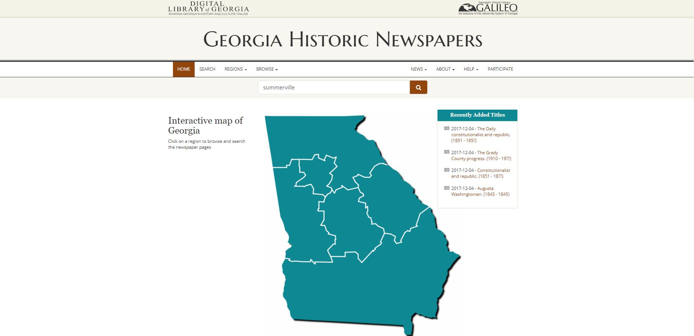
Georgia Historic Newspapers

Slide 18
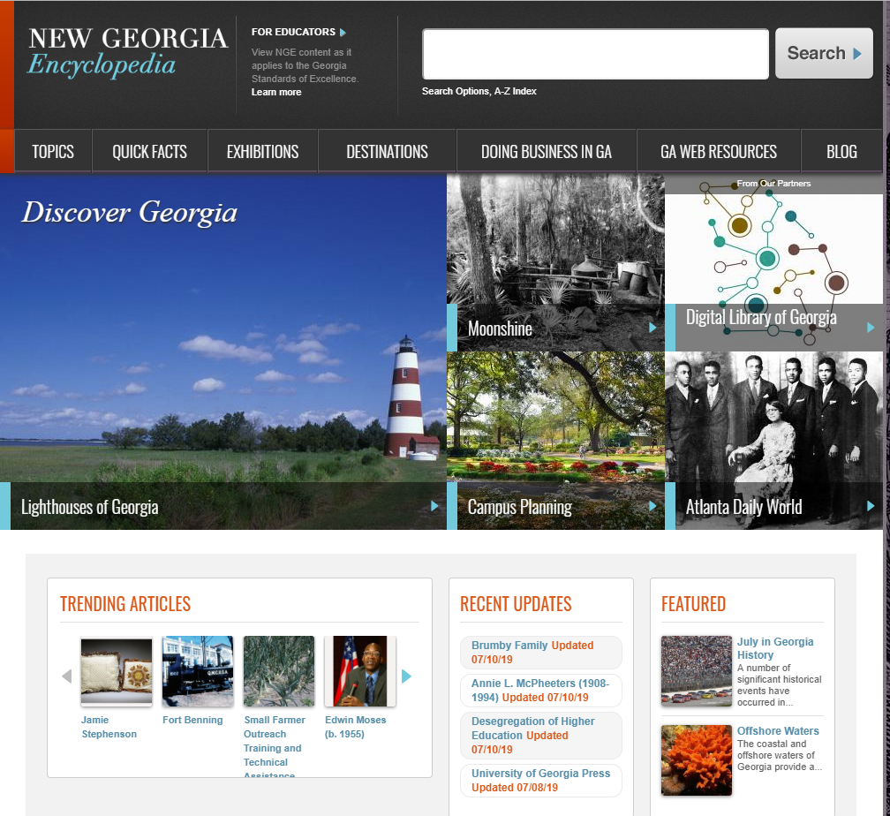

Slide 19
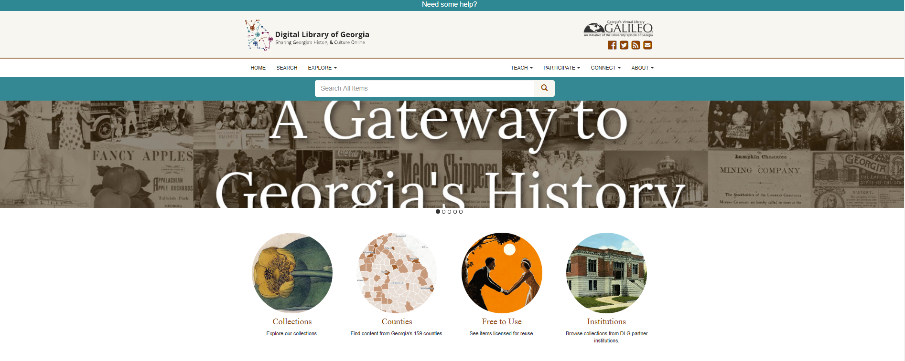

Slide 20
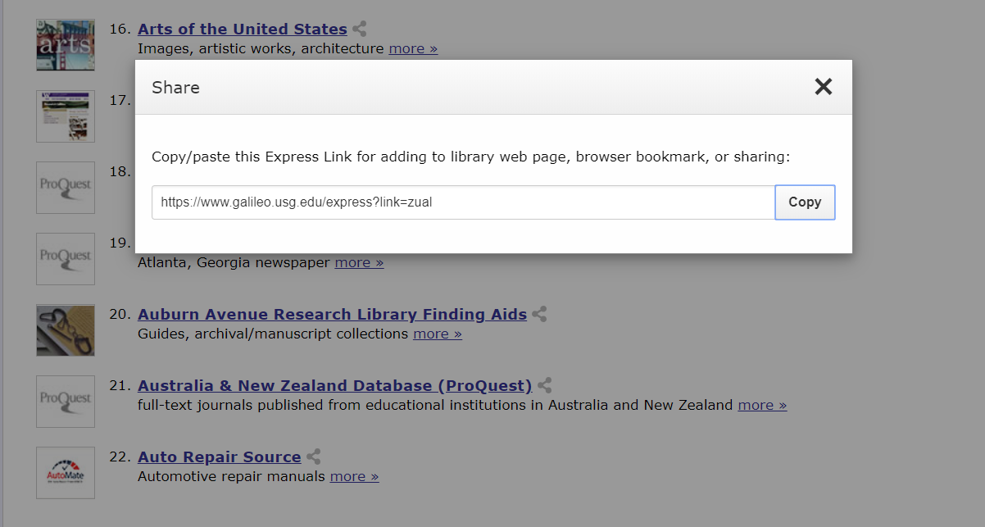
Making the most of GALILEO in the classroom and beyond
Express Links
Direct links to books/articles
Curriculum builder

Slide 21
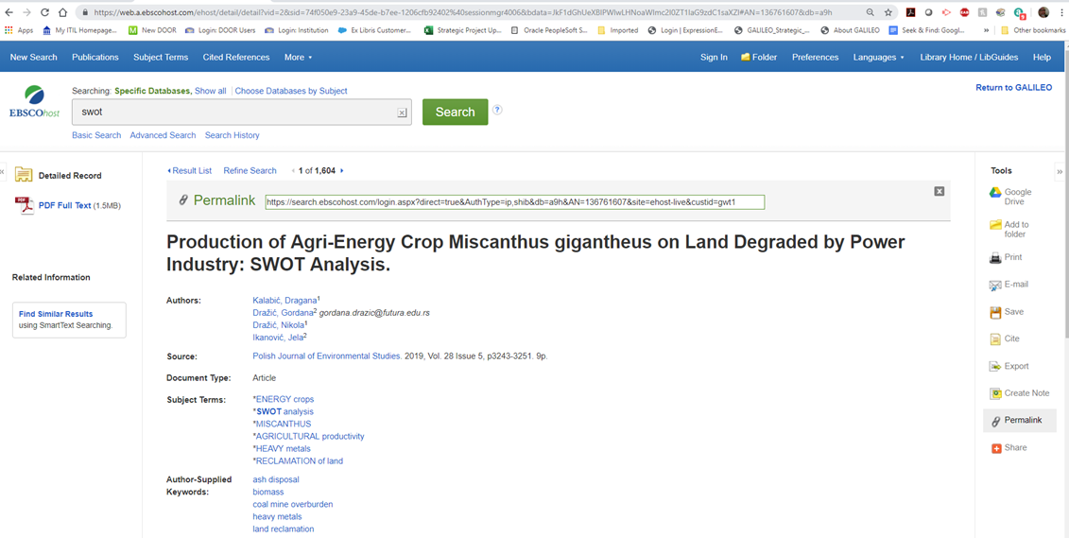

Slide 22
Curriculum Builder
Tool created by EBSCO which integrates into Blackboard
Allows faculty to easily build reading list using library resources (GALILEO and local) without leaving LMS
Student can access content without being prompted for password
Individual usage is reported when students access reading lists (eliminates copyright issues)
Available to all participating GALILEO institutions at no additional cost

Slide 23
Add Reading Lists (Instructor View)
You can add multiple reading lists and give each one a unique name.

Slide 24
Reading List (Instructor View)

Slide 25
Add Notes, Text, or External Resources (Instructor View)

Slide 26
Reading List (Student View)

Slide 27
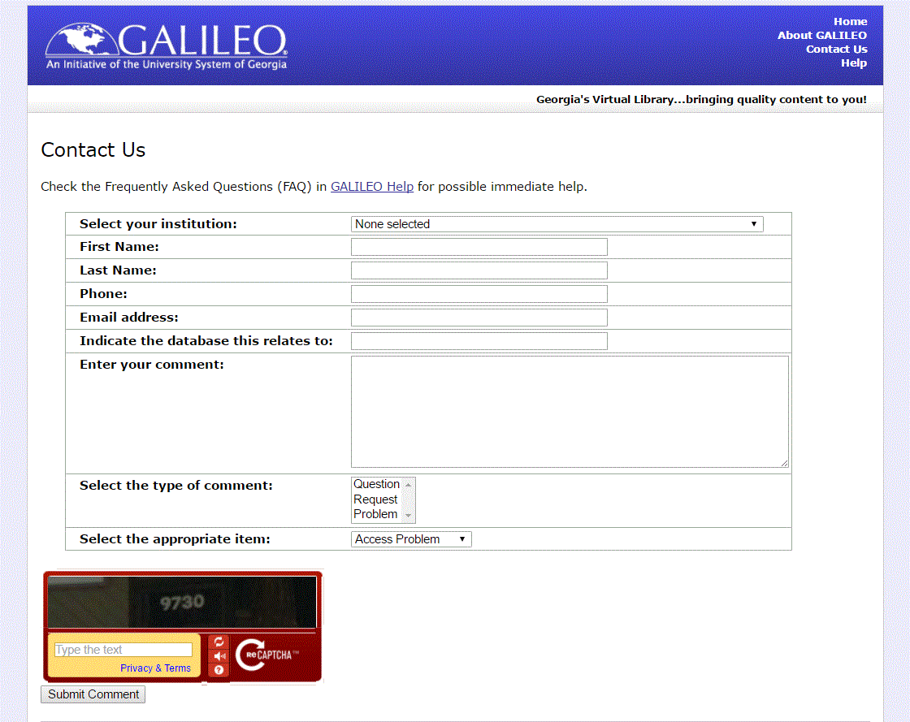
We are here for you!
GALILEO Support Services

Slide 28
GALILEO training is available
Our training schedule:
http://help.galileo.usg.edu/librarians/training
Face to face training?
russell.palmer@usg.edu

Slide 29
Thank you!
russell.palmer@usg.edu

