Slide 1
Discovering Triumph and Tragedy
Resources for Georgia
National History Day Research

Slide 2
Introductions
Penny Cliff, Education Specialist, Georgia Archives
Nicole Lawrence, Digital Library of Georgia Project Manager
Russell Palmer, Assistant Director, GALILEO Support

Slide 3
Agenda
Research Show & Tell (15 minutes each)
Georgia Archives
Digital Library of Georgia
GALILEO
NHD Research Focus Group (45 minutes)
Discussion
Q&A Time

Slide 4
The Georgia Archives
Resources for students and teachers
1918 to 2018 – 100-year Anniversary
National History Day Research
“Creating a More Educated Georgia”

Slide 5
National History Day Triumph and Tragedy Where to go? What to do? Resources at the click of a button Online or visit the Georgia Archives
Webpage (www.georgiaarchives.org)
Investigating with the click of a button. HOW?
Online Research – In House Research
Virtual Vault
Finding Aids
Book and Manuscript Catalog

Slide 6
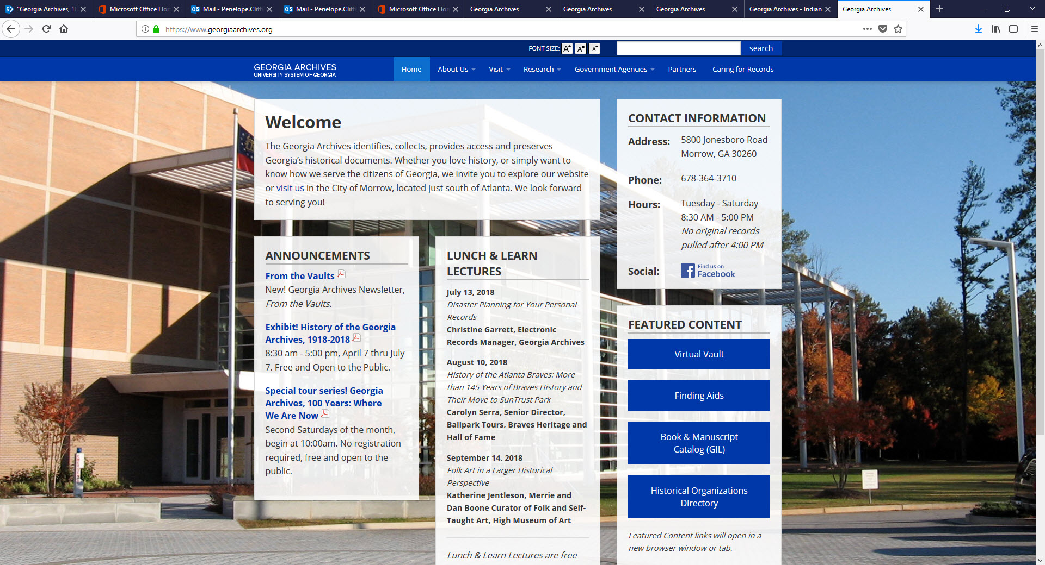
WHERE TO BEGIN: www.georgiaarchives.org

Slide 7
Reference Room
Ancestry
Family Search
Fold 3 (military records)
Search Finding Aids, Virtual Vault, Book and Manuscript Catalog
FREE – bring a flash drive

Slide 8
Reference Library -- Found in Book and Manuscript Catalog

Slide 9
Microfilm Area – Information on microfilm found in Virtual Vault or card catalog

Slide 10
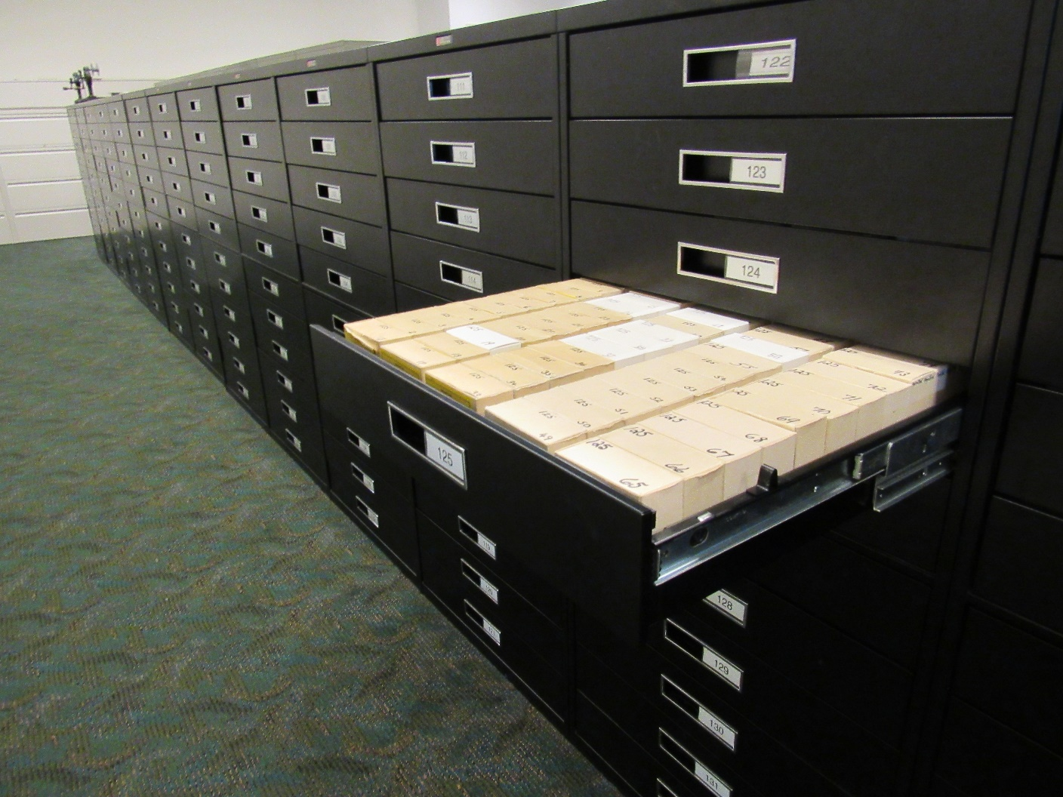
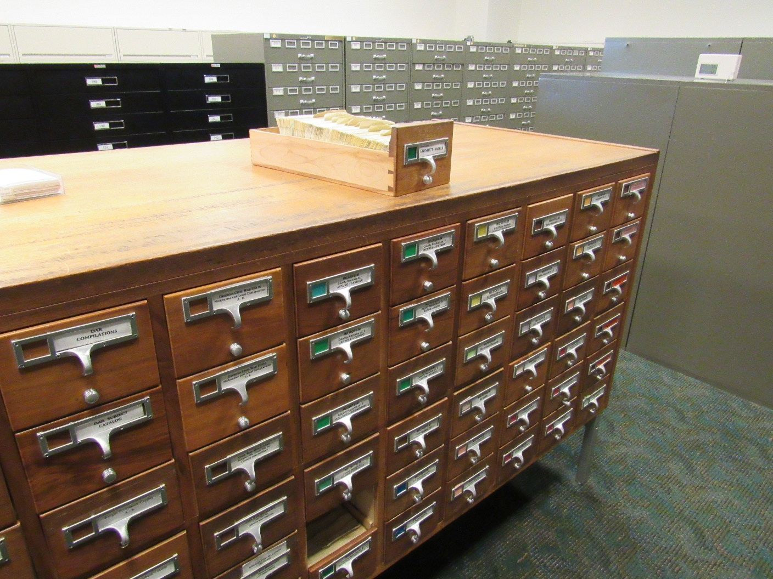
Microfilm drawers and card catalog

Slide 11
Original Documents Reading Area (ODRA) --Documents found in Finding Aids are viewed here

Slide 12
Original Documents Reading Area

Slide 13
Original Documents Reading Area (ODRA)

Slide 14
WHERE TO BEGIN: www.georgiaarchives.org

Slide 15
Virtual Vault – Online Resources
About the collections
This is your portal to some of Georgia's most important historical documents, from 1733 to the present. The Virtual Vault provides virtual access to historic Georgia manuscripts, photographs, maps, and government records housed in the state archives.
Start your search by typing a keyword into the "Search" box.
You do not need to login to the Virtual Vault to search the collections. The login at the top right of the screen is for administrative functions.
© 2017 Georgia Archives

Slide 17
Timpoochee Barnard, an Uchee warrior Large Print Collection, RG 48-2-2, Georgia Archives Ad Hoc Collection, Virtual Vault, Georgia Archives, University System of Georgia

Slide 18
Finding Aids
Online Descriptive inventories for Government Records Series
Browse Record Groups (Numeric) Browse Record Groups (A-Z) Search HTML Inventories
Browse by Record Group –

Slide 19
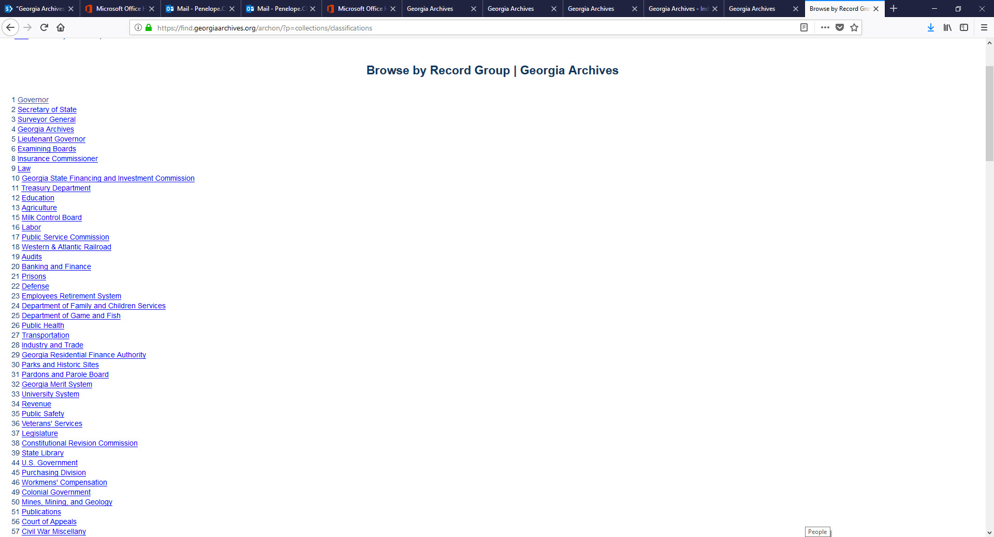

Slide 20
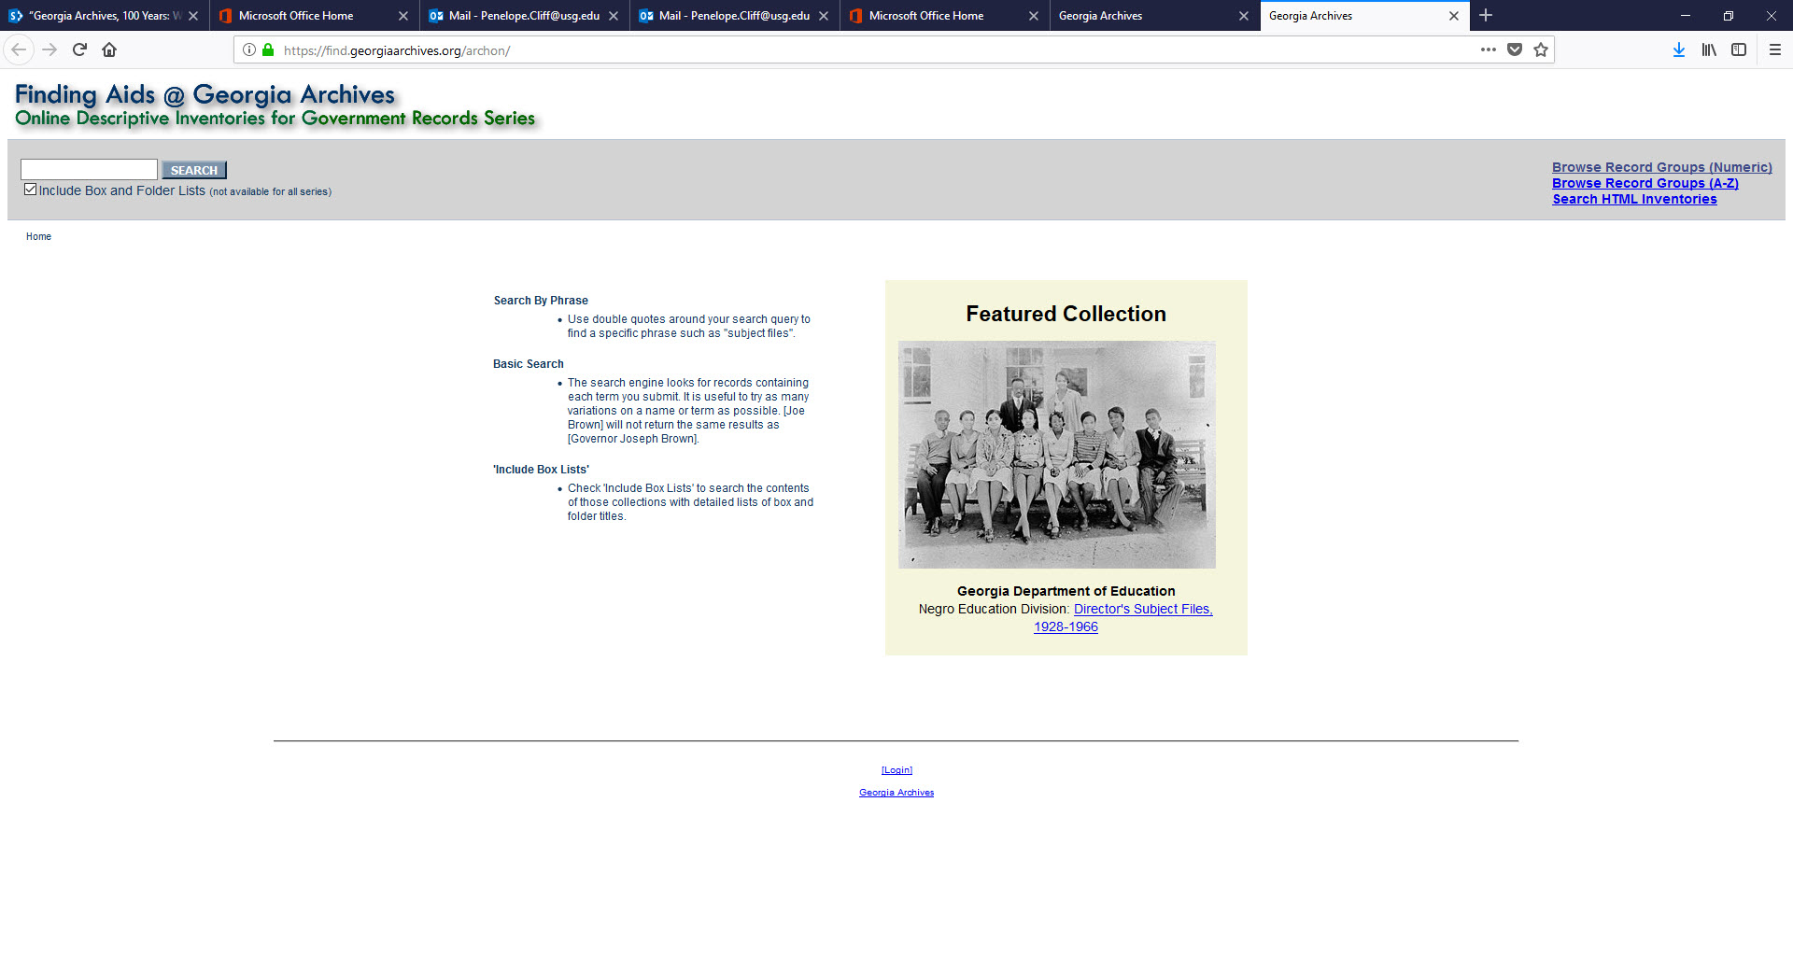

Slide 21
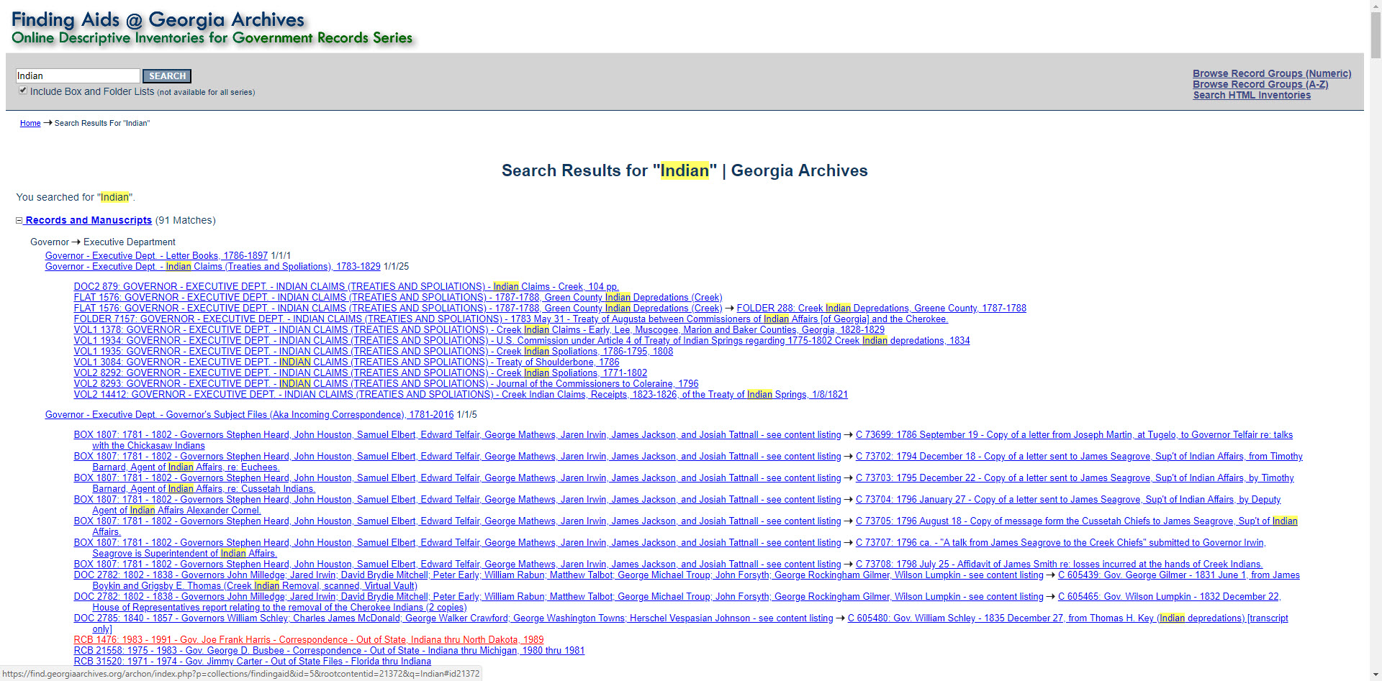

Slide 22
Book and Manuscript Catalog
Search Book and Manuscript Catalog

Slide 23
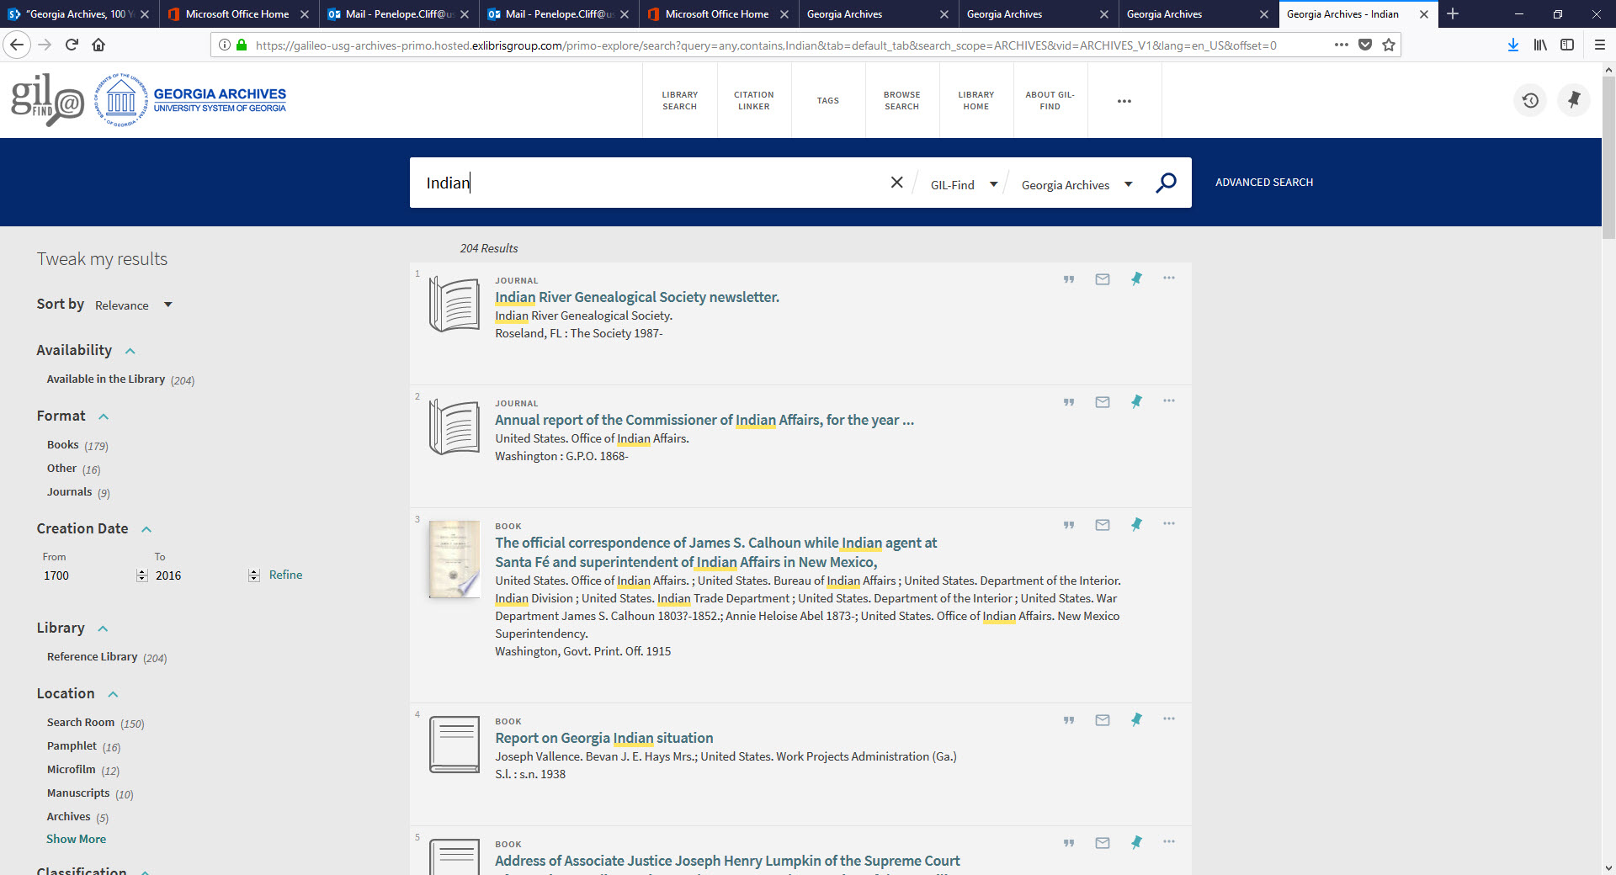

Slide 24
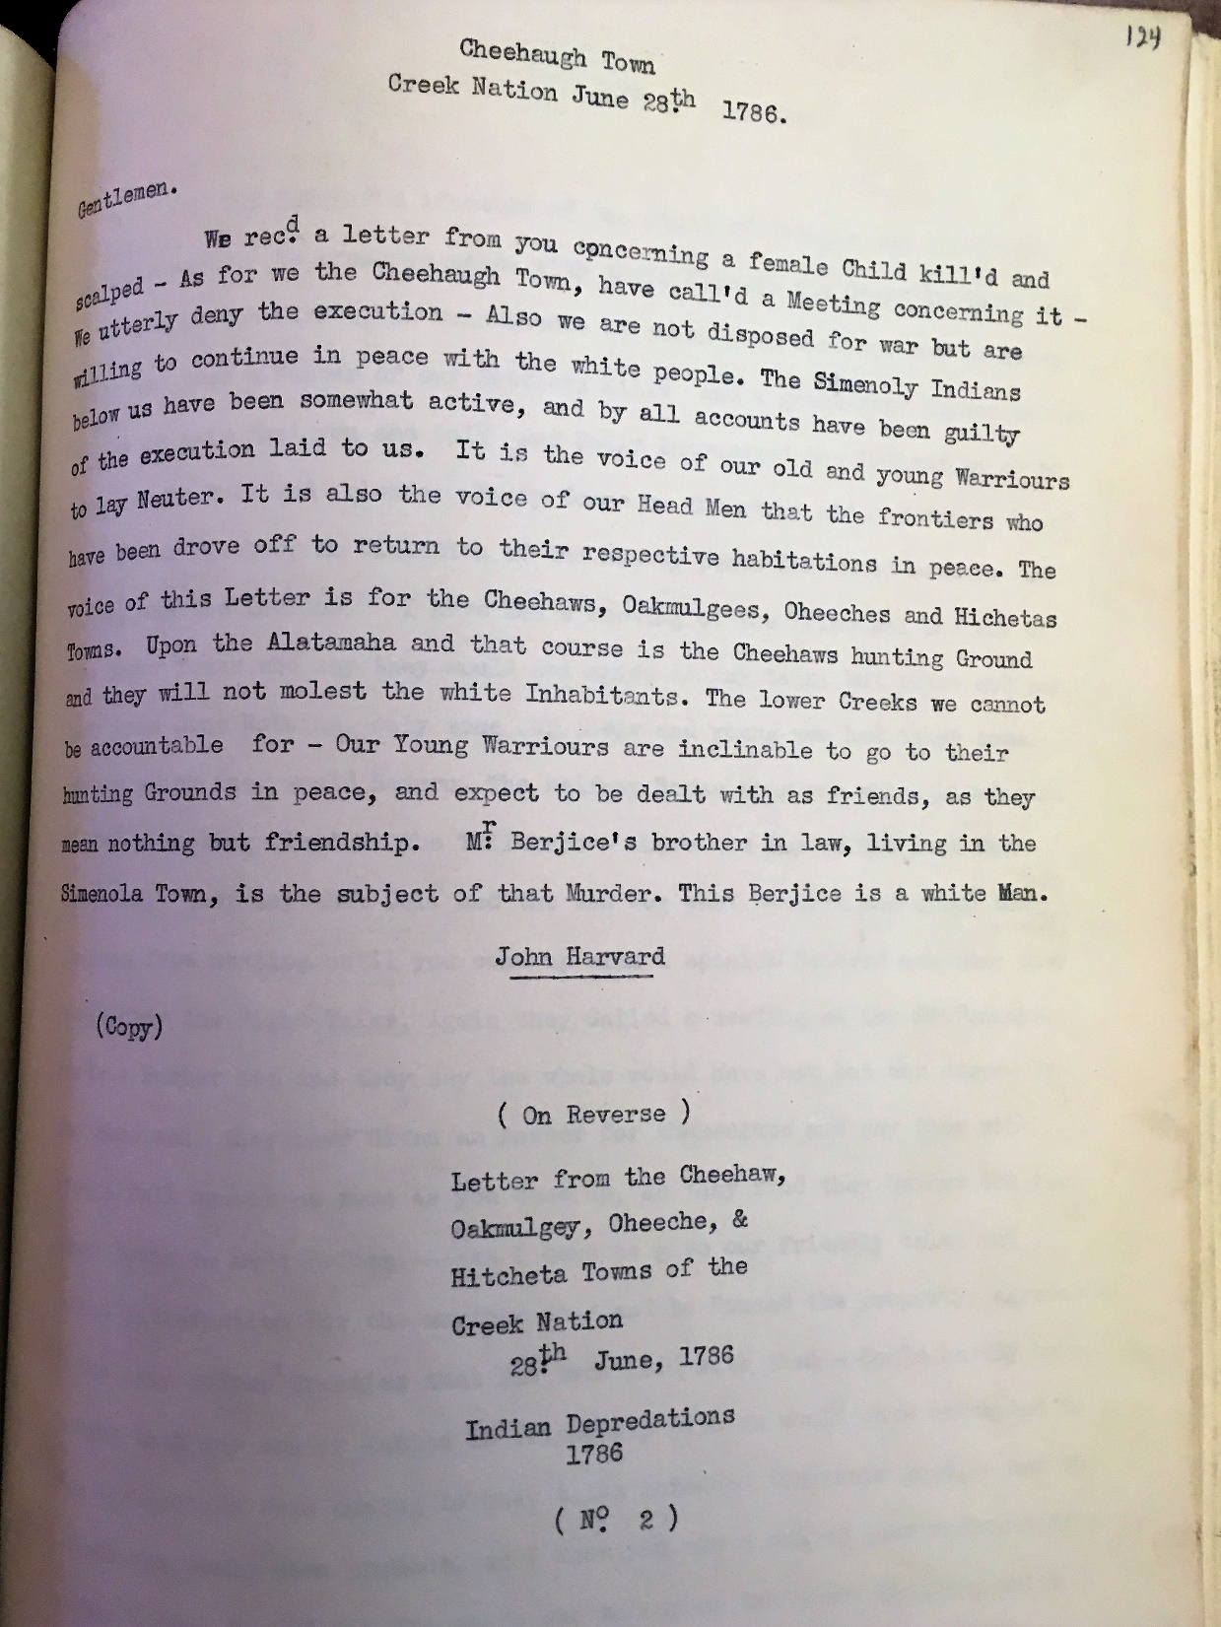
Native American History
Creek Indian Letters, Talks and Treaties, 1705-1839
Reference Library Search Room
Treaties
Head rights and Land Lotteries
Westward Expansion
Originals transcribed by the Works Progress Administration

Slide 25
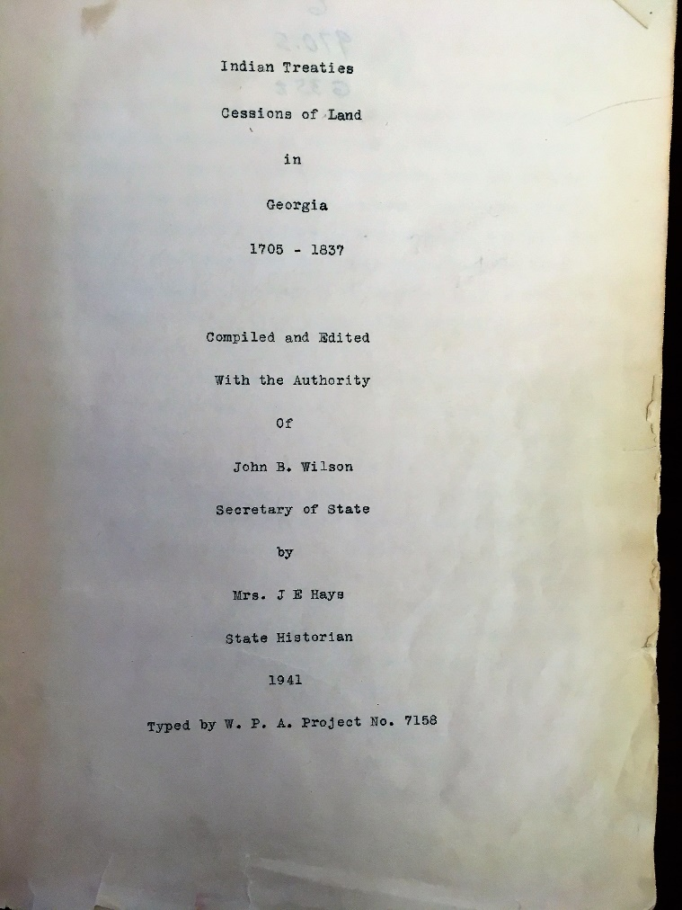
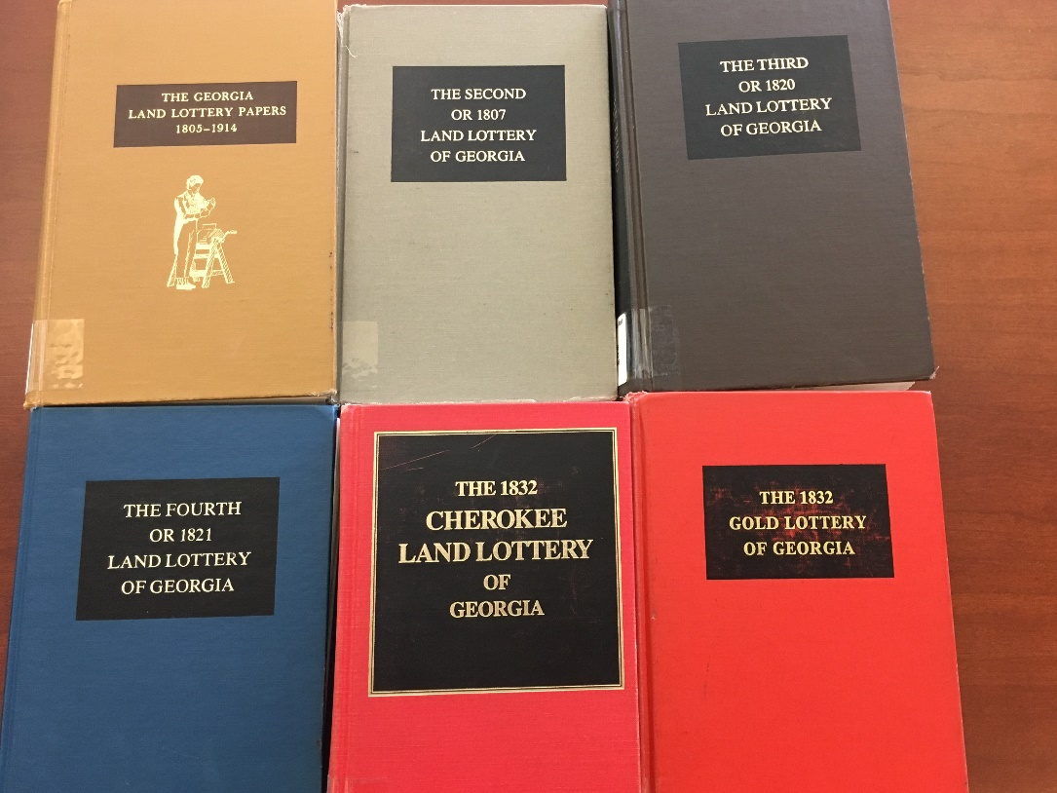
Native American History -- Book and Manuscript Catalog

Slide 26
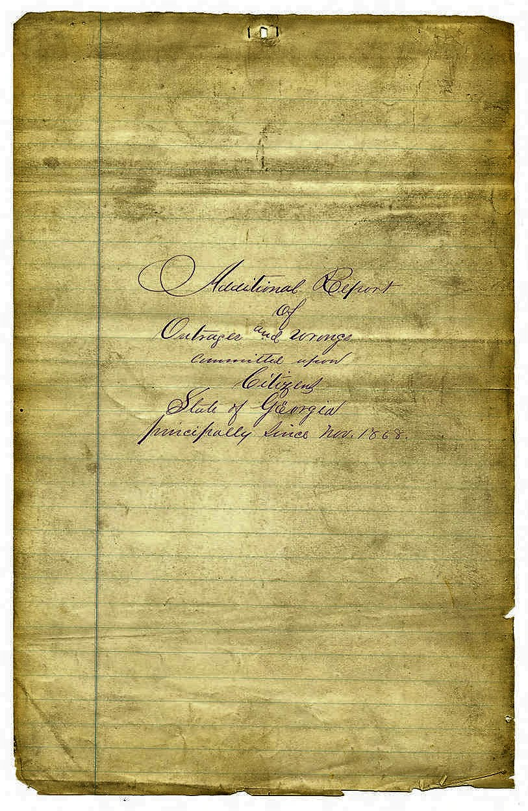
Virtual Vault: Triumph and Tragedy Challenges of the freedmen Triumph: Emancipation Tragedy: Living under Jim Crow
ONLINE in the Virtual Vault
Reconstruction – Freedmen’s Bureau
File II, Reference Services, RG 4-2-46, Georgia Archives

Slide 27
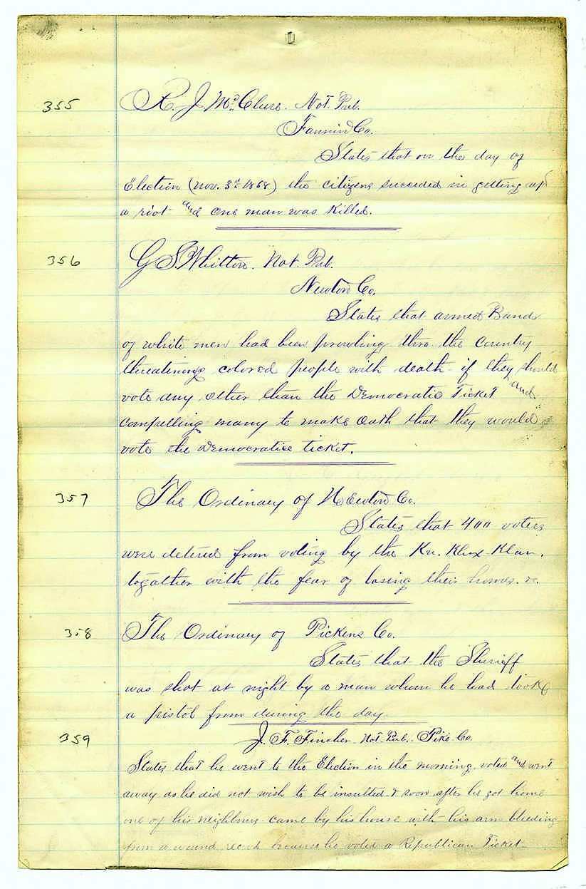

Slide 28
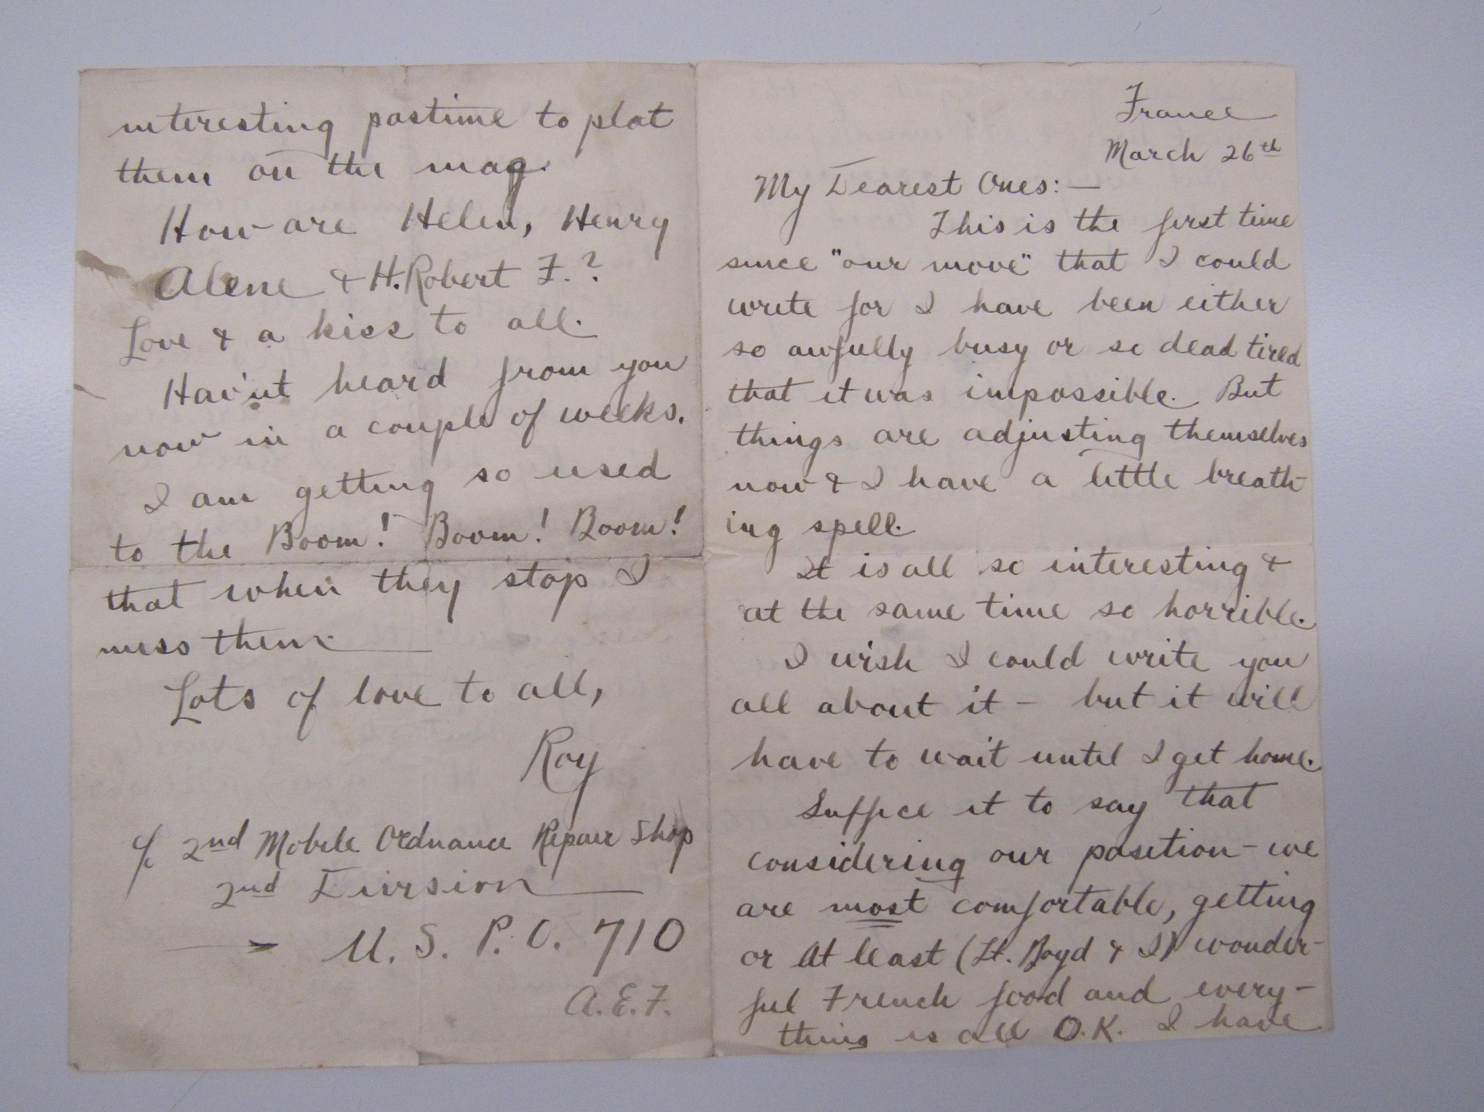
Triumph and Tragedy
Horrors of WWI
Hope of Home
Letter from Roy L. Bauer to his family in Atlanta, written while he was serving in France, Mary 26, 1918. Roy L. Bauer Papers, ac. 1975-0468M
PRIVATE manuscript

Slide 29
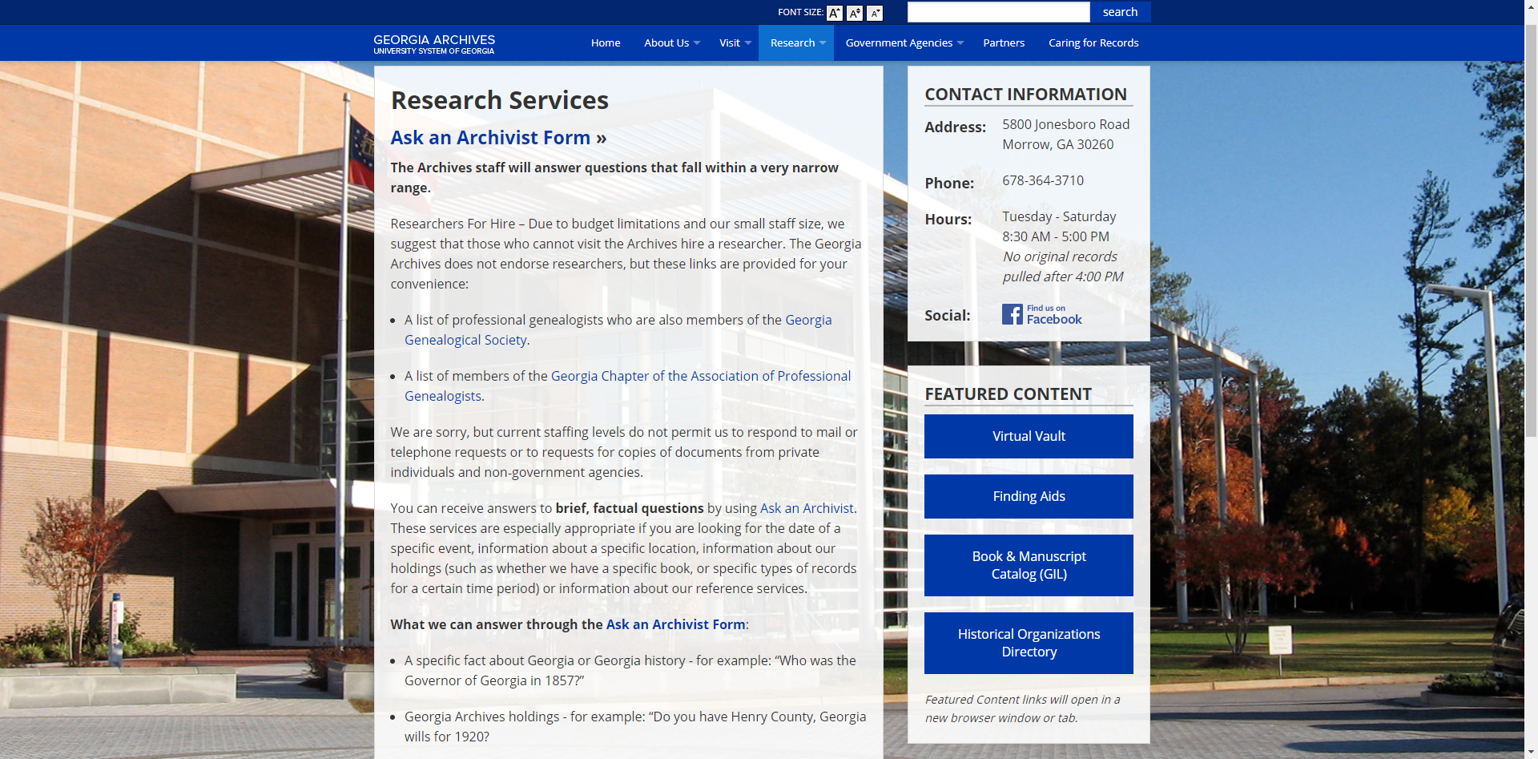
Resources At the Click of a Button
Ask an archivist
Online and In-House collections: Virtual Vault, Finding Aids and Book and Manuscript Catalog

Slide 30
Research Help – Research Guides

Slide 31
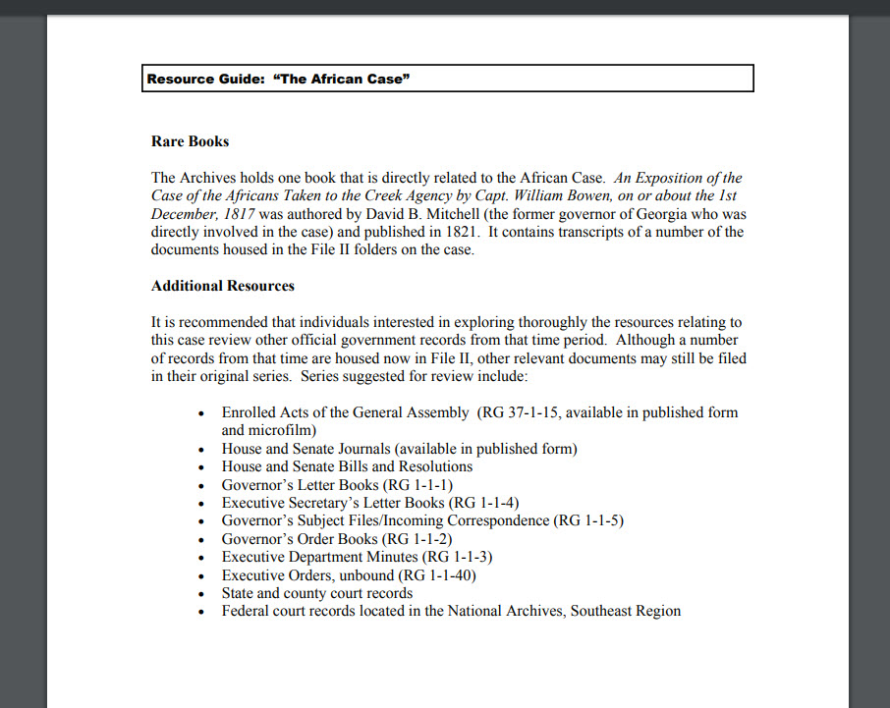
The African Case – Research Materials

Slide 32
GEORGIA ARCHIVES
5800 Jonesboro Road
Morrow, GA 30286
678-364-3710
HOURS:
Tuesday – Saturday
8:30 AM – 5:00 PM
QUESTIONS???

Slide 33
Digital Library of Georgia
Who we are and what we provide

Slide 34
Digital Library of Georgia
GALILEO Initiative
Collaboration
Access
Partnership

Slide 35
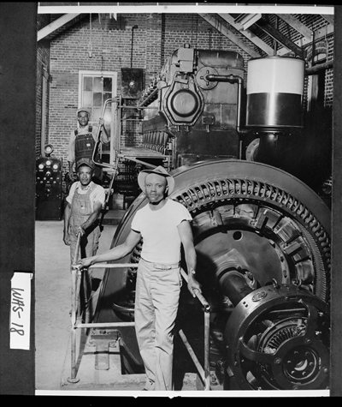
Materials you can access
Government documents
Georgia books and newspapers
Historical manuscripts
Photographs
Sound recordings
Moving images
Cartographic resources
Sandersville, early 1940s. Workers seen standing beside the diesel engine and generator used by the city to produce its own electricity, Vanishing Georgia, Georgia Archives

Slide 36
Time Periods Covered
Archaeology & Early History
(pre 1733)
Colonial Era
(1733-1775)
Revolution & Early Republic
(1775-1800)
Antebellum Era
(1800-1860)
Civil War and Reconstruction
(1861-1877)
Late Nineteenth Century
(1877-1900)
Progressive Era to World War II
(1900-1945)
Civil Rights & Sunbelt Georgia
(1945-1980)
Georgia at the Turn of the Millennium
(1990-present)

Slide 37
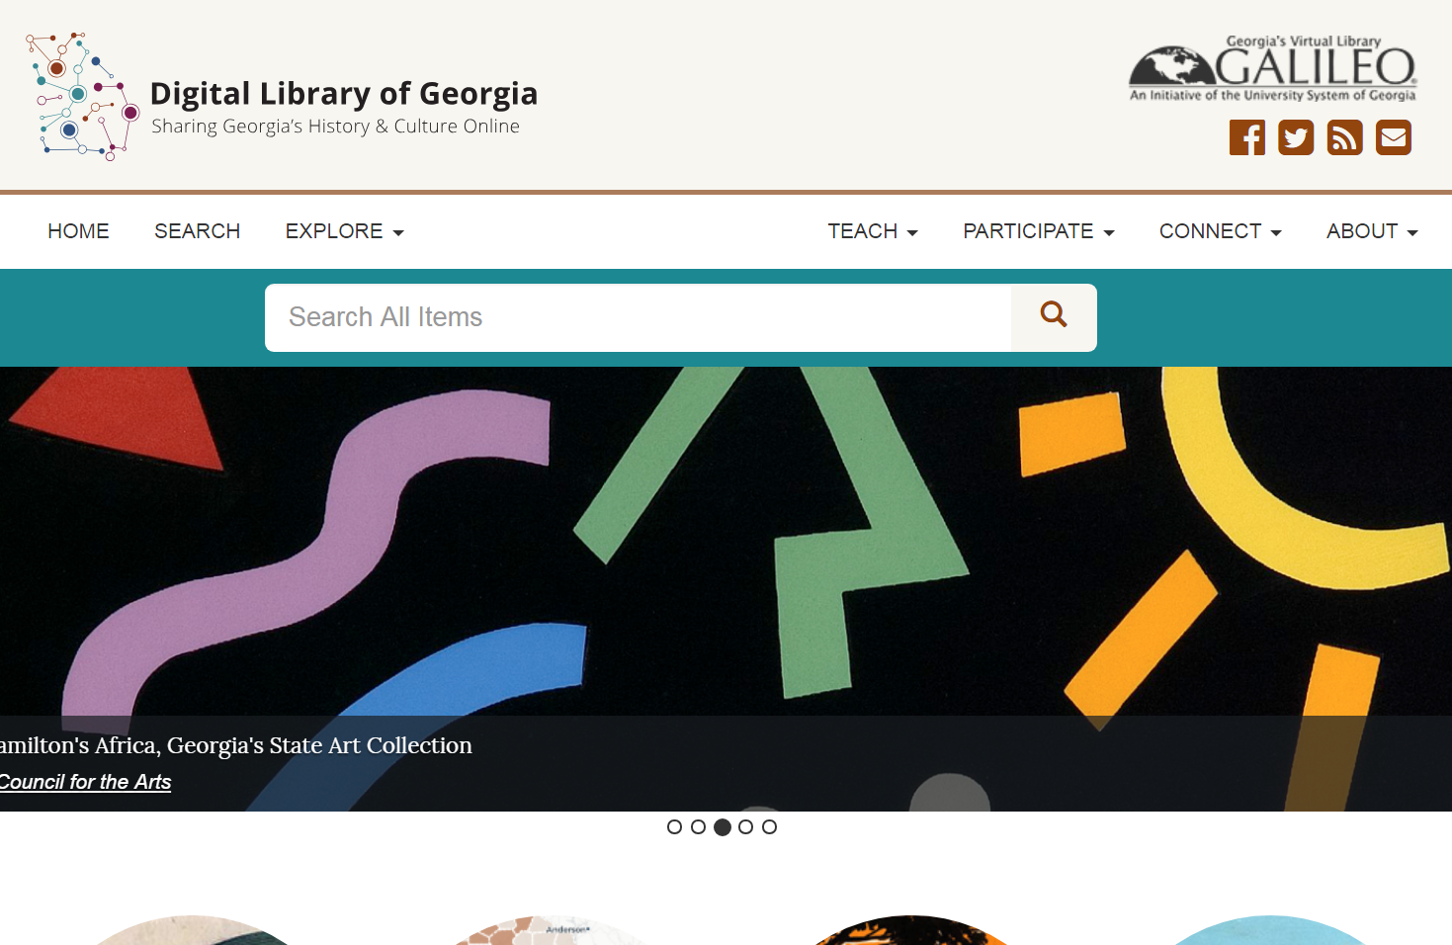
Digital Library of Georgia

Slide 38
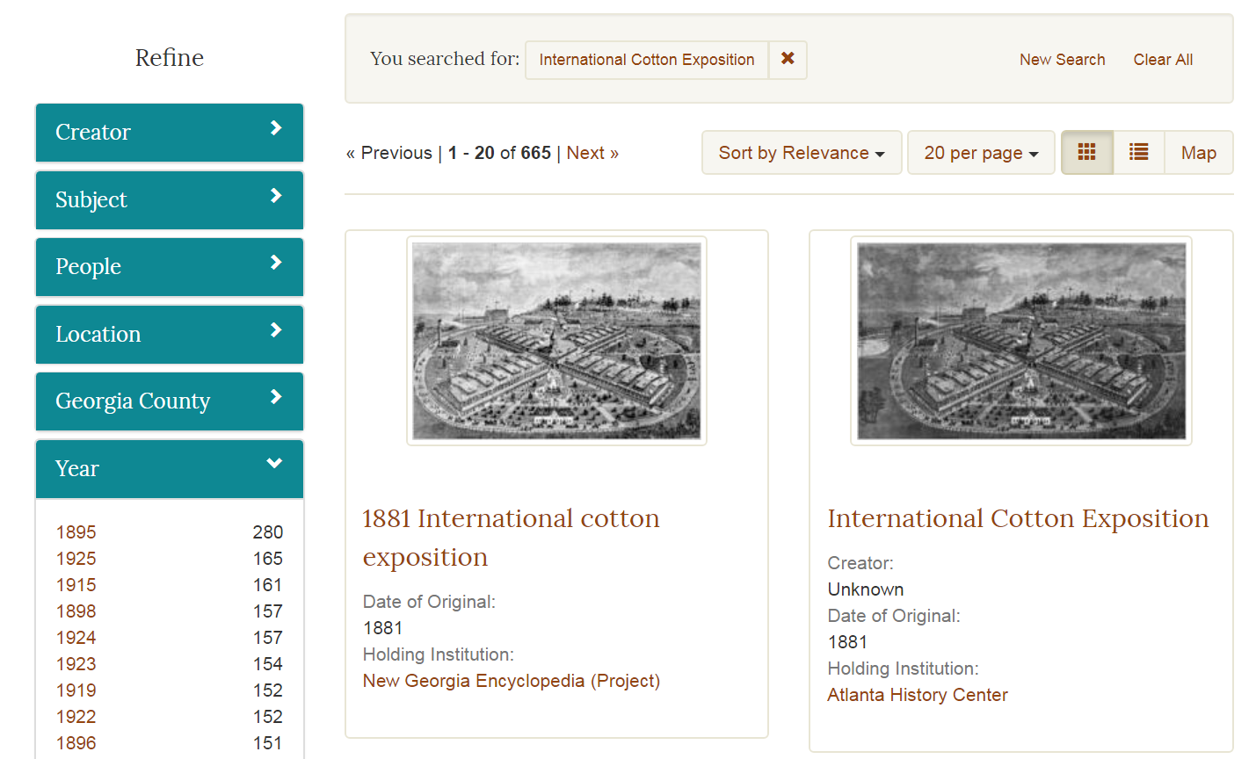
Digital Library of Georgia

Slide 39
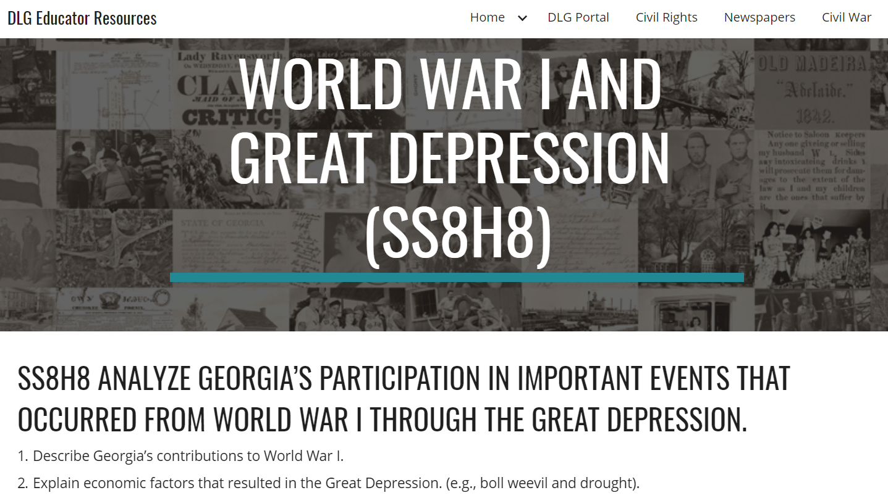
Digital Library of Georgia

Slide 40
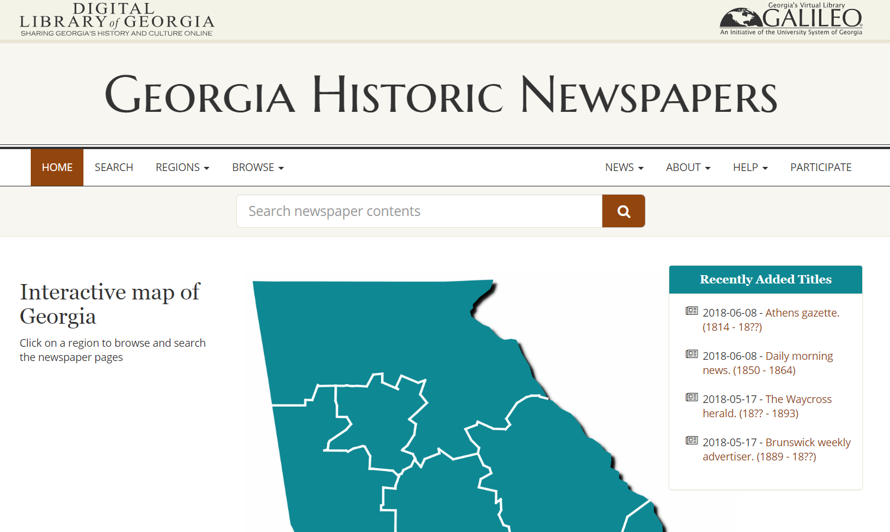
Georgia Historic Newspapers

Slide 41
Georgia Historic Newspapers
Search term: International Cotton Exposition

Slide 42
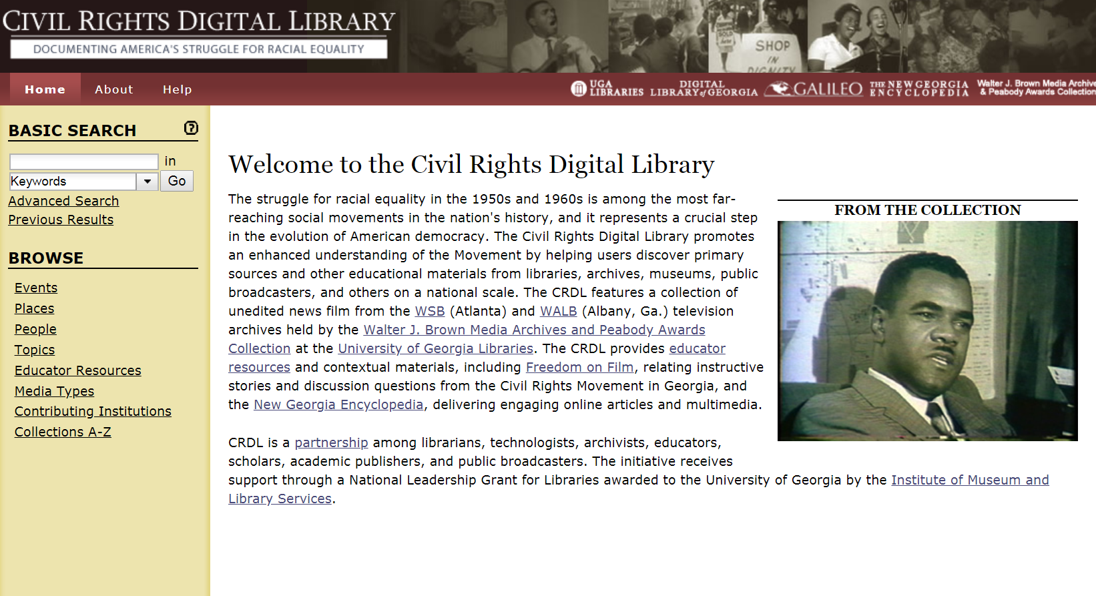
Civil Rights Digital Library

Slide 43
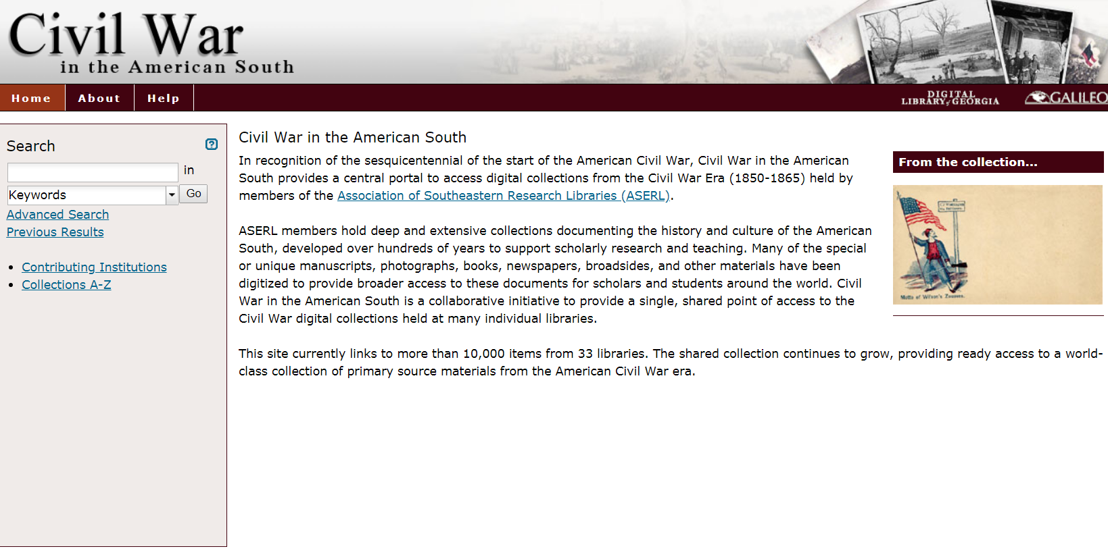
Civil War in the American South

Slide 44
GALILEO
Discover and Share History Resources with GALILEO

Slide 45
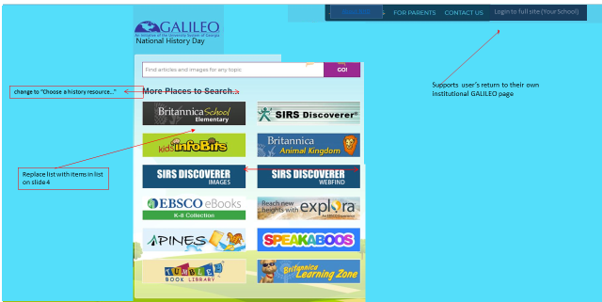
GALILEO: National History Day site

Slide 47
Resource Overview
History Reference Center
Explora
EBSCO ebooks
New Georgia Encyclopedia
Britannica /Annals of American History

Slide 48
Sharing with students
GALILEO Express Links (Add database links to your sites and docs)
Persistent links to articles/books
Add to Google drive or Google classroom
e-mail/save content

Slide 49
Questions?
Thank you!

Slide 50
Discussion questions
Are you and your students familiar with using physical and digital archives?
What are barriers to students and teachers using our content?
How can we communicate what we have available to you and your students?

Slide 51
Discussion questions
What sorts of resources do you like to see students using?
What types of training on historical resources are most useful/preferable? (online, recorded, documents, tutorials, handouts)
Are primary resource sets useful?
DLG Educator Resources: https://goo.gl/1kzex2
DPLA Primary Source Sets: https://dp.la/primary-source-sets
In a fully-funded, perfect world, what sorts of things/resources would be helpful for you?

Slide 53
Thank you!
We love working with you!
Please reach out with questions or ideas any time
Penny Cliff, Georgia Archives
Penelope.Cliff@usg.edu
Nicole Lawrence, Digital Library of Georgia
Nicole.Lawrence@uga.edu
Russell Palmer, GALILEO
russell.palmer@usg.edu

