Slide 1
GALILEO Update
Russell Palmer
Assistant Director
GALILEO Support Services

Slide 2
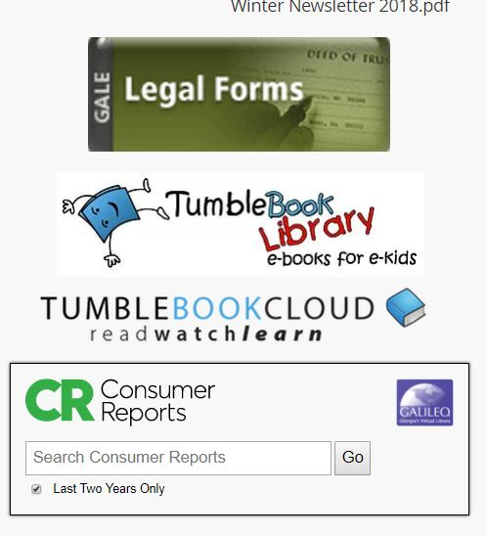
We are here for you!
Bookmarks/marketing materials
Assistance with electronic resources
Great content!
Learning Express
GALE LegalForms
Ebooks
Articles

Slide 3
What’s new and different?
What are we up to?
What are we planning?

Slide 4
What’s new and different?

Slide 5
Georgia Historic Newspapers—New site!

Slide 6
New Resources/changes
TumbleBookCloud (trial)
History Reference Center
ebrary
Now ProQuest Ebook Central

Slide 7
Discover Placards: Mango & LearningExpress

Slide 8
What are we up to?

Slide 9
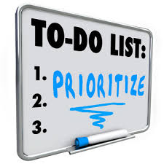
Strategic Planning
GALILEO Vision Statement:
“GALILEO facilitates the creation of knowledge and provides tools and resources for all Georgians to meet their lifelong learning needs.”

Slide 10
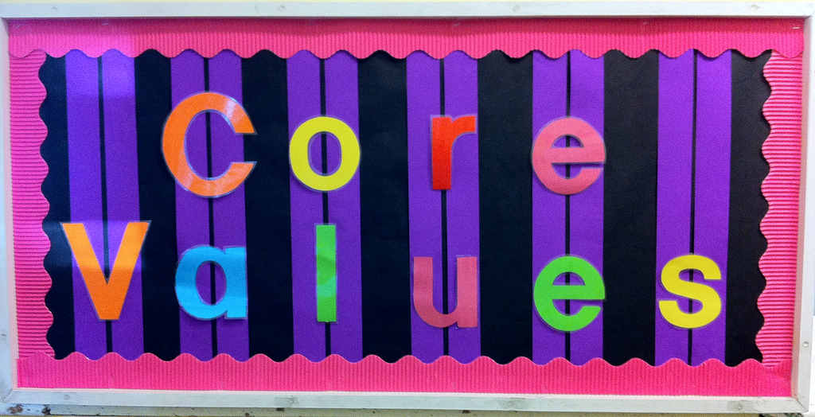
GALILEO Core Values
Innovation
Equity
Collaboration
Reliability
Accountability

Slide 11
GALILEO Mission
Serve as Georgia’s statewide virtual library providing:
Equitable access to core high-quality instructional and informational resources to all Georgians
Access to the tools necessary to help Georgians become lifelong learners
Partnerships that create open access to historical, cultural, and educational content for and about Georgia
Interface(s) that are easy to access and designed and customized to meet the needs of GALILEO libraries and the learners they serve
Provide the tools and resources GALILEO libraries and partners need to support the learners they serve.
Facilitate the efficient and cost-effective provision of library services across the state through collaborative resource acquisition, training, and sharing of workflows, resources, and technological infrastructure.

Slide 12
Draft GALILEO Goals
Improve user experience
Better authentication solutions
Provide great content and assess user needs
New statistics and reports
Raise awareness of GALILEO via marketing
A marketing tool kit where library staff can download and customize materials
Provide great training
An improved online training portal
Provide partner tools and services
Better access to GALILEO data for reporting and assessment

Slide 13
What are we planning?

Slide 14
Special projects
National History Day
Authenticaton: OpenAthens

Slide 15
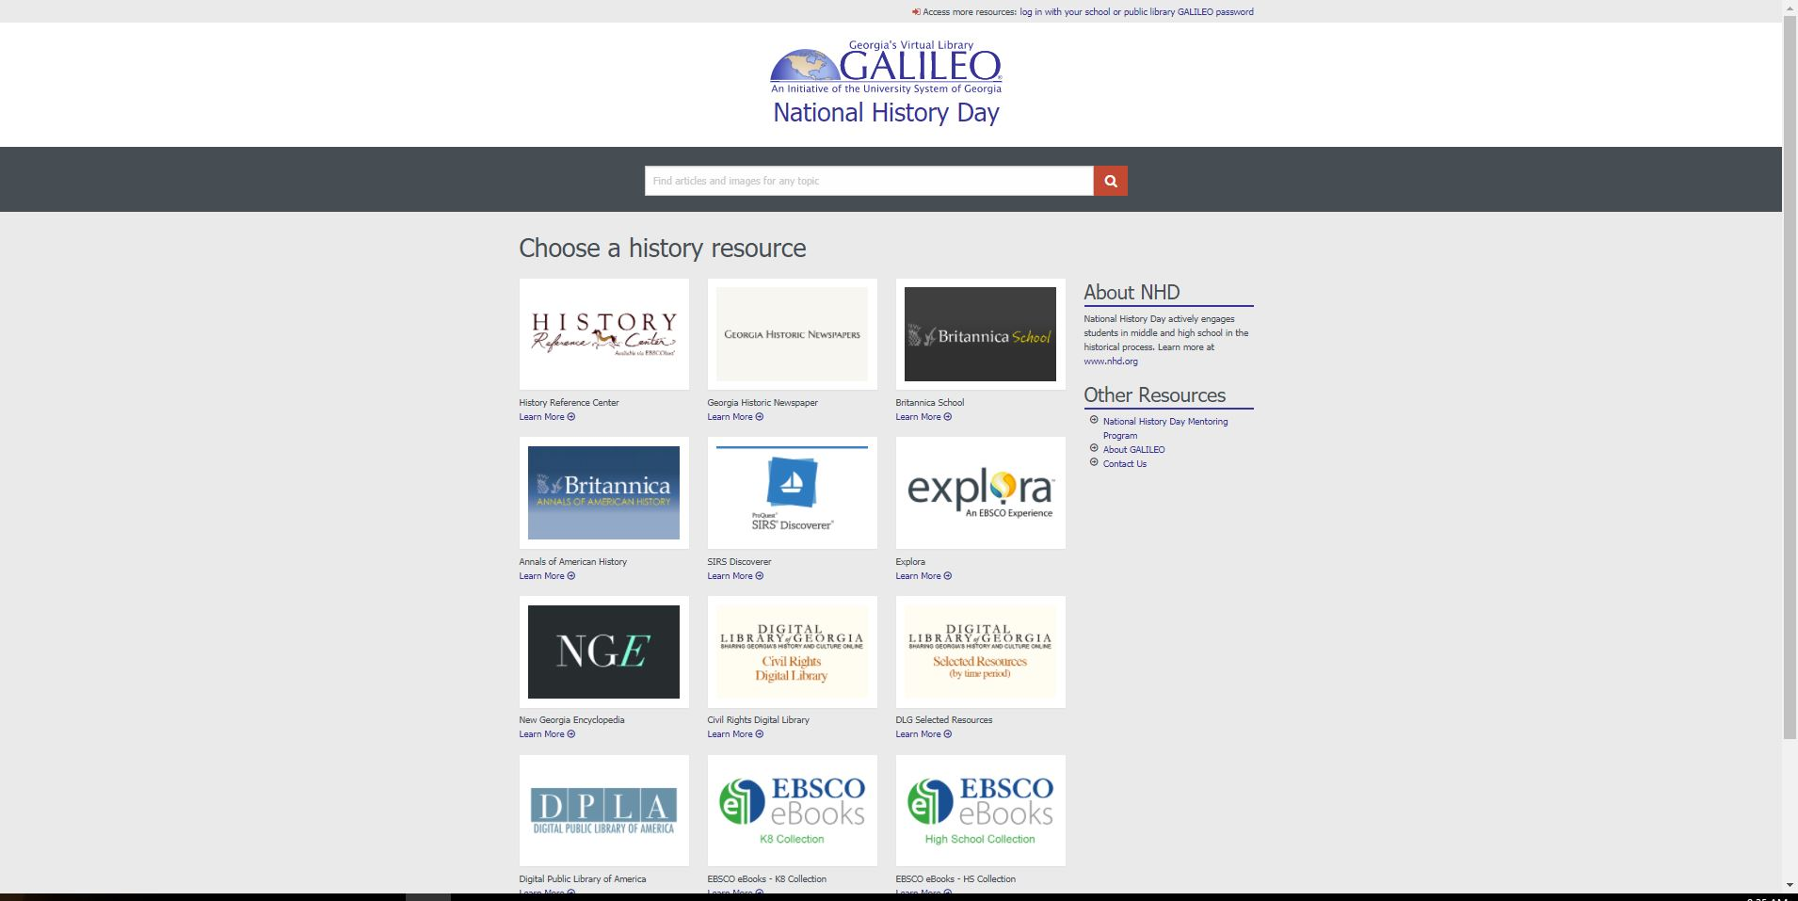
What a web designer did with that…

Slide 16
OpenAthens
SAML Authentication (single sign on)
Users will use common login option--no more remembering GALILEO passwords or dealing with quarterly password changes!
Improved usage statistics

Slide 17
Questions?

Slide 18
Show and tell
Are there resources you would like to see?
Are there questions I can help you answer?

Slide 19
Thank you!
Russell Palmer, Assistant Director, Support Services
russell.palmer@usg.edu

