Slide 1
Getting GALILEO to the User: Tools and Best Practices in Linking
Courtney McGough
March 2015

Slide 2
Overview
Linking
GALILEO portal
GALILEO pages
Databases
Journals
Searches
Articles or Videos
Using logos to create buttons
Creating search boxes/widgets
Adding GALILEO integrations for GeorgiaVIEW

Slide 3
Where Can I Link to GALILEO?
Subject guides / LibGuides
Handouts
Promotional materials
Library website
Learning management system
Communications to users
Chat/email reference
Announcements
Blog posts

Slide 4
Link to GALILEO
Use the main GALILEO link
http://www.galileo.usg.edu
Why?
Authentication
Recognizes IPs to allow on-site users direct access
Prompts for the GALILEO password for off-site users
GALILEO Statistics

Slide 5
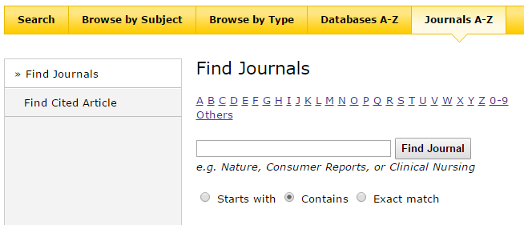
Link to Pages in GALILEO
Each page in GALILEO is a persistent link that is bookmarkable
Links are unique to your institution:
http://www.galileo.usg.edu/scholar/highlands/journals/

Slide 6
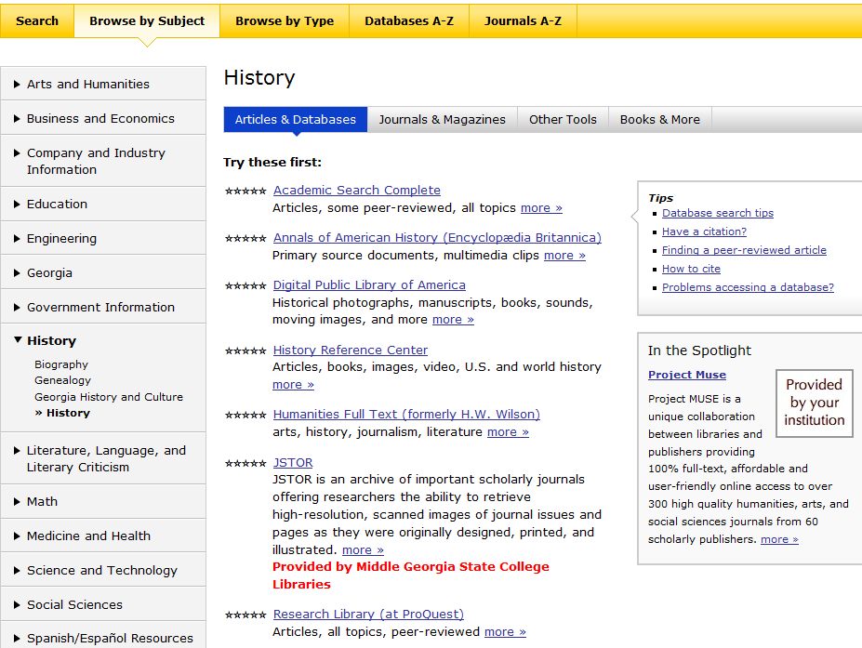
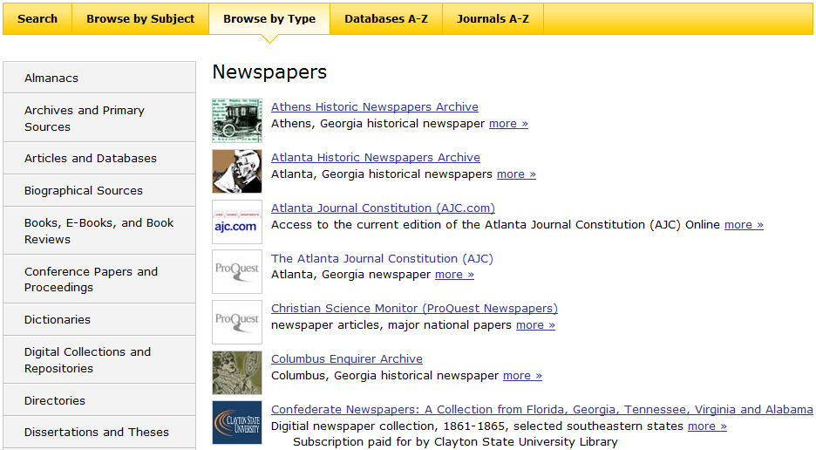
Link to Pages in GALILEO
http://www.galileo.usg.edu/scholar/mgsc/subjects/history/articles-databases/
http://www.galileo.usg.edu/scholar/clayton/types/newspapers/

Slide 7
Link to Databases
Express Links (http://www.galileo.usg.edu/express?link=xxxx)
Link users directly to one database
Authentication works like main GALILEO link
Clicks count towards your institution’s GALILEO statistics
GLRI databases also have Express Links
Note Express Link policies

Slide 8
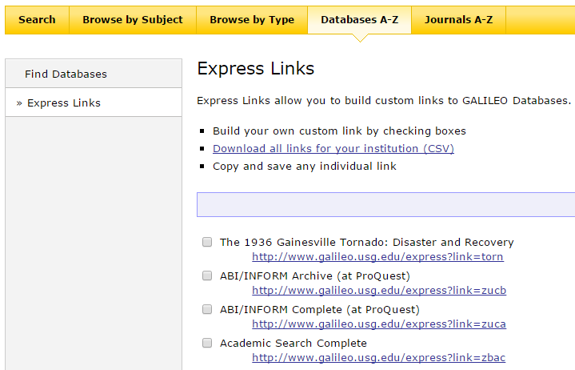
Link to Databases
See all Express Links under Databases A-Z > Express Links

Slide 9
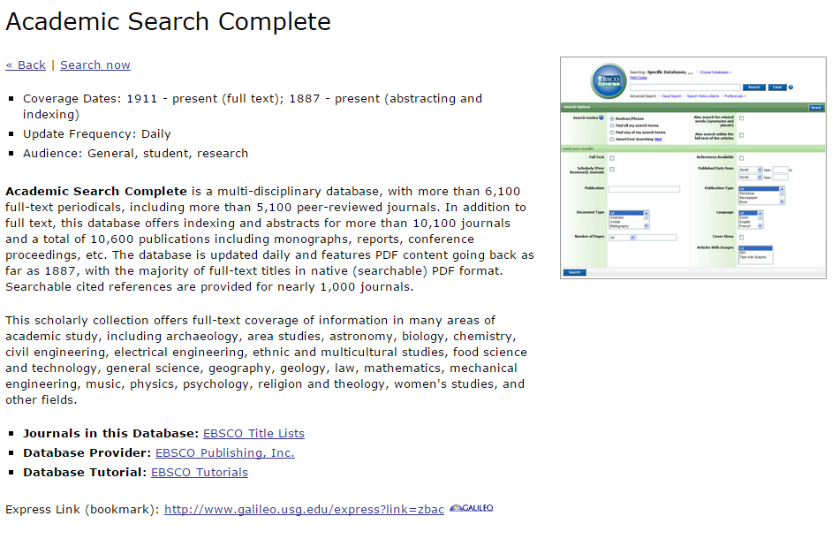
Link to Databases
See the Express Link for an individual database by clicking the more>> link

Slide 10
Link to Journals
Two ways:
Journals A-Z – use the Capture Citation or URL on SFX/Find It menu
Publication record in an EBSCO database

Slide 11
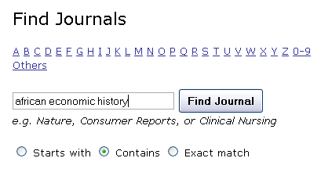
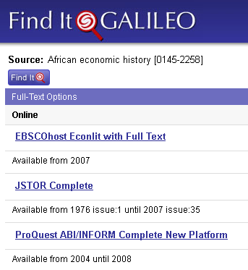
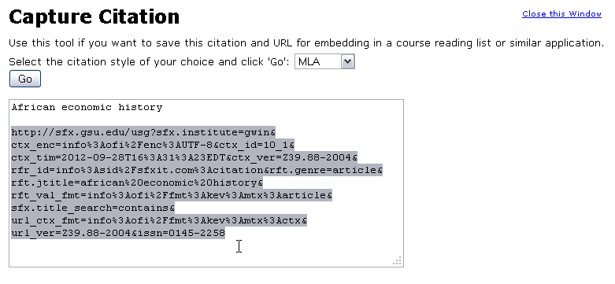
Link to Journals
Through Journals A-Z, use the Capture Citation or URL link at the bottom of the SFX/Find It menu
Notes:
Best to use the SFX link when you have a title with coverage in several databases

Slide 12
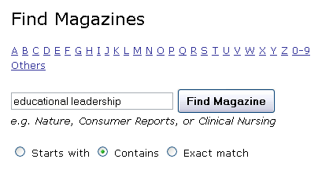
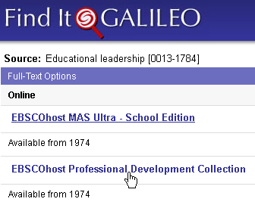
Link to Journals
Publication record in EBSCO databases
Notes:
Can use the link from the database when you have coverage in only one database or two databases with the same coverage because the link from the publication record requires fewer clicks for the user

Slide 13
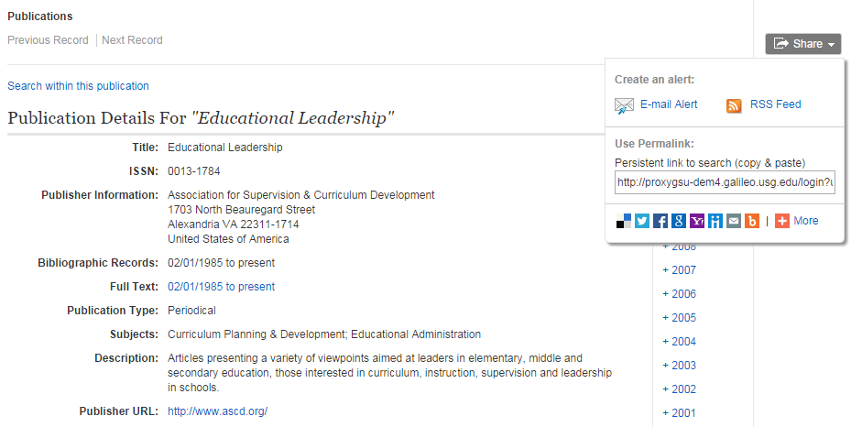
Link to Journals
Publication record in EBSCO databases

Slide 14
Tip: Journal Alerts
Click the Email Alert link to set up an alert to be notified by email when a new issue of the journal has been added

Slide 15
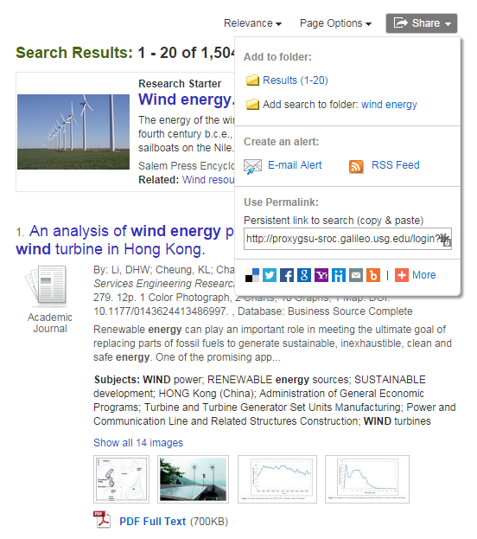
Link to Searches
Save a link to a search in Discover GALILEO

Slide 16
Tip: Search Alerts
Click the Email Alert link to set up an alert to be notified by email when a new article matching your search has been added

Slide 17
Link to Articles and Videos
Use the persistent link in the article’s citation information
Permalink in EBSCO databases (e.g., Academic Search Complete) or in discovery searches
Document URL in ProQuest (e.g., Research Library)
Document link in LexisNexis Academic
Link in citation or embed code for a video in Films on Demand

Slide 18
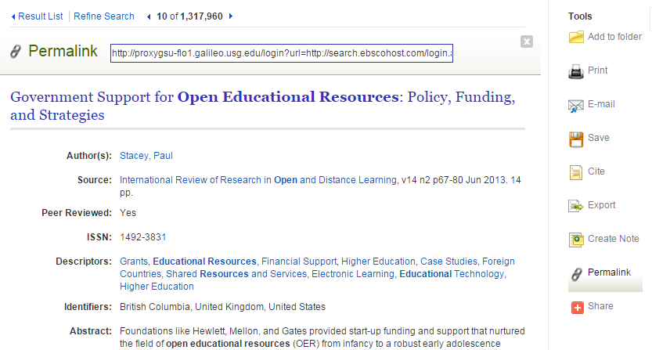
Link to Articles: EBSCO and Discover GALILEO

Slide 19
Link to Articles: ProQuest
Scroll to the bottom of a ProQuest article to see the document URL

Slide 20
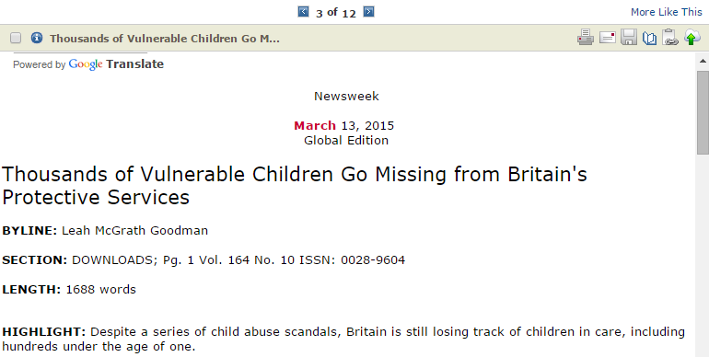
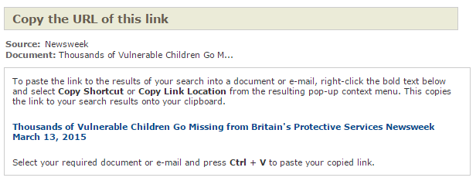
Link to Articles: LexisNexis Academic
Click the clipboard/link icon to see the document link in LexisNexis Academic

Slide 21
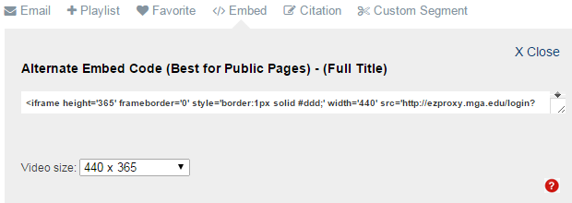
Link to Videos: Films on Demand
Click the citation or embed code in Films on Demand

Slide 22
Logos and Buttons
GALILEO and several vendors provide their logos or other graphics that can be used on websites as buttons
See our FAQ for links to sites

Slide 23
Search Boxes
Embed the Discover GALILEO search box

Slide 24
Search Boxes
Several vendors allow you to create widgets or search boxes that you can add to your library website
Note that you will need to add the GALILEO or your institution’s proxy to allow off-site access to work
See GALILEO FAQs for instructions
EBSCO
Britannica
Check with other vendors to see what they offer
Contact Us if you need any assistance creating these

Slide 25
GeorgiaVIEW Integrations

Slide 26
GALILEO Auto-Authentication Widget
With this integration, when users log in to GeorgiaVIEW, they are automatically logged in to GALILEO
Contact your primary campus administrator

Slide 27
GALILEO Search Box Widget
A Discover GALILEO search box can be added to a course page or to the main landing page
Contact your primary campus administrator

Slide 28
Questions? Contact Us
http://www.galileo.usg.edu/contact

