Slide 1
GALILEO vs. Fake News
GALILEO WINS!

Slide 2
What is fake news?
“Fake news is frequently used to describe a political story which is seen as damaging to an agency, entity, or person[…]it is by no means restricted to politics, and seems to have currency in terms of general news.”
--Merriam-Webster Online

Slide 3
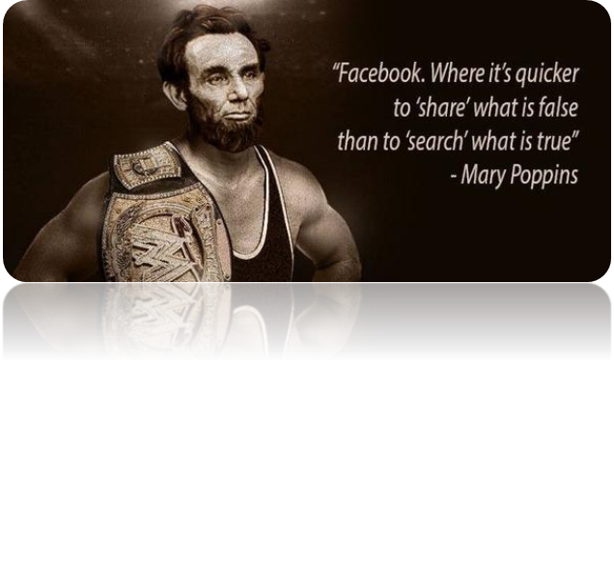
Fake news facts
67% of people get at least some of their news from social media
64% believe it causes confusion about facts
23% have posted/reposted a fake news story (14% knew, 16% oops)
46% somewhat (over) confident and 39% Very (over) confident in their ability to recognize fake news
More at Pew Research Center, Journalism and Media
http://www.journalism.org/2016/12/15/many-americans-believe-fake-news-is-sowing-confusion/

Slide 4
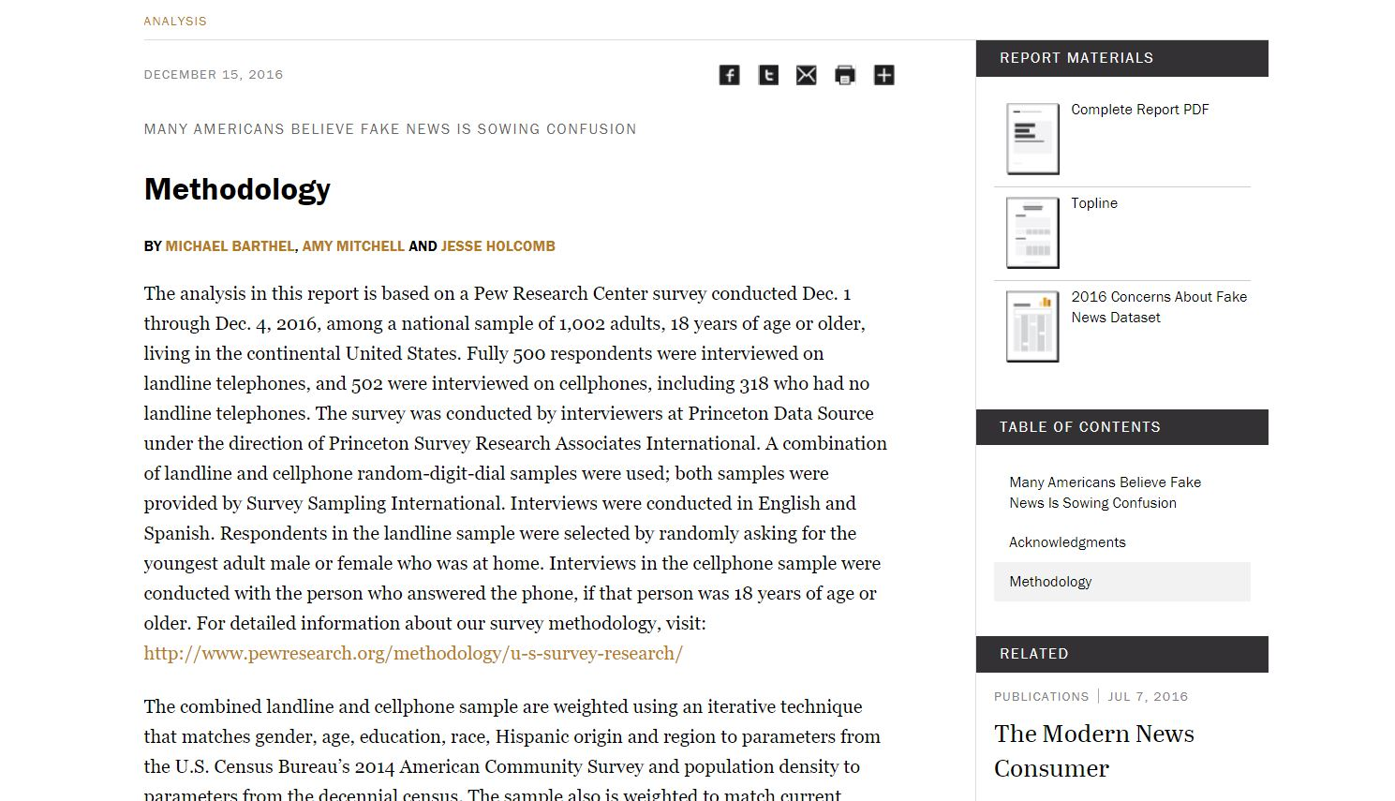
“Now wait a minute, you just tossed out a bunch of percentages!”
How can we trust you?
I used a reliable/trusted source
I am able to review their statistical methodology in detail to see how they reached their conclusions
I cited it so that you can review it on your own time and compare it to other information

Slide 5
Types of misinformation
Propaganda
Clickbait
Sponsored content
Satire/Hoax
Conspiracy theory
Pseudoscience
Misinformation
Error
Partisanship

Slide 6
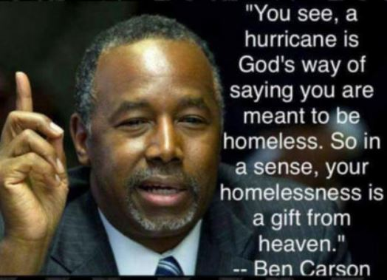
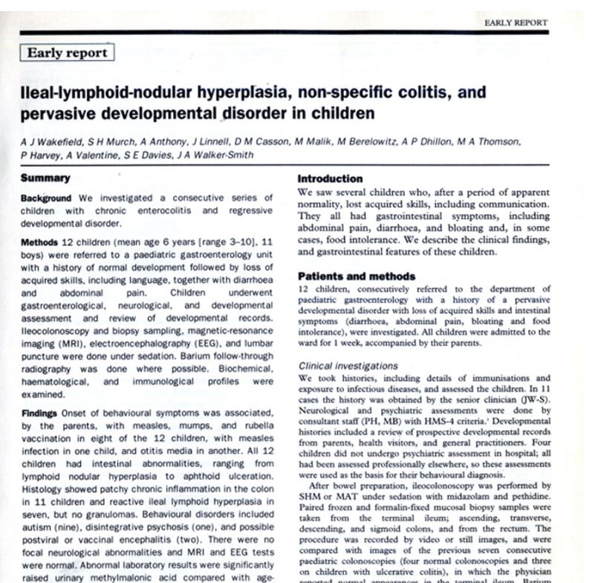
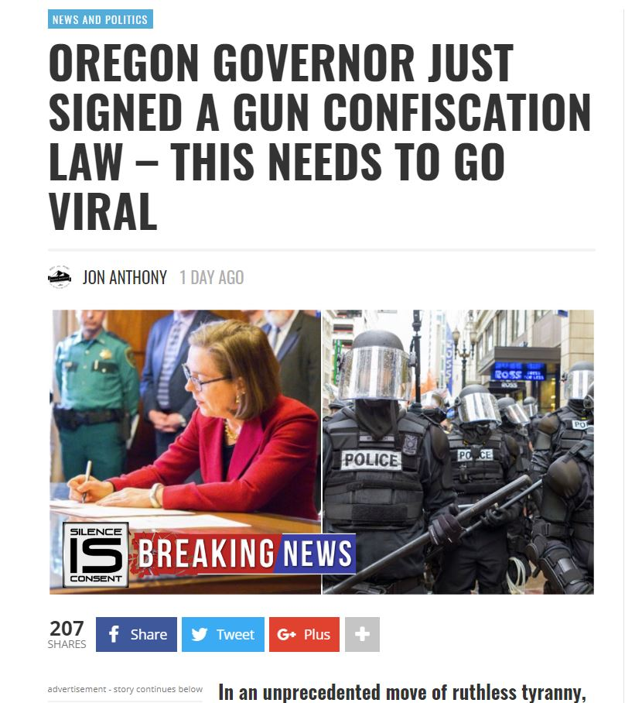
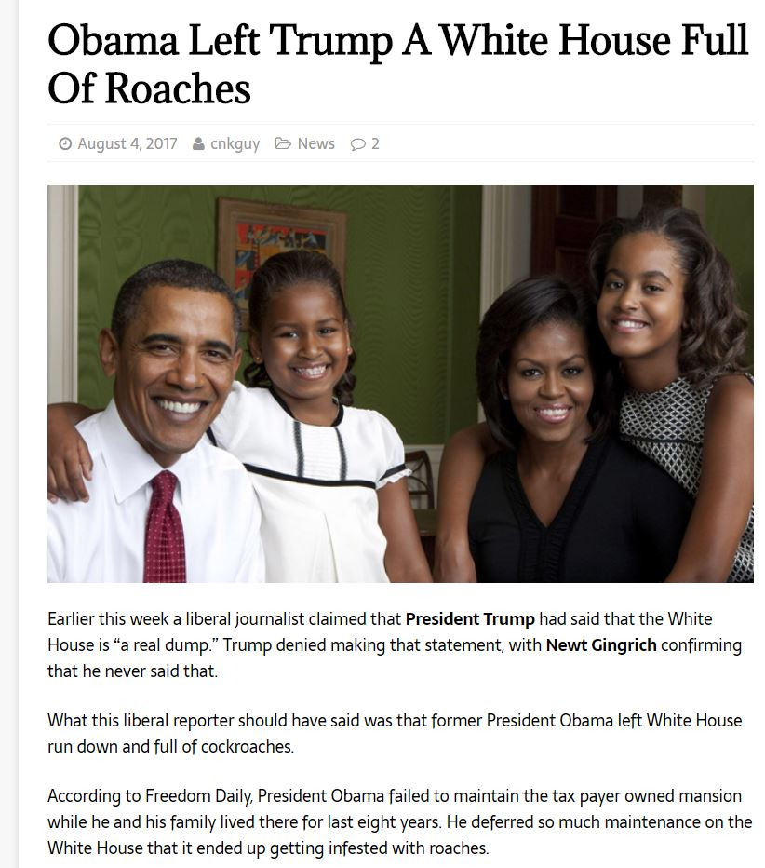
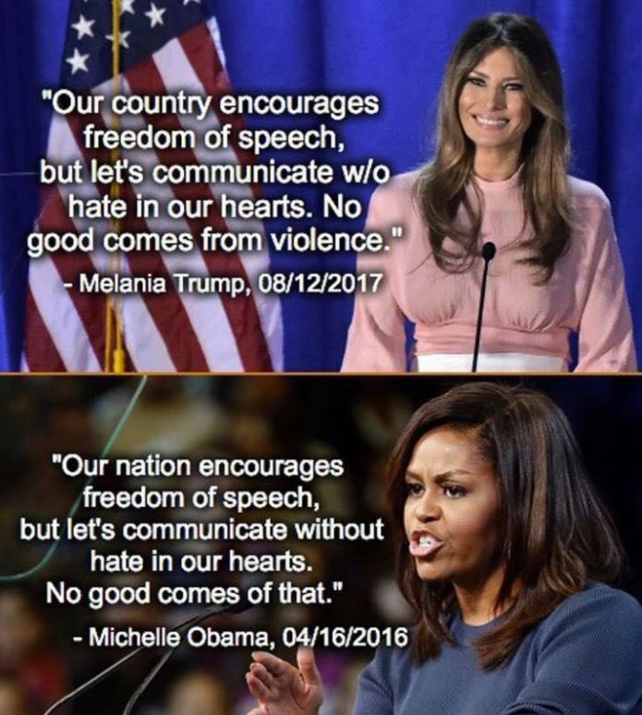
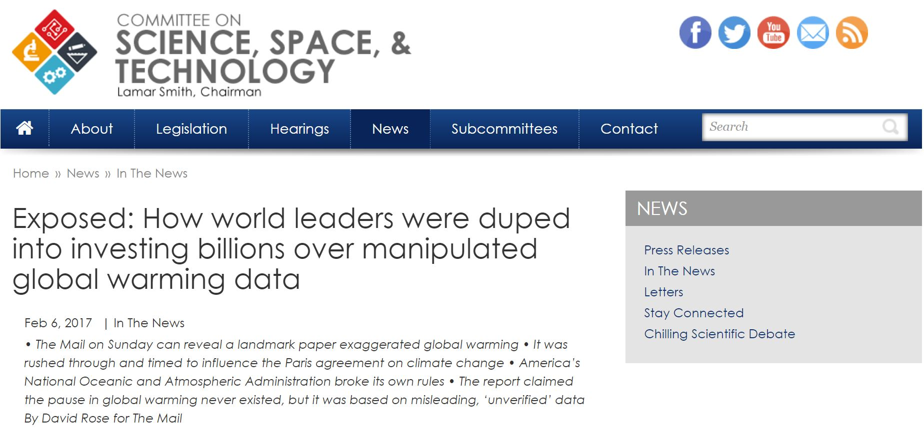
Examples

Slide 7
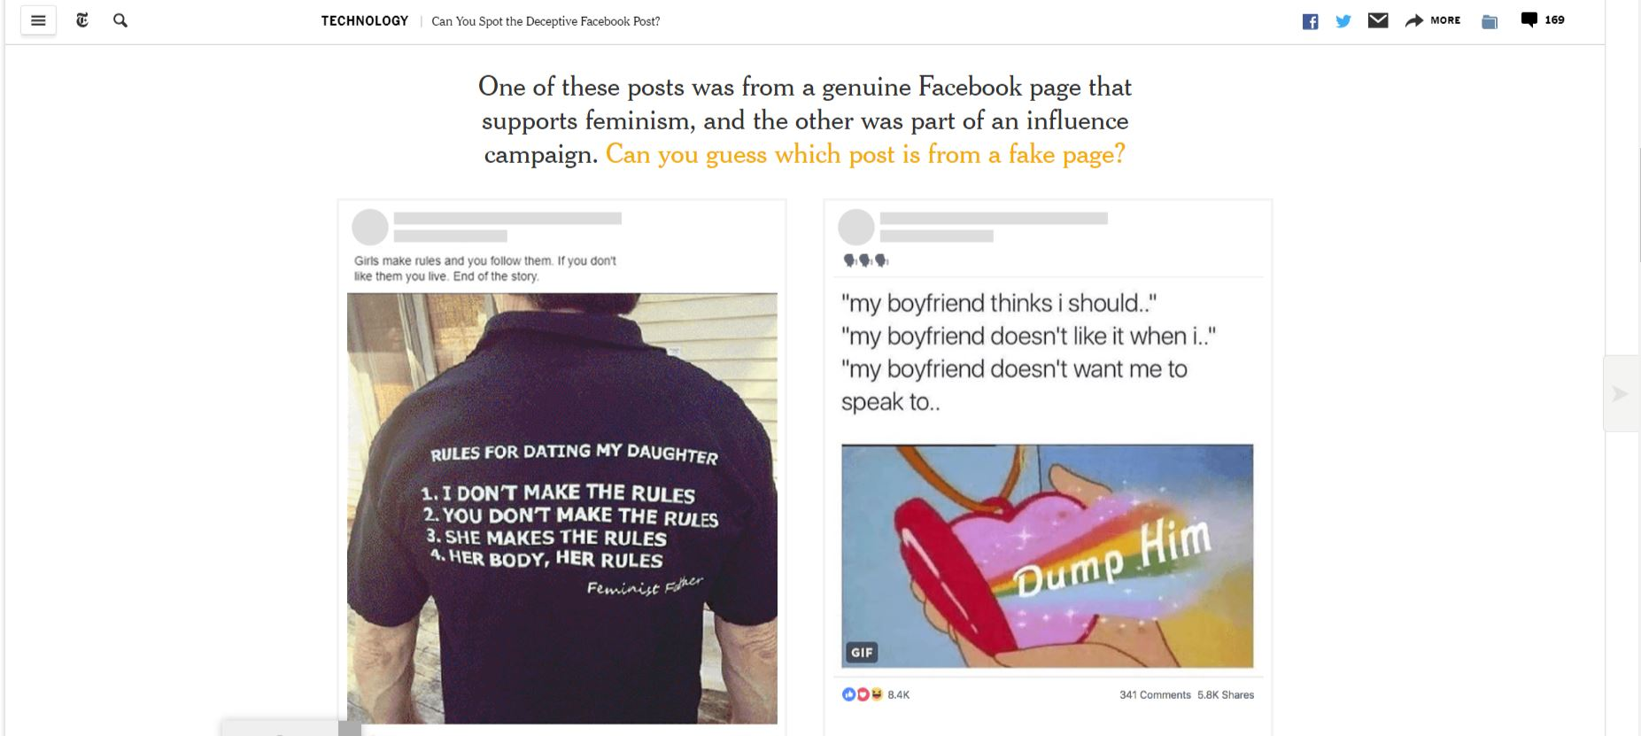
Fun with the New York Times
Full article/more examples: https://www.nytimes.com/interactive/2018/09/04/technology/facebook-influence-campaigns-quiz.html
Notes:
Dude with shirt is fake….any reasons why?
“Resisters” was a fake account that Facebook removed in July. “Feminist News” is a real Facebook page, as far as we can tell. (We asked Facebook to confirm the examples of real accounts used here are in fact authentic, and were told there was no apparent reason to suspect otherwise.)
The Resisters page existed for more than a year and described itself as “online and offline feminist activism against fascism,” according to Facebook and researchers at the Atlantic Council’s Digital Forensic Research Lab, which analyzes disinformation online and works with Facebook.
You may have guessed the post was from a fake page if you looked closely at the language: “Girls make rules and you follow them. If you don’t like it you live. End of the story.”
Broken English is not a sure sign that a post is part of an influence operation. But grammatical errors were a common trait among the Russian ads Facebook disclosed in 2017 — particularly the misuse of “a” and “the,” which don’t exist in the Russian language.

Slide 8
Tactics (what to watch for)
Logical fallacies
Gaslighting
Lying with math and statistics
Lying with charts and graphs
Cherry picking
Context, context, context
New (to me):
Astroturfing

Slide 9
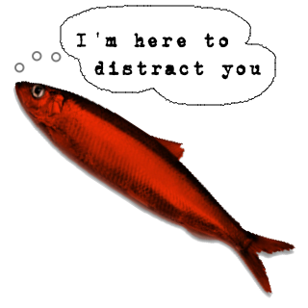
Logical fallacies
Slippery slope
Hasty generalization
Post hoc ergo propter hoc
Genetic fallacy
Begging the claim
Circular argument
Either/or
Ad hominem
Ad populum
Red herring
Straw man
Moral equivalence
Read all about logical fallacies at the Purdue Owl: https://owl.purdue.edu/owl/general_writing/academic_writing/logic_in_argumentative_writing/fallacies.html
Notes:
Slippery Slope—if we ban assault weapons, other types of guns will be banned soon after
Hasty—ugh, Russell has only been presenting for a few minutes, but I know I’m not going to learn anything
Post hoc (after this, because of this)—I got sick after I got a flu shot, so it must be the flu shot
Genetic—I could never believe the earth is round, because I saw it on CNN
Begging the claim—nasty, chemical laden, ineffective vaccines should be banned.
Circular argument--It should be okay to destroy property when you are angry because angry people destroy things.
Either/or—I thought you were a good person, but you didn’t contribute a dollar to your public schools when given the opportunity at check out
Ad hominem—Russell can’t possibly be credible because he’s bald an goofy looking librarian (attacking me, not my arguments)
Ad populum— Real Americans who are patriots buy American cars.
Red herring—Coal causes pollution, but how will coal miners feed their families? Shifting in this case from environment and safety to economics while the issue is more complex
Straw Man—”You don’t support deregulation of the mining industry, so you hate miners and don’t want them to be able to feed their families.”
Moral Equivalence—”The US has interfered in elections, too.”

Slide 10
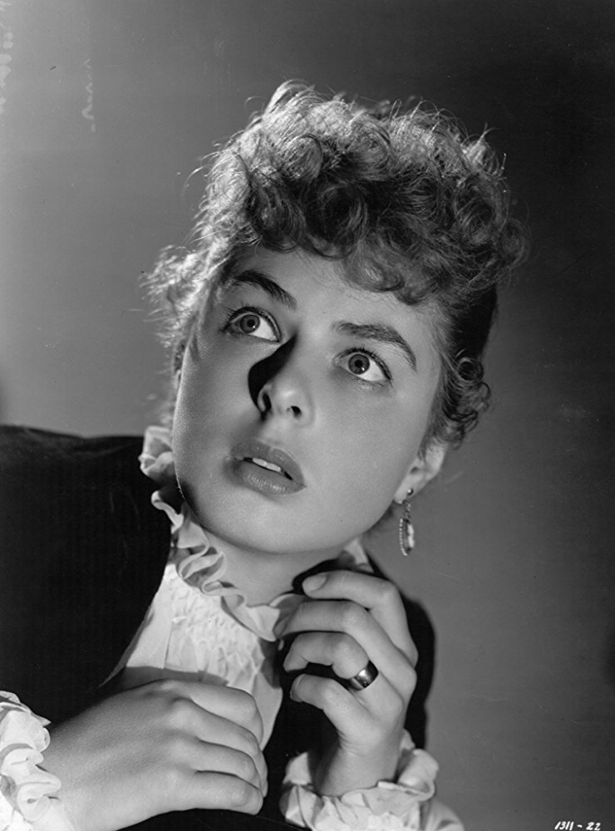
Gaslighting
Context is important here
Manipulation tactic, “psychological warfare”
Deliberate distortions made (and repeated) to manipulate
Done to incite doubt and lower self confidence
Results in suppression of facts, repressing doubts/concerns

Slide 11
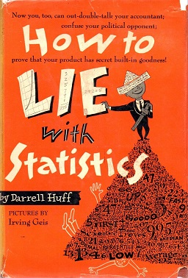
Lying with math and statistics
The lie of averages
“Average income”
1+2+ (5.5) 9+10=22/4=5.5
1+2+20+30+70+55+100 + (164.2)200+1000=1478/9=164.2

Slide 12
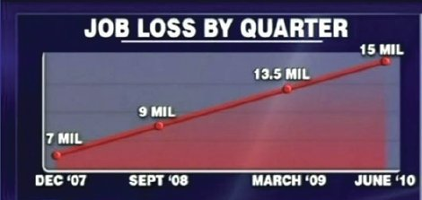
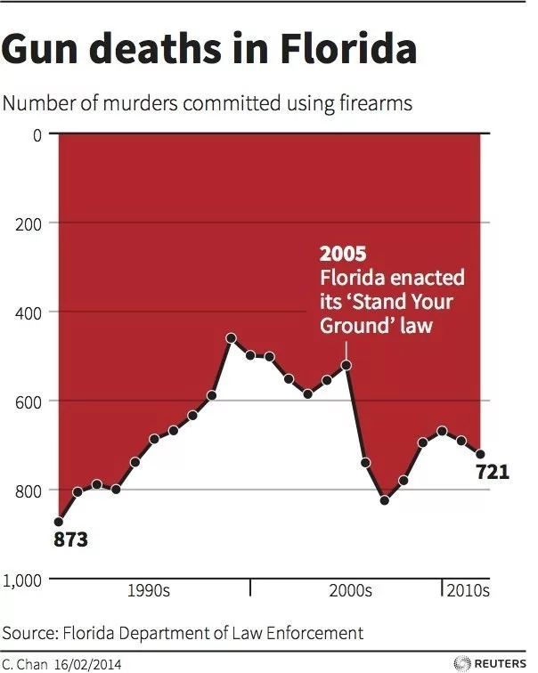
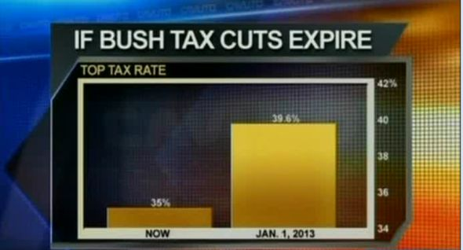
Lying with charts and graphs (watch your axes!)

Slide 13
Context, context, context

Slide 14
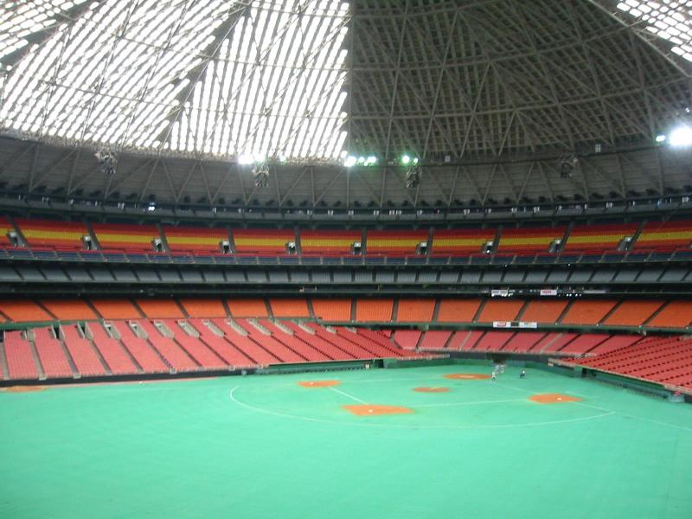
Astroturfing
Classic astroturfing is the practice of disguising an orchestrated campaign as a spontaneous upwelling of public opinion. … The term itself appears to have been coined in 1985 by then Texas Senator Lloyd Bentsen, who noted that the mountains of letters he received about legislation on insurance originated with insurers. —New Scientist, 10 Feb. 2007
The modern form of astroturfing uses the Internet, and corporations, religious groups with a social agenda, and public interest groups can flood an in-box in an hour with e-mails that may come from a single source using many accounts. —Alan Boraas, Anchorage Daily News, 4 Apr. 2009
--Merriam-Webster Online

Slide 15
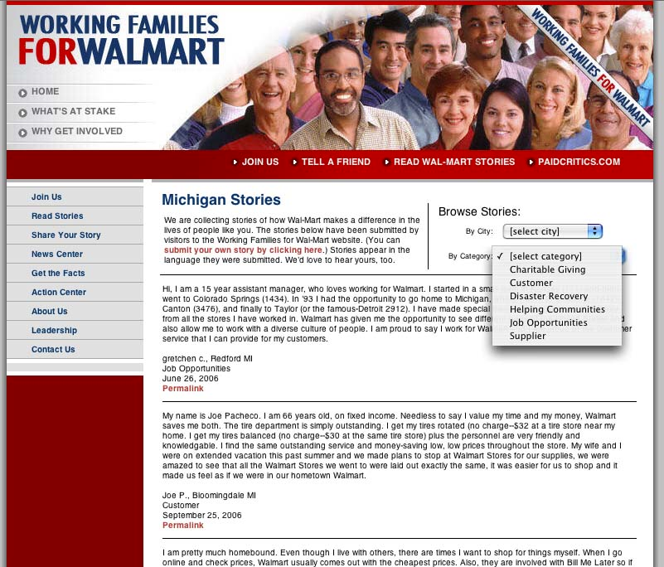
Astroturfing: example

Slide 16
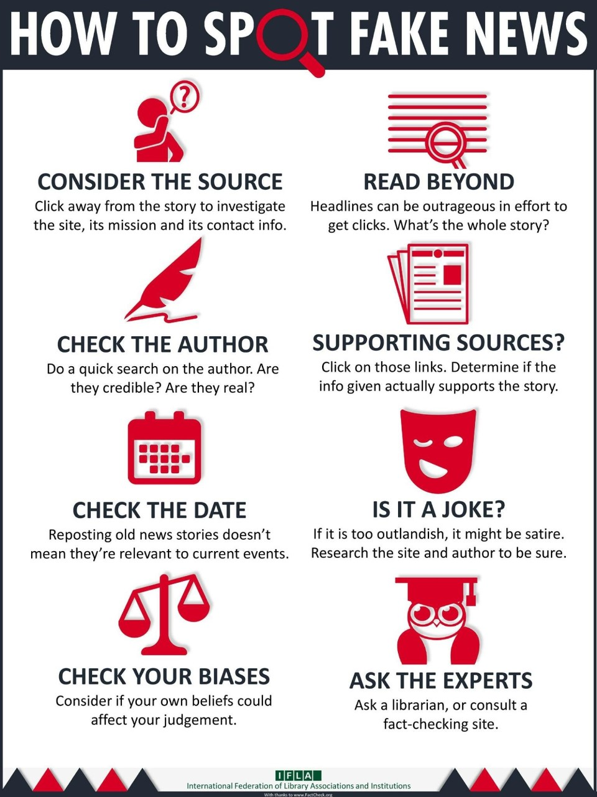

Slide 17
Fact checking sites –the basics
Duke University—Reporter’s Lab
https://reporterslab.org/fact-checking/
FactCheck (Annenberg Policy Center)
http://www.factcheck.org
HealthNewsReview
https://www.healthnewsreview.org
Politifact
http://www.politifact.com
Snopes
http://www.snopes.com
Explore more at: http://libguides.umw.edu/c.php?g=424264&p=2898977
And here http://guides.library.stonybrook.edu/fakenews/resources

Slide 18
That said…
Recent study: Lay and Holman
you’d think that citing a nonpartisan, neutral source like Snopes or Politifact might be the best way to correct misinformation.
Nope.
“Republicans and Democrats weren’t persuaded to abandon false beliefs about election fraud after reading correct information from fact-checking organizations
What did work? Surprisingly, both sides were most persuaded when the factual information was believed to be from conservative news source Breitbart.
Mirya R. Holman & J. Celeste Lay (2018) They See Dead People (Voting): Correcting Misperceptions about Voter Fraud in the 2016 U.S. Presidential Election, Journal of Political Marketing, DOI: 10.1080/15377857.2018.1478656

Slide 19
So…
“When partisan media provide accurate information that counters its typical ideological position, this can be especially persuasive not only to co-partisans, but also to members of the other party.”

Slide 20
Who fact checks the fact checkers?

Slide 21
What else can I do? Evaluating sources
Critical thinking—where does the information in divergent reports interact?
There is almost always bias in conclusions; draw from facts
Controversial? Give it a day
Often, more details come to light
Anonymous sources
One? A few? Consider the source
They got it wrong! Did they retract or correct?
Outlets that do (vs. refusing to back down) are more trustworthy

Slide 22
GALILEO wins! Databases that help
Academic Search Complete
Newspaper Source
Consumer Health Complete
Gale LegalForms
Statistical Abstract of the United States
Explora (kids)
What else do you use?

Slide 23
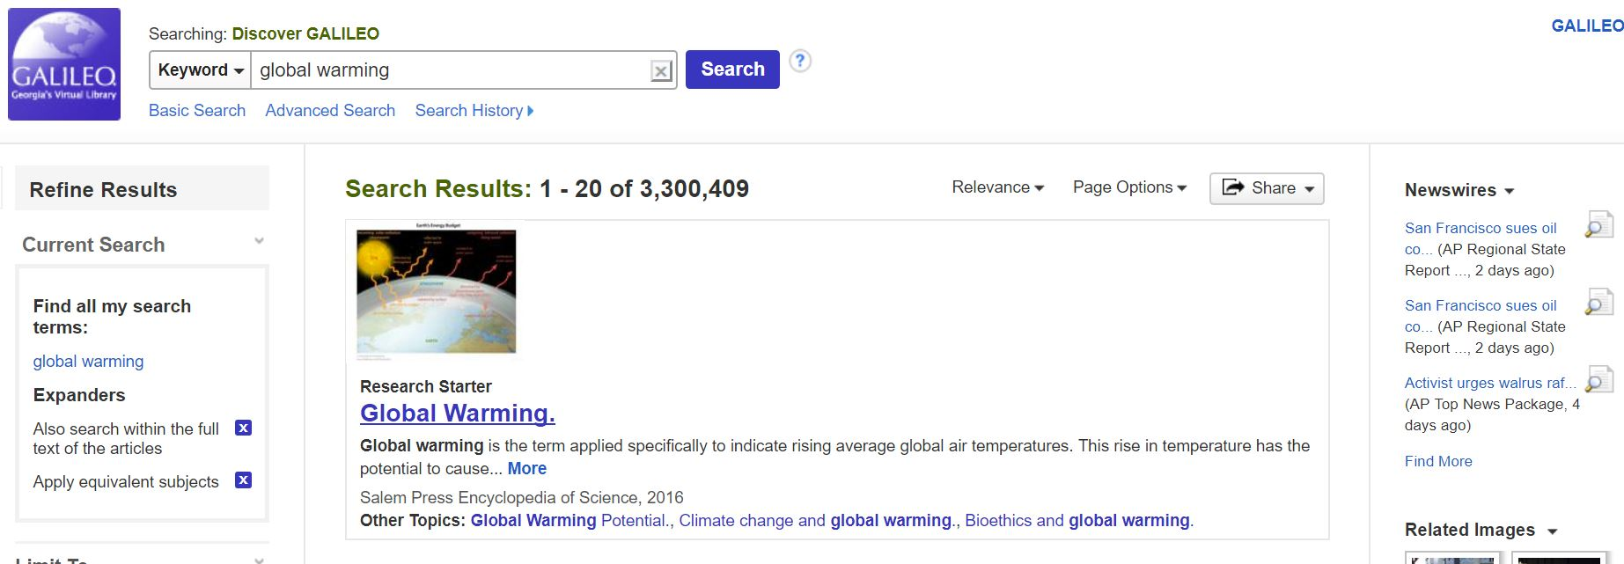
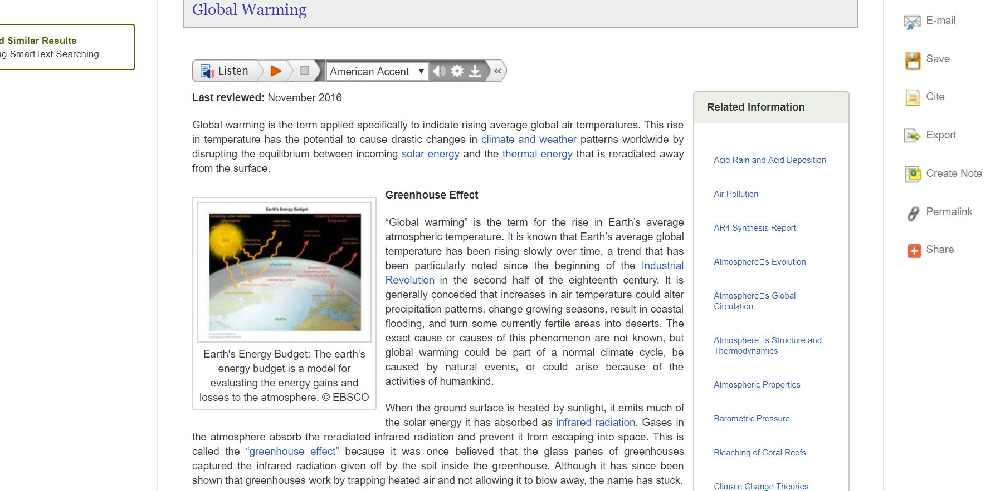
How the Discover search can help
Research Starters –lots of facts, lots of links to more, lots of citations

Slide 24
Ethically speaking…
We provide tools and access to information
Present accurate facts
Teach users to be media literate and apply the strategies we discussed today in their approach to the news and other media
Challenges:
Avoiding letting our own opinions/bias creep into the reference encounter
Treating those with wildly different opinions than our own respectfully

Slide 26
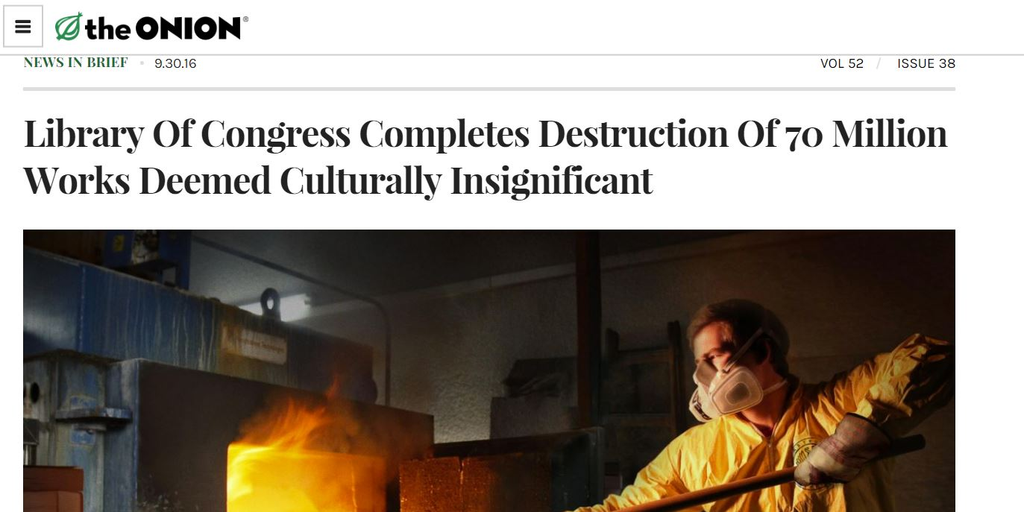
Thank you!
Russell Palmer
Assistant Director, GALILEO Support Services
russell.palmer@usg.edu
Slides available:

