Slide 1
GALILEO vs. Fake News
GALILEO WINS!
Russell Palmer
GaETC
9 November 2017

Slide 2
What is fake news?
“Fake news is frequently used to describe a political story which is seen as damaging to an agency, entity, or person[…]it is by no means restricted to politics, and seems to have currency in terms of general news.”
--Merriam-Webster Online

Slide 3
Fake news facts
67% of people get at least some of their news from social media
64% believe it causes confusion about facts
23% have posted/reposted a fake news story (14% knew, 16% oops)
46% somewhat (over) confident and 39% Very (over) confident in their ability to recognize fake news
More at Pew Research Center, Journalism and Media
http://www.journalism.org/2016/12/15/many-americans-believe-fake-news-is-sowing-confusion/

Slide 4
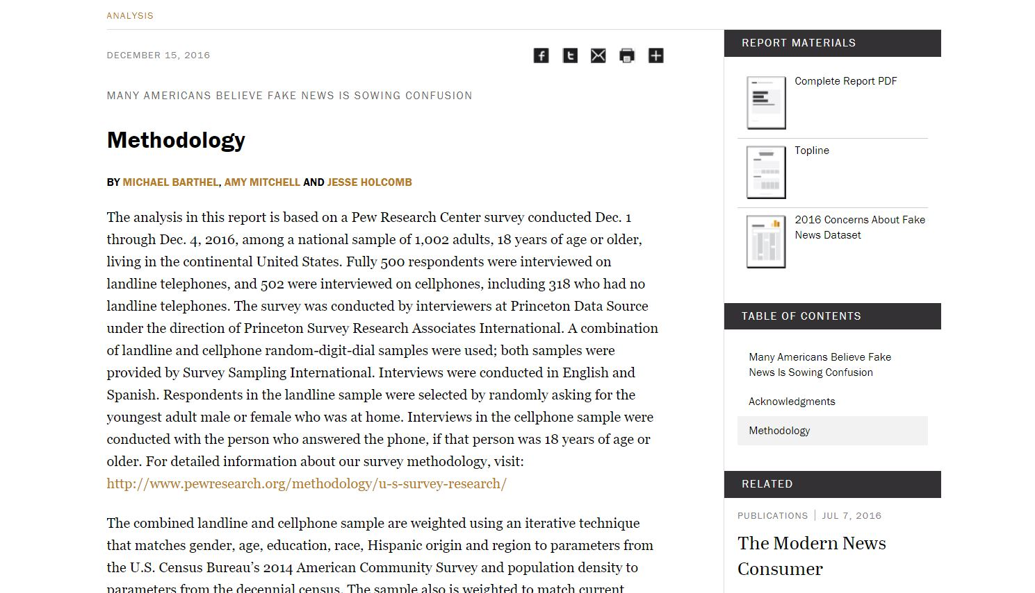
“Now wait a minute, you just tossed out a bunch of percentages!”
How can we trust you?
I used a reliable/trusted source
I am able to review their statistical methodology in detail to see how they reached their conclusions
I cited it so that you can review it on your own time and compare it to other information

Slide 5
Types of misinformation
Propaganda
Clickbait
Sponsored content
Satire/Hoax
Conspiracy theory
Pseudoscience
Misinformation
Error
Partisanship

Slide 6
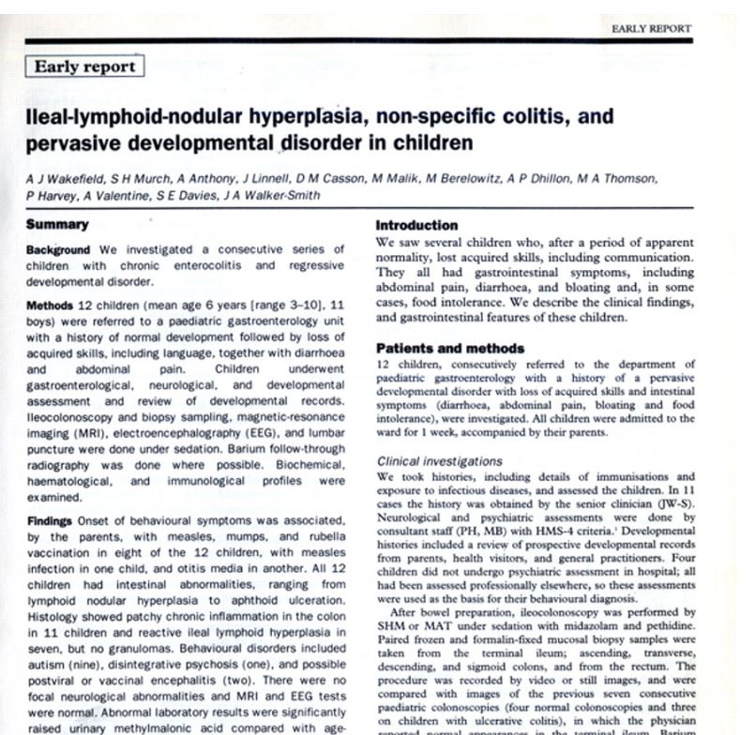
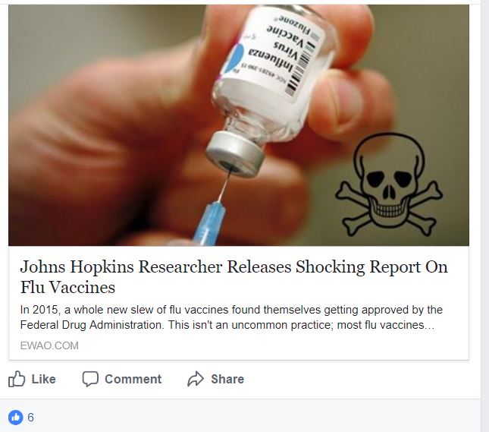
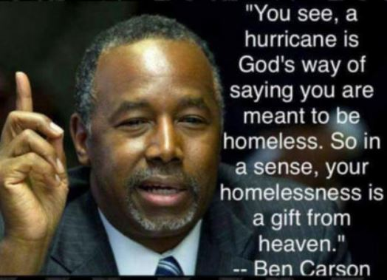
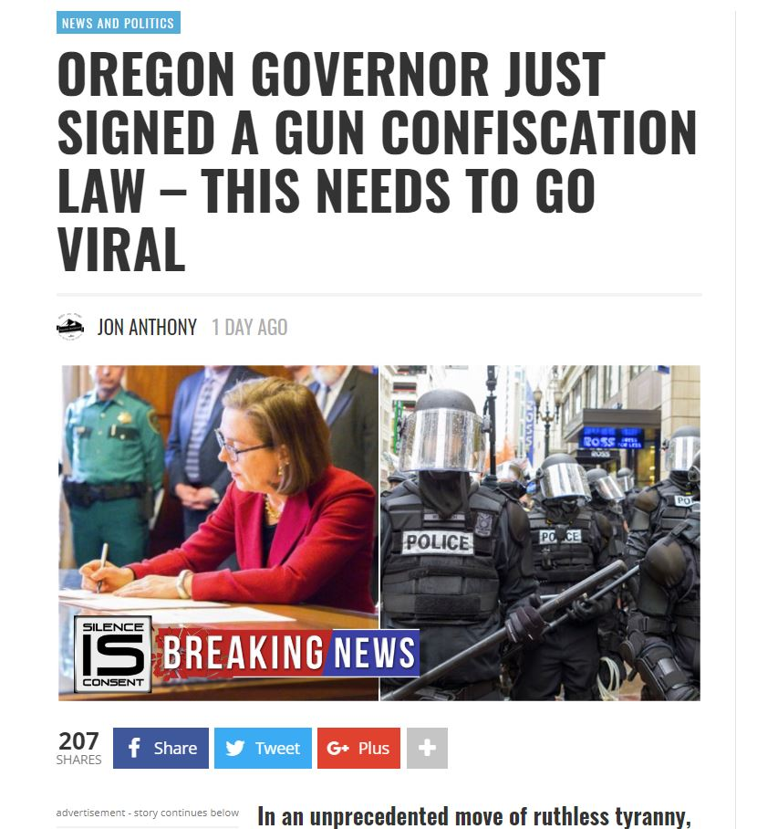
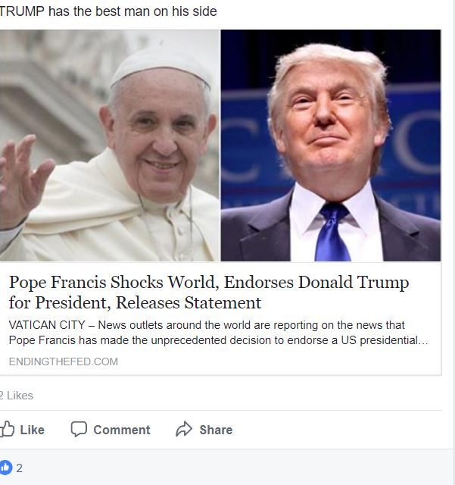
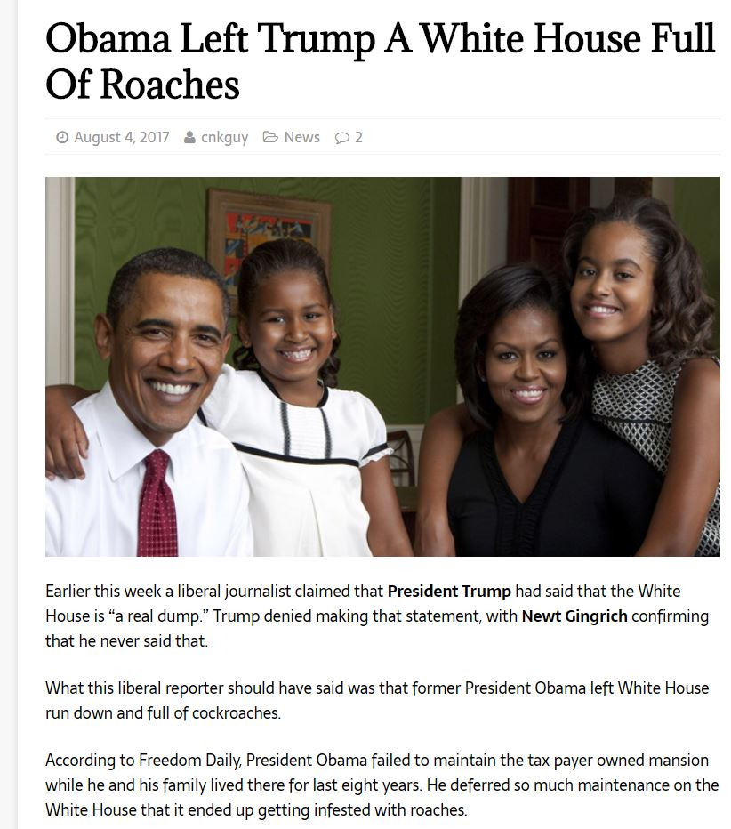
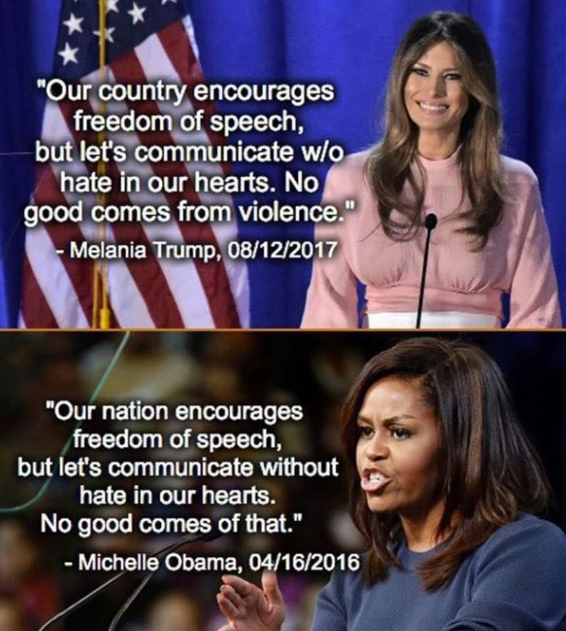
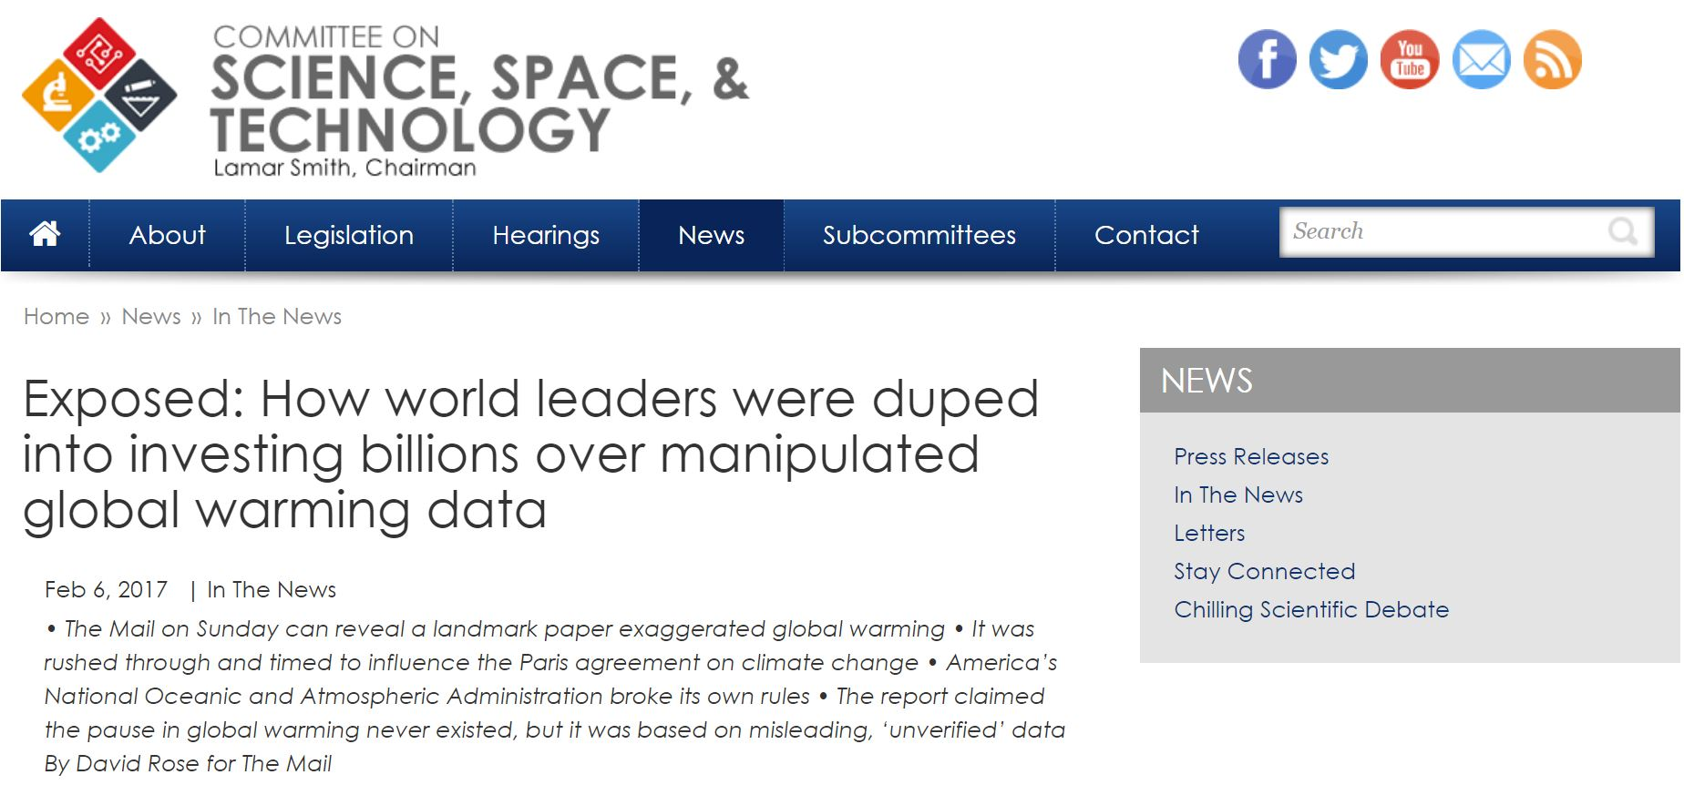

Slide 7
Tactics (what to watch for)
Logical fallacies
Gaslighting
Lying with math and statistics
Lying with charts and graphs
Cherry picking
Context, context, context

Slide 8
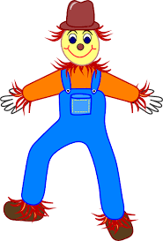
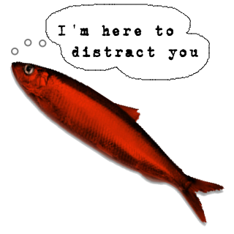
Logical fallacies
Slippery slope
Hasty generalization
Post hoc ergo propter hoc
Genetic fallacy
Begging the claim
Circular argument
Either/or
Ad hominem
Ad populum
Red herring
Straw man
Moral equivalence
Read all about logical fallacies at the Purdue Owl: https://owl.english.purdue.edu/owl/resource/659/03/
Notes:
Slippery Slope: This is a conclusion based on the premise that if A happens, then eventually through a series of small steps, through B, C,..., X, Y, Z will happen, too, basically equating A and Z. So, if we don't want Z to occur, A must not be allowed to occur either. Example:
If we ban Hummers because they are bad for the environment eventually the government will ban all cars, so we should not ban Hummers.
In this example, the author is equating banning Hummers with banning all cars, which is not the same thing.
Hasty Generalization: This is a conclusion based on insufficient or biased evidence. In other words, you are rushing to a conclusion before you have all the relevant facts. Example:
Even though it's only the first day, I can tell this is going to be a boring course.
In this example, the author is basing his evaluation of the entire course on only the first day, which is notoriously boring and full of housekeeping tasks for most courses. To make a fair and reasonable evaluation the author must attend not one but several classes, and possibly even examine the textbook, talk to the professor, or talk to others who have previously finished the course in order to have sufficient evidence to base a conclusion on.
Post hoc ergo propter hoc: This is a conclusion that assumes that if 'A' occurred after 'B' then 'B' must have caused 'A.' Example:
I drank bottled water and now I am sick, so the water must have made me sick.
In this example, the author assumes that if one event chronologically follows another the first event must have caused the second. But the illness could have been caused by the burrito the night before, a flu bug that had been working on the body for days, or a chemical spill across campus. There is no reason, without more evidence, to assume the water caused the person to be sick.
Genetic Fallacy: This conclusion is based on an argument that the origins of a person, idea, institute, or theory determine its character, nature, or worth. Example:
The Volkswagen Beetle is an evil car because it was originally designed by Hitler's army.
In this example the author is equating the character of a car with the character of the people who built the car. However, the two are not inherently related.
Begging the Claim: The conclusion that the writer should prove is validated within the claim. Example:
Filthy and polluting coal should be banned.
Arguing that coal pollutes the earth and thus should be banned would be logical. But the very conclusion that should be proved, that coal causes enough pollution to warrant banning its use, is already assumed in the claim by referring to it as "filthy and polluting."
Circular Argument: This restates the argument rather than actually proving it. Example:
George Bush is a good communicator because he speaks effectively.
In this example, the conclusion that Bush is a "good communicator" and the evidence used to prove it "he speaks effectively" are basically the same idea. Specific evidence such as using everyday language, breaking down complex problems, or illustrating his points with humorous stories would be needed to prove either half of the sentence.
Either/or: This is a conclusion that oversimplifies the argument by reducing it to only two sides or choices. Example:
We can either stop using cars or destroy the earth.
In this example, the two choices are presented as the only options, yet the author ignores a range of choices in between such as developing cleaner technology, car-sharing systems for necessities and emergencies, or better community planning to discourage daily driving.
Ad hominem: This is an attack on the character of a person rather than his or her opinions or arguments. Example:
Green Peace's strategies aren't effective because they are all dirty, lazy hippies.
In this example, the author doesn't even name particular strategies Green Peace has suggested, much less evaluate those strategies on their merits. Instead, the author attacks the characters of the individuals in the group.
Ad populum: This is an emotional appeal that speaks to positive (such as patriotism, religion, democracy) or negative (such as terrorism or fascism) concepts rather than the real issue at hand. Example:
If you were a true American you would support the rights of people to choose whatever vehicle they want.
In this example, the author equates being a "true American," a concept that people want to be associated with, particularly in a time of war, with allowing people to buy any vehicle they want even though there is no inherent connection between the two.
Red Herring: This is a diversionary tactic that avoids the key issues, often by avoiding opposing arguments rather than addressing them. Example:
The level of mercury in seafood may be unsafe, but what will fishers do to support their families?
In this example, the author switches the discussion away from the safety of the food and talks instead about an economic issue, the livelihood of those catching fish. While one issue may affect the other it does not mean we should ignore possible safety issues because of possible economic consequences to a few individuals.
Straw Man: This move oversimplifies an opponent's viewpoint and then attacks that hollow argument.
People who don't support the proposed state minimum wage increase hate the poor.
In this example, the author attributes the worst possible motive to an opponent's position. In reality, however, the opposition probably has more complex and sympathetic arguments to support their point. By not addressing those arguments, the author is not treating the opposition with respect or refuting their position.
Moral Equivalence: This fallacy compares minor misdeeds with major atrocities.
That parking attendant who gave me a ticket is as bad as Hitler.
In this example, the author is comparing the relatively harmless actions of a person doing their job with the horrific actions of Hitler. This comparison is unfair and inaccurate.

Slide 9
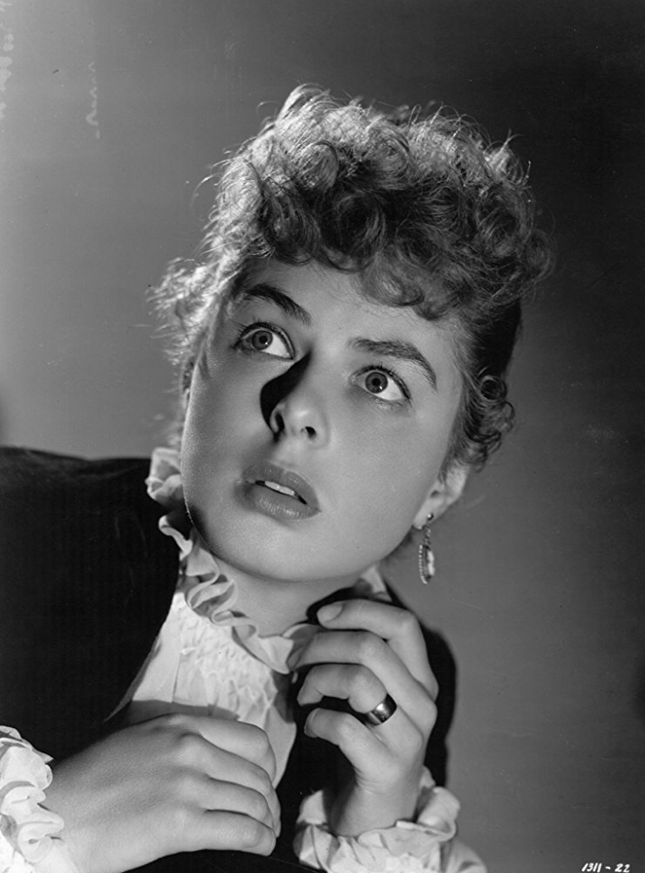
Gaslighting
Context is important here
Manipulation tactic, “psychological warfare”
Deliberate distortions made (and repeated) to manipulate
Done to incite doubt and lower self confidence
Results in suppression of facts, repressing doubts/concerns

Slide 10
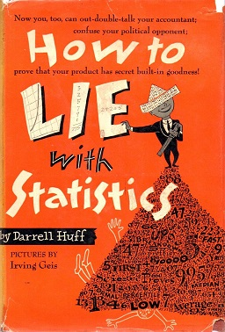
Lying with math and statistics
The lie of averages
“Average income”
1+2+ (5.5) 9+10=22/4=5.5
1+2+20+30+70+55+100 + (164.2)200+1000=1478/9=164.2

Slide 11
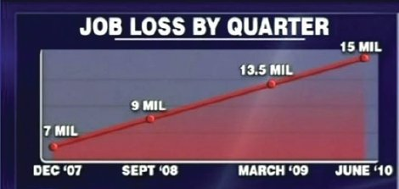
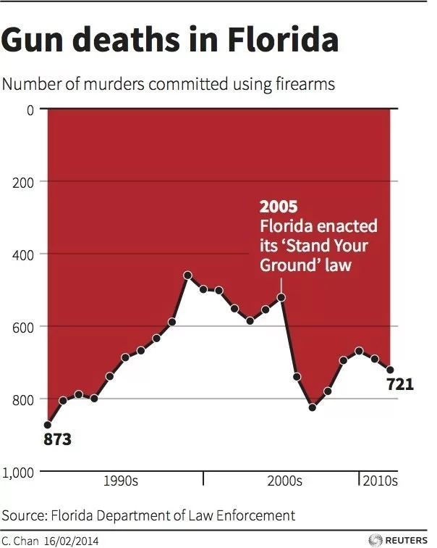
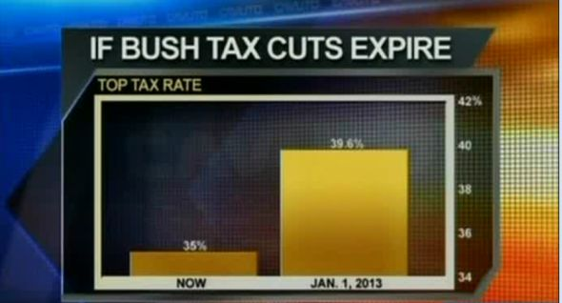
Lying with charts and graphs (watch your axes!)

Slide 12
Context, context, context

Slide 13
Fact checking sites
Duke University—Reporter’s Lab
https://reporterslab.org/fact-checking/
FactCheck (Annenberg Policy Center)
http://www.factcheck.org
HealthNewsReview
https://www.healthnewsreview.org
Politifact
http://www.politifact.com
Snopes
http://www.snopes.com
Explore more at: http://libguides.umw.edu/c.php?g=424264&p=2898977
And here http://guides.library.stonybrook.edu/fakenews/resources

Slide 14
Who fact checks the fact checkers?

Slide 15
What else can I do? Evaluating sources
Critical thinking—where does the information in divergent reports interact?
There is almost always bias in conclusions; draw from facts
Controversial? Give it a day
Often, more details come to light
Anonymous sources
One? A few? Consider the source
They got it wrong! Did they retract or correct?
Outlets that do (vs. refusing to back down) are more trustworthy
National Review Online. A Field Guide to Harvard’s Field Guide on Fake News National Review
http://www.nationalreview.com/article/445768/harvard-fake-news-guide-proves-leftist-media-bias

Slide 16
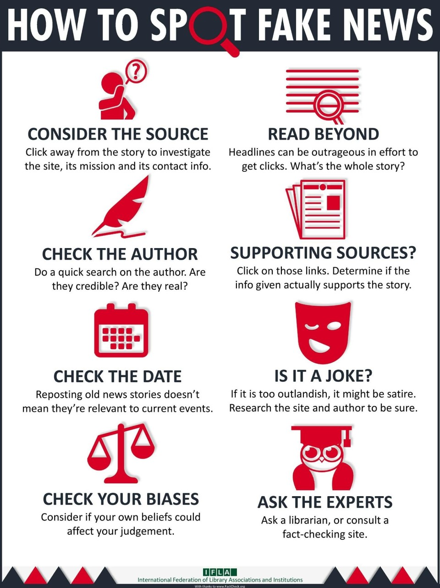

Slide 17
GALILEO wins! Databases that help
Academic Search Complete
Newspaper Source
Consumer Health Complete
Gale LegalForms
Statistical Abstract of the United States
Explora
SIRS
What else do you use?

Slide 18
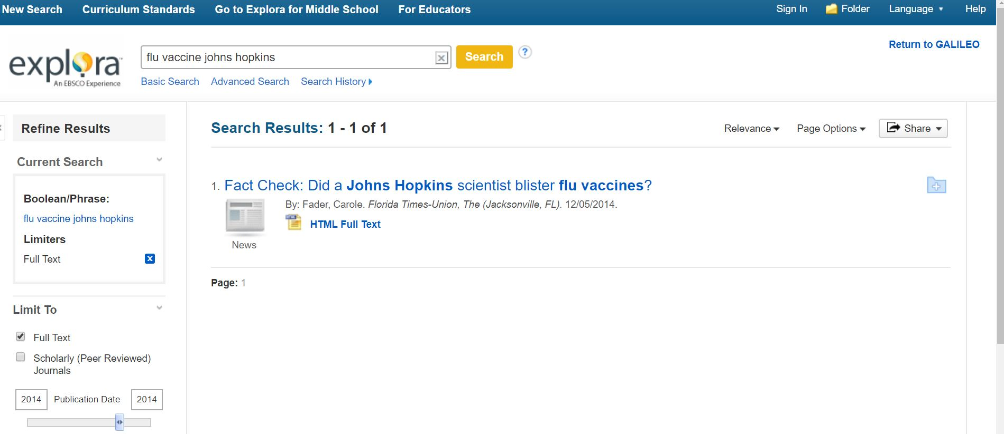
Explora vs. the flu vaccine scare

Slide 19
Academic Search Complete vs White House vermin (nothing)

Slide 20
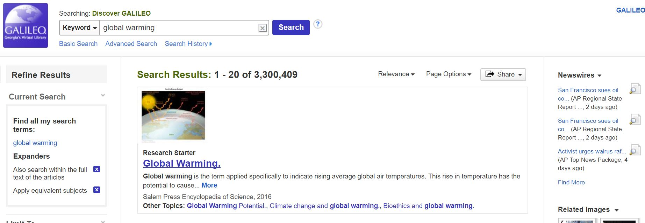
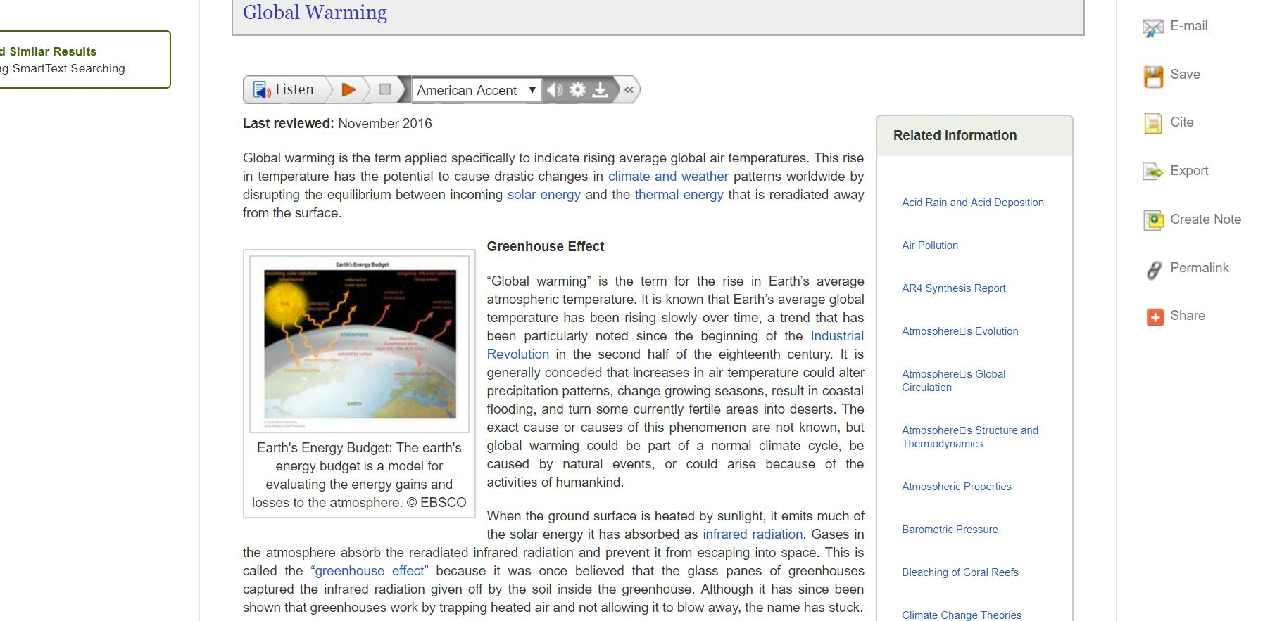
How the Discover search can help
Research Starters –lots of facts, lots of links to more, lots of citations

Slide 21
Topic Overviews in Explora

Slide 22
Ethically speaking…
We provide tools and access to information
Present accurate facts
Teach users to be media literate and apply the strategies we discussed today in their approach to the news and other media
Challenges:
Avoiding letting our own opinions/bias creep in
Treating those with wildly different opinions than our own respectfully

Slide 24
Thank you!
Russell Palmer
Assistant Director, GALILEO Support Services
russell.palmer@usg.edu
Slides available:
https://about.galileo.usg.edu/documents

Slide 25
Post Conference Additions
Thank you all for suggestions!
NPR Story and book info: “Think Like a Fact Checker” material
https://www.npr.org/sections/ed/2017/10/31/559571970/learning-to-spot-fake-news-start-with-a-gut-check

Slide 26
Google Doc, strategies and list of “fake news” sites
By Melissa Zimdars, Asst. Professor of Communication at Merrimack College
https://docs.google.com/document/d/10eA5-mCZLSS4MQY5QGb5ewC3VAL6pLkT53V_81ZyitM/preview

Slide 27
