Slide 1
GALILEO & OpenAthens: 21st Century Authentication for GALILEO Participating Libraries
Christopher Holly
Director of SaaS Innovation, EBSCO
cholly@ebsco.com

Slide 2
Helping over 2,600 organisations enable access to hundreds of thousands of journals, databases and ebooks, for over 4 million end users, across 200+ countries.

Slide 3
OpenAthens – What is it?
Username/Password system for access to electronic resources
Use current credentials or create in OpenAthens
Provides user categorization & statistics
Access Management - down to the Individual Platform & User
Customizable Permission Sets (by department, role, major, year of grad, etc)
Provides anonymized patron information to Service Providers
Fully Cloud-Based Service with 24/7 Customer Support

Slide 4
OpenAthens - Benefits
Easily configured by administrators
User account management tools can allocate or restrict access to categories of individuals or groups
Granular statistics
Informed collection management using statistics
Help determine patron outcomes
Cross charging different business units
By Librarians for Librarians

Slide 5
OpenAthens – Integration Options
Integrates with organization’s own systems…
SAML
Active Directory (ADFS or LDAP)
Portals
Learning Management Systems
Google G Suite Global Directory
ILS’s
Student Information Systems
APIs
No *new* usernames or passwords & improved license compliance
Library resources become another application managed via the SSO system which simplifies IT hierarchy & improves security.

Slide 6
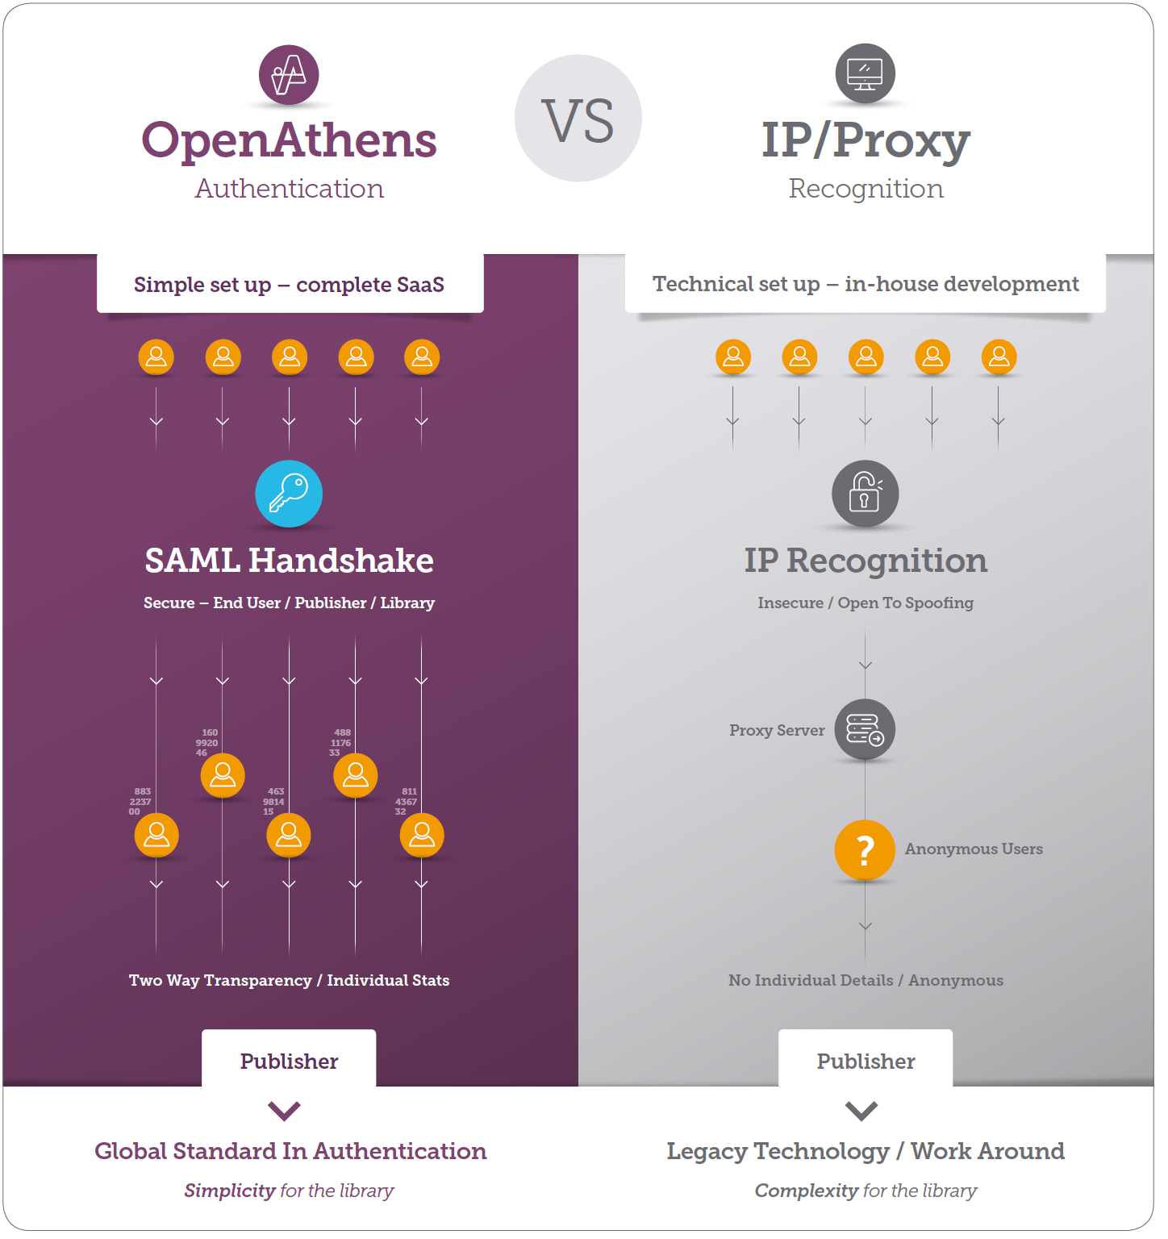
What makes OpenAthens different from IP/proxy?
Designed by librarians for librarians
Always fully hosted
Works across all devices and locations
Collects detailed usage statistics
Supports user personalization
Military-grade security with SAML

Slide 7
Changing user requirements: 1990 - today
Mobile access is key
Personalization is expected
Multiple devices are used

Slide 8
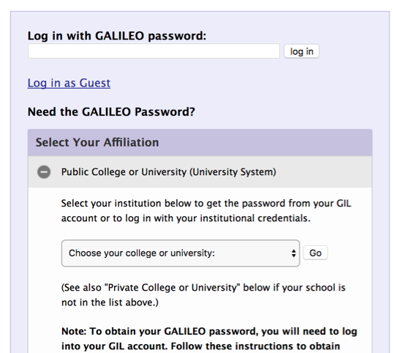
User Login Today

Slide 9
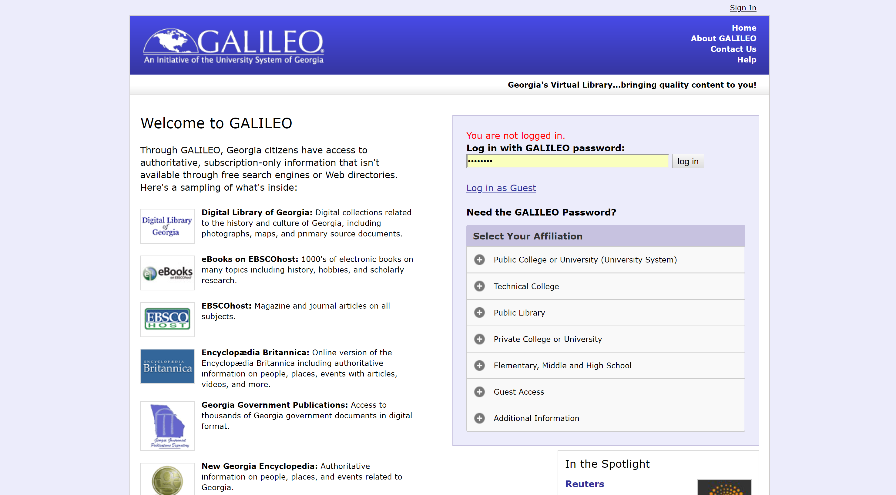
OpenAthens Wayfinder
Login to the virtual library of Georgia

Slide 10
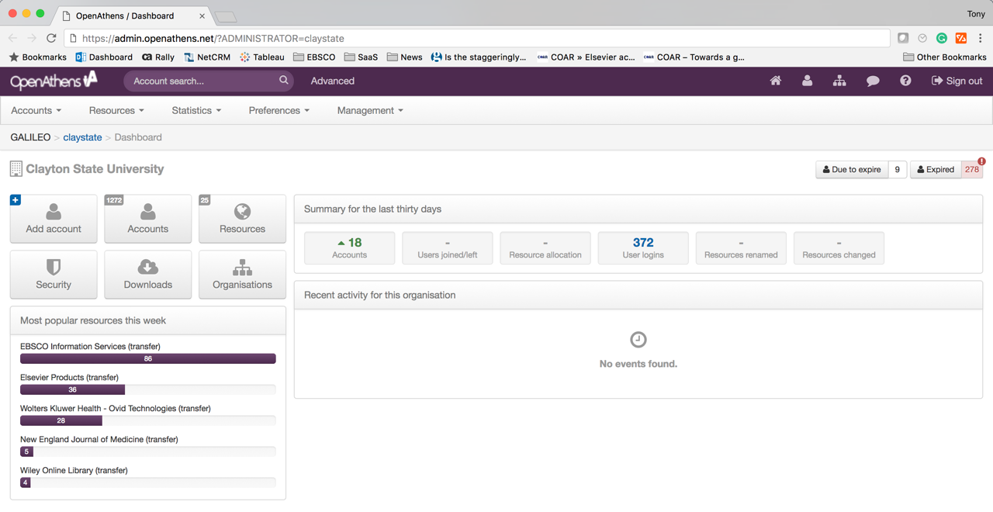

Slide 11
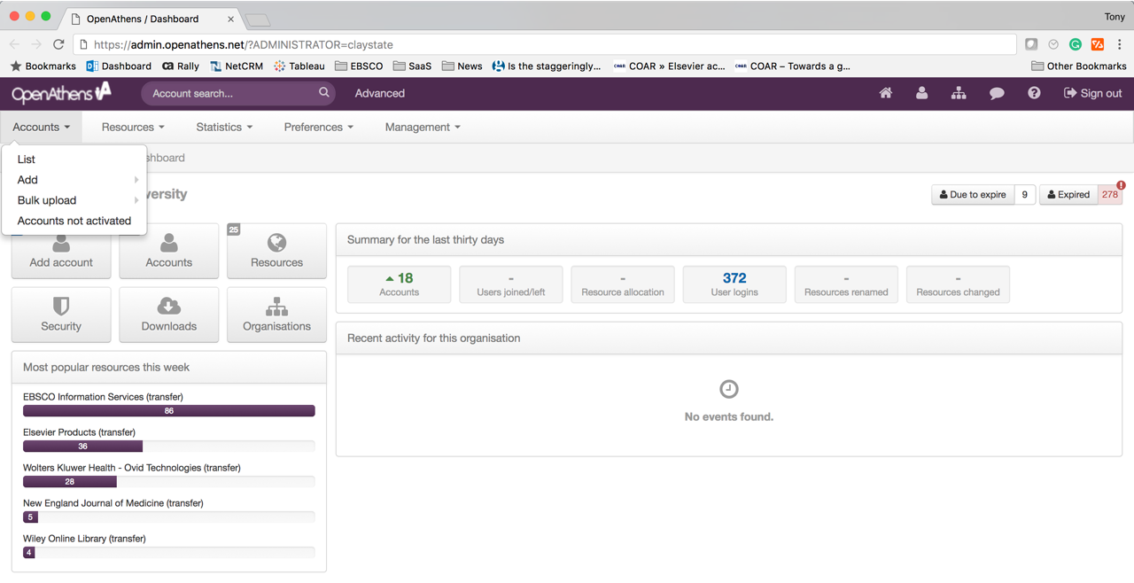

Slide 12
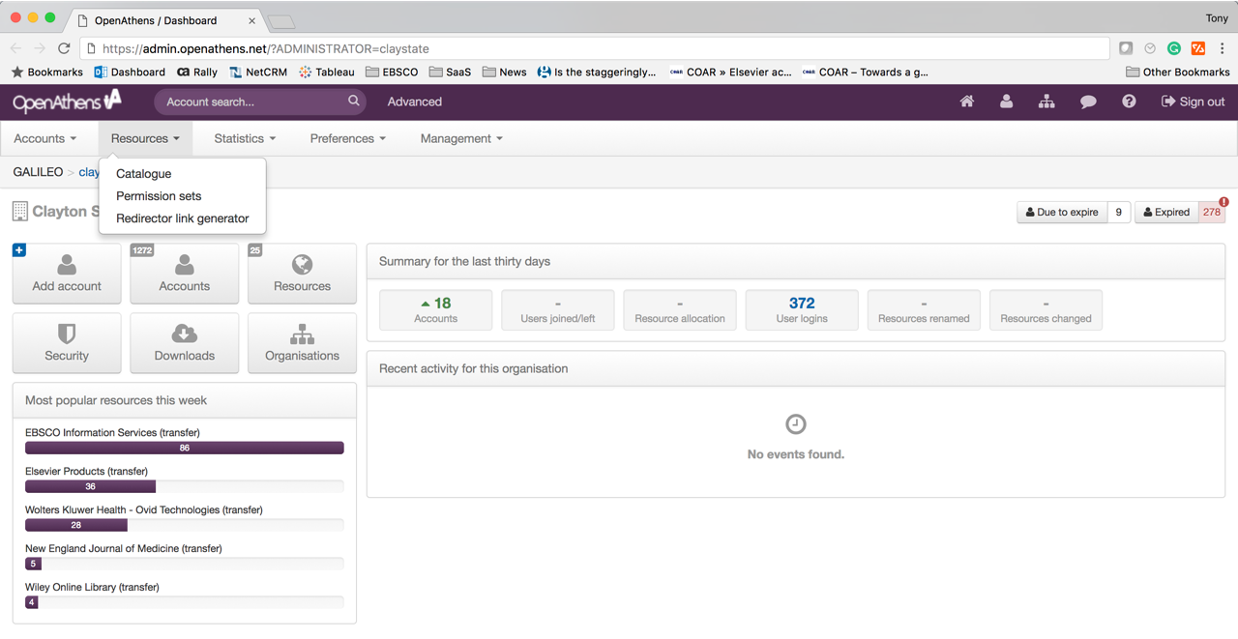

Slide 13
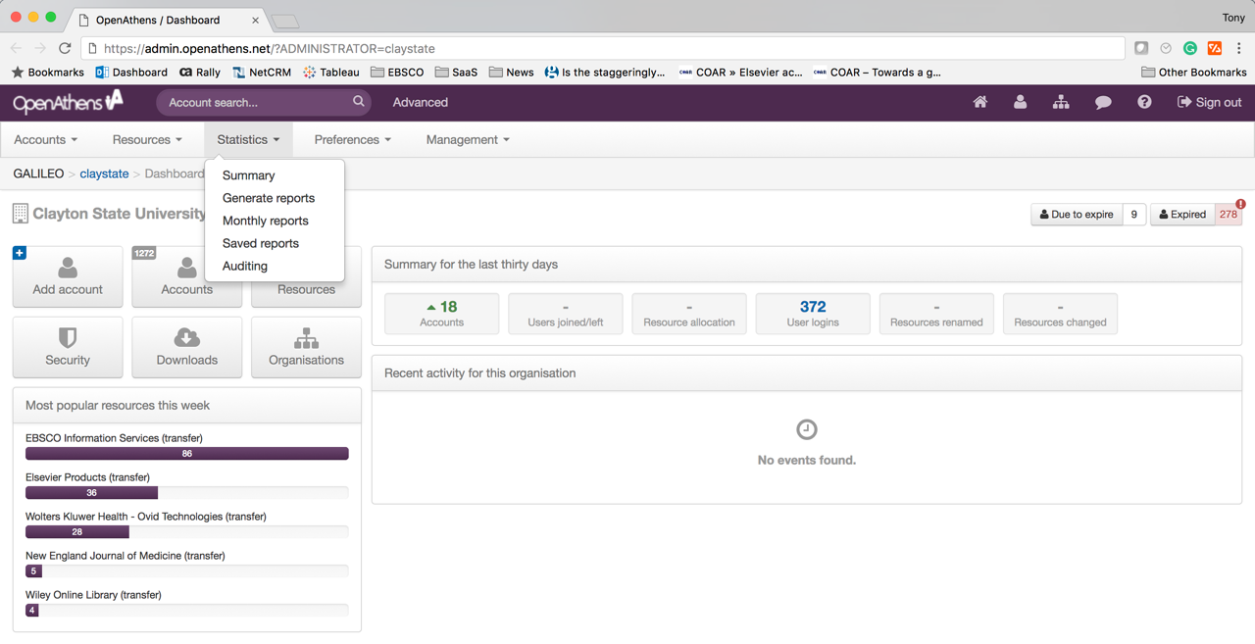

Slide 14
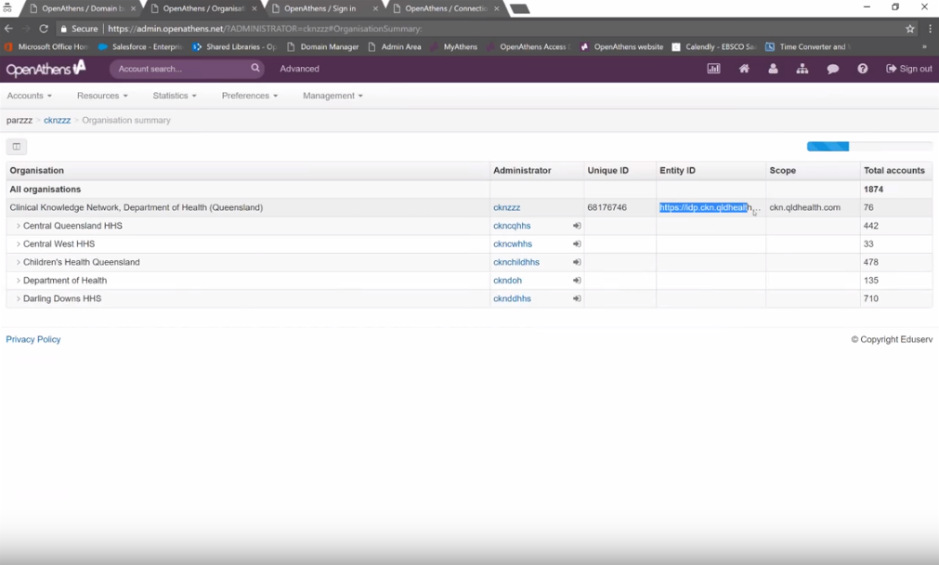

Slide 15
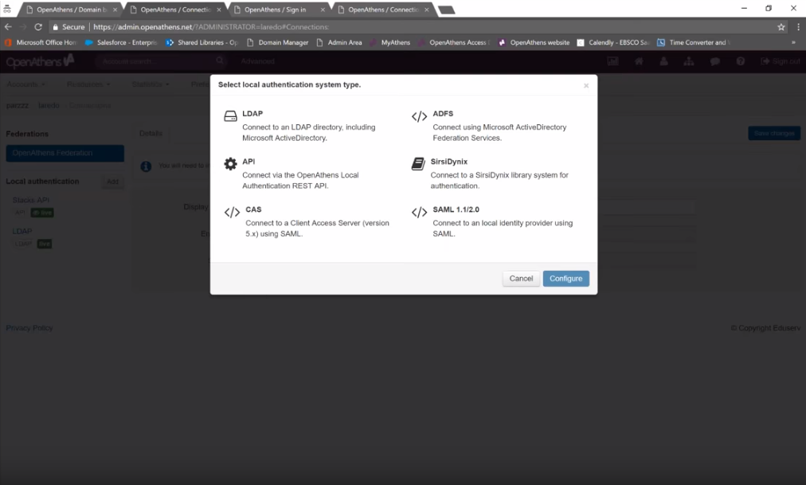

Slide 16
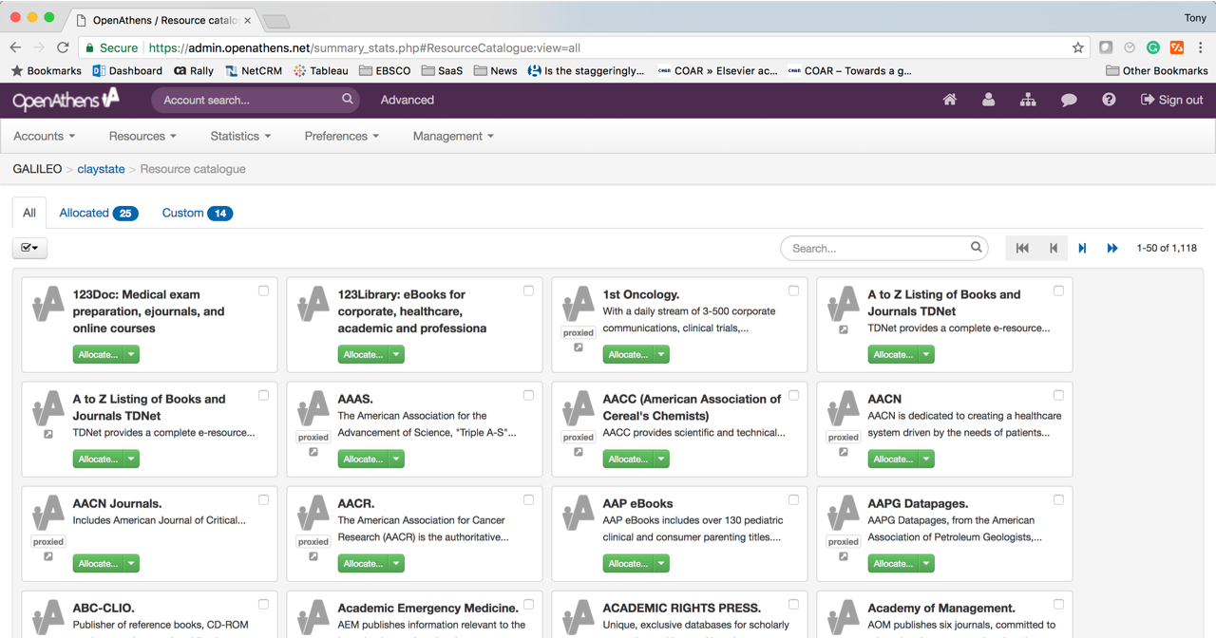

Slide 17
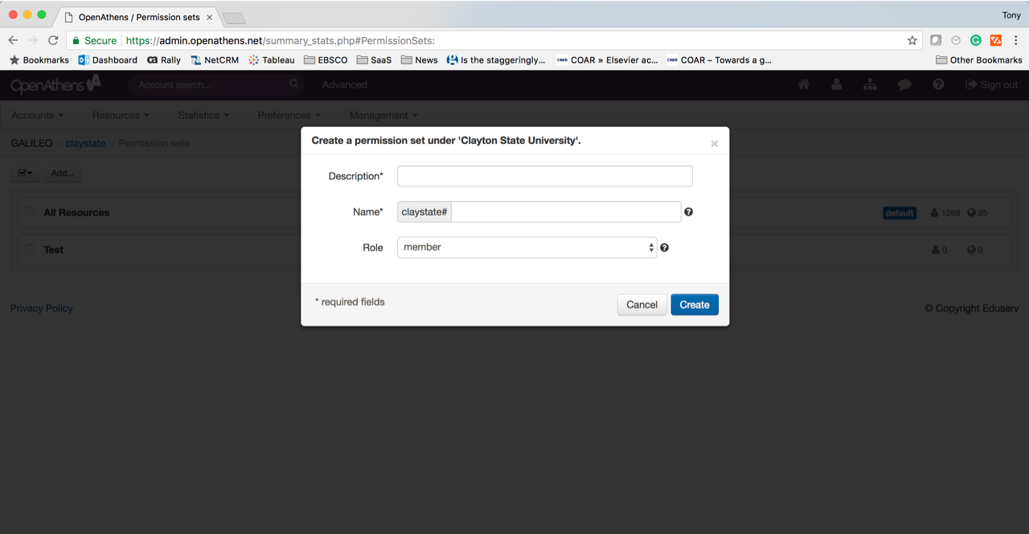

Slide 18
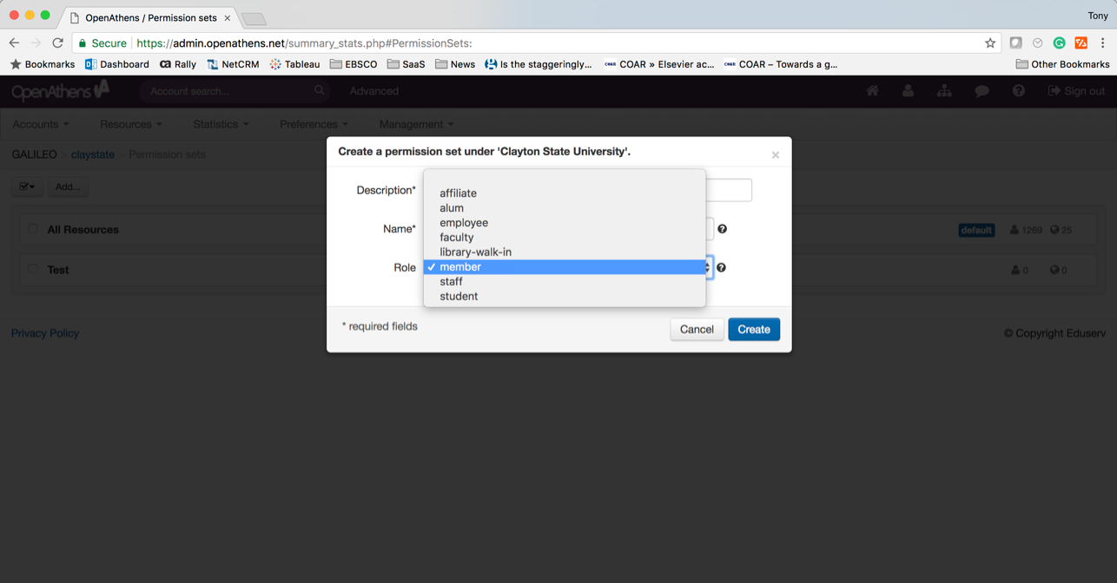

Slide 19
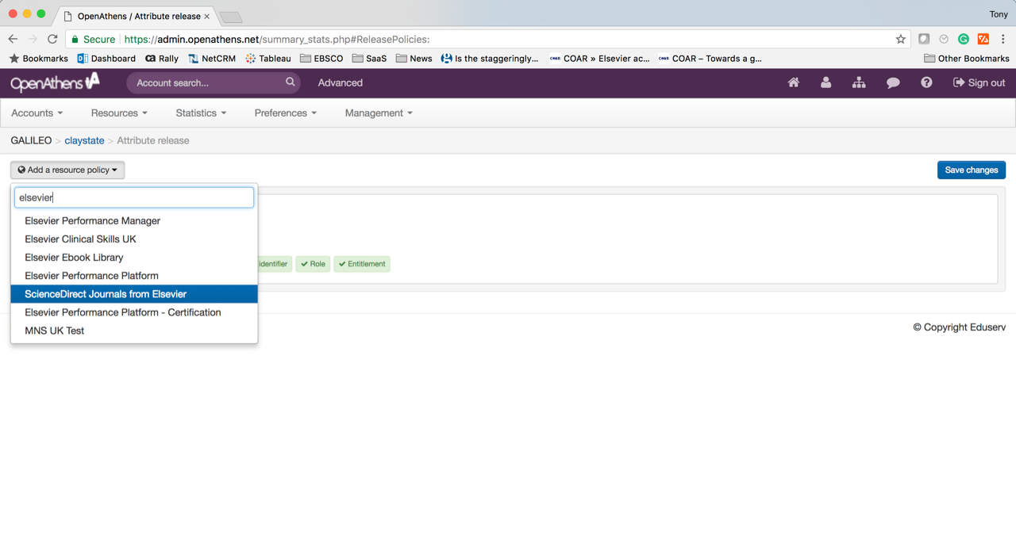

Slide 20
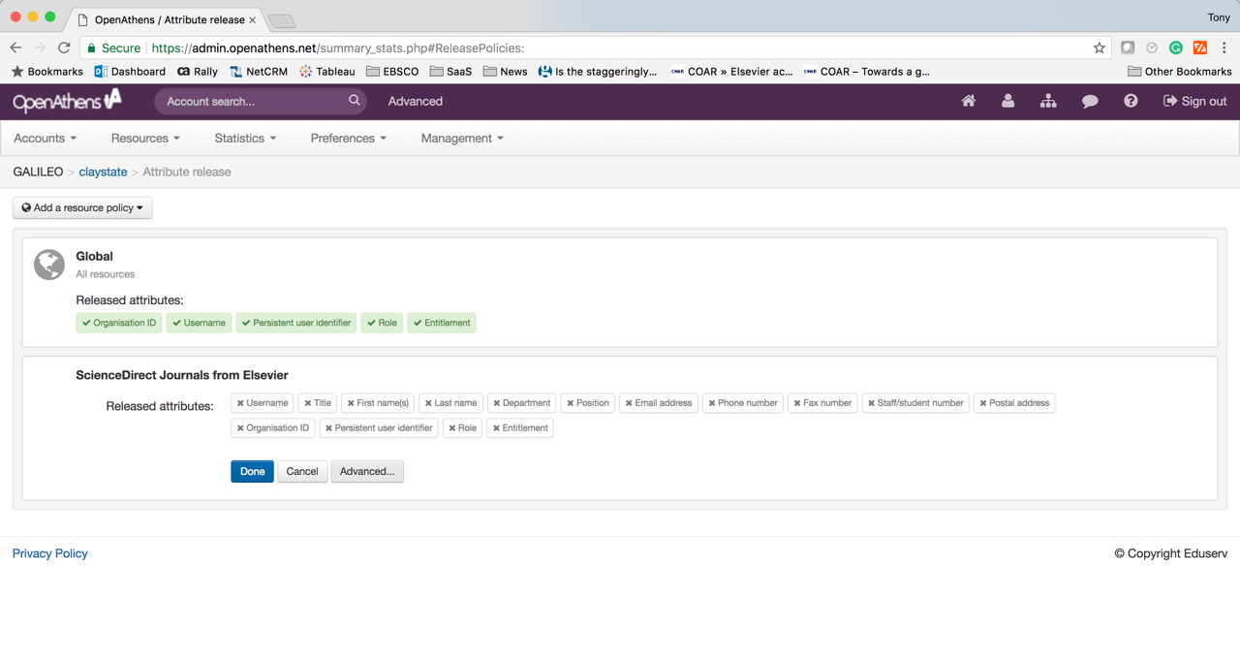

Slide 21
Reporting Features

Slide 22
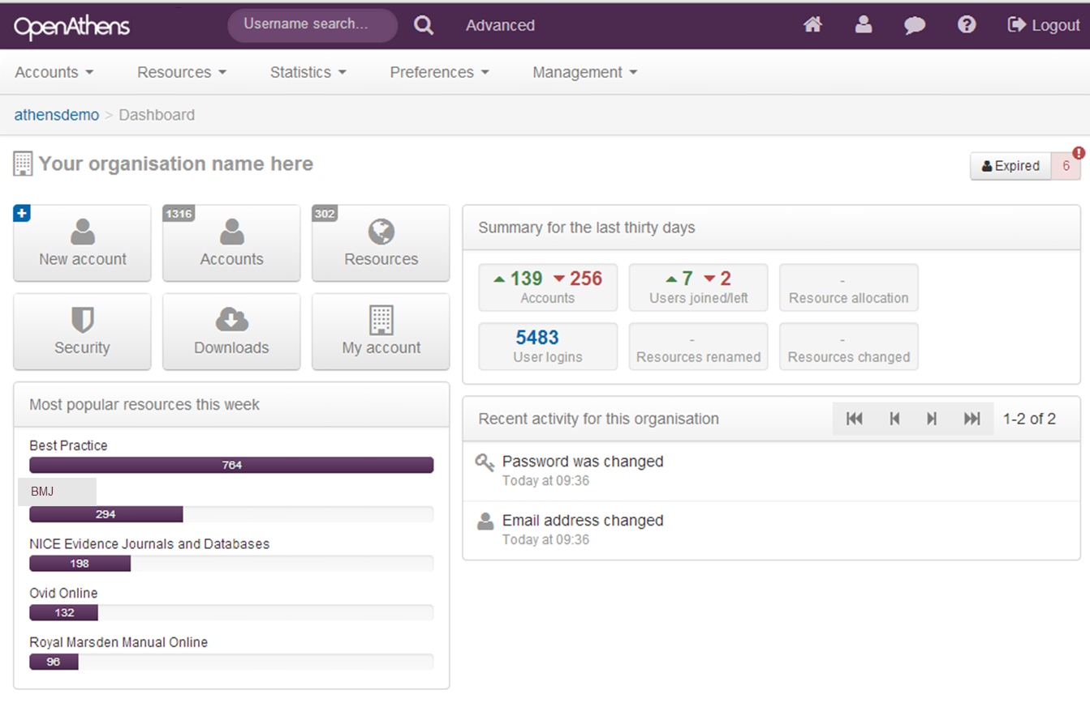
OpenAthens Admin Dashboard

Slide 23
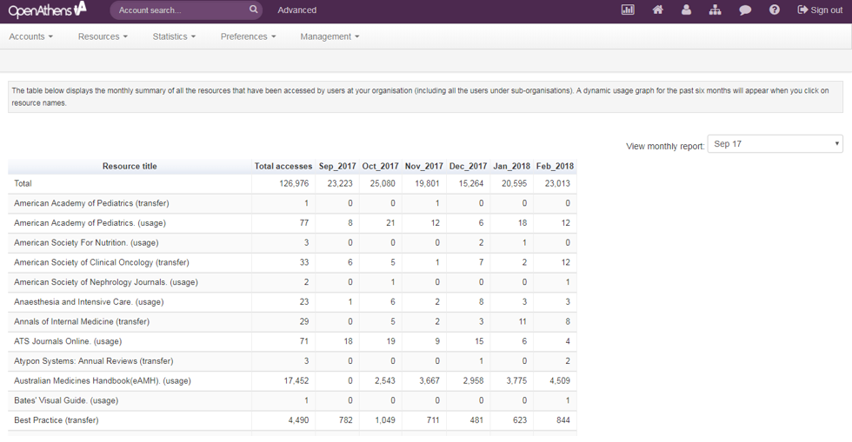
Resource usage statistics

Slide 24
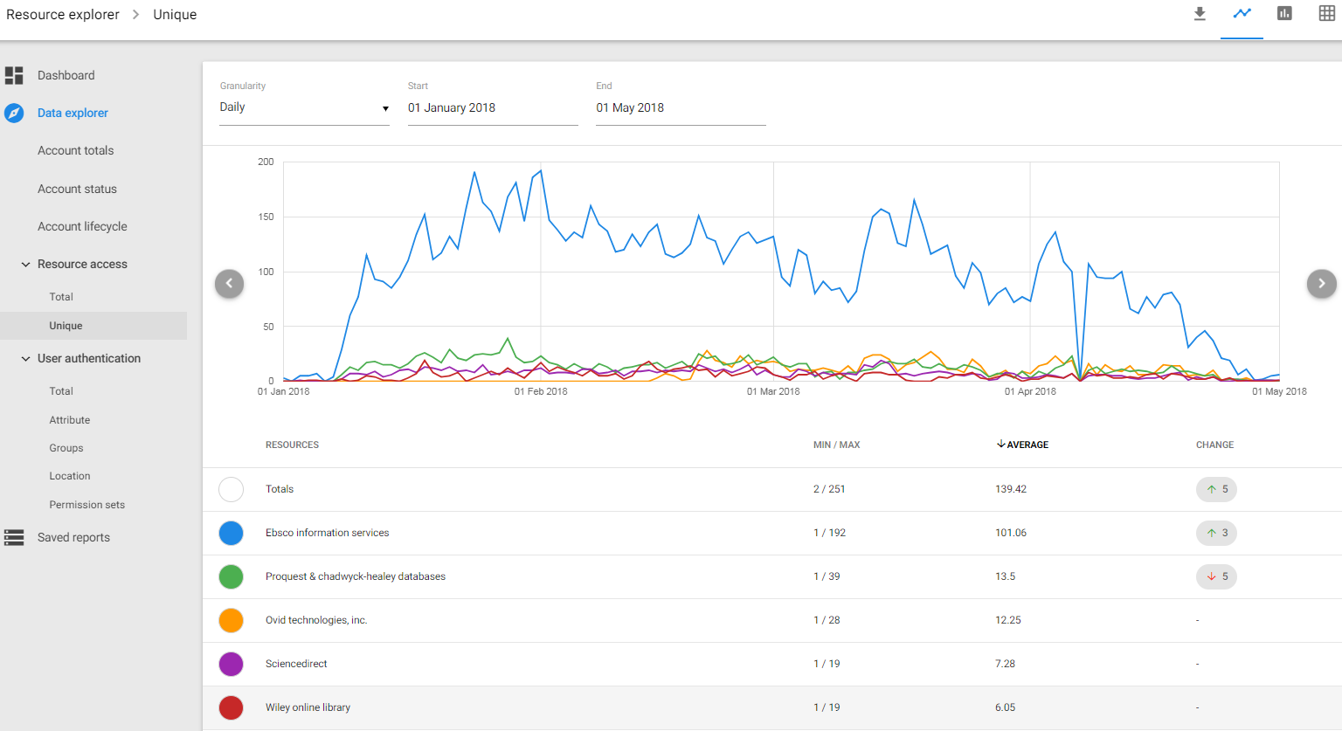
Resource Usage

Slide 25
Authentication by Location

Slide 26
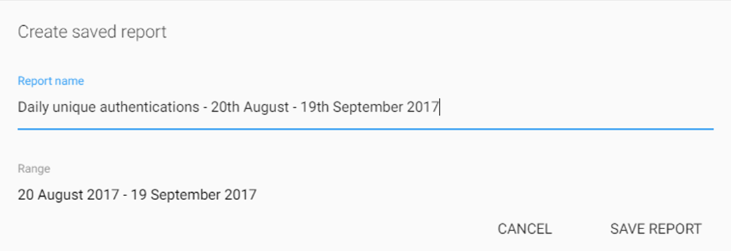
Save Custom Reports
SAVE REPORT
Mark Favorites
Notes:
Once you’ve created a new custom report then you’re able to save that and mark as a favourites for easy access next time
Of course we still have the functionality to schedule any of these so the system automatically generates the report and emails you on a monthly basis

Slide 27
EBSCO & OpenAthens - A united partnership
EBSCO sells & supports OpenAthens across the globe
Working together since 2007
Customers across 200+ countries

