Slide 1
GALILEO to the Core: Leveraging Digital Resources for Literacy in CCGPS Classes (High School)
Session will begin at 3:30PM
While you are waiting, please check your audio
(microphone and speakers)
Go to Tools > Audio > Audio Setup Wizard

Slide 2
Viewing Archived Webinar
ELA Georgiastandards.org: https://www.georgiastandards.org/Common-Core/Pages/ELA.aspx
Literacy Georgiastandards.org:
https://www.georgiastandards.org/Common-Core/Pages/CCGPS_Literacy.aspx

Slide 3
Common Core Shifts for ELA/Literacy
Building knowledge through content-rich nonfiction
Reading, writing, and speaking grounded in evidence from text, both literary and informational
Regular practice with complex text and its academic language

Slide 4
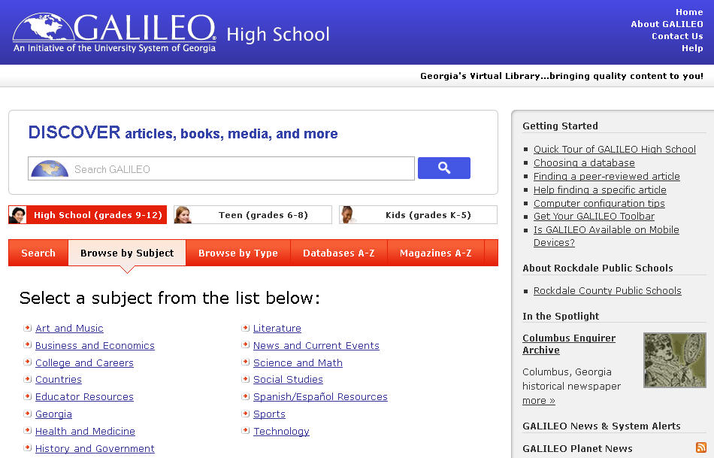
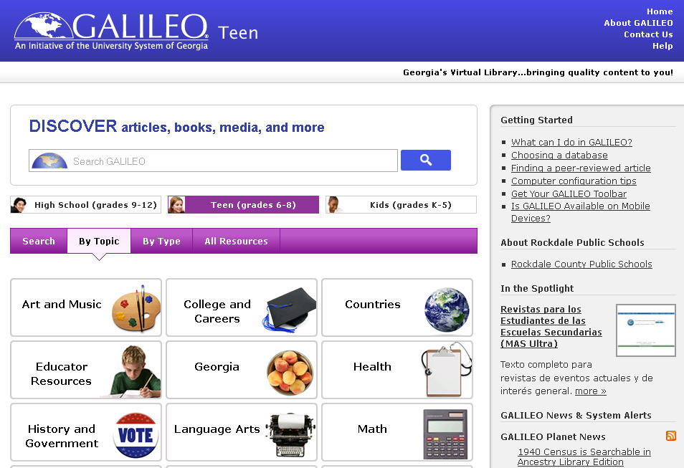
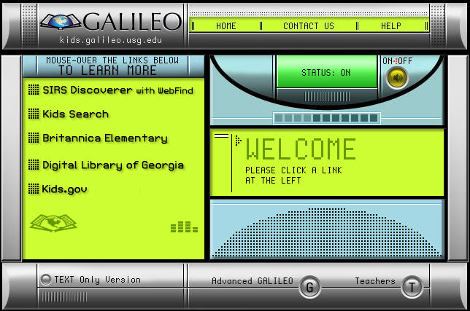
What is GALILEO?
GeorgiA LIbrary LEarning Online
Georgia’s Virtual Library
http://www.galileo.usg.edu
Notes:
What is GALILEO?
GALILEO stands for GeorgiA LIbrary LEarning Online.
It is Georgia's virtual library.
It can be found at http://www.galileo.usg.edu .

Slide 5
Who’s in GALILEO?
Public and Private Schools
Public Libraries
Public and Private Colleges and Universities

Slide 6
What’s in GALILEO?
Your portal to authoritative age-appropriate databases on multiple topics
Notes:
GALILEO is your portal to hundreds of databases that contain authoritative, subscription-only information that is not available in full text through Google and other search engines.

Slide 7
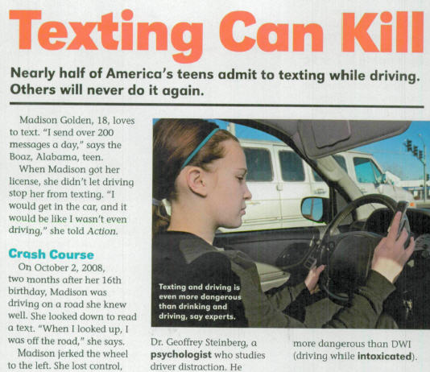
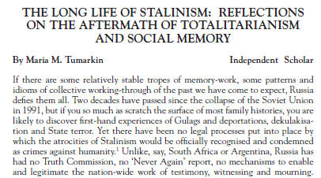
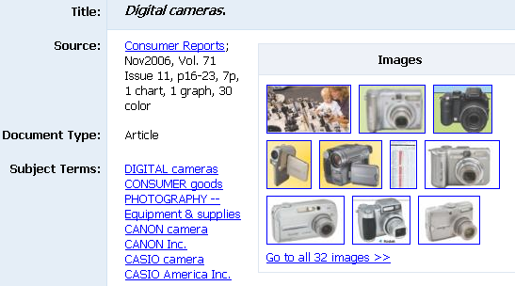
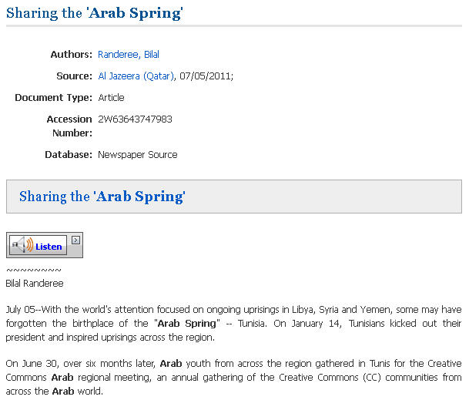
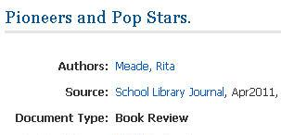
What’s in a database?
Databases can contain
magazine articles,
scholarly journal articles,
newspaper articles,
reviews,
and…
Notes:
So, what can you find in a database? A database can contain magazine articles, scholarly journal articles, newspaper articles, book and product reviews, and…

Slide 8
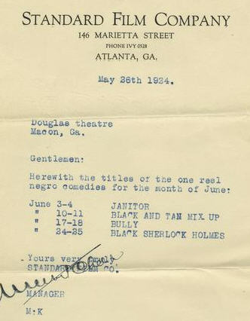
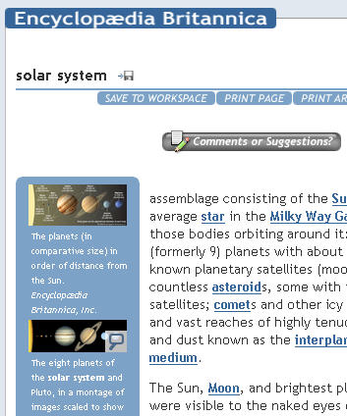
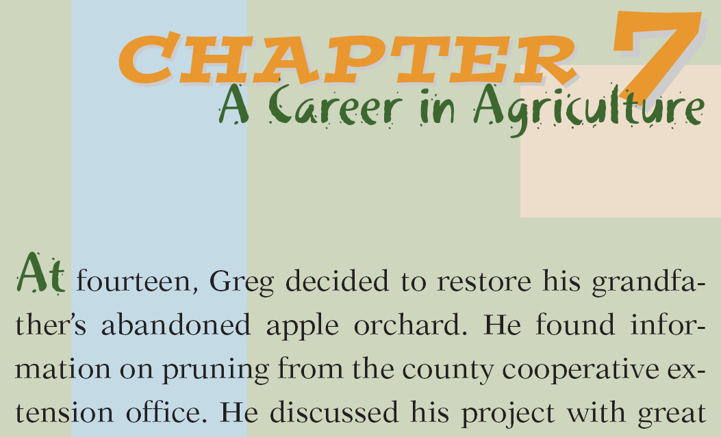
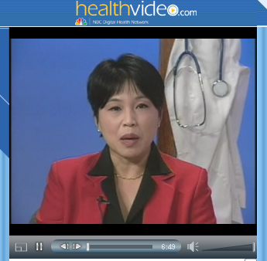
What’s in a database?
Databases can also contain
primary source documents,
encyclopedia entries,
book chapters,
images,
videos,
and much more
Notes:
They can also contain primary source documents, encyclopedia entries, book chapters, images, and videos.

Slide 9
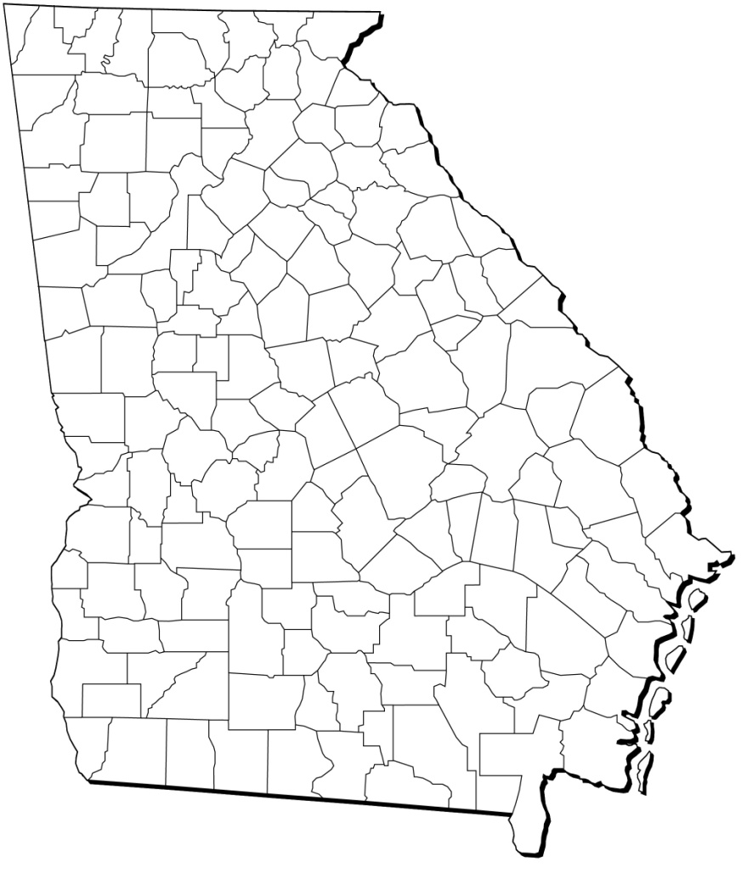
Georgia Resources in GALILEO
Notes:
GALILEO also includes several resources on the history and culture of Georgia, including the Digital Library of
Georgia, the New Georgia Encyclopedia, and GeorgiaInfo.

Slide 10
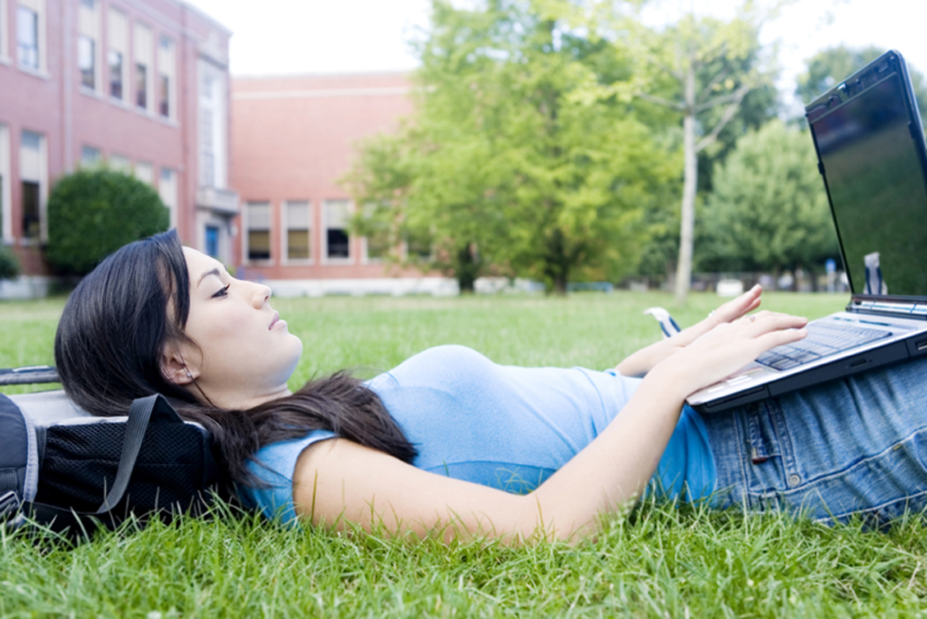
Get GALILEO Anytime, Anywhere
Seamless access on-campus via IP authentication
Log in off campus with GALILEO password
Notes:
GALILEO is available at any time of day and anywhere there is an internet connection, so your students can do research at school or at home.

Slide 11
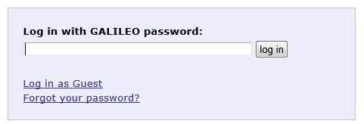
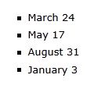
GALILEO Password
Each public school system, private school, public library system, and academic institution gets a unique password
Passwords change 4 times a year
Teachers: Get your password from your media specialist
Media specialists: Request to be added to the password list by contacting us.
Notes:
Any media specialist can be added to the password distribution list to receive a notice of a password change 30 days before it changes. If the password is problematic, let GALILEO staff know.

Slide 12
Up Next
A Tour of GALILEO
http://www.galileo.usg.edu
Notes:
http://www.galileo.usg.edu

Slide 13
Tour
Discover GALILEO
Encyclopædia Britannica High School
NoveList
Browse by Subject > Georgia
New Georgia Encyclopedia
Digital Library of Georgia
GeorgiaInfo

Slide 14
GALILEO offers
On-level informational text
Primary sources
Multimedia
Citing
Curriculum Tools
Lesson Plans from GALILEO

Slide 15
Informational Text ELACCXRI: Reading Informational Standards
Discover GALILEO offers a single search of resources with magazine, newspaper, and encyclopedia articles as well as book chapters
Search from GALILEO High School for any topic
Notes:
*Tip: It may help to use quotes for a name (e.g., “Mary Musgrove”) to get results with the first and last name together, but may also need to check for several forms of the name (e.g., General Sherman, William Sherman, William T. Sherman).
*Tip: If getting too many academic journals in search, limit to Trade Publications, Magazines, and/or News in Limit by Type.
*Tip: Limit results by subject to get better results. This works especially well for a person, historical event, or well-known topic.
*Tip: When student see an article title, note the Cite feature on the right that provides pre-formatted citations for the article and note the Permalink, which is a persistent link to the article that can be used in bibliographies, classroom websites, learning management systems, etc.
*Tip: Note Relevance Sort at the top of the search results list can be changed to Date Descending to see articles for current events topics.

Slide 16
Informational Text ELACCXRI: Reading Informational Standards
Or, see individual resources
Encyclopædia Britannica High School
Student Research Center
See more in your Databases A-Z list

Slide 17
Literary Text ELACCXRL: Reading Literary Standards
NoveList (NOT in Discover GALILEO)
Book and author recommendations
Curriculum-based book lists (by grade and topic)
Book Discussion Guides
Literary Reference Center (also in Discover GALILEO)
Literary Criticism
Plot Summaries
Full-text classics – poems, stories, some books

Slide 18
On-Level Text
Many GALILEO resources include Lexile scores
See Lexile Handout

Slide 19
Primary Sources LXRH: Literacy Standards for Reading in History and Social Studies
Discover GALILEO (use Limit by Type to find primary sources)
Digital Library of Georgia (also in Discover GALILEO)
SIRS Discoverer (NOT in Discover GALILEO)
Maps – current, historical, and outline
Annals of American History (from Britannica, NOT in Discover GALILEO)
American Memory (from Library of Congress, NOT in Discover GALILEO)
See more at High School > Browse by Type > Primary Source Documents

Slide 20
Multimedia
GALILEO offers resources with images, videos, and/or audio
Discover GALILEO (use Limit by Type to see Videos, Audio, and Non-Print Resources)
Encyclopædia Britannica High School
See more in High School > Browse by Type > Images , Maps, and Flags

Slide 21
Citing Sources
Several GALILEO resources have pre-formatted citations for articles

Slide 22
Citing Sources
Several GALILEO resources offer persistent links to articles

Slide 23
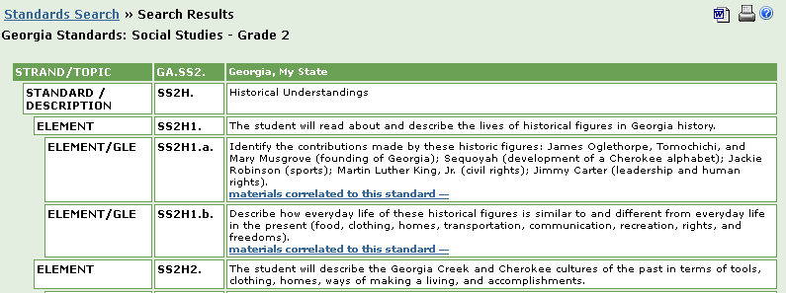
Encyclopædia Britannica
Look in Teachers’ Resources in Encyclopædia Britannica High School
Click the orange buttons for Curriculum Standards tool

Slide 24
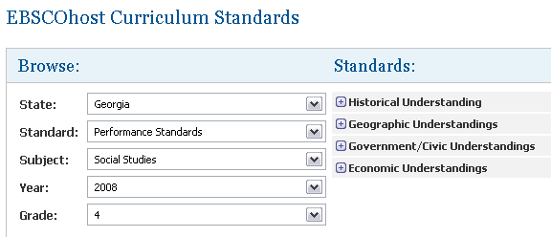
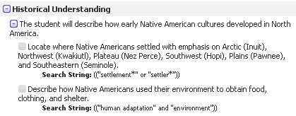
EBSCO Curriculum Standards
Appears in Student Research Center, History Reference Center, and Literary Reference Center
Look in Teacher Resources or Curriculum Standards

Slide 25
Linking to GALILEO Databases Express Links!!
Link directly to one GALILEO resource from your website
Students at home are only asked for the GALILEO password
Find all of your Express Links at GALILEO High School > Databases A-Z > Express Links

Slide 26
GALILEO Lesson Plans
Where I’m From in GALILEO – create a local history poem
Create Your Own Story – create a digital story

Slide 27
Questions?
For assistance, contact your media specialist or
Contact Us
http://www.galileo.usg.edu/contact

