Slide 1
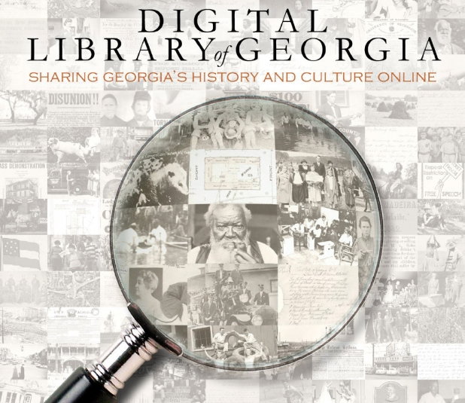
Finding Primary Documents
The Digital Library of Georgia and Beyond

Slide 2
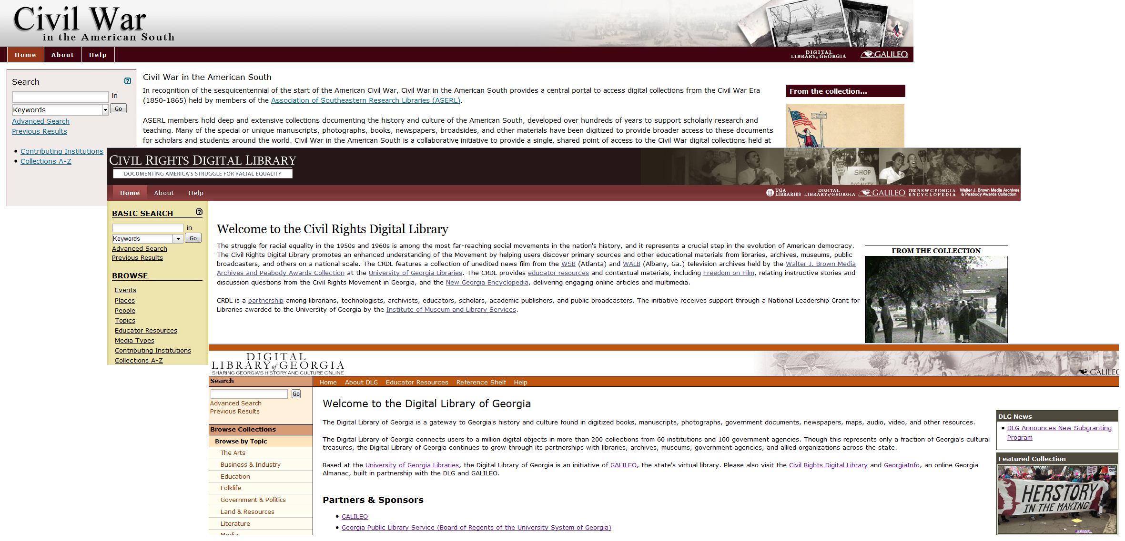
The Digital Library of Georgia
http://american-south.org
http://crdl.usg.edu
http://dlg.galileo.usg.edu
Notes:
"The Digital Library of Georgia is a GALILEO initiative based at the University of Georgia Libraries that collaborates with Georgia's Libraries, archives, museums, and other institutions of education and culture to provide access to key information resources on Georgia history, culture, and life. This primary mission is accomplished through the ongoing development, maintenance, and preservation of digital collections and online digital library resources. DLG acts not only as a digitizing agency, but also provides consultation and other services to strengthen digital initiatives in the state. We are also the home of the state's newspaper microfilming project, the Georgia Newspaper Project. We support three portals
* Georgia portal
* Civil Rights Digital Library (nation-wide)
* The Civil War in the American South (nation-wide)
In our role as an aggregator, we bring together the primary resources content from cultural heritage institutions all over the state including
municipal archives
public libraries
historical societies
religious archives
state agencies
colleges and universities
state archives
museums
"one stop shop"

Slide 3
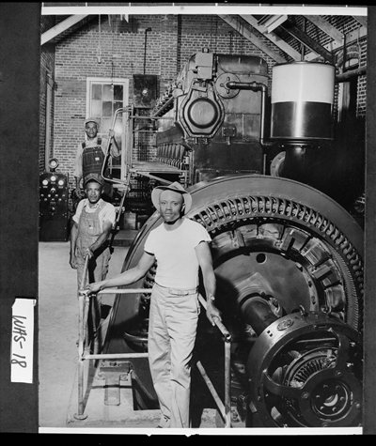
About the Digital Library of Georgia
What’s in there?
Digitized books, manuscripts, photographs, government documents, newspapers, maps, audio, video, and other resources.
How much is in there?
1m digital objects, in 200 collections from 60 institutions and 100 government agencies
How did it get there?
Hard work, partners, sponsors
Sandersville, early 1940s. Workers seen standing beside the diesel engine and generator used by the city to produce its own electricity, Vanishing Georgia, Georgia Archives
Notes:
In addition to a wide variety of types of materials, the resources in the DLG portals cover a wide range of topics and time periods.
From Revolution and Early Republic 1775-1800
* sermons and notes of Presbyterian minister, John Newton
* records of colonial/early republic governors
Ante-bellum 1800-1860
* coverage of relations between the early government and the Native peoples of Georgia
For example, an 1825 letter from Peggy and Susannah McIntosh, wives of the late Creek leader William McIntosh, describing his death at the hands of other Creeks oposed to the Treaty of Indian Springs, and stained with the blood of McIntosh
* growth of the state and the nation as evidenced by the personal papers of Georgia Statesman John MacPherson Berrien and the records of the mayors of Savannah
* documentation of the plantation system and slavery within the state through the Port of Savannah slave manifests, and a listing of the expenses incurred by medical treatment of Francis T. Tennille's slaves in Calhoun County
Civil War and Reconstruction
Documentation of the Confederate troops through diaries and correspondence of soldiers and military records. Items of note include telegrams from P.G.T. Beauregard and Joseph E. Johnston, a personal letter signed by Abraham Lincoln, and Barnard's Photographic Views of the Sherman Campaign.
Late nineteenth century 1877-1900
Images of Savannah's first public school, photographs of the 1895 Cotton States and International Exposition in Atlanta, and catalogs and other publications related to the emergence of the HBCU's in Atlanta.
Progressive Era to WWII 1900-1945
Martha Berry's correspondence, women's club minutes, and documentation of Georgia citizen's participation in WWI and WWII
Civil Rights and Sunbelt 1945-1980s
Living Atlanta Oral Histories-- Oral history interviews of Atlantans discussing race relations, social life, customs, economic conditions, politics, and government during the twentieth century.
Newsfilm from WSB-TV and WALB that document the civil rights movement.
Turn of Millennium
Development of the city of Atlanta from the 1940s onward as documented in GSU's Planning Atlanta, MARTA collections and AHC's collection of the papers of Mayor Sam Massell.
[above images are:
Colonial: Lotter, Tobias Conrad, 1717-1777. Mappa geographica regionem Mexicanam et Floridam terrasque adjecentes, ut et anteriores Americae insulas, curses itidem et reditus navigantium versus flumen Missisipi et alias colonias ob oculos ponens / cura et sumptibus Tobiae Conradi Lotteri, geographi et chalcographi Augustae Vindel 1739?
Revolution: Newton, John, 1759-1797 Catechetical questions based on the Westminster Shorter Catechism by Presbyterian minister John Newton, Lexington, Georgia, 1789-1791 (Columbia Theological Seminary)
Antebellum: James Monroe to William Harris Crawford, 1822 May 2 (GHS)
Civil War: Andersonville Prison photographs, 1864 (Hargrett)
Late 19th: African American Woman with a Bicycle (AHC)
Progressive era: Soldiers reading about Roosevelt's death, 1945, GSU (AJC)
Civil Rights:Martin Luther King, Jr. Birthday Observance, 1976 ( Boyd Lewis, AHC)
Millenium, 7 Stages Theatre, GSU
DLG is a collaborative.
We regularly work with other agencies with state-wide educational and cultural heritage missions → GALILEO, GPLS, Georgia Humanities Council, Georgia Council for the Arts
Past funders include DPLA, Institute for Museum and library Services, NEH, NHPRC
We work with a wide variety of cultural heritage institutions including
municipal archives
public libraries
historical societies
religious archives
state agencies
colleges and universities
state archives
museums
Our success depends on meaningful collaboration with our partners across the state.

Slide 4
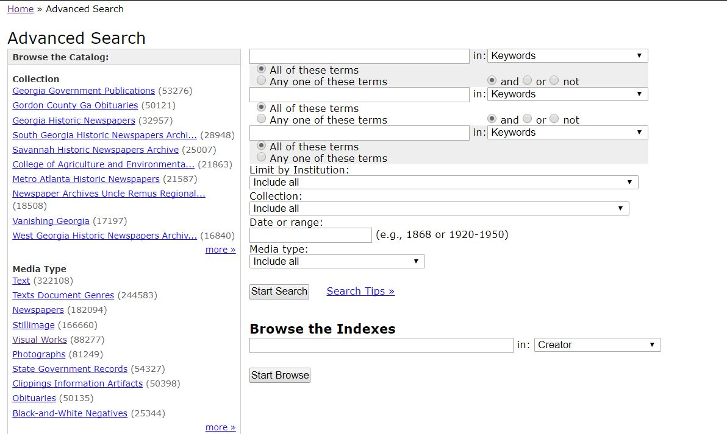
Finding primary documents in DLG--browse or search; search within a specific collection
Notes:
The DLG portals offer a number of ways that users can access historical resources. In the case of DLG's Georgia portal, users can browse collections by topics based on the New Georgia Encyclopedia's subject categories, time period, county, institution, and medium. CRDL also provides a number of browsing opportunities: by event, place, people, broad topics, media types, and contributing institution. All three of DLG's portals provide robust searching of item descriptions. For those who prefer precision in searching, advanced searching is available. Let's take a look at doing a basic search in the Georgia portal.

Slide 5
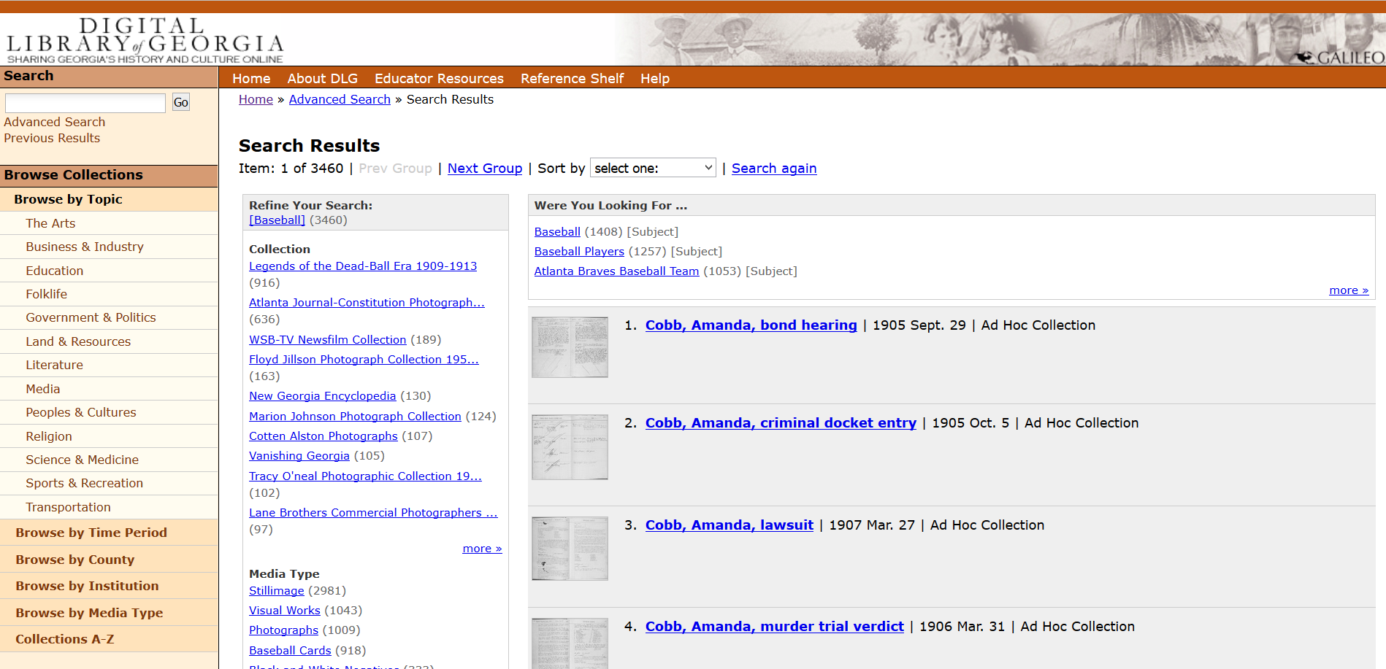
Notes:
So, if I were to search the DLG portal for baseball, I'd get a result list like [change slide] t
I've used the basic search box on the homepage of the portal to search for baseball. The results include a list of 3460 items that fit our search criteria. If we want to further refine our results we can use the facets found on the left side of the screen
Facets include
Collection
Media type,
City/County/State
Subject

Slide 6
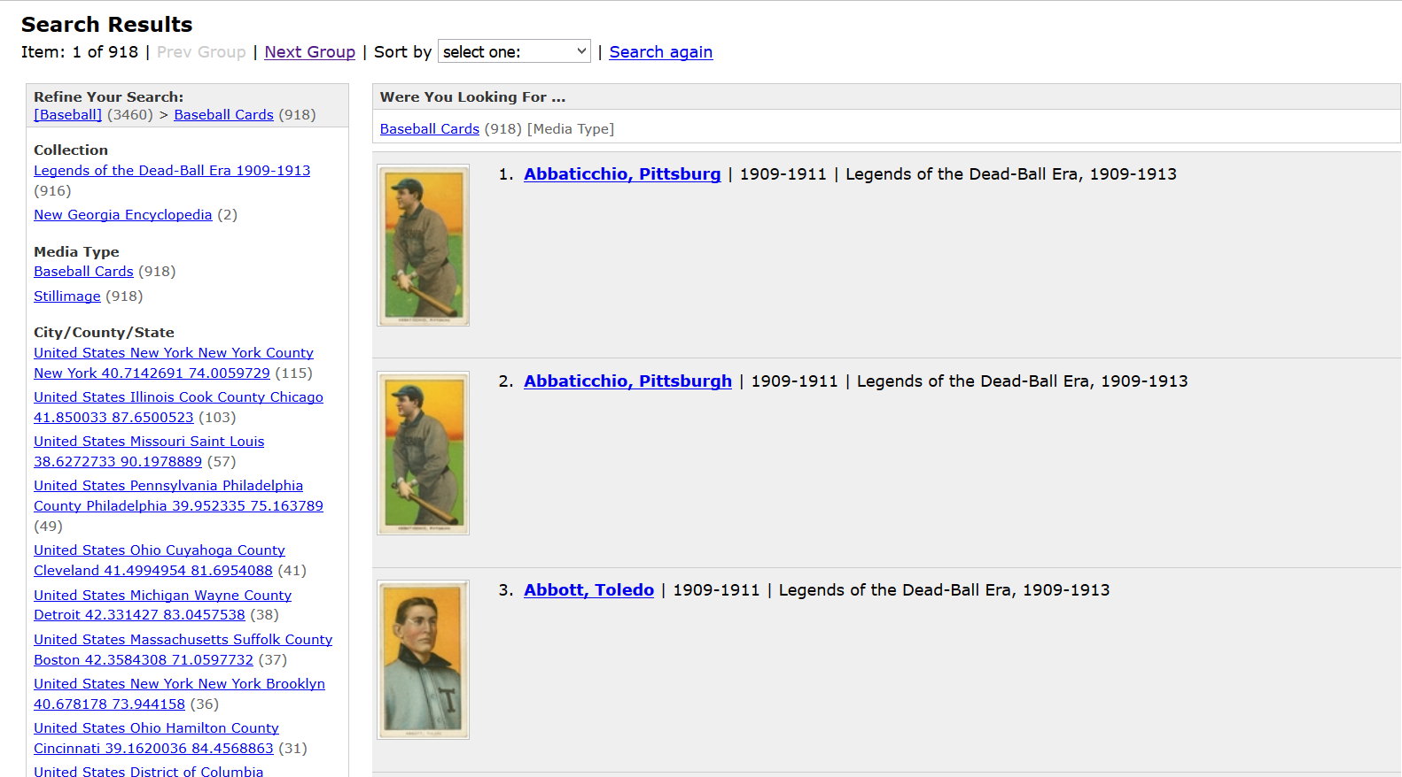
Notes:
If I select Baseball cards from the media type list,
I'll get a list of items that are baseball cards. You'll notice that the facets have changed and reflect only the items that are baseball cards. You can choose to further refine your search or choose an item. By clicking on the thumbnail, you'll be brought to digital object; if you click on the title, you'll see a record that describes the object.

Slide 7
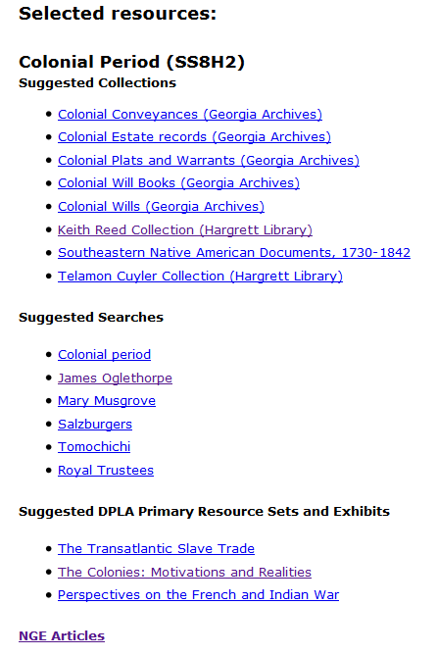
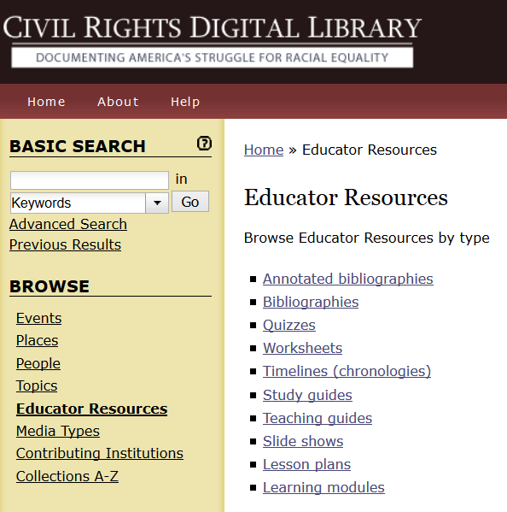
Educator Resources
Notes:
In addition to the primary resources you can find in the DLG portals, there are also some suggested Educator Resources in both the Georgia Portal and the Civil Rights Digital Library.

Slide 8
Georgia Historic Newspapers
Notes:
Over the past several years, DLG has digitized almost 1 million pages of newspapers from around the state (the bulk of which are in the public domain). Areas covered include Athens, Atlanta, Augusta, Columbus, Macon, Milledgeville, Savannah, East, North, West and South Georgia. We've just launched a new user interface and will be incorporating all previously digitized content into this single site over the next year.

Slide 9
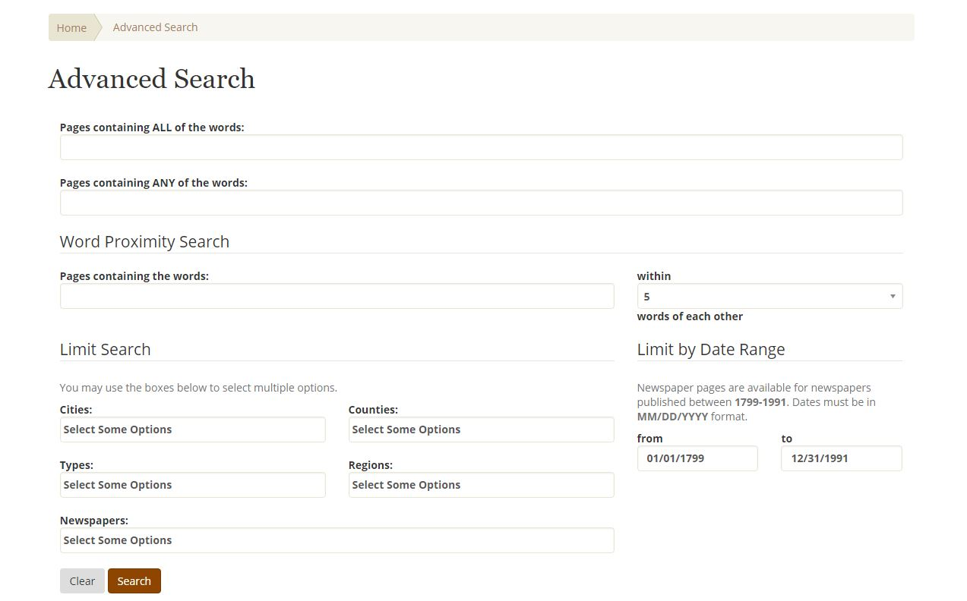
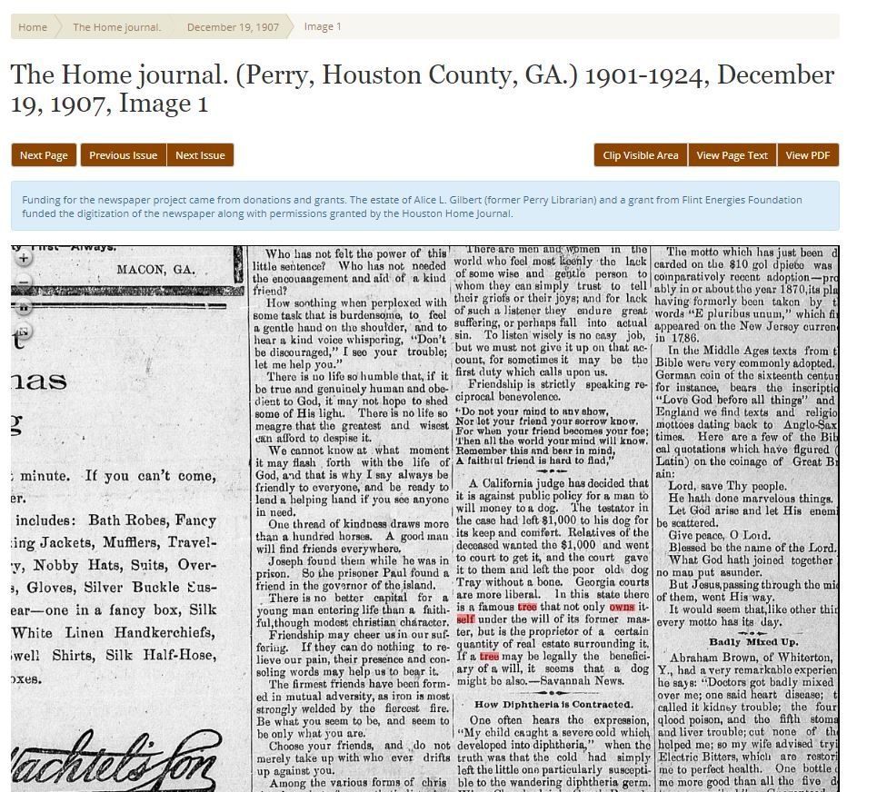
Notes:
Features of the new site include:
Advanced searching
Hit highlighting
Essays about the publishing history of various newspaper titles,
Browsing by region (corresponding to regions of older sites), and
Browsing by types that include community papers, papers-of-record, African-American papers, religious papers, school papers, or Native American papers.

Slide 10
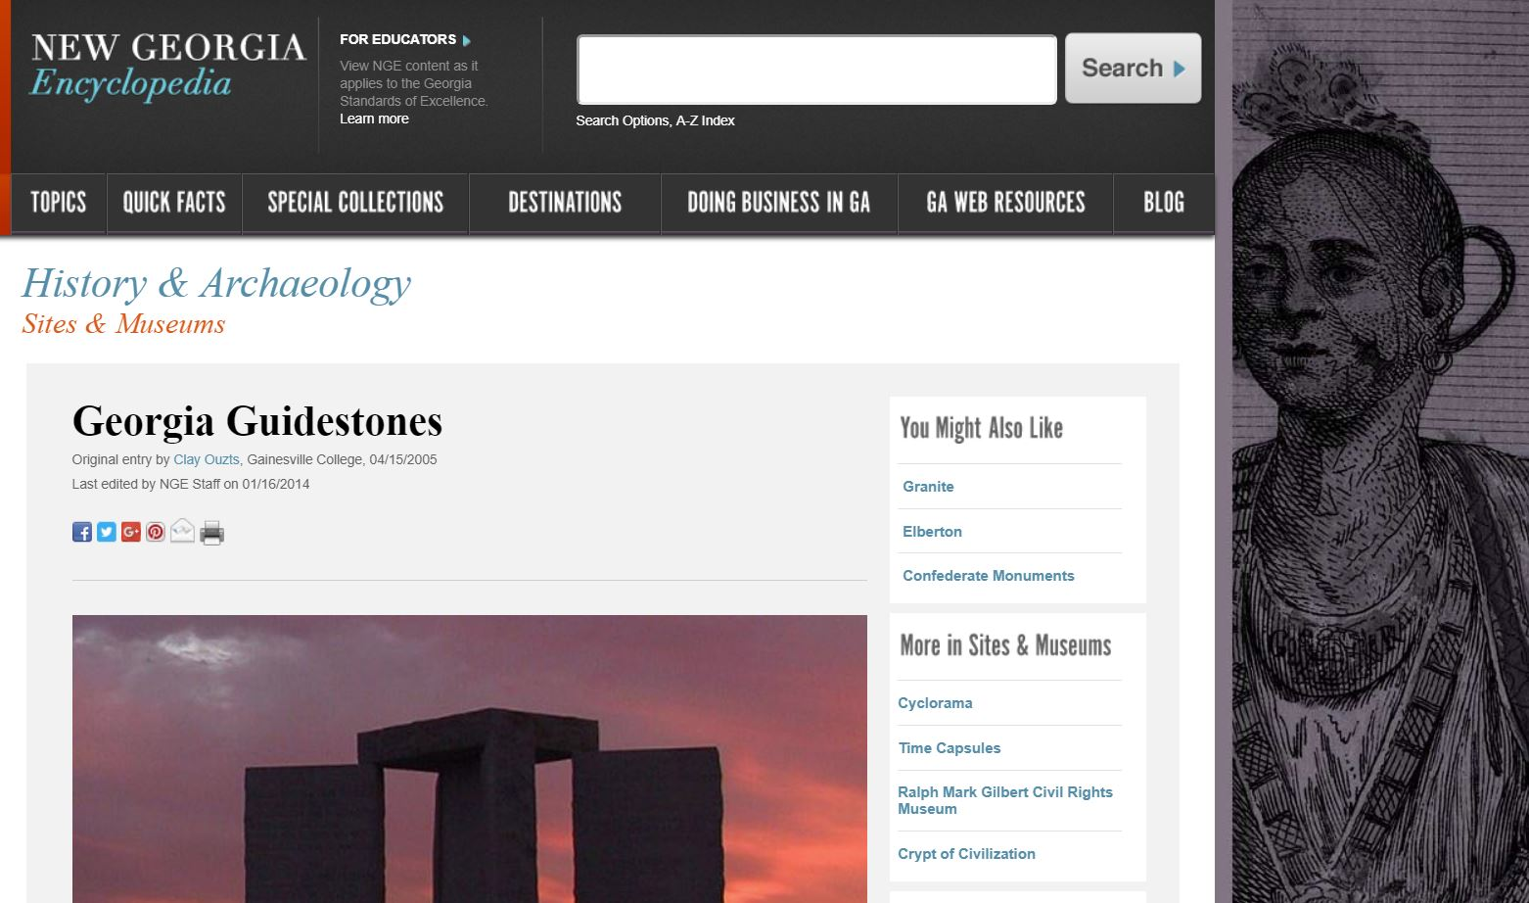
The New Georgia Encyclopedia

Slide 11
New Georgia Encyclopedia-For Educators

Slide 12
Beyond Georgia

Slide 13
How Digital Collections of Primary Documents Help Us
History –National, Local, Regional
Manuscripts
Maps
Newspapers
Photographs
Music/Media
Art and objects
Books
Scholarly literature
Learning objects

Slide 14
Organizationally speaking…
National initiatives
Consortia
State library organizations
Individual libraries/museums/archives
Individuals/corporations

Slide 15
National initiatives
Digital Public Library of America
http://dp.la
Library of Congress, American Memory
http://memory.loc.gov/ammem/index.html
Chronicling America
http://chroniclingamerica.loc.gov/

Slide 16
The Digital Public Library of America

Slide 17
The Digital Public Library of America

Slide 18
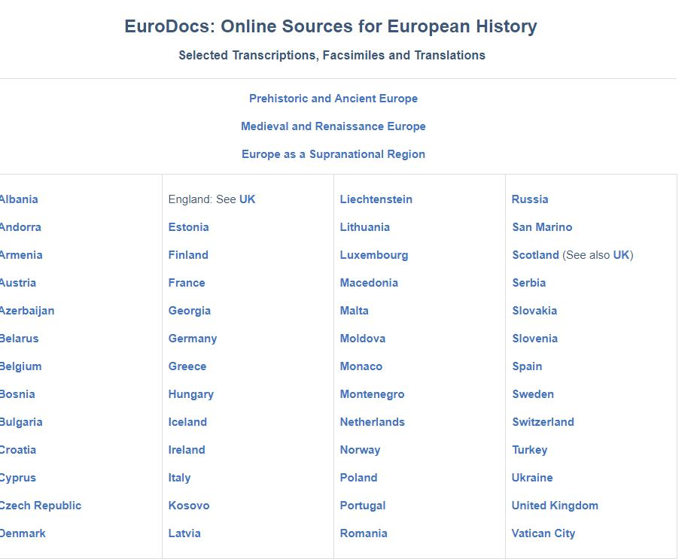
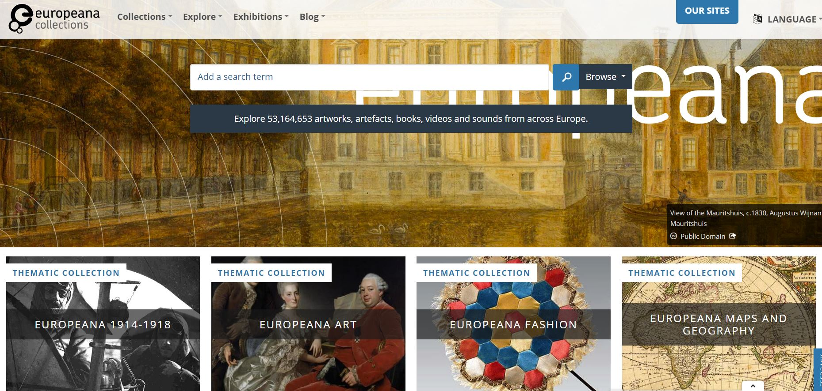
Europe
Europeana (EU sister to dp.la)
http://www.europeana.eu/
Eurodocs
http://eudocs.lib.byu.edu/index.php/Main_Page

Slide 19
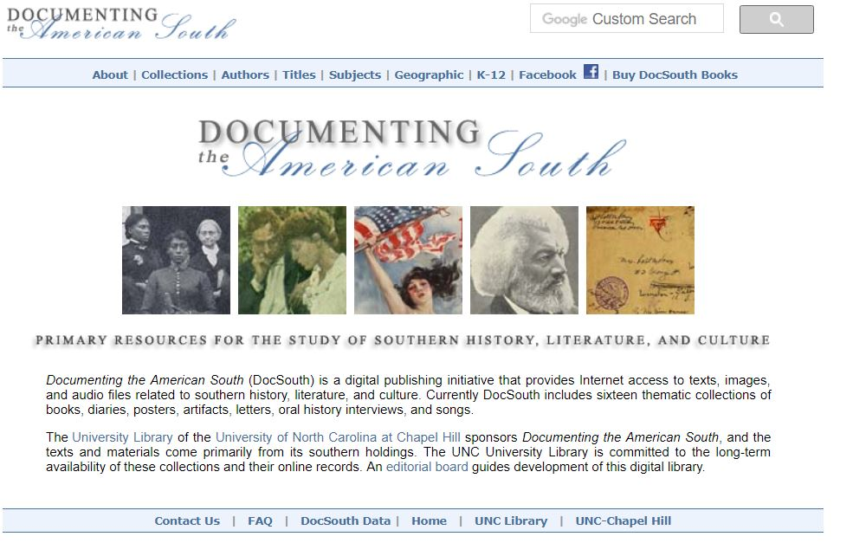
Regional
Documenting the American South
http://docsouth.unc.edu/
Mountain West Digital Library
http://mwdl.org/
Sometimes done by individual institutions, sometimes done collaboratively

Slide 20
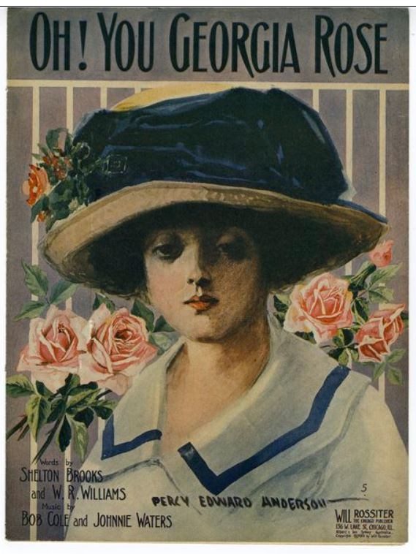
Consortia
The Sheet Music Consortium
http://digital2.library.ucla.edu/sheetmusic/
The HBCU Alliance Digital Collections
http://contentdm.auctr.edu/cdm/

Slide 21
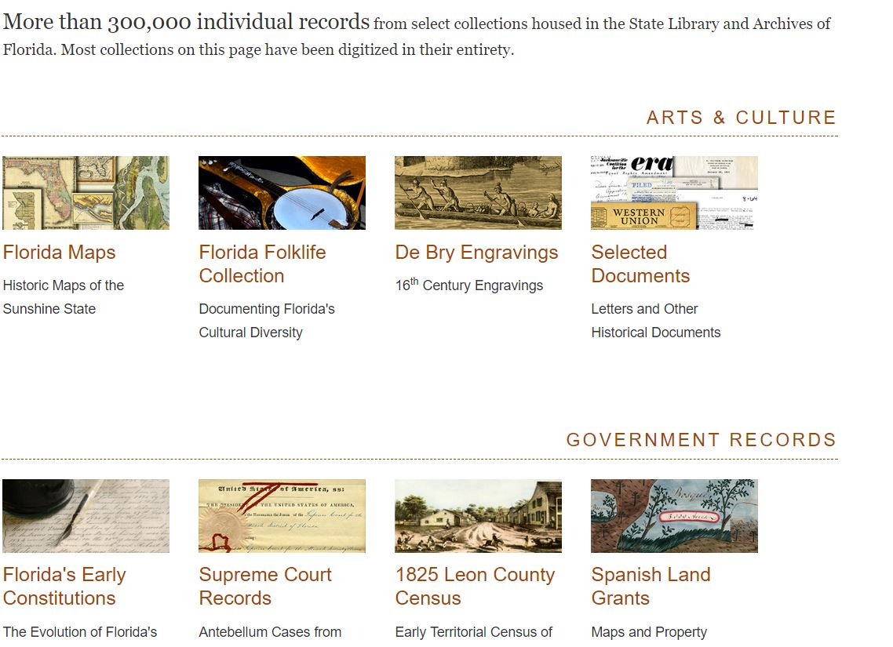
State agencies
Georgia Archives, Virtual Vault
http://vault.georgiaarchives.org
Florida Memory
http://www.floridamemory.com/
Kentucky Digital Archive
http://kdl.kyvl.org/

Slide 22
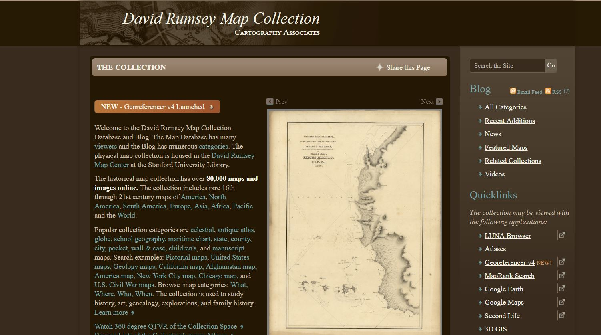
Universities, archives, museums, libraries
Cornell University
https://newcatalog.library.cornell.edu/digitalcollections
The Getty Research Institute
http://www.getty.edu/research/tools/digital_collections/
David Rumsey Map Collection
http://www.davidrumsey.com/

Slide 23
Where else to look?
Google! Considering the possible “homes” we’ve discussed
Internet Archive
ArchiveGrid
WorldCat (GALILEO, or free version)

Slide 24
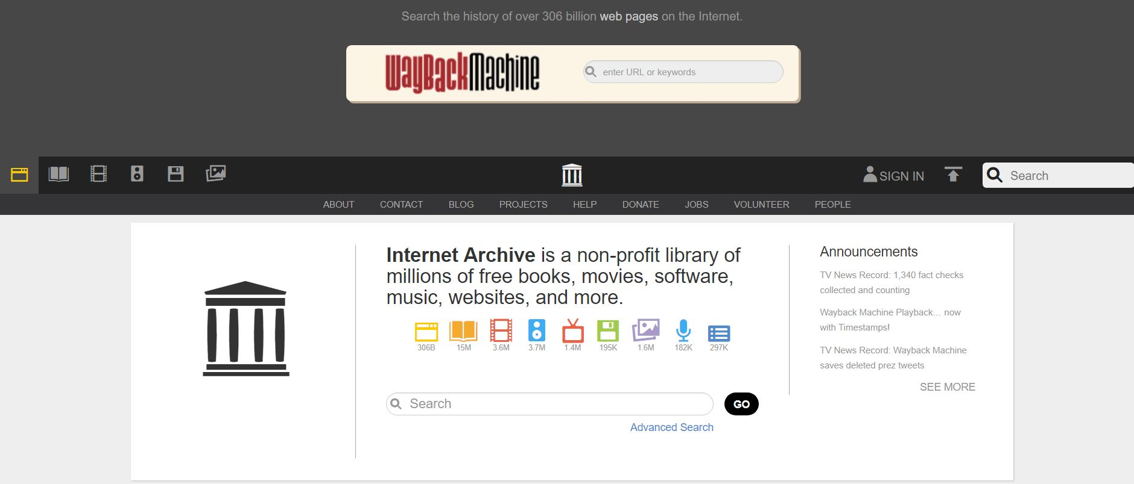
Internet Archive

Slide 25
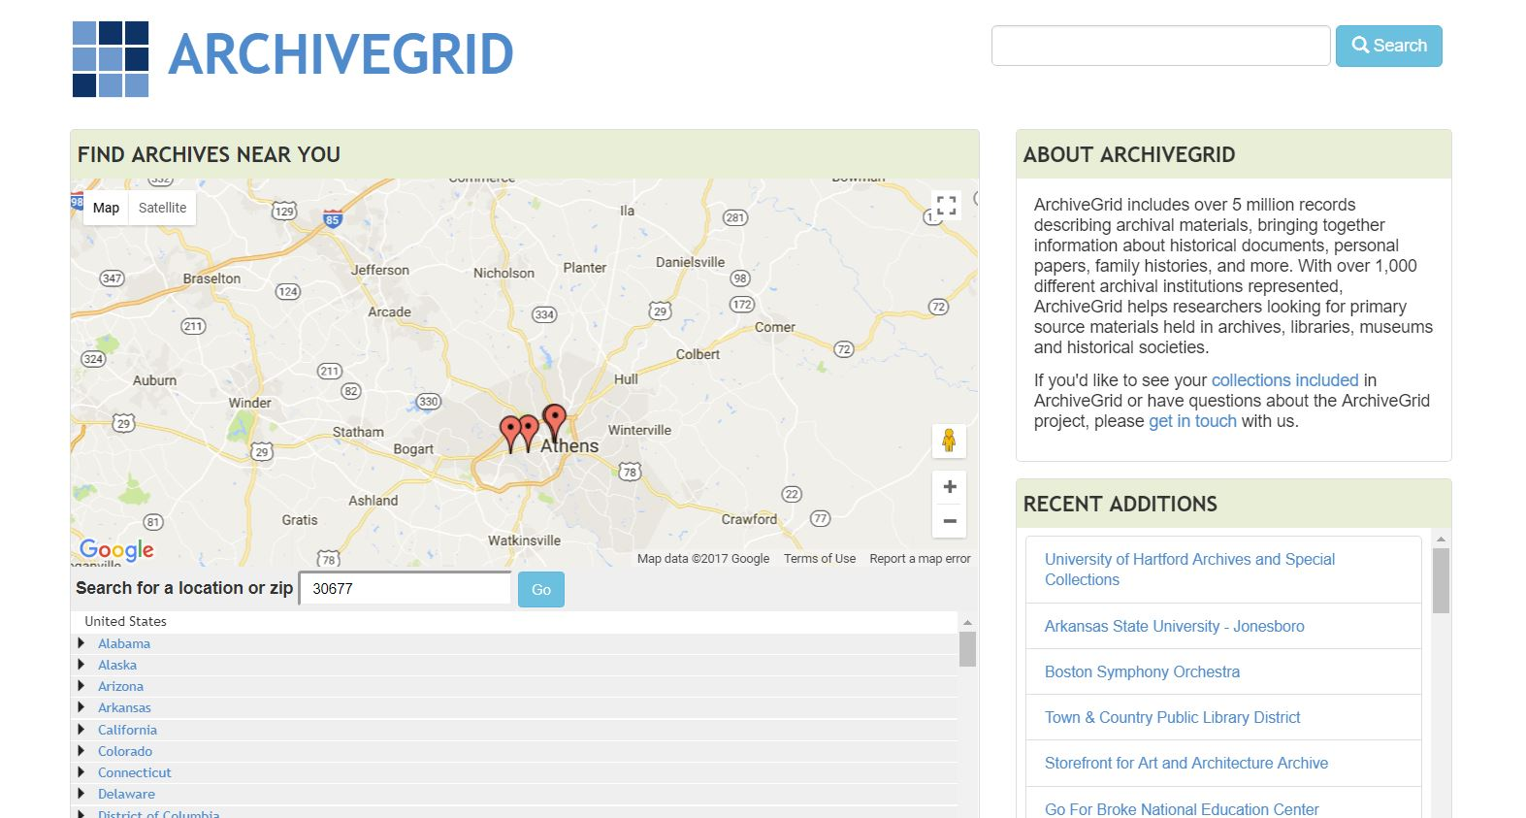
WorldCat and ArchiveGrid
WorldCat
www.worldcat.org
ArchiveGrid
http://beta.worldcat.org/archivegrid/

Slide 26
Thank you!
Sheila McAlister, Director
Digital Library of Georgia
mcalists@uga.edu
Russell Palmer, Asst. Director
GALILEO Support Services
russell.palmer@usg.edu

