Slide 1

Tough Questions, Tougher Answers
Preparing library employees to support ethical and effective AI use
Presented by: Jean Cook
Date: April 14, 2026

Slide 2

Jean Cook
University of West Georgia’s Ingram Library
Head of Learning and Research Services
Subject Librarian For School of Nursing, College of Education, and College of Science
LIBR2100 Coordinator
Reference Coordinator
Springshare Admin

Slide 3
The People
20 faculty and staff, 14 student assistants
I don’t know I do know
what it can do what it can do
Reality
End of Civilization
Miracle
Trash
Shortcut
I don’t know how to use it
I do know
how to use it

Slide 4
The Action Item
Create and implement a training plan for library employees on teaching effective and ethical use of AI to students both in instruction and in research support settings.

Slide 5
The Action Plan
Update AI literacy research guide
Add AI literacy to instructional tools like Library DIY, Library Den, and LIBR2100 curriculum
Staff-led reading group
Faculty-led AI training program for the library

Slide 6
Faculty-led AI Training Program
Develop and/or adapt an existing curriculum
Discover what policies and units on campus exist
Create a program a curriculum to address AI at our campus
All library employees complete the program
Follow up with all-library discussion(s)
Foster a shared understanding of AI ethics in an academic setting

Slide 7
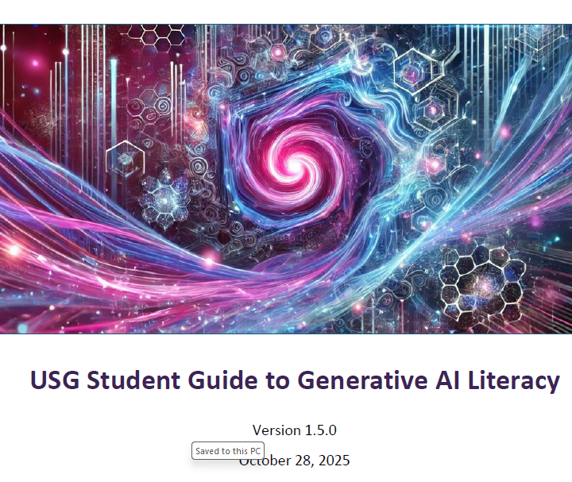
The Curriculum
24 pages
No presumption of knowledge or experience
No recommended AI
Mix of theory and guided activities

Slide 8
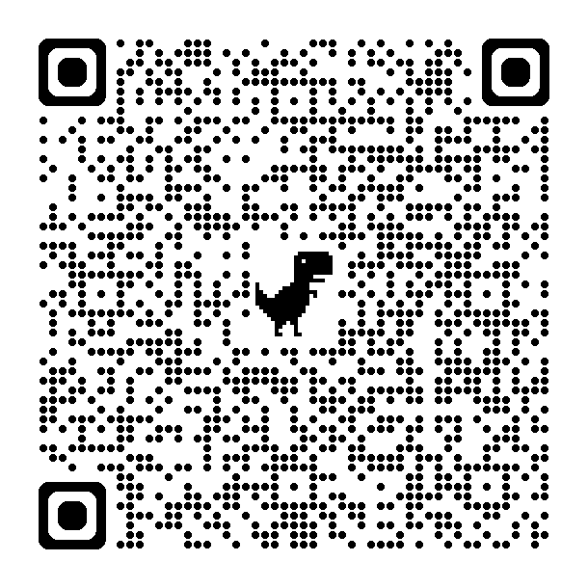
The Curriculum
What is GenAI?
GenAI Tools for Academic Tasks
Prompt Engineering
Advanced Prompt Engineering
Self-Study Techniques
Accountability
From Prompts to Conversations
Accuracy and Best Practices
From Average to Excellent

Slide 9
The UWG Supplement
UWG Policies on GenAI
Faculty Policy
1. Generative Artificial Intelligence is not allowed in any coursework.
2. Generative Artificial Intelligence is permitted in specific coursework.
3. Generative Artificial Intelligence is permitted [in all coursework].
4. Generative Artificial Intelligence is expected (or required).
Citation Styles
Stock Answers

Slide 10
The All-Library Discussion
What sort of questions or experiences are you encountering with outside students, faculty, and staff?
How do you define the ethical use of AI in an academic setting? What is okay and what goes too far?
How are you/might you use AI in the completion of your work tasks?

Slide 11
The Follow-up
Student Guide to GenAI literacy shared with new employees
Campus visitors to all-library meetings
Collaborations with outside speakers & trainers

Slide 12
If I had to do it again
Clear goals for all levels
Discover the baseline knowledge of your staff
Formal CMS section
Track completion
Pre-test and post-test
Share materials, readings, and updates

Slide 13
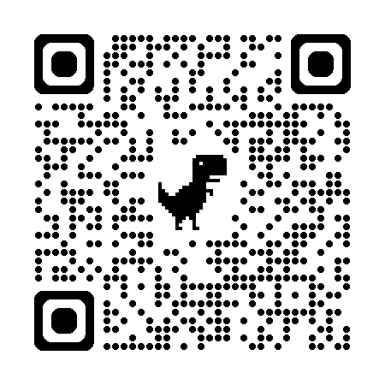
Questions?
Jean Cook
jcook@westga.edu
678-839-6356
USG Student Guide to Generative AI Literacy
MomentumU @USG
USG Guide to Generative AI Literacy

