Slide 1
Tailoring Your GALILEO Portal: Unleashing the Power of GALILEO Admin
Mike White
GALILEO Support
June 11, 2024 - 11:00 AM

Slide 2
Agenda
What is GALILEO Admin?
GALILEO Admin Demo
GALILEO Local Resource Integration (GLRI)
Brandings
Customizing Bento Boxes
Customizing Featured Resources (In the Spotlight)
Institution Information
Wayfinder Keywords
Institutional Links
View by Subscription type *
Hide Tools

Slide 3
Agenda
Customizing GALILEO-managed Resources
Managing the display of resources
Adding additional Subjects to GALILEO resources
Adding additional Keywords to GALILEO resources
Add branding to cost-share resources *
Account Types
Upcoming Training
Q&A

Slide 4
What is GALILEO Admin?
GALILEO Admin is an administrative area that allows you to customize the GALILEO portal and view and edit institutional information. In GALILEO Admin, you can add locally purchased resources (GLRI) to your database list, add banners, customize bento boxes, manage the “In the Spotlight” area, view your institutional information, manage brandings, run institutional reports, and more.

Slide 5
DEMO !

Slide 6
GALILEO Local Resource Integration (GLRI)
Resource Logo
Branding Image and Note

Slide 7
GLRI Management – Viewing / Searching

Slide 8
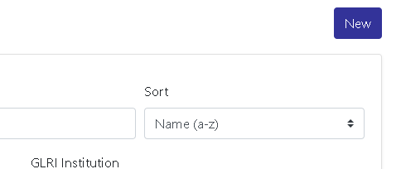
GLRI Management – Creating/Copying Record
Create new record from scratch
Copy existing record.

Slide 9
GLRI Management – Updating Records (1)

Slide 10
GLRI Management – Updating Records (2)

Slide 11
GLRI Management – Updating Records (3)

Slide 12
GLRI Management – Updating Records (4)

Slide 13
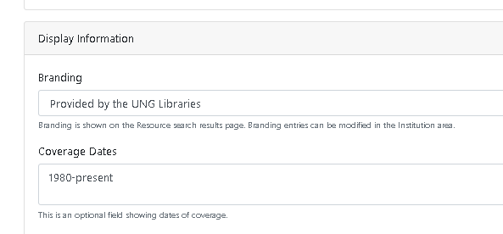
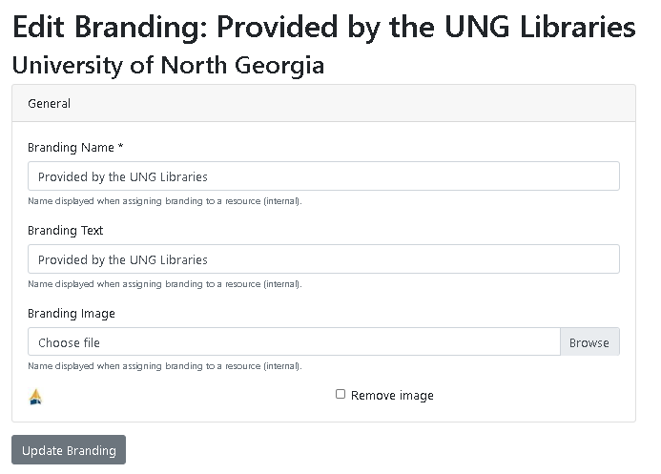
Brandings

Slide 14
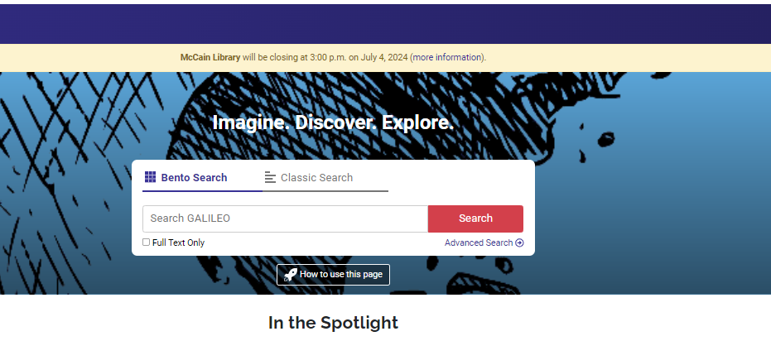
Banners – Adding Banner

Slide 15
Bento Box Overview

Slide 16
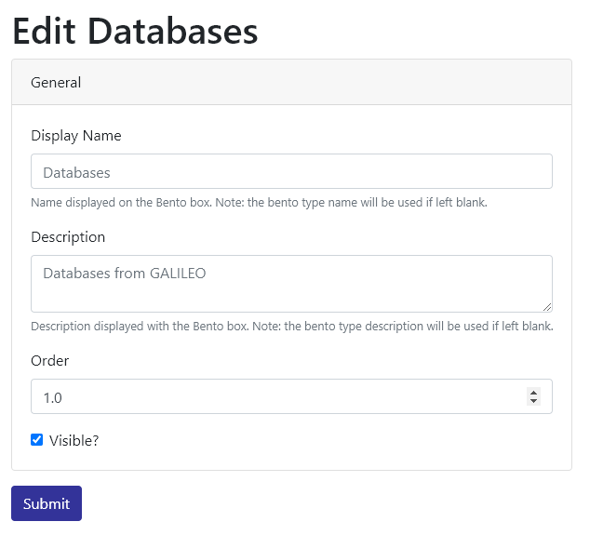
Bento Box: Customize/Reorder

Slide 17
New Bento Box

Slide 18
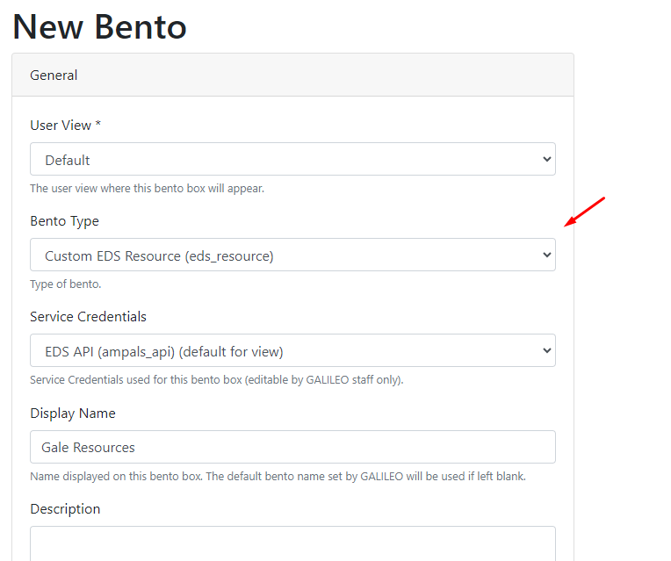
Enhanced Custom EDS Resource Bentos

Slide 19
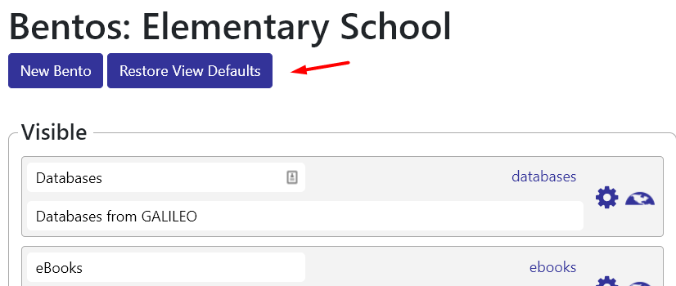
Restore Bento Defaults

Slide 20
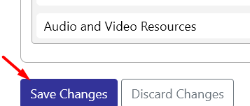
Deleting Bento

Slide 21
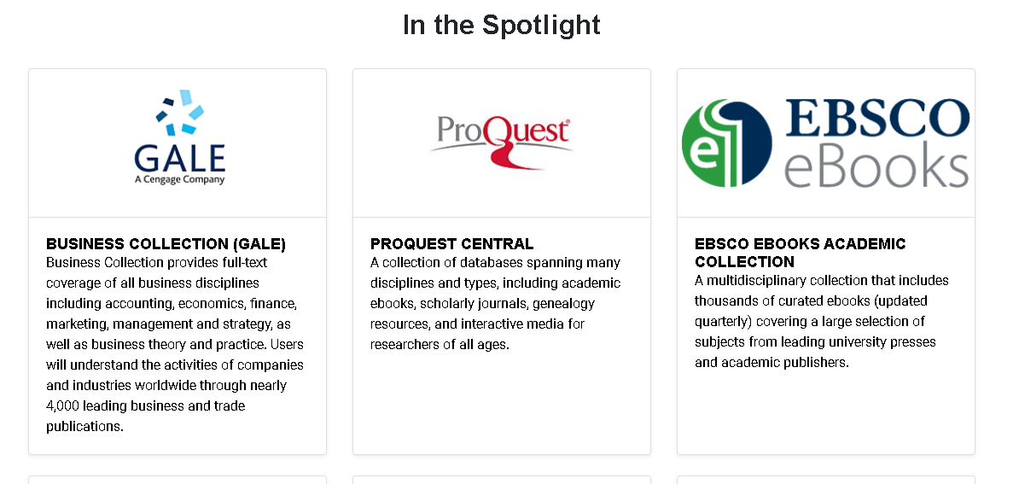
Featured Resources (In the Spotlight)

Slide 22
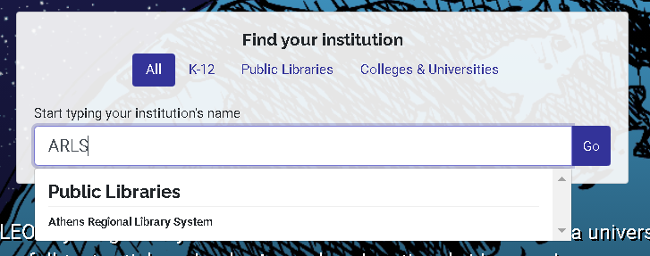
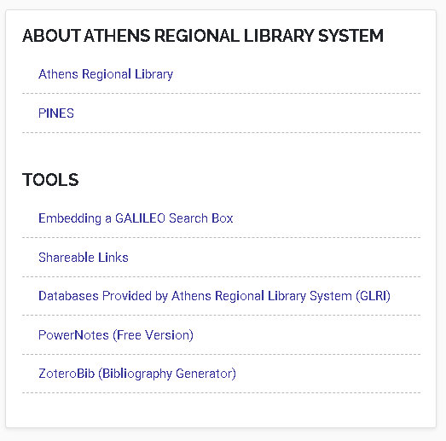
Institution Information (Editing)

Slide 23
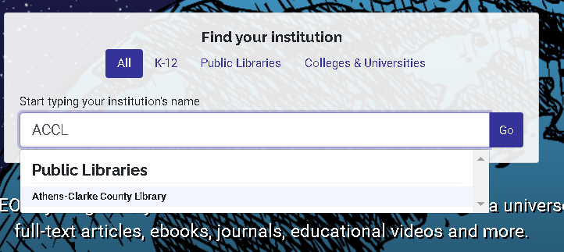
Site Information (Editing)

Slide 24
Customizing GALILEO-managed Resources

Slide 25
Customizing GALILEO-managed Resources

Slide 26
Customizing GALILEO-managed Resources (Editing)

Slide 27
Add institutional branding to cost-share resources

Slide 28
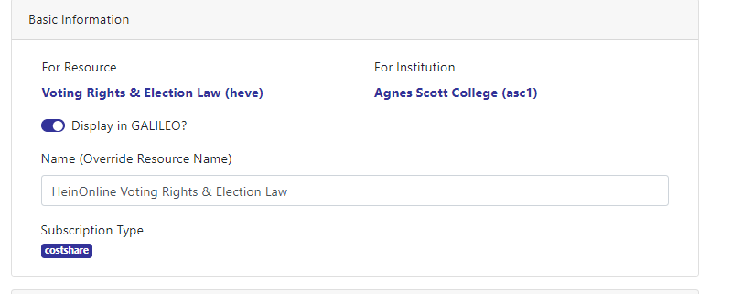
Rename GALILEO managed resources

Slide 29
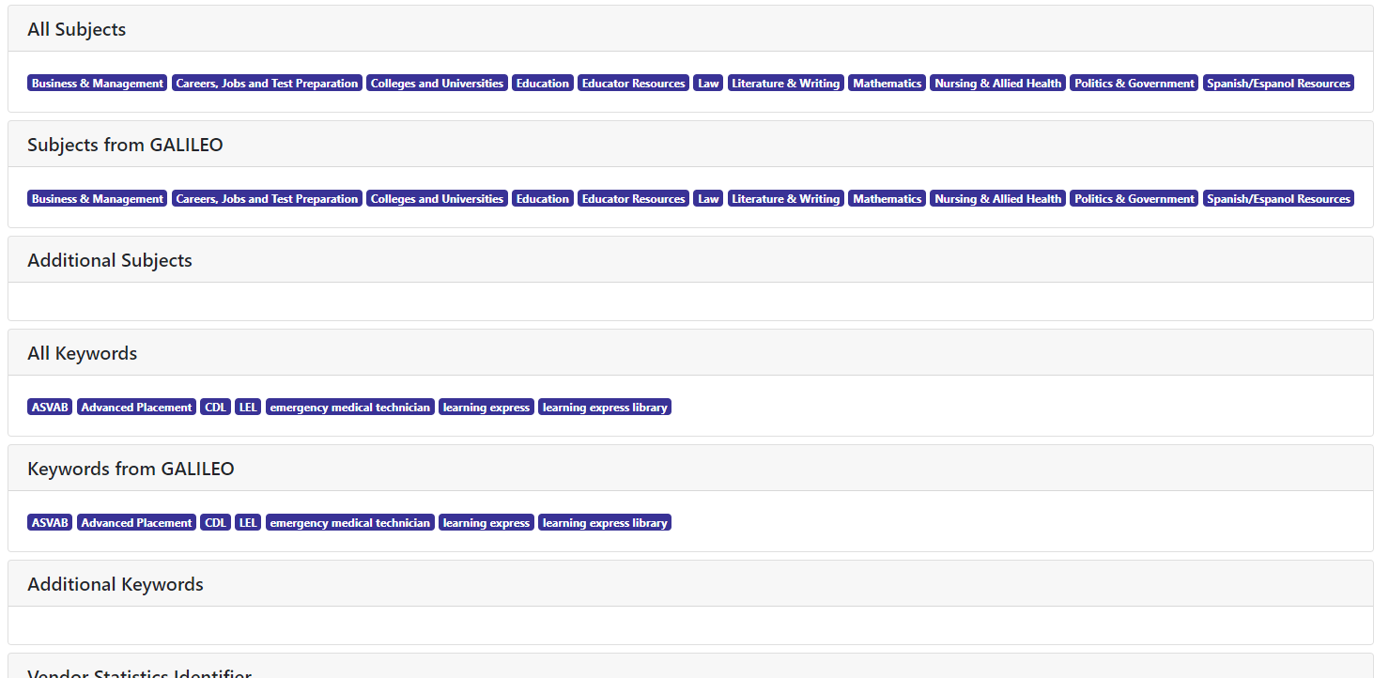
Customizing GALILEO-managed Resources (Viewing)

Slide 30
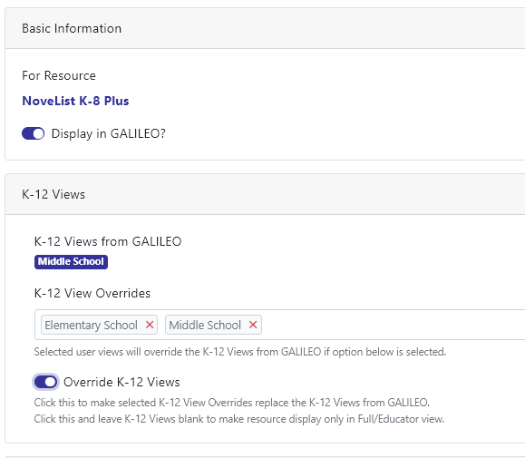
Customizing resources in K-12 Views (K-12 and GPLS only)

Slide 31
Resource K-12 Views Show Page (K-12 and GPLS only)

Slide 32
User Account Types
VIEWER (new)
GENERAL
ADVANCED
Institutional Reports (Express Link, Serials, GLRI, and Resources)
View-only access to everything
Unable to edit any fields
Banners
In the Spotlight
Bento customization
Featured Resources
Customizing GALILEO-managed Resources
Institution Information
Reporting
Everything General Users can do plus:
Local Resource Management (GLRI)
Brandings

Slide 33
Upcoming GALILEO Admin Training
GALILEO Admin I:
Covers In the Spotlight, Institutional Information, Reports, and Customizing GALILEO Provided Resources
For General and Advanced Users
GALILEO Admin II:
Covers Local Resource Integration (GLRI) and Branding
For Advanced Users Only
July 9 @ 10am (1.5 hours)
August 8 @ 2pm (1.5 hours)
Training available based on need

Slide 34
Questions?
https://www.galileo.usg.edu/contact/

