Slide 1
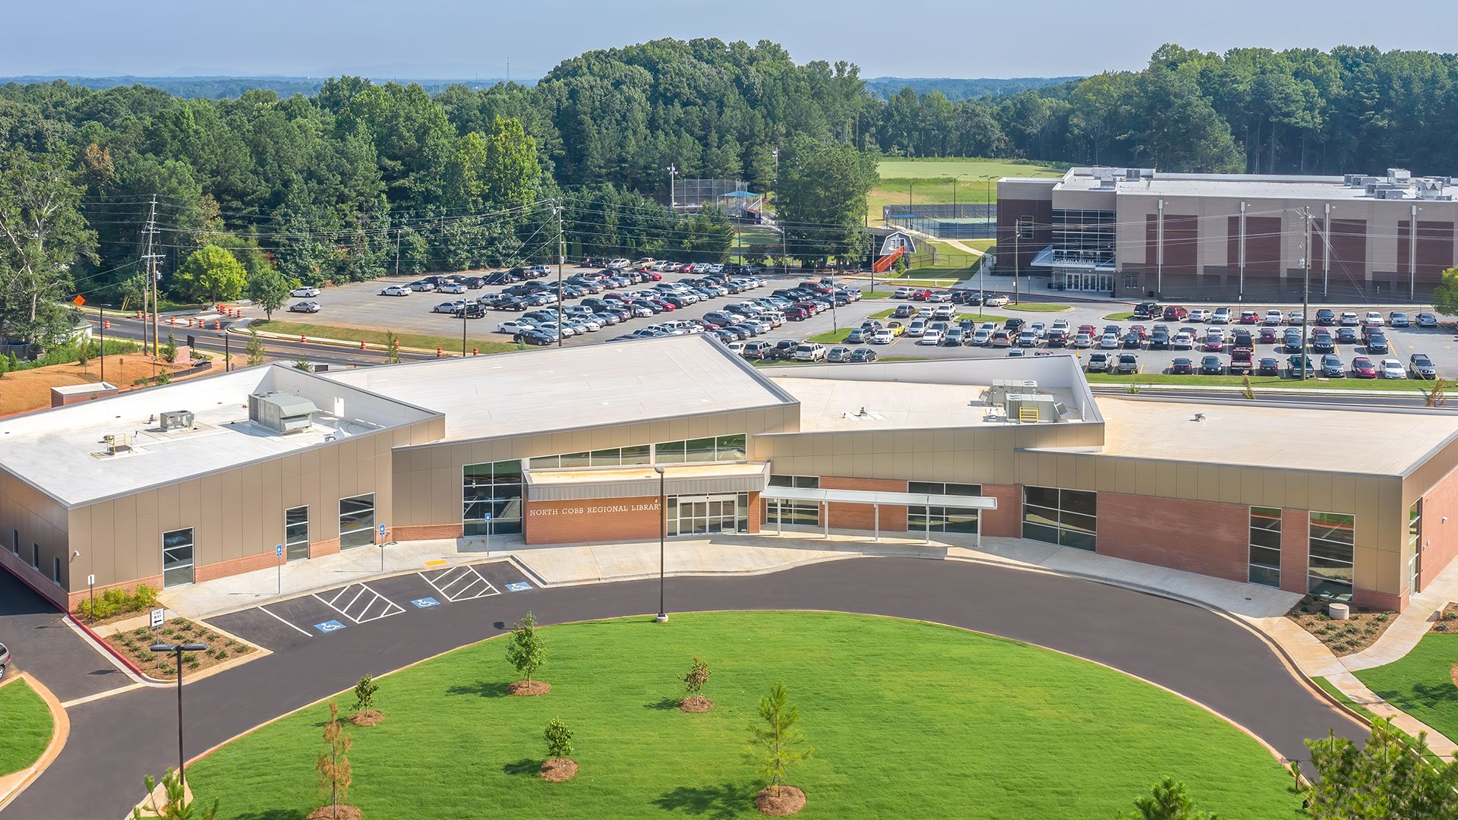
PRESENTATION TITLE

Slide 2
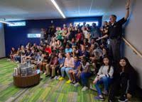
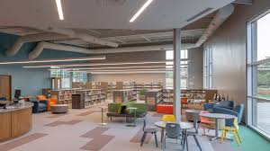
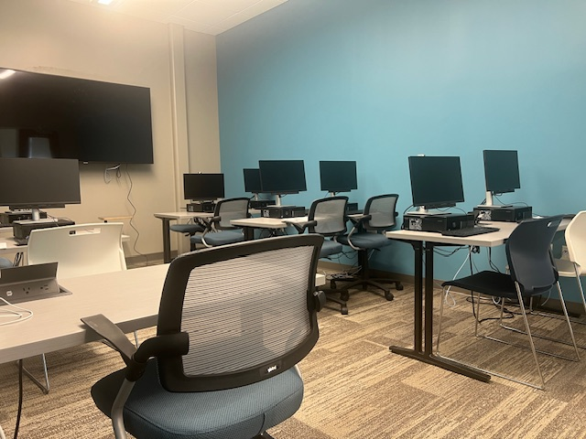
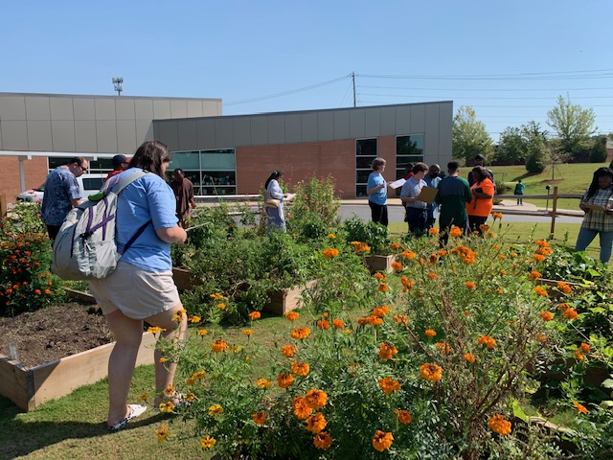
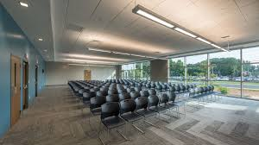
North Cobb Regional Library
Teen Room
Children Space
Digital Training Lab
Community Garden
Community Meeting Room

Slide 3
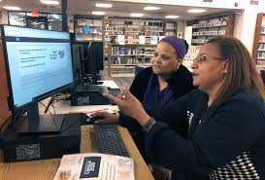
Cobb County Public Library
Pat introduces vision to expand digital services at CCPL through partnership with the Barbara Bush Foundation digital services initiatives
Provide teachable digital literacy lesson plans for libraries
Introduce patrons to digital learning curriculum easily available online
Identify digital learn needs in service areas
Support digital learn workshops with grant funds

Slide 4
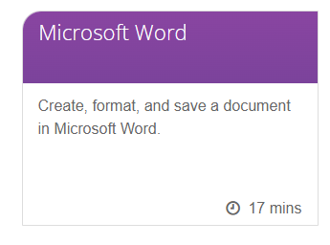
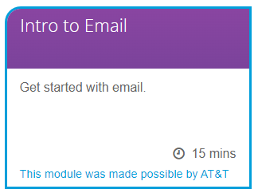
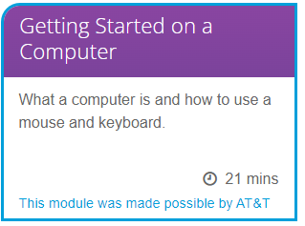
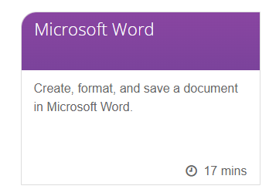
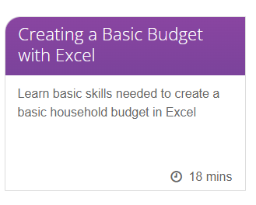
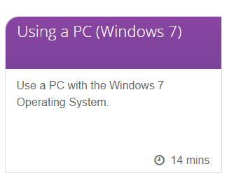

Slide 5
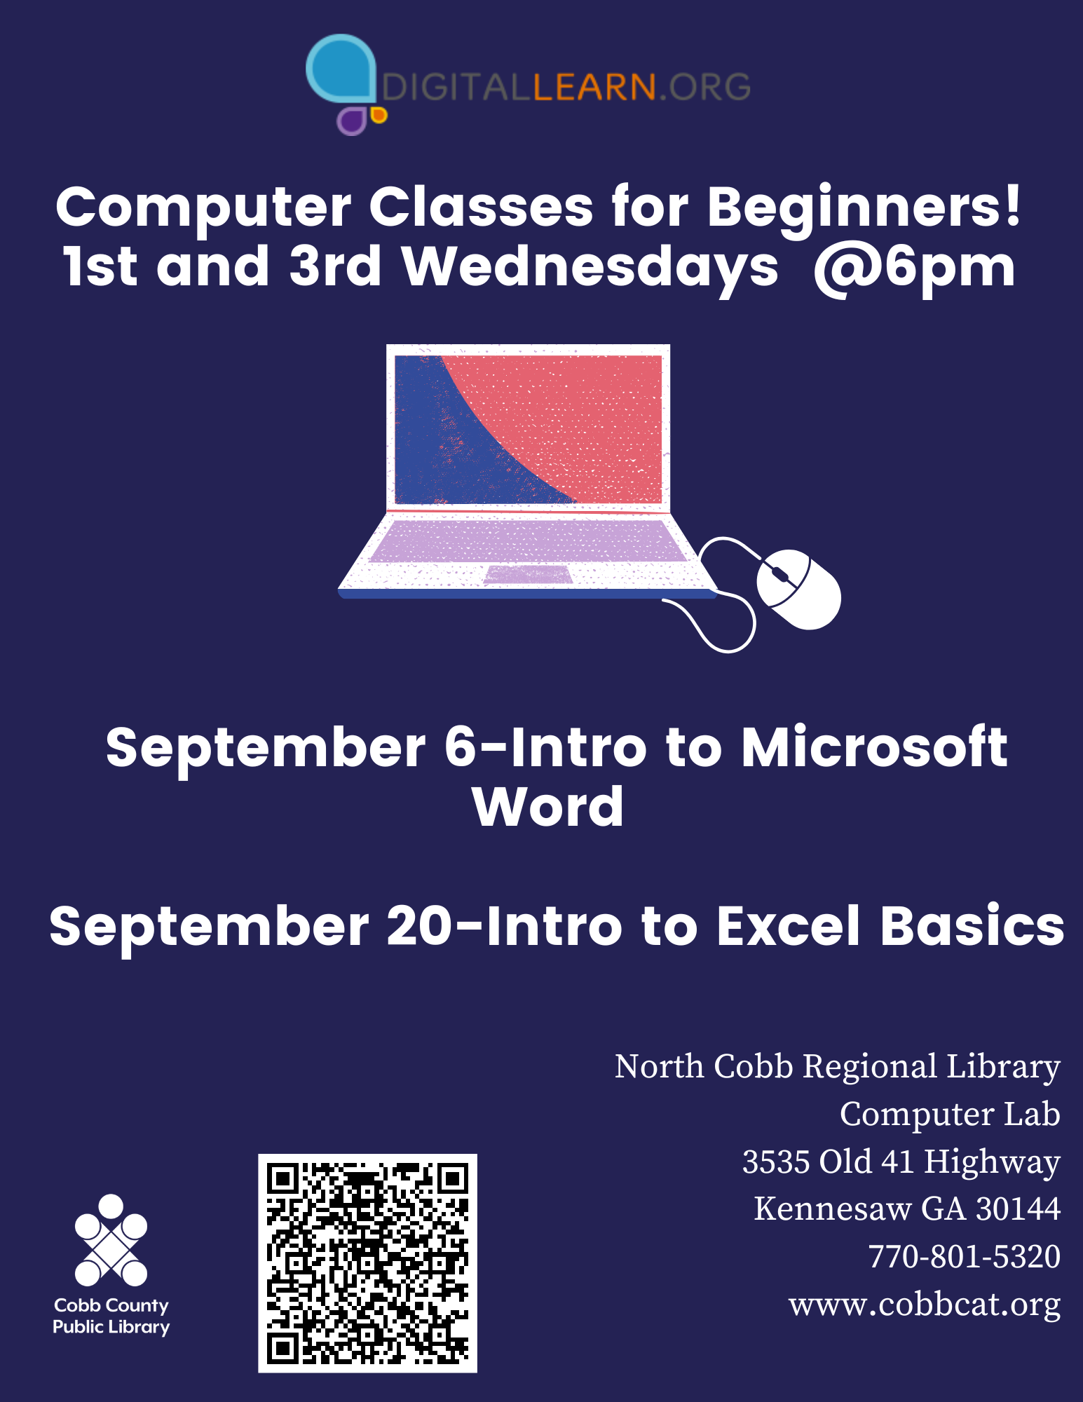
Digital Learn Patron Profile
Patrons re-entering the workplace
Patrons with minimal digital literacy skills seeking to increase those skills for personal fulfillment
Workers seeking to increase skills to improve chances for promotion

Slide 6
Outcomes
Provide teaching and learning resources for librarians and patrons
Develop relationships with patrons needing to improve digital learn skills and lead them to tools for learning and study
Standardize digital learn classes for CCPL
Help with a significant community needs

Slide 7
QUESTIONS?
Nichole Knox
Manager
770-801-2744
cobbcat.org
3535 Old 41 Highway , Kennesaw GA 30144

