Slide 1

Tailoring Your GALILEO Portal:
Unleashing the Power of GALILEO Admin
Mike White
GALILEO Support
June 11, 2024 - 11:00 AM

Slide 2
Agenda
What is GALILEO Admin?
GALILEO Admin Demo
  GALILEO Local Resource Integration (GLRI)
  Brandings
  Customizing Bento Boxes
  Customizing Featured Resources (In the Spotlight)
  Institution Information
    Wayfinder Keywords
    Institutional Links
    View by Subscription type *
    Hide Tools

Slide 3
Agenda
  Customizing GALILEO-managed Resources
    Managing the display of resources
    Adding additional Subjects to GALILEO resources
    Adding additional Keywords to GALILEO resources
    Add branding to cost-share resources *
Account Types
Upcoming Training
Q&A

Slide 4
What is GALILEO Admin?
GALILEO Admin is an administrative area that allows you to customize the GALILEO portal and view and edit institutional information. In GALILEO Admin, you can add locally purchased resources (GLRI) to your database list, add banners, customize bento boxes, manage the “In the Spotlight” area, view your institutional information, manage brandings, run institutional reports, and more.

Slide 5
DEMO !

Slide 6
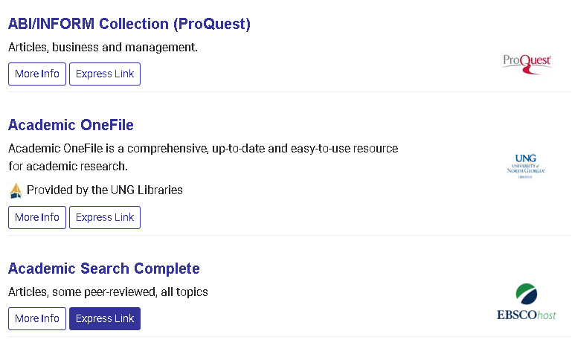
GALILEO Local Resource Integration (GLRI)
Resource Logo
Branding Image and Note

Slide 7
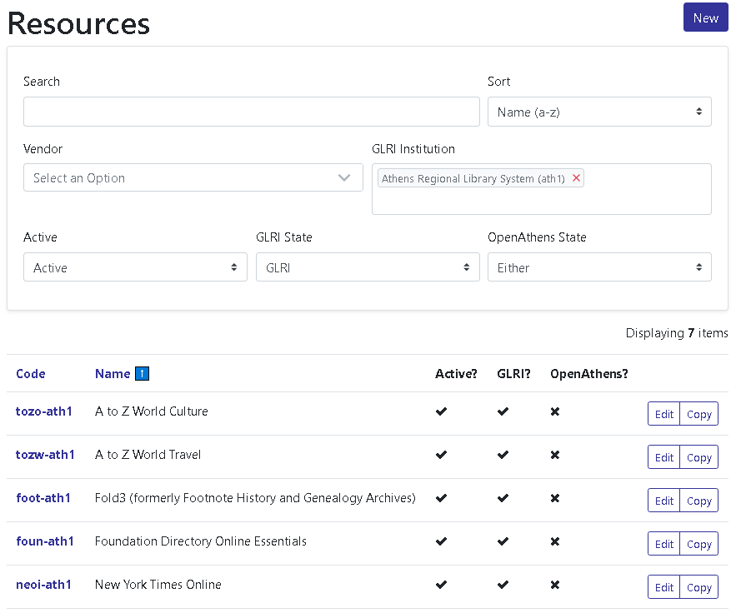
GLRI Management – Viewing / Searching

Slide 8
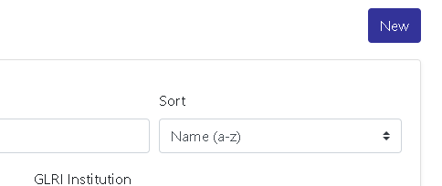
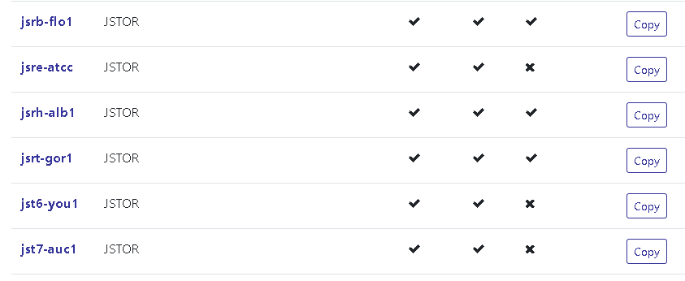
GLRI Management – Creating/Copying Record
Create new record from scratch
Copy existing record.

Slide 9
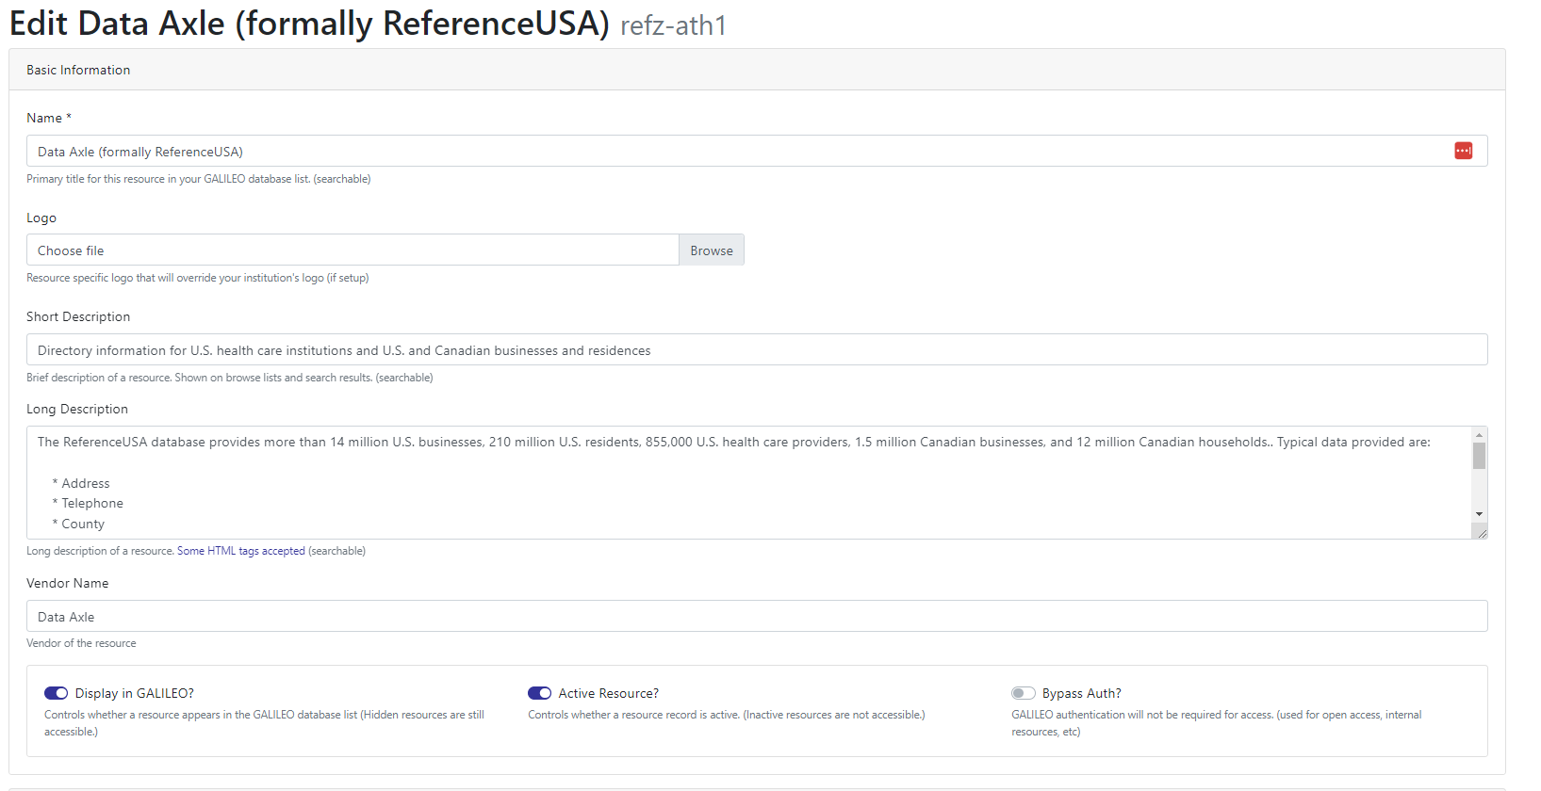
GLRI Management – Updating Records (1)

Slide 10
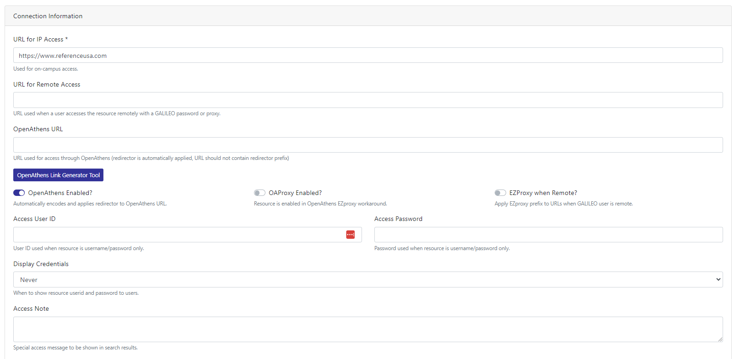
GLRI Management – Updating Records (2)

Slide 11
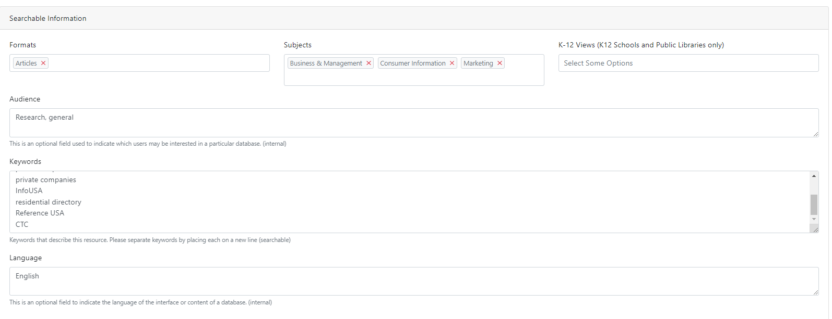
GLRI Management – Updating Records (3)

Slide 12
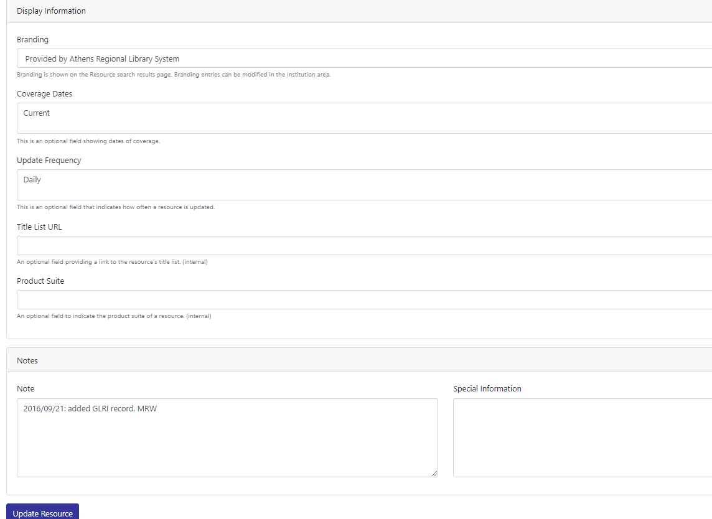
GLRI Management – Updating Records (4)

Slide 13
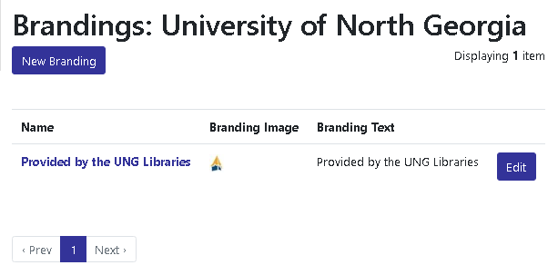
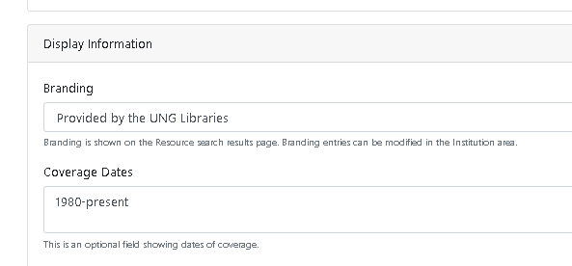
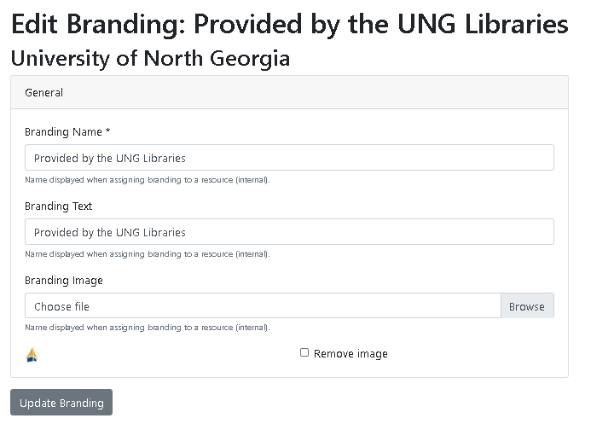
Brandings

Slide 14
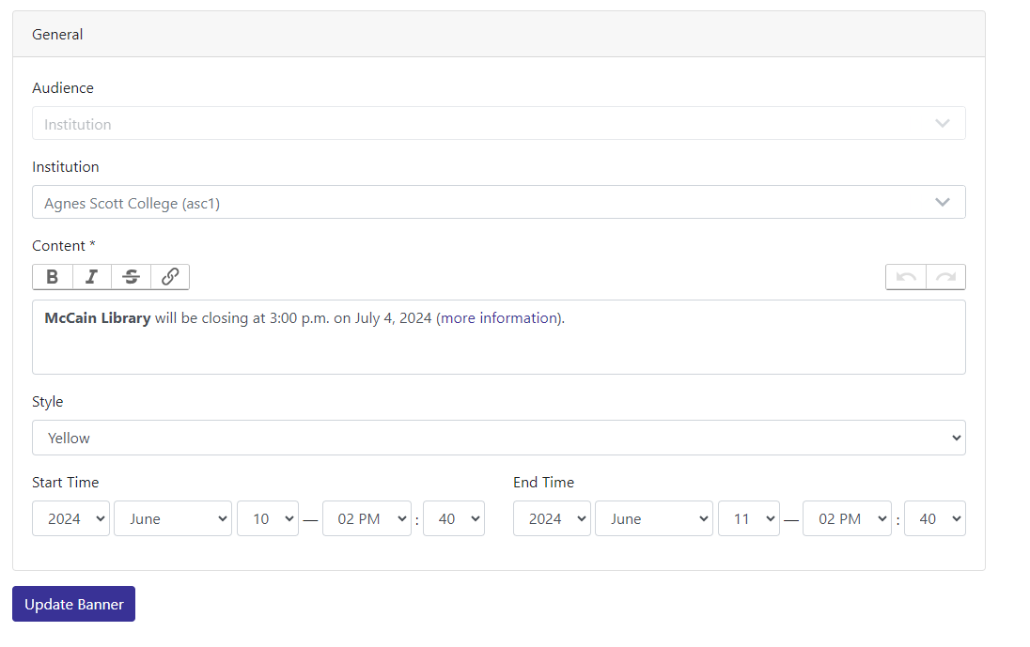
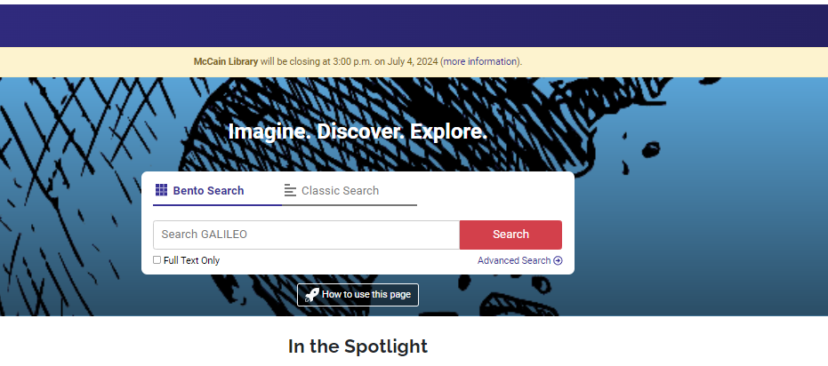
Banners – Adding Banner

Slide 15
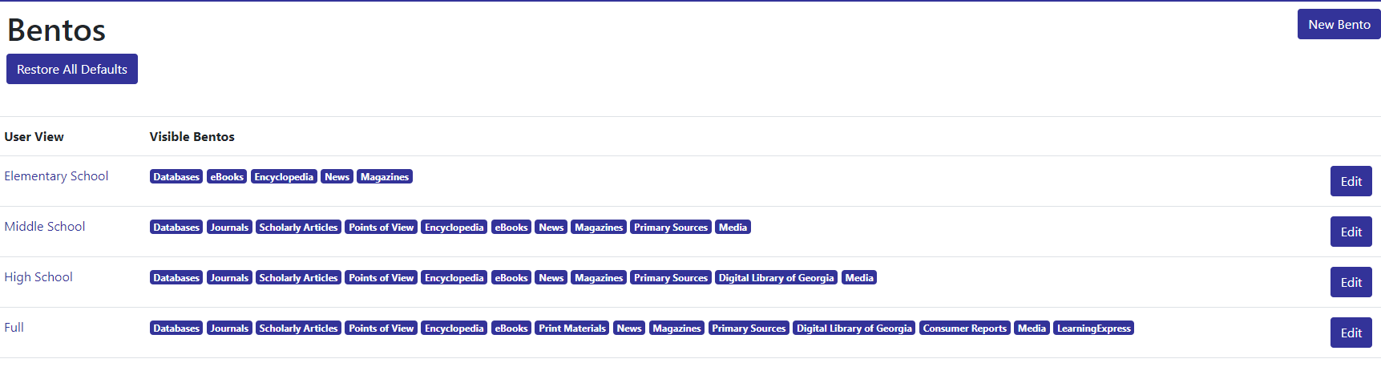
Bento Box Overview

Slide 16
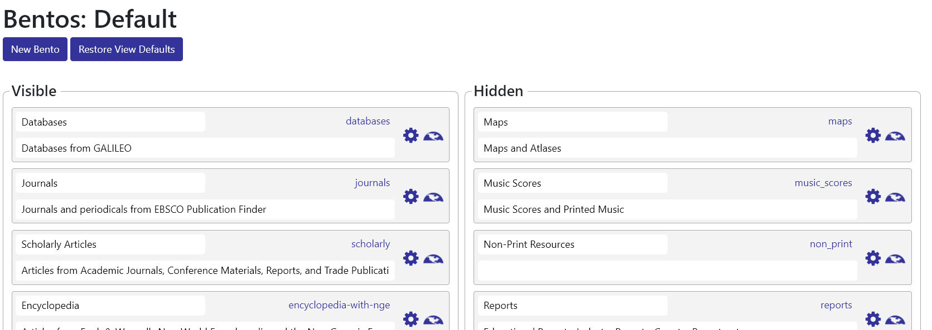
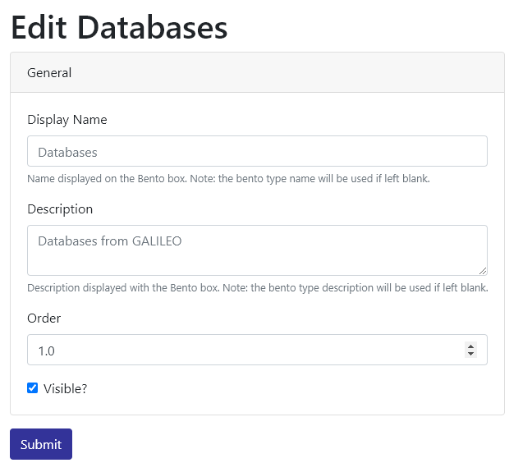
Bento Box: Customize/Reorder

Slide 17
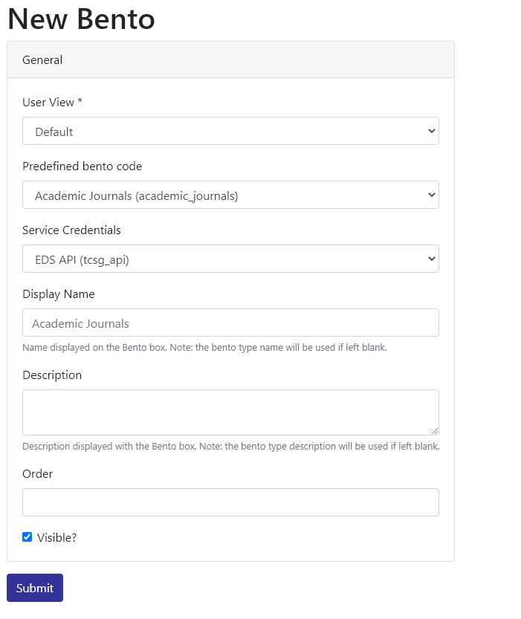
New Bento Box

Slide 18
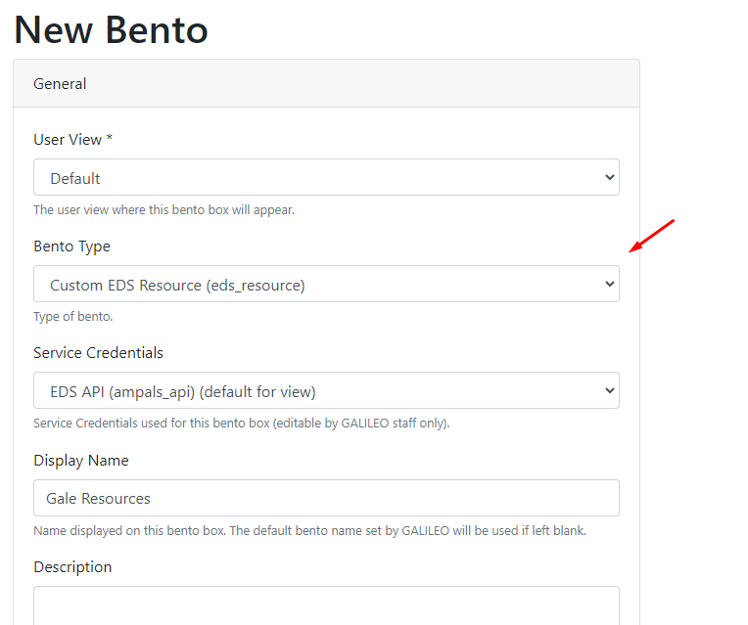
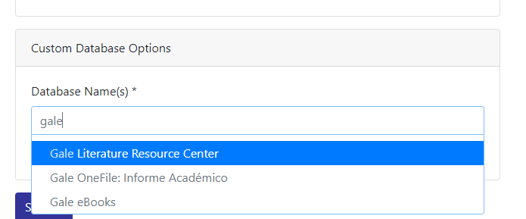
Enhanced Custom EDS Resource Bentos

Slide 19
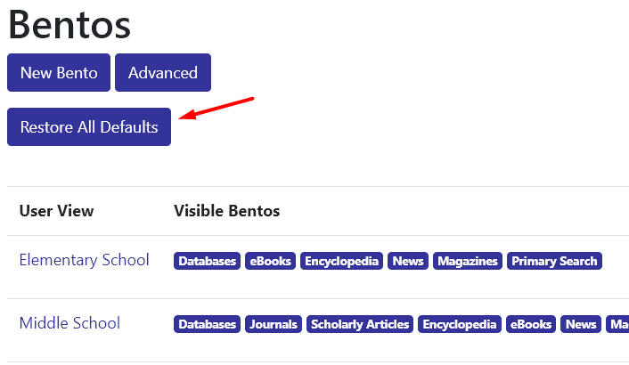
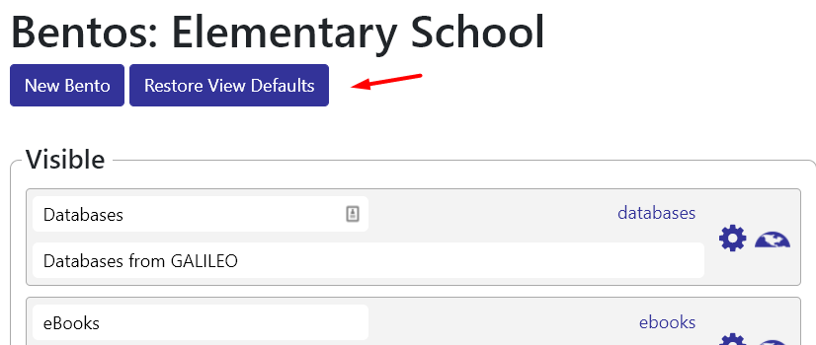
Restore Bento Defaults

Slide 20
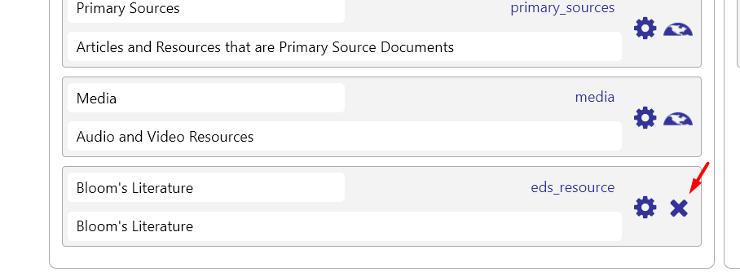
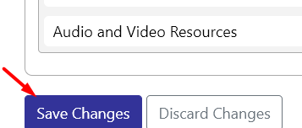
Deleting Bento

Slide 21
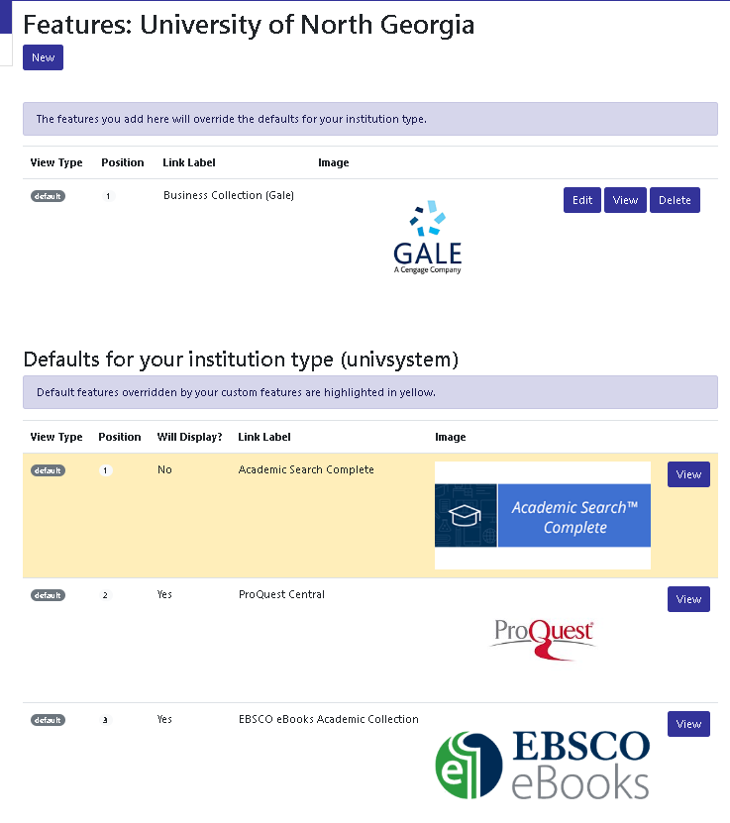
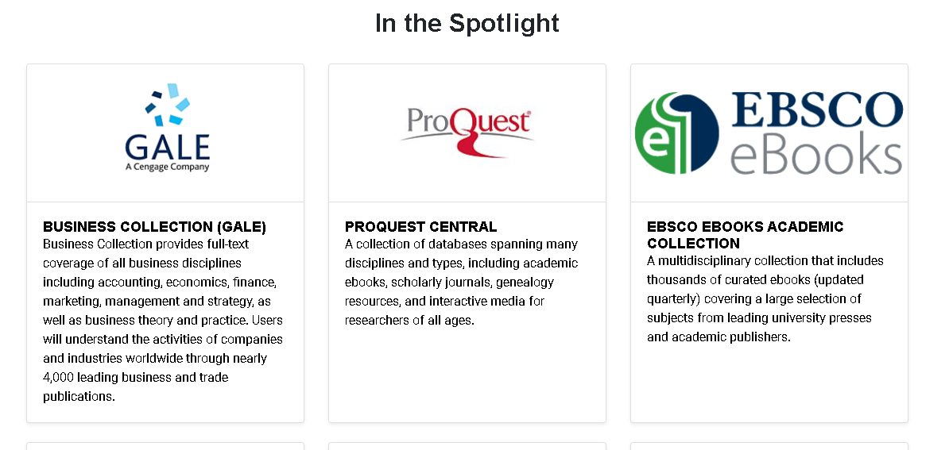
Featured Resources (In the Spotlight)

Slide 22
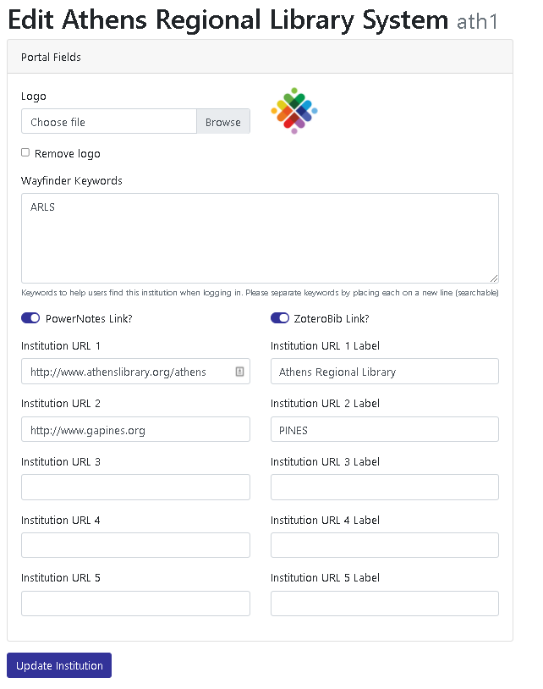
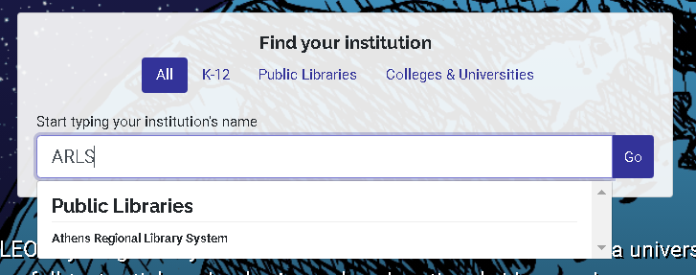
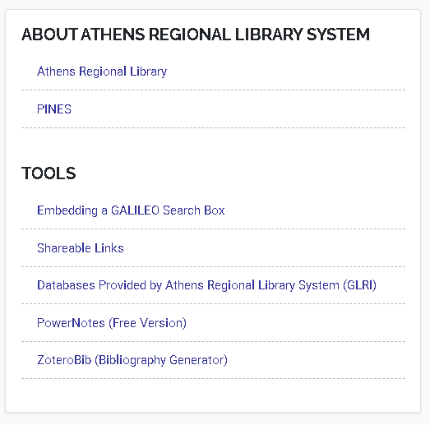
Institution Information (Editing)

Slide 23
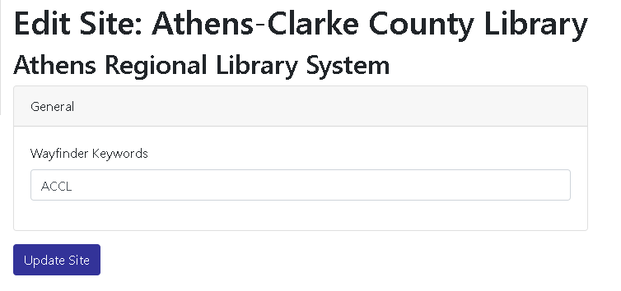
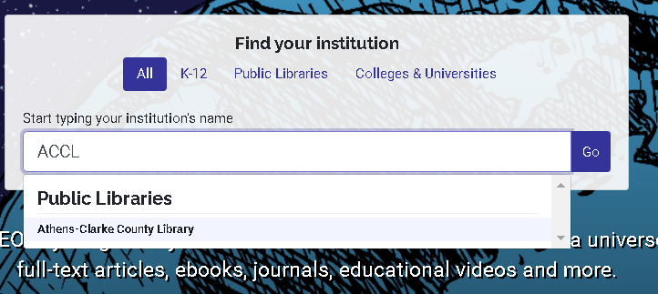
Site Information (Editing)

Slide 24
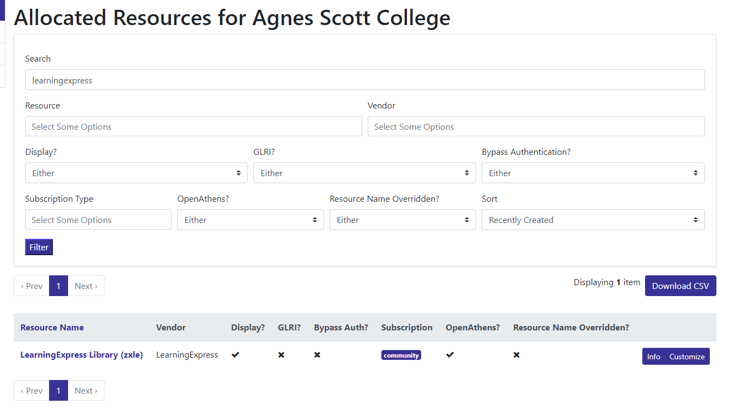
Customizing GALILEO-managed Resources

Slide 25
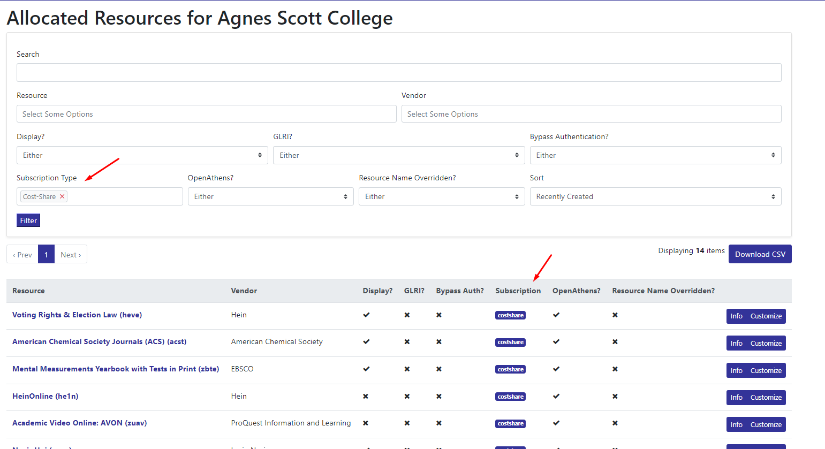
Customizing GALILEO-managed Resources

Slide 26
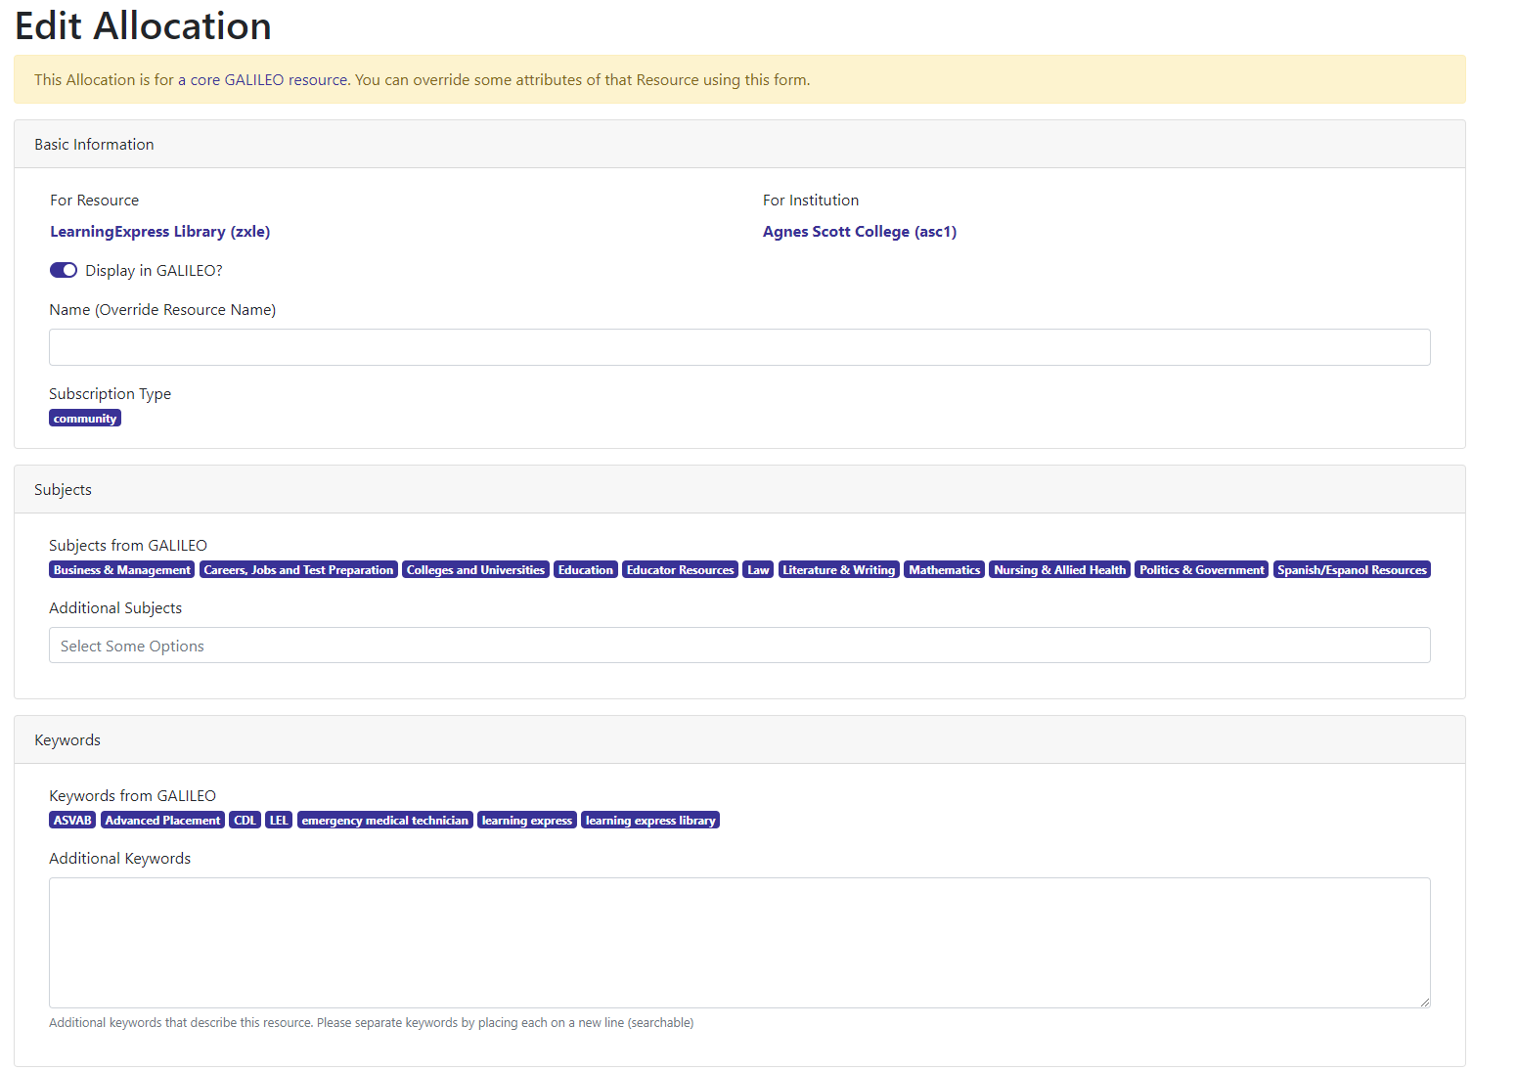
Customizing GALILEO-managed Resources (Editing)

Slide 27
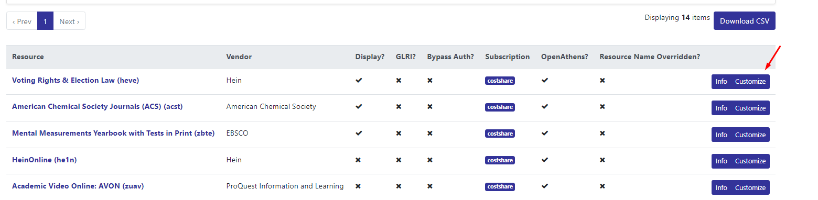
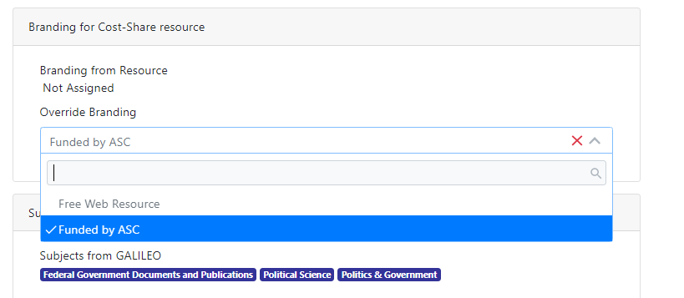
Add institutional branding to cost-share resources

Slide 28
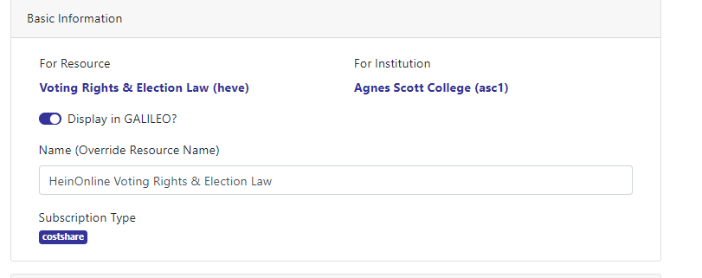
Rename GALILEO managed resources

Slide 29
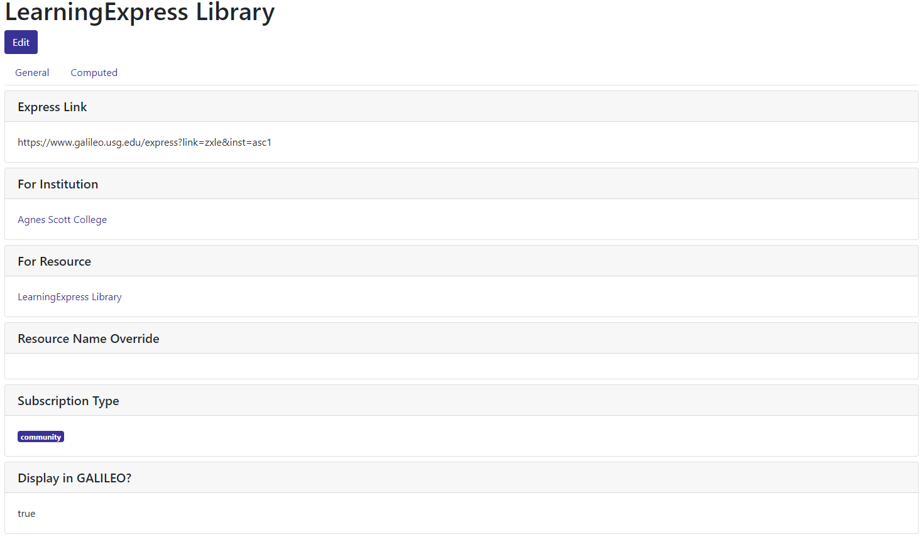
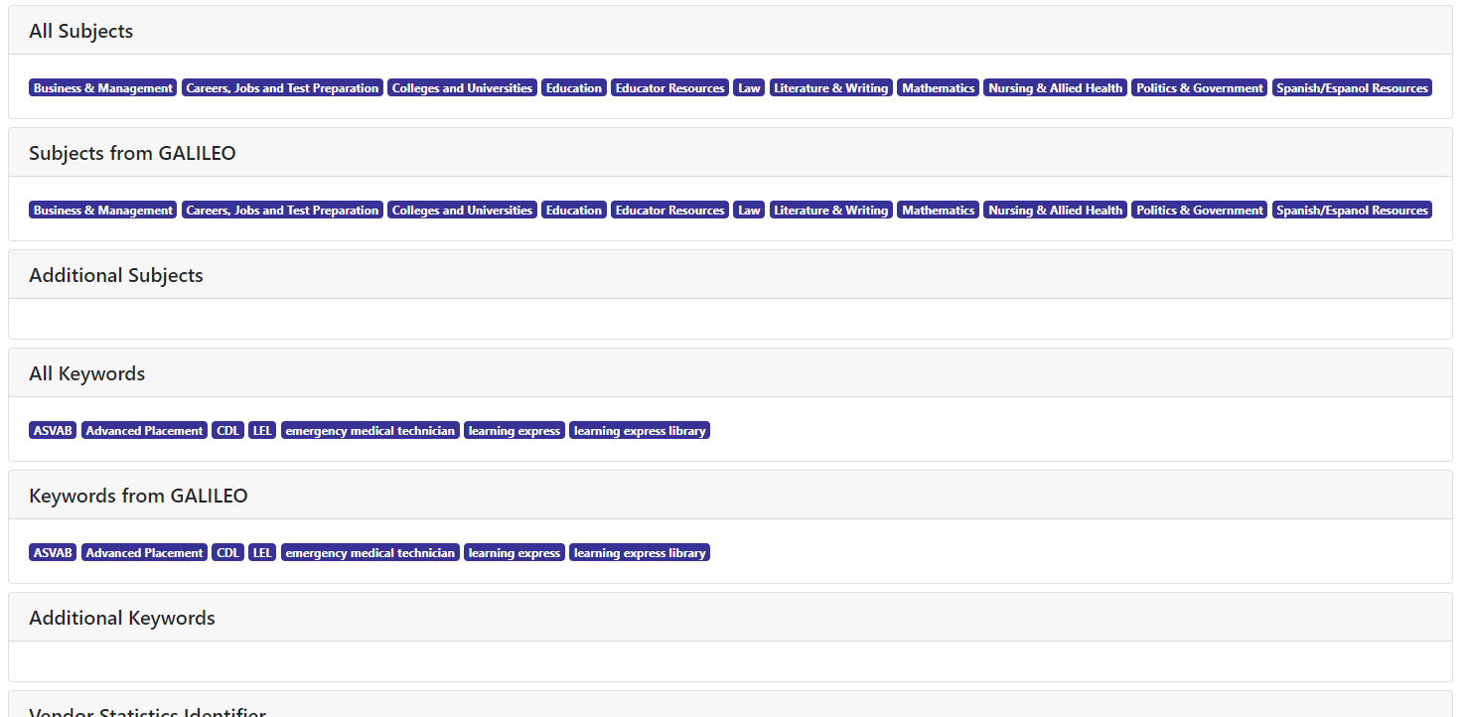
Customizing GALILEO-managed Resources (Viewing)

Slide 30
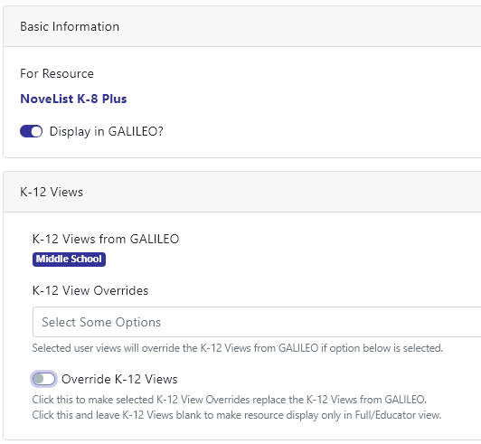
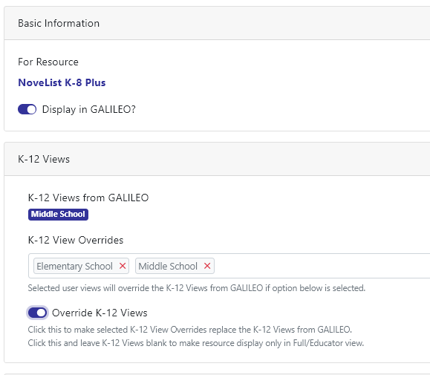
Customizing resources in K-12 Views (K-12 and GPLS only)

Slide 31
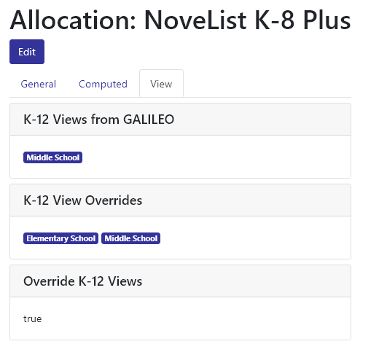
Resource K-12 Views Show Page (K-12 and GPLS only)

Slide 32
User Account Types
VIEWER (new)
GENERAL
ADVANCED
Institutional Reports
(Express Link, Serials, GLRI, and Resources)
View-only access to everything
Unable to edit any fields
Banners
In the Spotlight
Bento customization
Featured Resources
Customizing GALILEO-managed Resources
Institution Information
Reporting
Everything General Users can do plus:
  Local Resource Management (GLRI)
  Brandings

Slide 33
Upcoming GALILEO Admin Training
GALILEO Admin I:
Covers In the Spotlight, Institutional Information, Reports, and Customizing GALILEO Provided Resources
For General and Advanced Users
GALILEO Admin II:
Covers Local Resource Integration (GLRI) and Branding
For Advanced Users Only
  July 9 @ 10am (1.5 hours)
  August 8 @ 2pm (1.5 hours)
Training available based on need

Slide 34
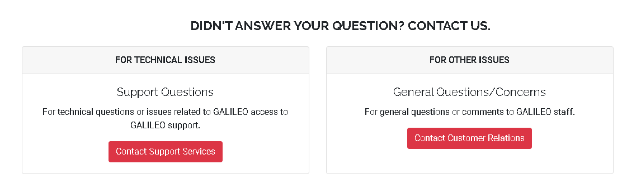
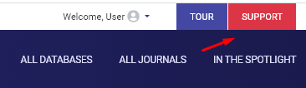
Questions?
https://www.galileo.usg.edu/contact/

