Slide 1

GALILEO Unbound:
New Perspectives on Literacy
2024 GALILEO Annual Conference
June 11-12, 2024
Staying Ahead of the Technology (and Business) Learning Curves with O’Reilly
Peg Bessette Knight, Sr. Product Manager, Partners & Distributors
ProQuest, a part of Clarivate
Notes:
Welcome
Thanks for the opportunity to speak to you about Business and Technology as in Public Libraries
And thanks for letting me tell you about O’Reilly for Public Libraries
Most of all, thank you for coming today.

Slide 2
Business & Technology
Trends

Slide 3
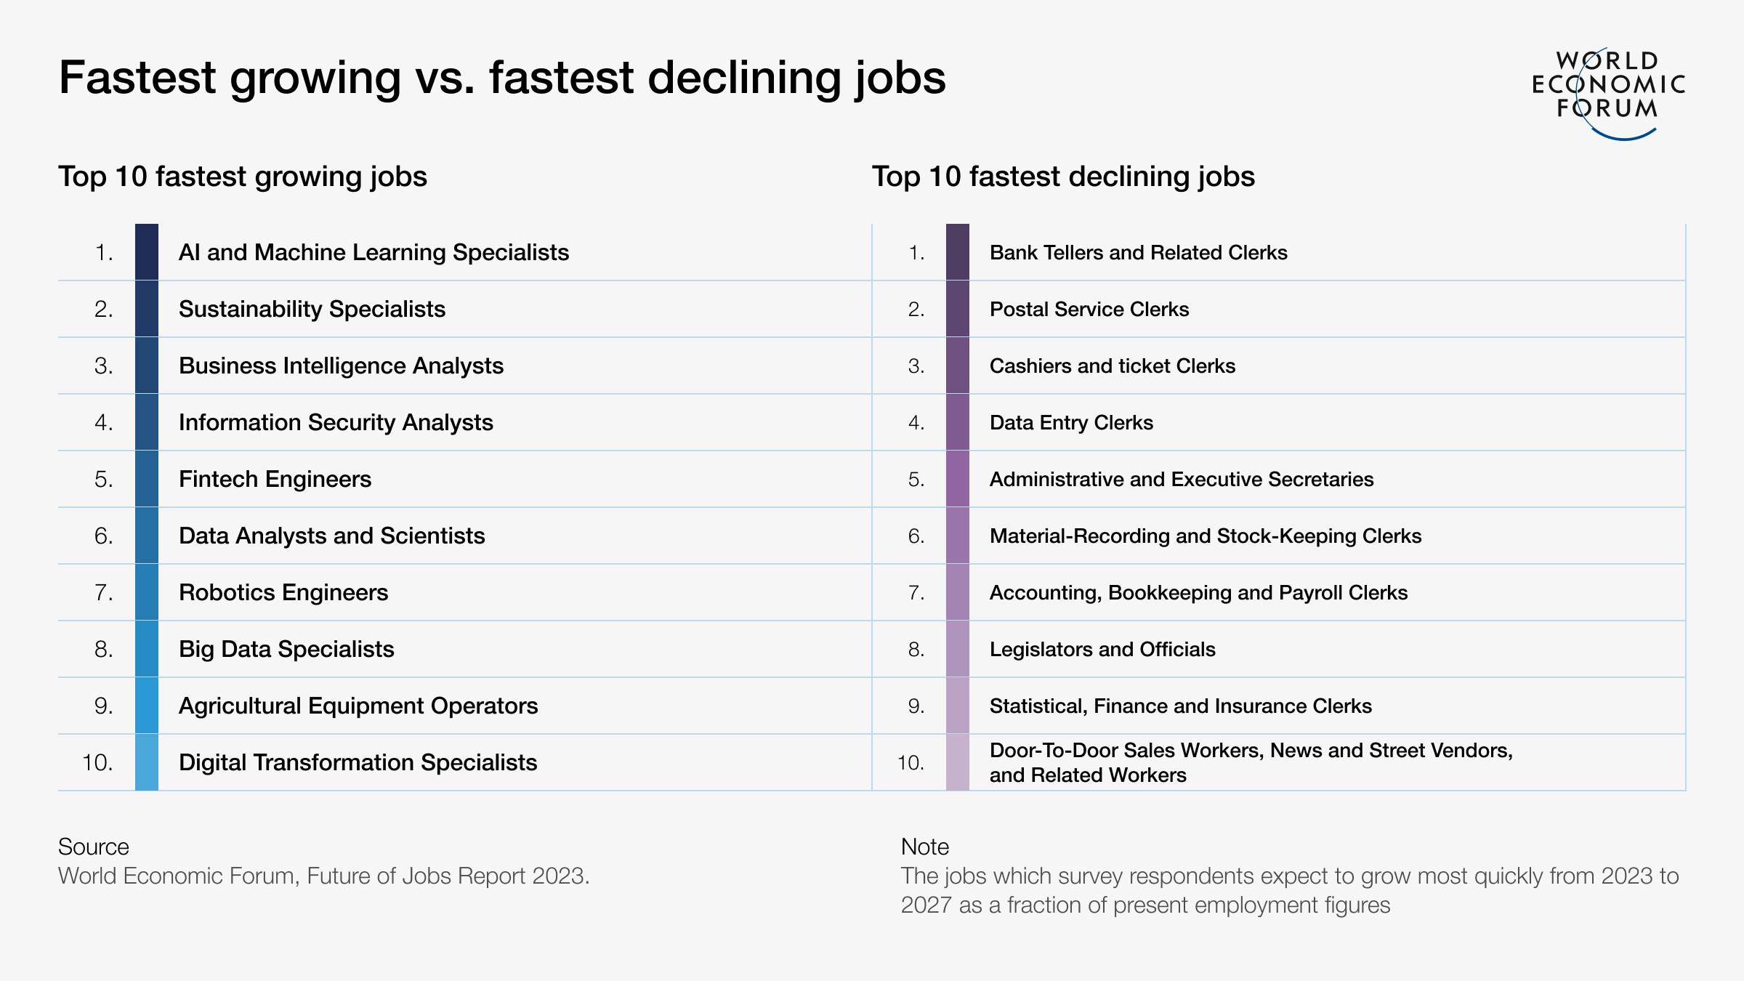
Business & Technology Trends
Source: World Economic Forum “The Future of Jobs Report 2023” (30 April 2023)

Slide 4
Business & Technology Trends: The Future of Jobs

Slide 5
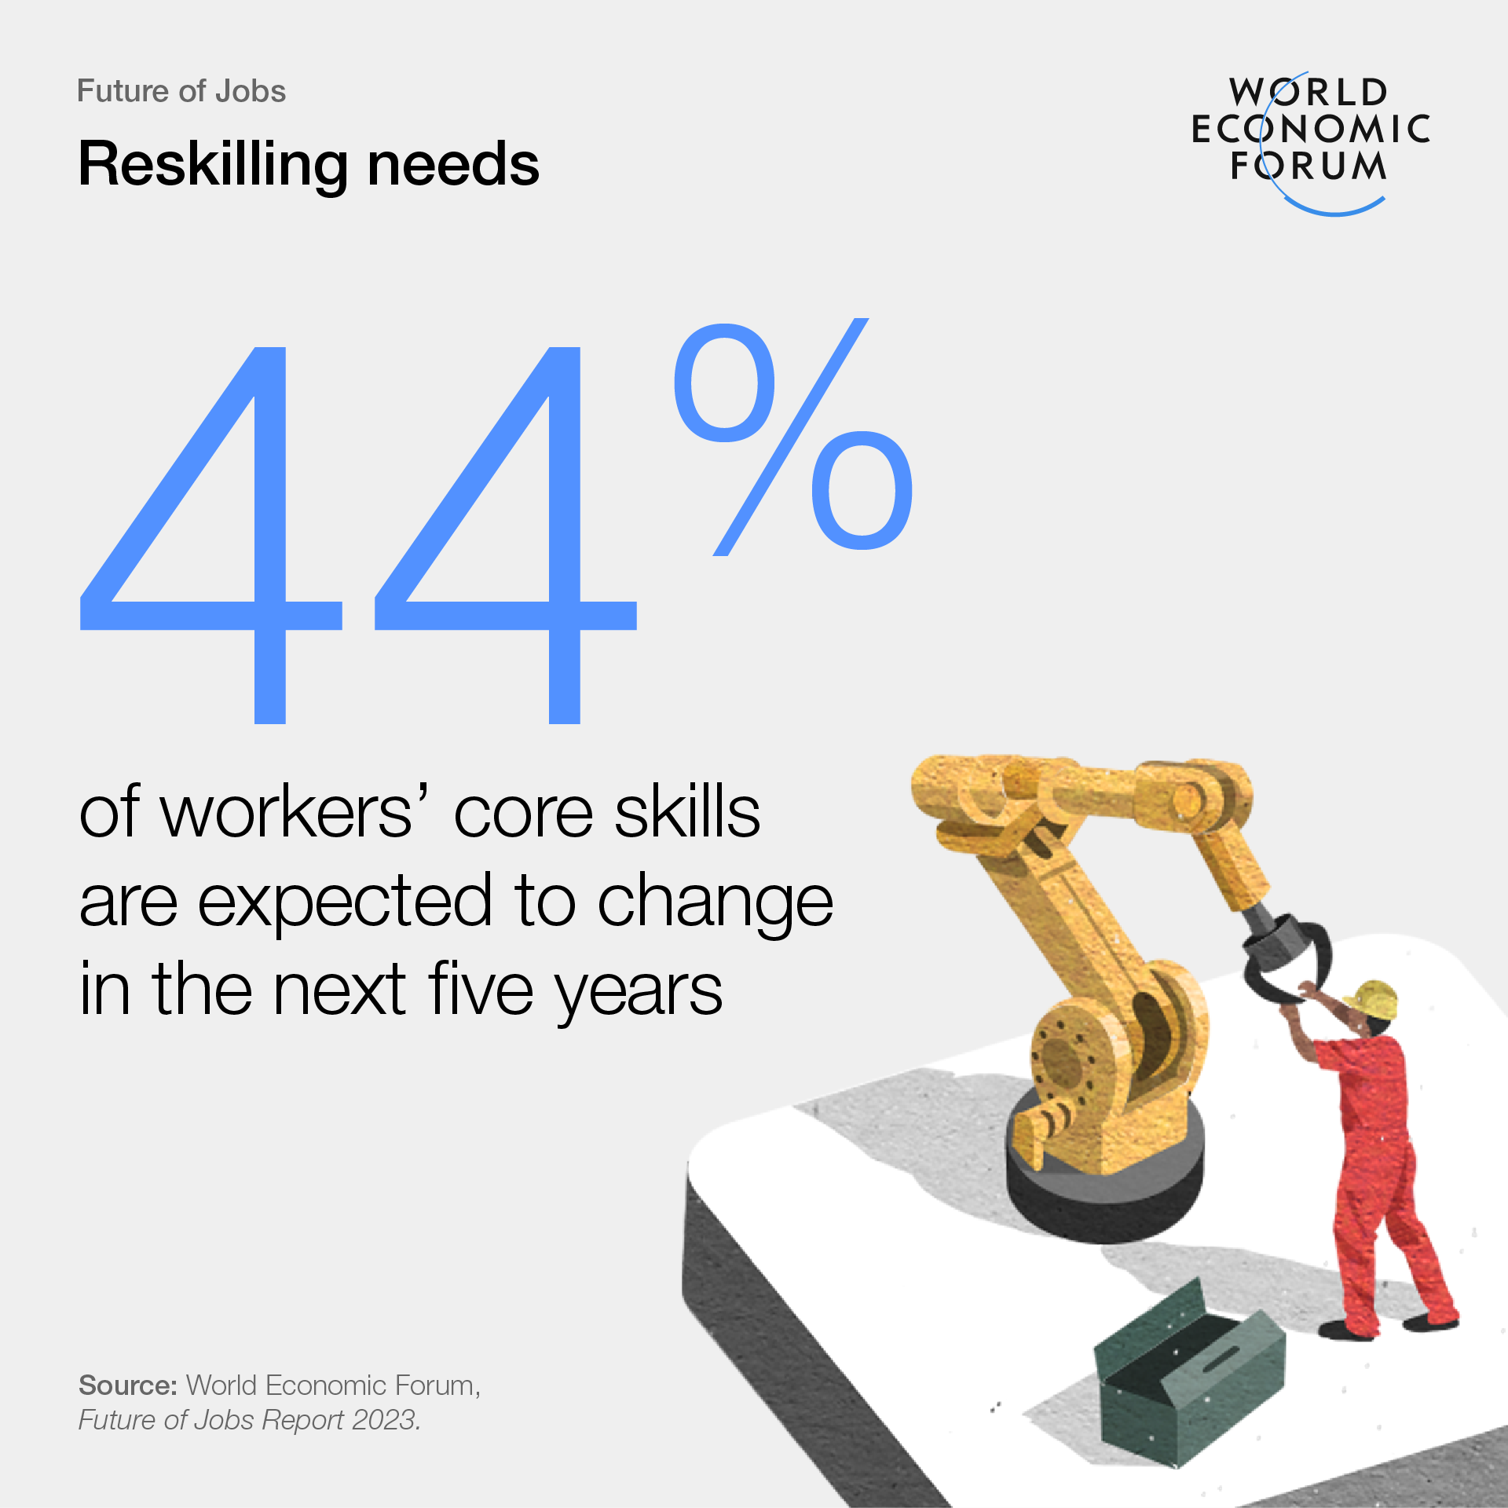
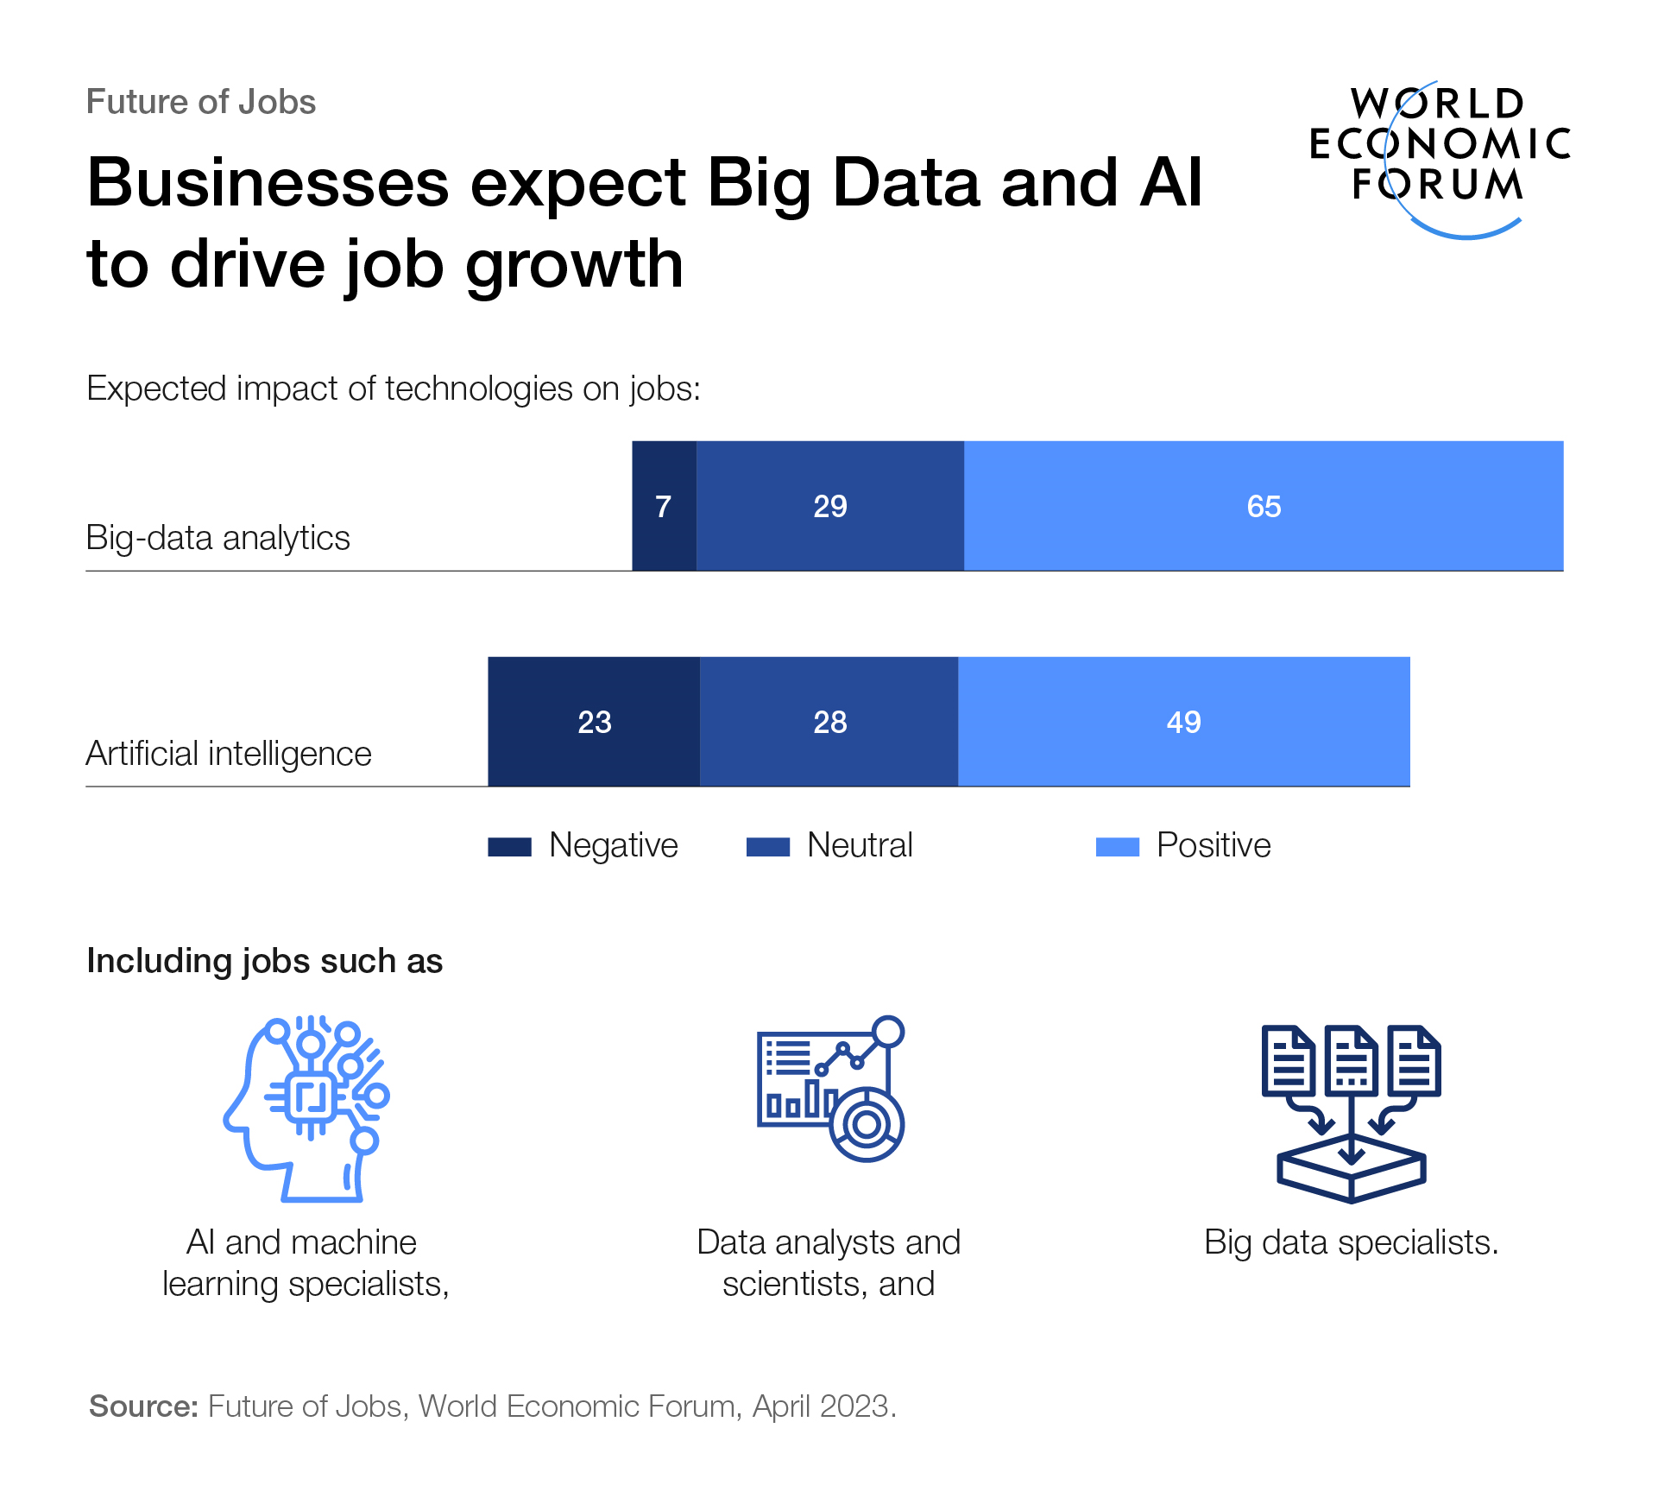
Business & Technology Trends: Reskilling, and the Intertwining of Business and Technology

Slide 6
O’Reilly and ProQuest
A 20-Year Partnership
ProQuest is proud to be O’Reilly’s exclusive partner, serving academic and public libraries worldwide.

Slide 7








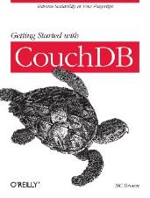









"The internet was built on O'Reilly books."
–Publisher Weekly
Notes:
When we started over 40 years ago, the web didn't exist.
If someone wanted to learn something, they'd teach themselves from a book. And there were only two kinds of technical books on the market: mass-market books for complete beginners and advanced books that were dry and technical. It left a gap that O'Reilly filled.
O'Reilly books are written by practitioners with first-hand knowledge on what’s made them productive so others could be productive too

Slide 8




40+ year history of educating technology professionals
Robust online learning platform
Groundbreaking
book publishing
Forward-thinking tech events
Notes:
O'Reilly has been educating professionals in technology and business for over 40 years. And during those four decades, we've given learners precisely what they need to stay ahead.
We started as a technical book publisher and continue to publish some of the best technical content available (you might recognize our books by the woodcut animals on the covers).
We also gather the brightest technical minds at O'Reilly tapping into thoughtleaders and innovators in areas such as AI, big data, software architecture, and open source.
In 2001 we launched O'Reilly for Public Libraries, a subscription-based online learning platform with all our ebooks and videos, certification guides, and more while inviting other technology and business publishers to join.

Slide 9
About O’Reilly

Slide 10


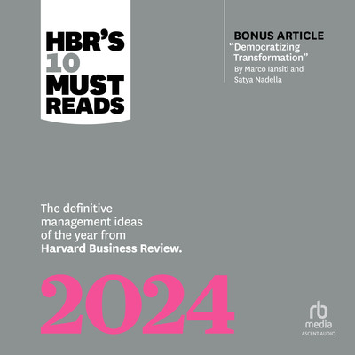





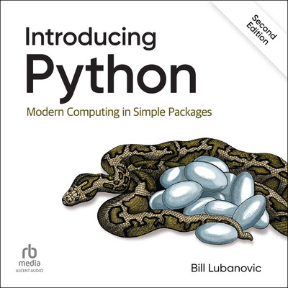

O’Reilly Content – By the Numbers*
~51,300 Books
2,900+ Audiobooks
6,400+ Videos
*as of May 2024

Slide 11




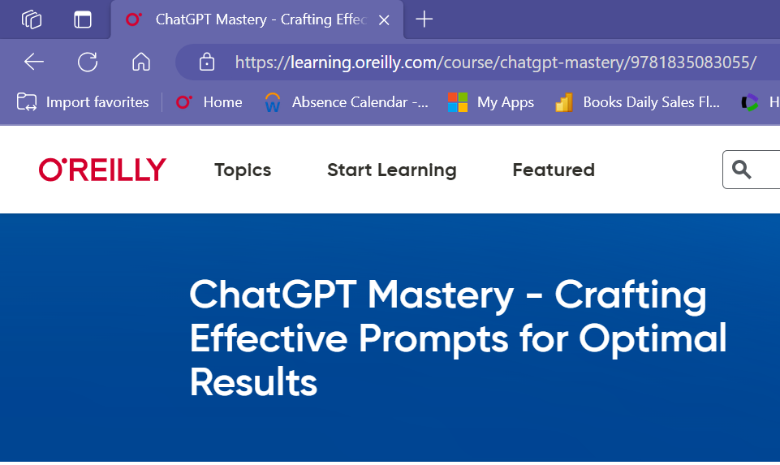




O’Reilly New Content Added in 2023
2,600+ Books
610+ Audiobooks
540+ Videos
*as of January 2024

Slide 12


Industry Recognition
Rated 4.33/5
Must-Have
“This platform is extremely easy to use - it is very intuitive, no instructions or training is needed, and patrons can start using it right away from the Search box
Must-Have Database for Technology
Users will “find this an all-in-one solution for building skills in business and tech at any level."
Source: The Charleston Advisor, Volume 24, Issue 3, January 2023
Source: Must-Have Databases for Academic and Public Libraries 2020, Library Journal December 2020 https://www.libraryjournal.com/story/must-have-databases-academic-public-libraries

Slide 13

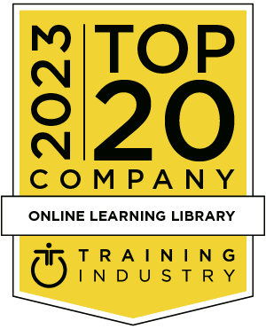




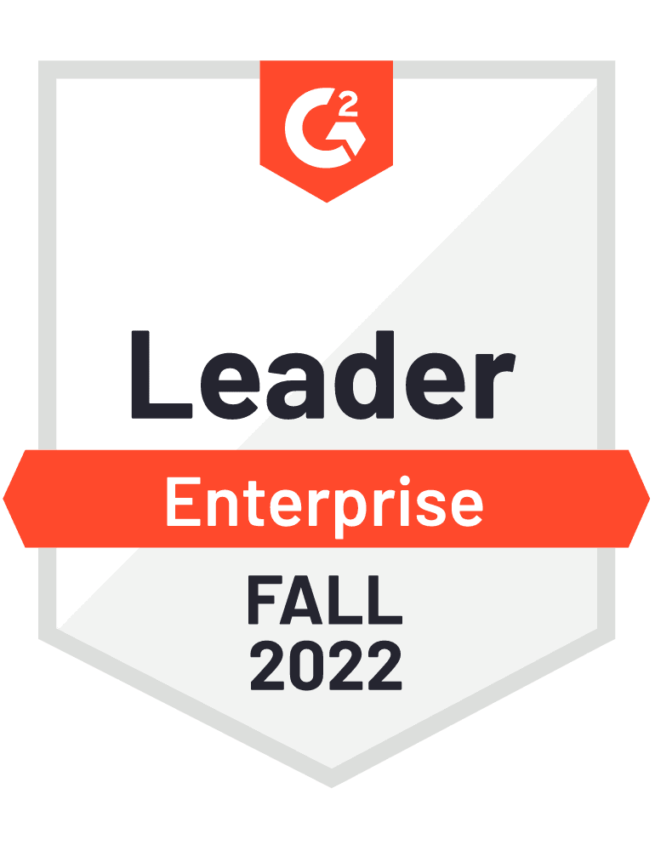



A recognized and award-winning learning platform
Notes:
Leading institutions and companies trust O’Reilly… recent awards highlighted here.
- world class content, helping users build skills for career-readiness and helping faculty and staff support classroom learning.
Only learning solution that also provides problem-solving resources for learners who need on-demand resource to fit their specific contextual needs
helps learners save time when they need specific answers quickly. O’Reilly’s natural language search—O’Reilly Answers—delivers users not only lists of results, but pinpoints relevant passages that answer the user’s question.
knows what the modern-day enterprise expects from employees and the skills they need for success. You can be sure your patrons are getting the most accurate information about tools and technologies and skills they need to bring into the workplace.

Slide 14


Slide 15
Spreading the knowledge of innovators
Let’s see How O’Reilly Can Help

