Slide 1
DLG Newspaper
Digitization 101
Donnie Summerlin
Daniel Britt
Digital Library of Georgia

Slide 2
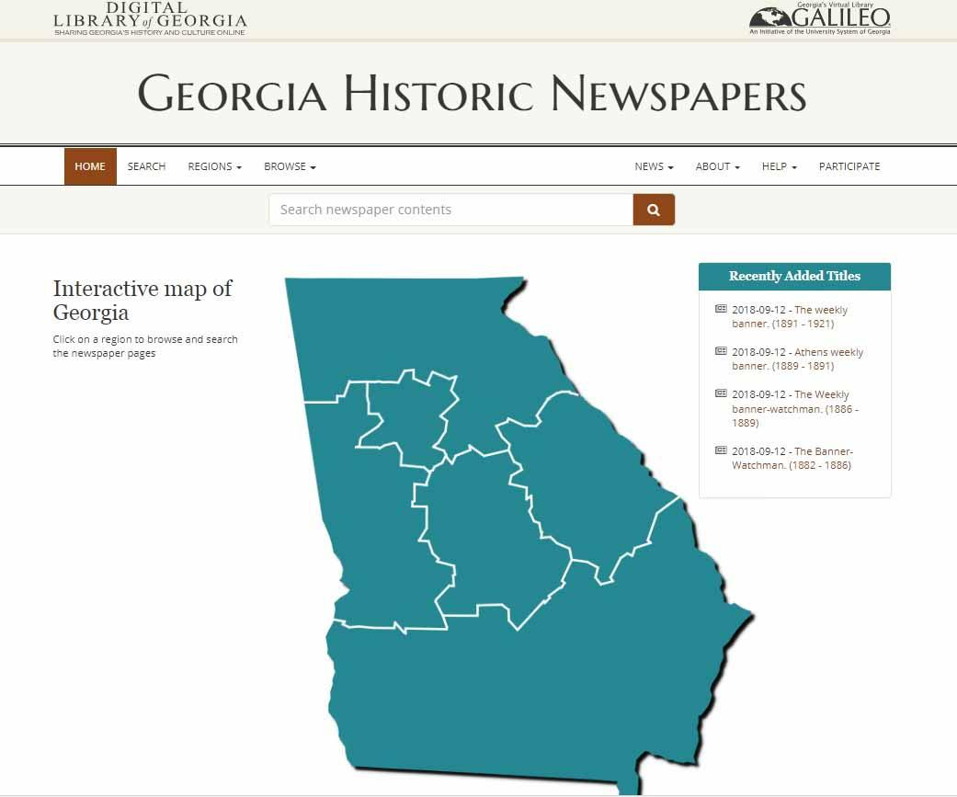
Georgia Historic Newspapers Website
3.5 Million Pages
1,075 Titles
1763-2023
151 Counties
204 Cities
Completely Free

Slide 3

Georgia Newspaper Project
Largest collection of Georgia newspaper microfilm in the world.
Most of the newspapers in the Georgia Historic Newspapers website are digitized from that microfilm collection.
Image courtesy of the Preservation Self-Assessment Program, University of Illinois at Urbana Champaign

Slide 4
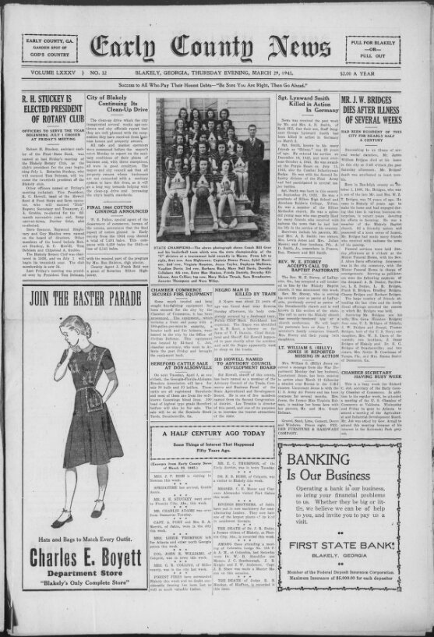
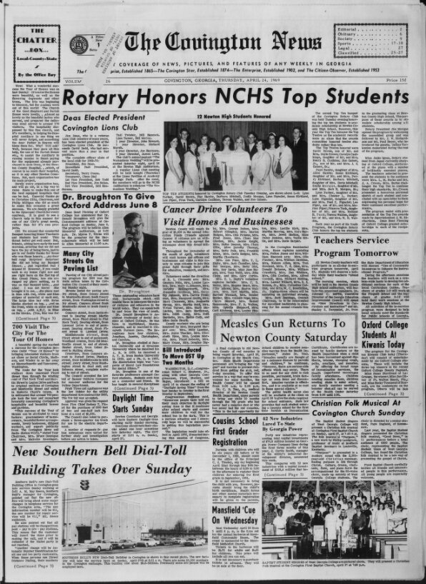
How Do I Get My Local Paper Included?

Slide 5
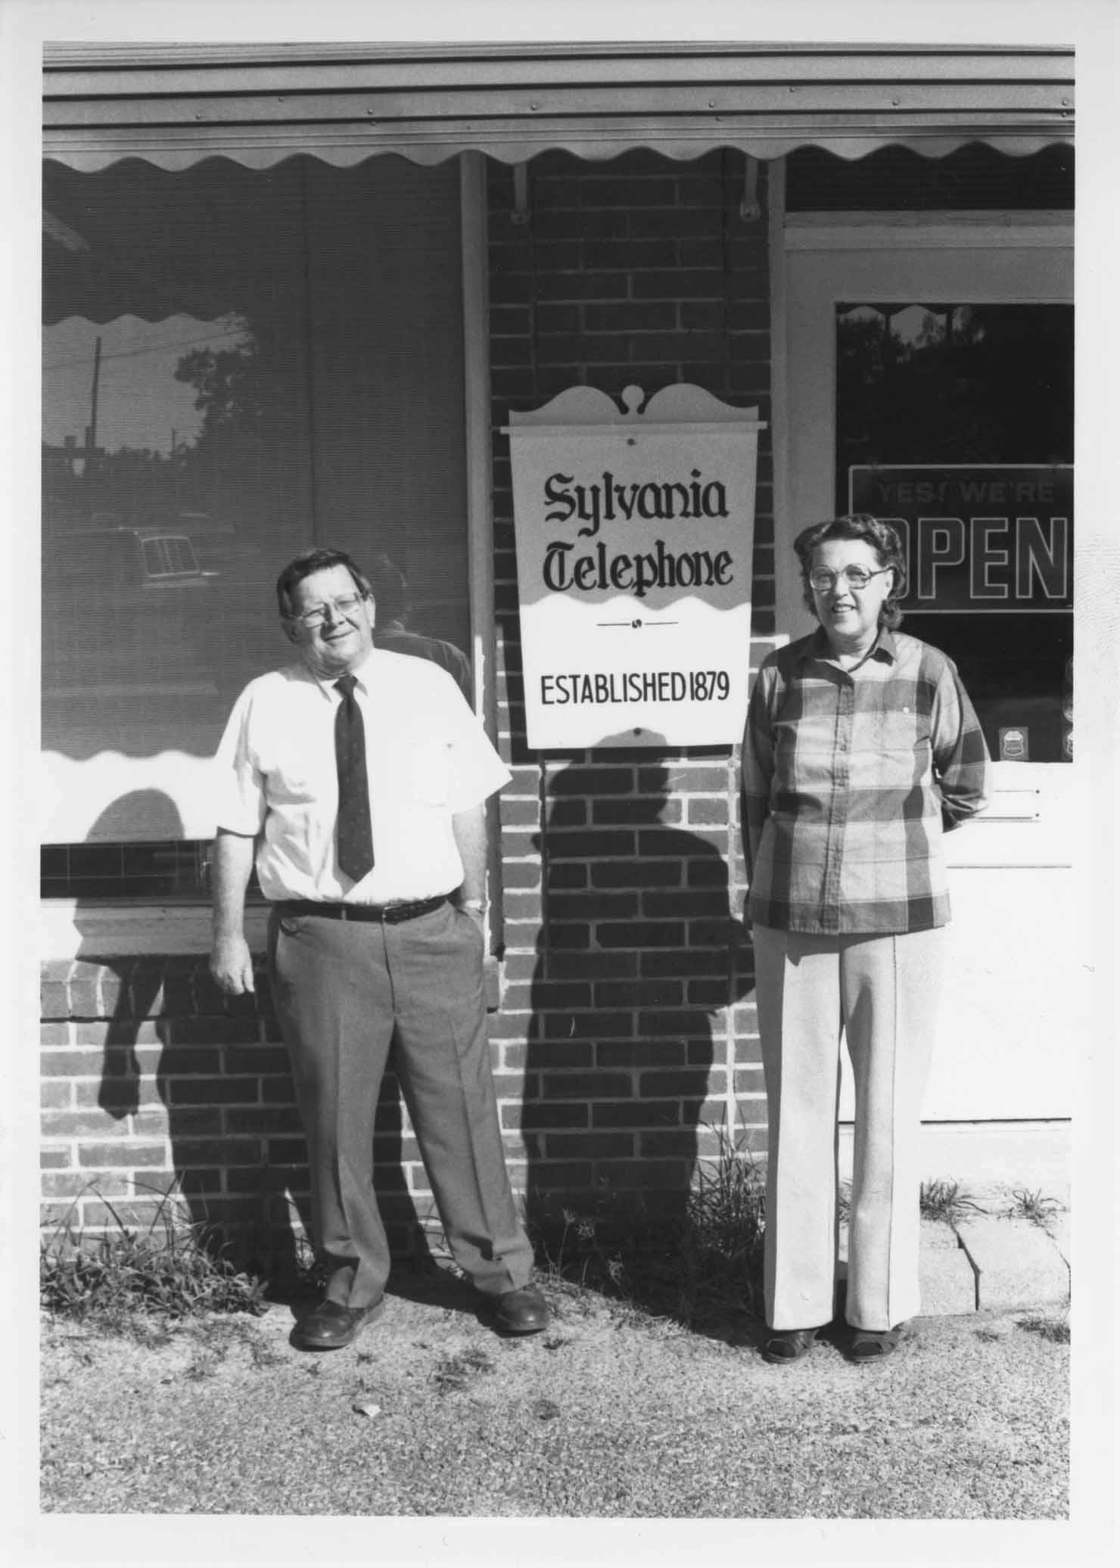
Partnership to Digitize Newspapers
Reach out and let us know of your interest.
We can prepare a page count and cost quote.

Slide 6
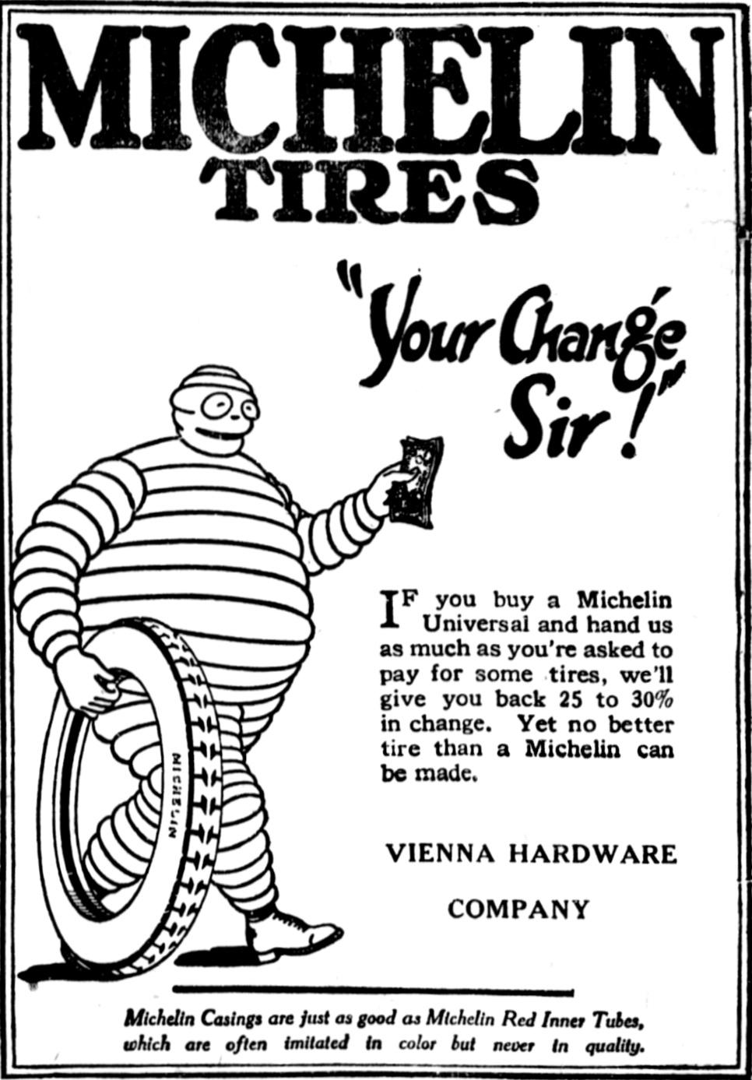
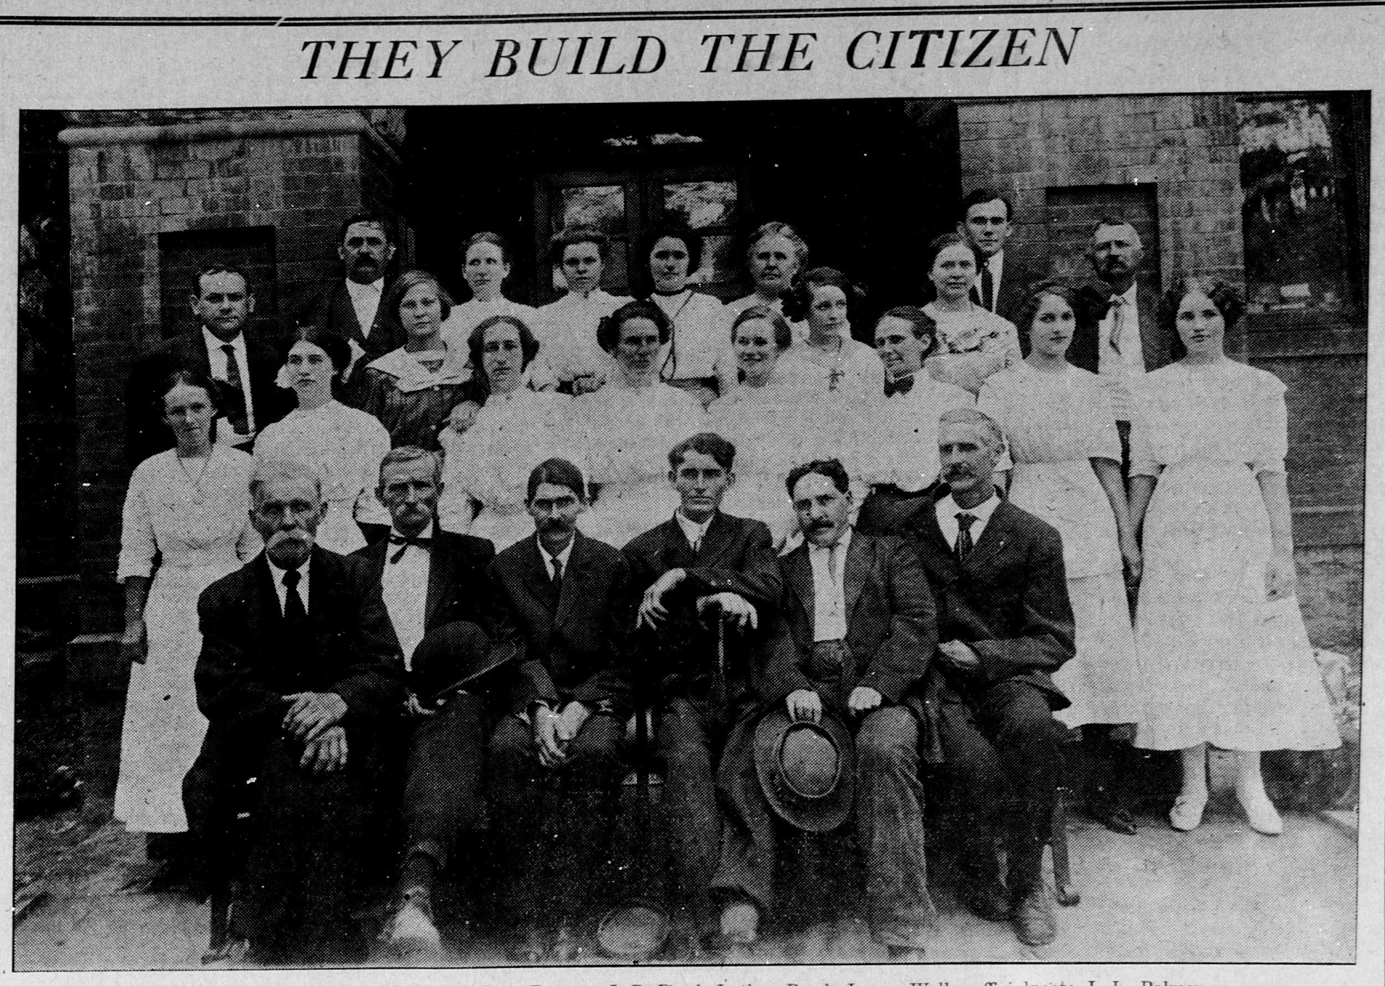
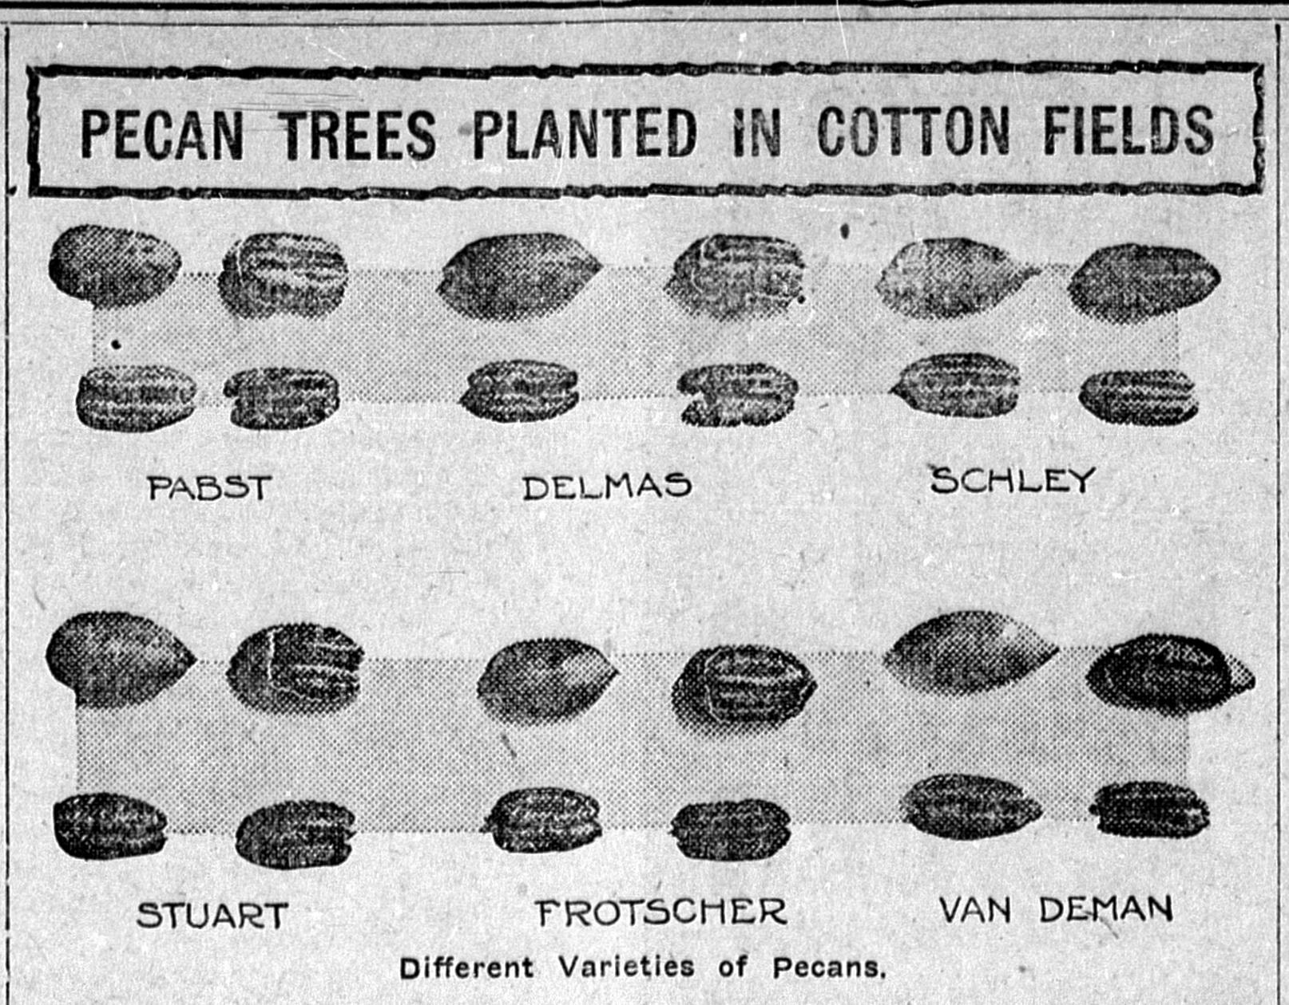
Securing Funding
We depend on our partners to help securing funding for the project.
DLG and GPLS can help you in the process.
For public libraries:
Josh Kitchens, GPLS jkitchens@georgialibraries.org

Slide 7
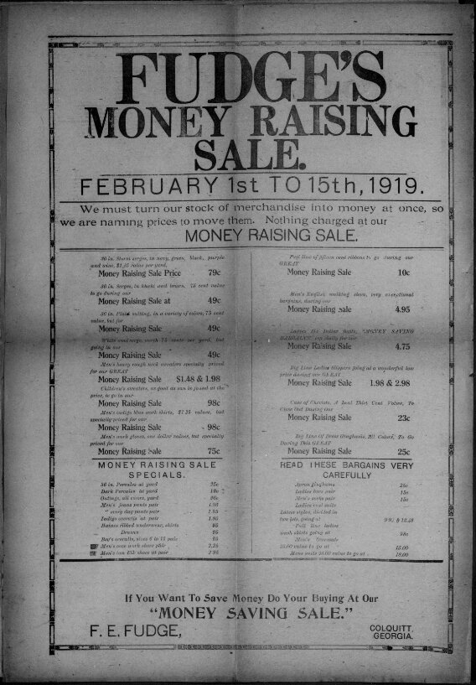
Funding Options
Funding options:
Georgia Public Library Service
Friends of the Public Library Organizations
Historical/Genealogical Societies
Local Foundations/Power Companies

Slide 8
Copyright Investigation
Two options:
1. Publisher permission
2. We perform a copyright investigation
Newspapers published after 1928 may be under copyright protection.

Slide 9
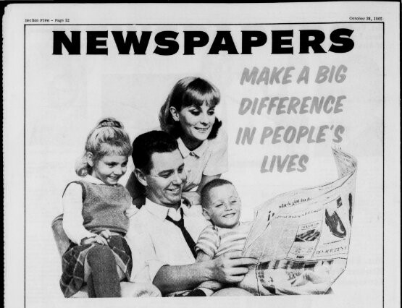
Newspaper Digitization Project
We take care of:
Digitization
Online Hosting
Preservation

Slide 10

Benefits to Digitizing With

Slide 11
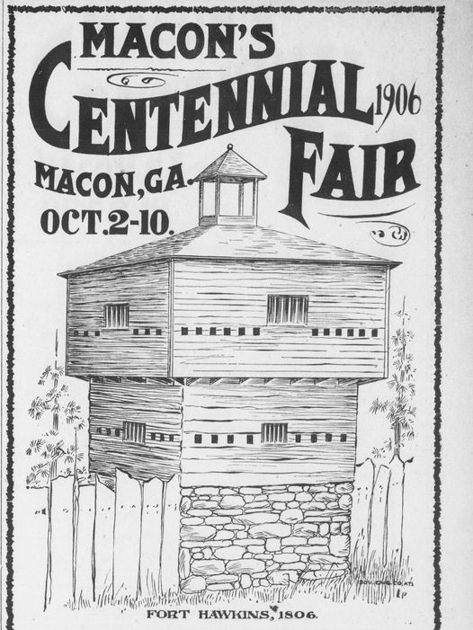
The Most Comprehensive
Georgia Newspaper Archive
More Georgia Counties and Cities Represented Than Any Other Newspaper Archive

Slide 12
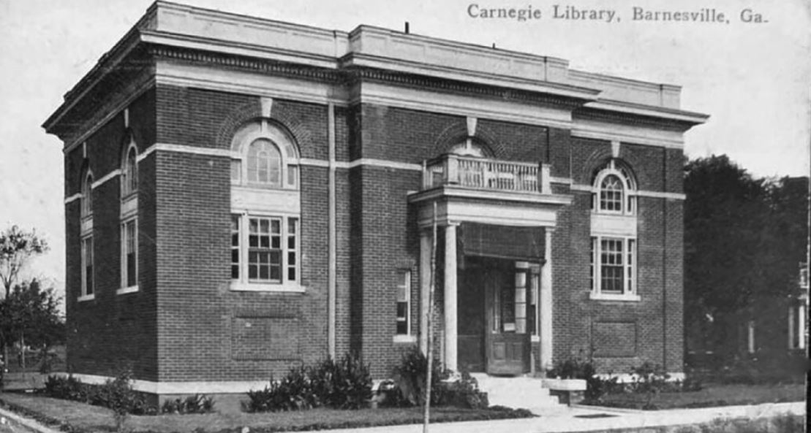
Always Free and Open to the Public
The GHN website is completely free and openly accessible online from anywhere in the world.
No subscriptions, passwords, or plug-ins

Slide 13
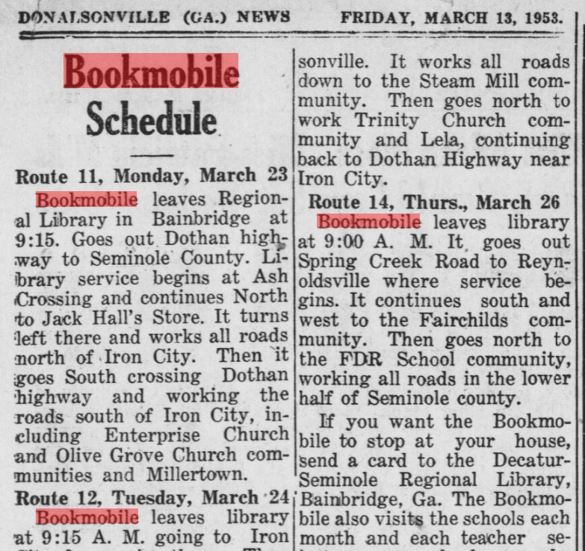
Best Search Results
We use pristine negative microfilm for digitization
Produces the best search results for users

Slide 14
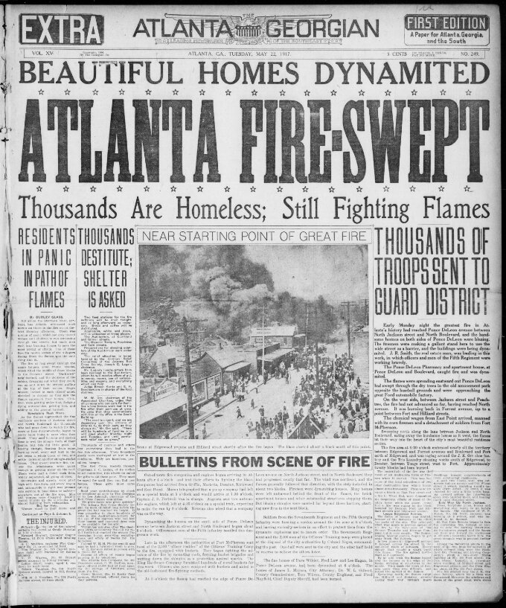
Non-Exclusive
If you digitize with us we don’t require any exclusive contract
You can work with others later if you like

Slide 15
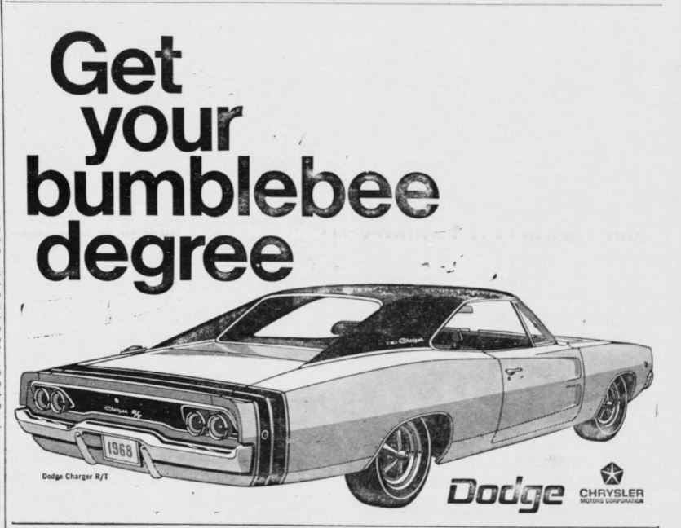
Faster Online Availability
No long embargos
We are usually able to complete a digitization project within a fiscal year

Slide 16
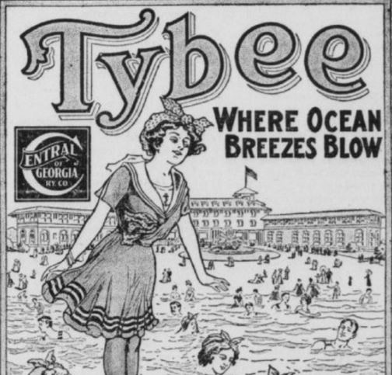
We’re Local
We are Georgia-based and only work on Georgia newspapers
You will have easy access to us for assistance

Slide 17
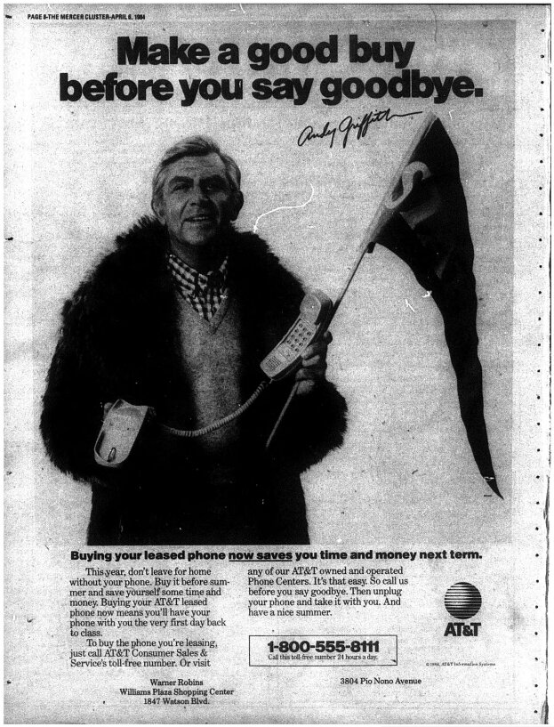
Come Talk With Us
Before you make a decision on newspaper digitization, contact us.
Regardless of what you decide, we’re here to help!

Slide 18
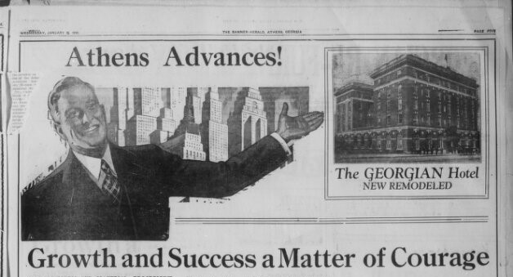
Current Projects

Slide 19
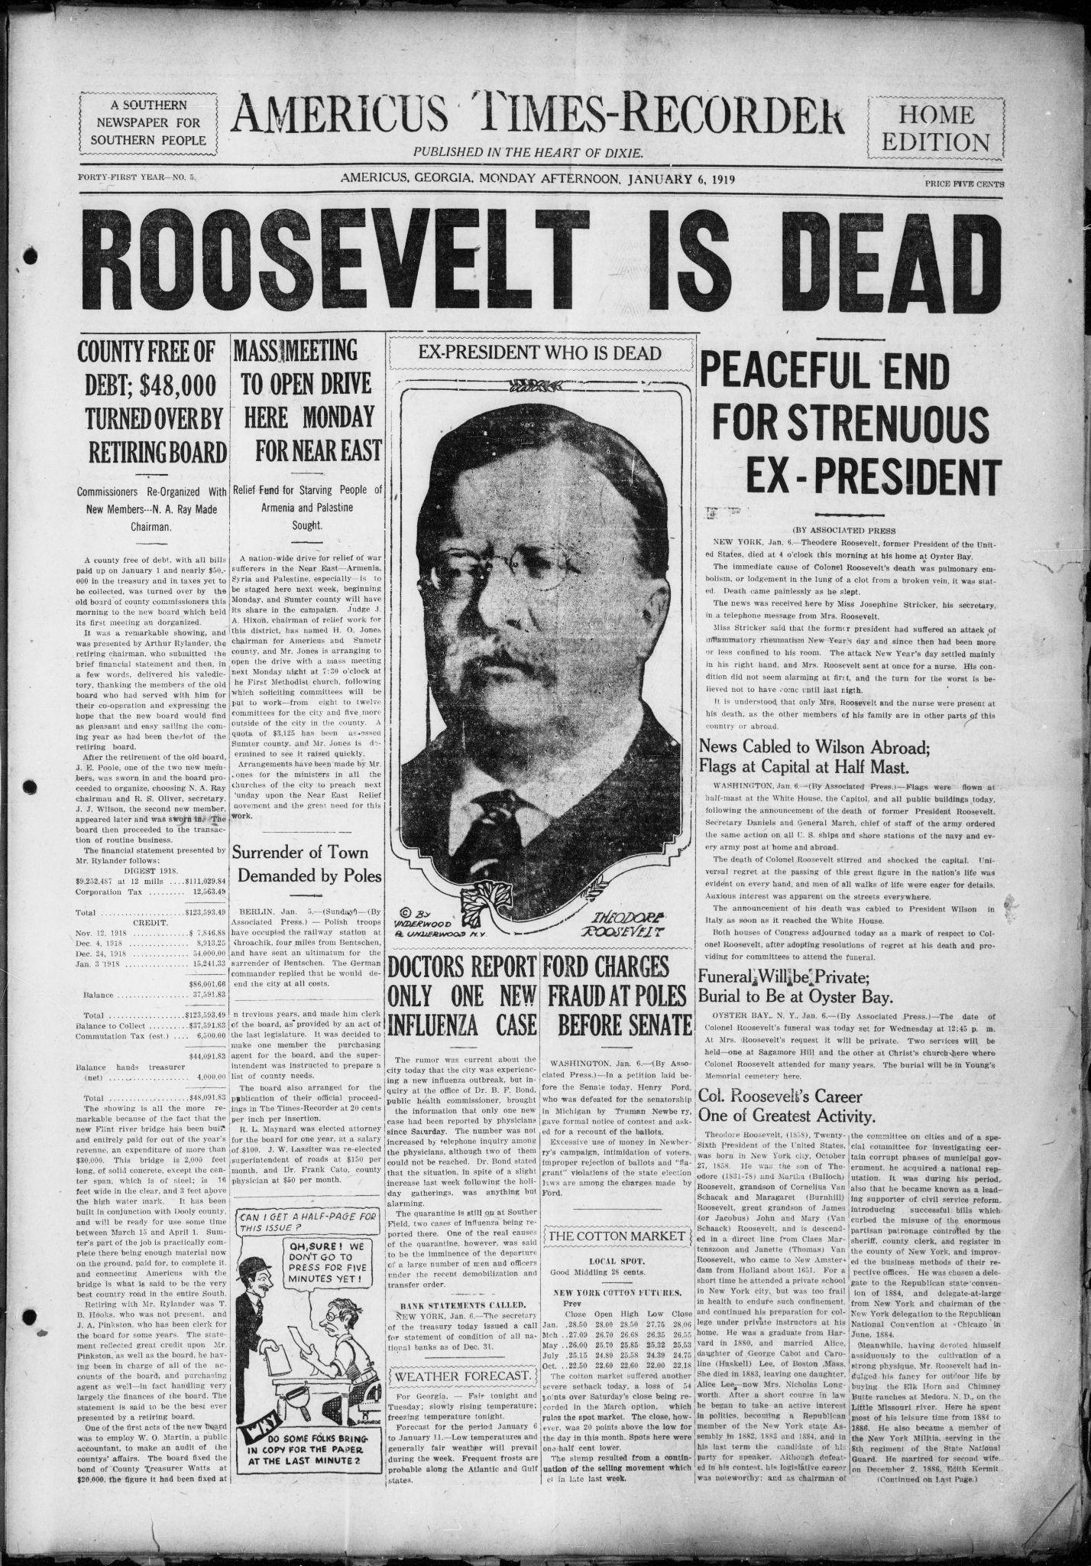
National Digital Newspaper Program
NEH-funded grant to digitize historically significant newspapers published between 1690 and 1963.
Our current grant focuses on black-owned newspapers in Georgia.

Slide 20
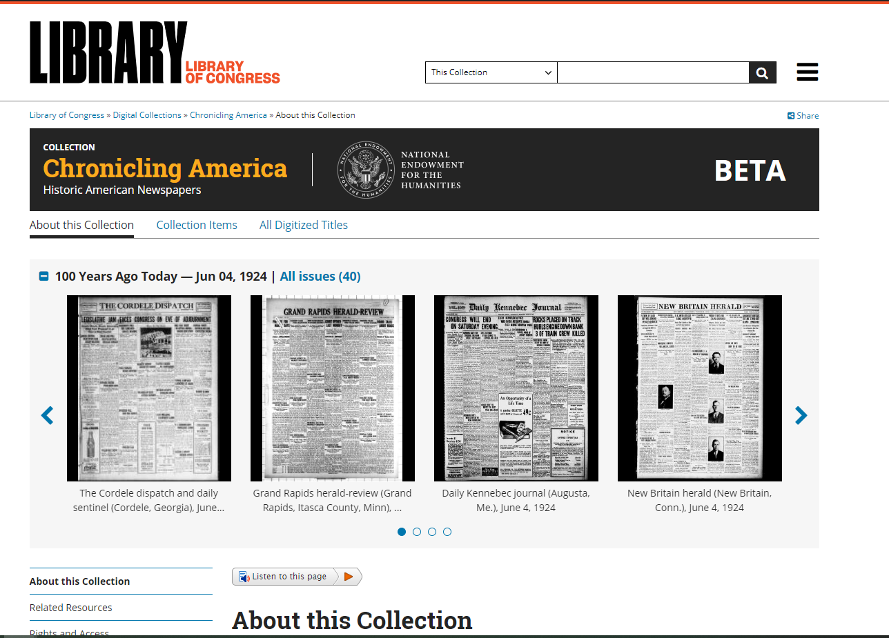
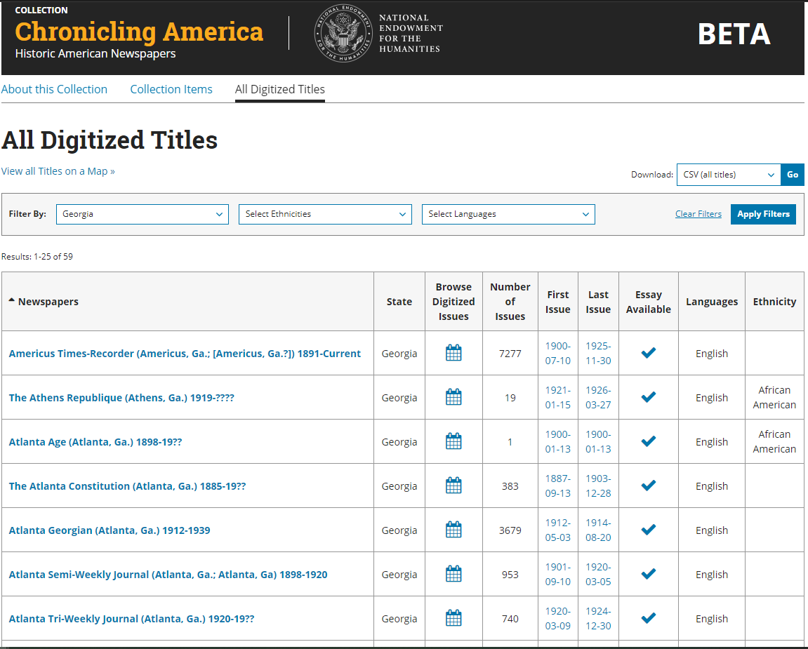
Chronicling America

Slide 21
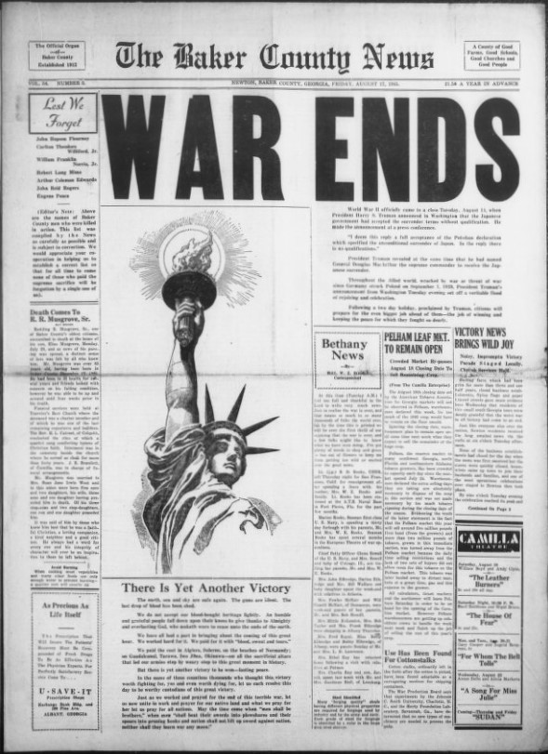
Georgia Public Library Service Partnership
Digitizing newspapers from unrepresented counties
Baker, Bryan, Clayton, Wheeler, and Wilkinson Counties this year

Slide 22
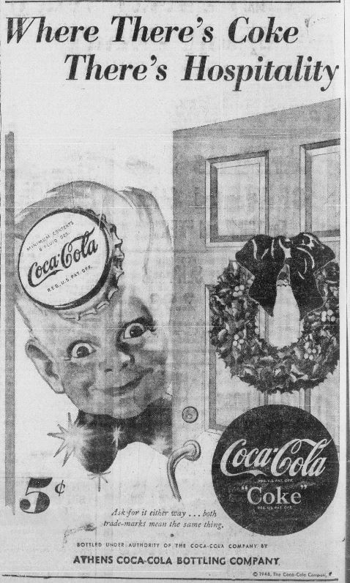
Athens Banner-Herald
Expanding availability of Athens Banner-Herald.
1928-1965
120,000 Pages

Slide 23
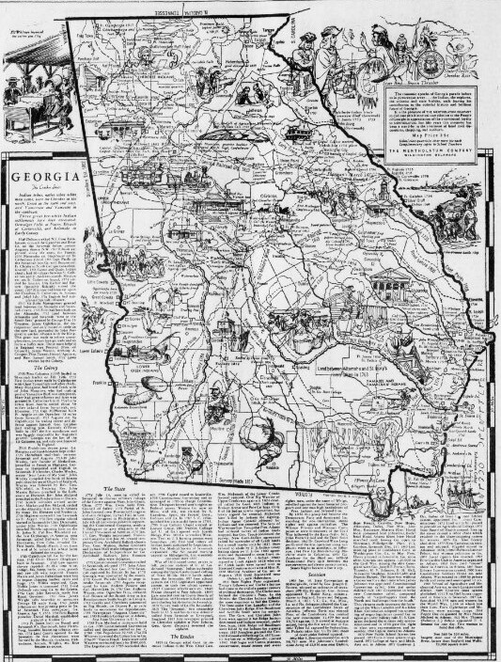
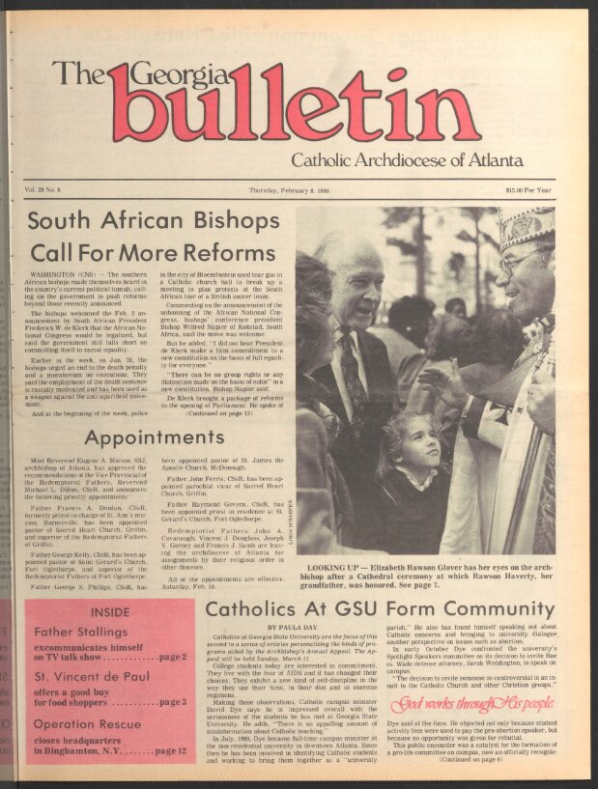
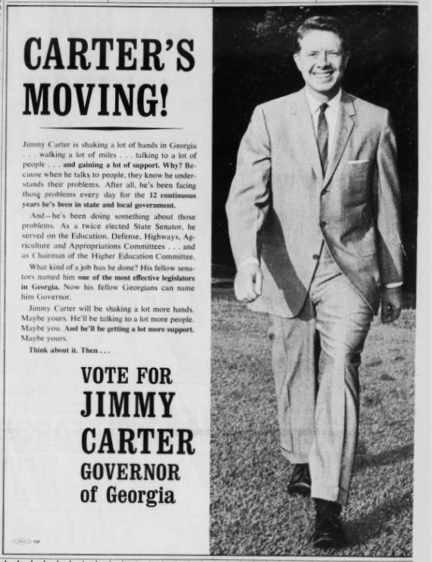
Additional Projects
Covington News
1942-1969
Georgia Bulletin
1981-1990
Summerville News
1980-2000

Slide 24
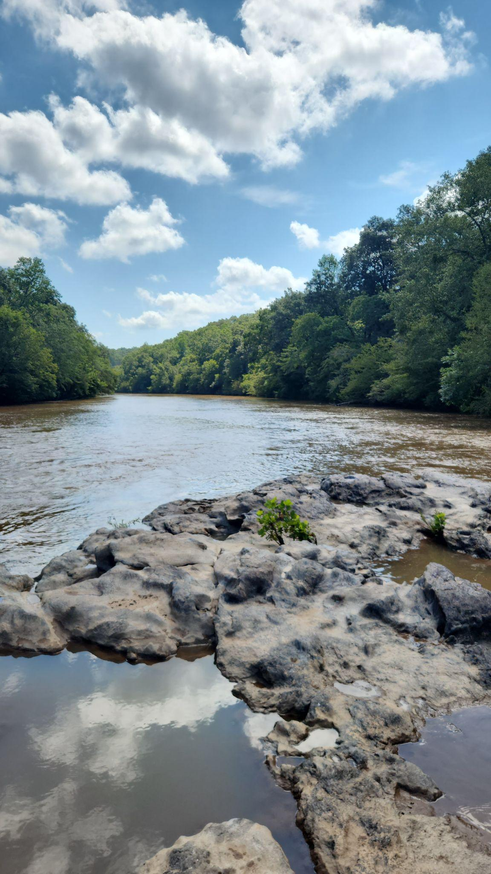
Thank You
Donnie Summerlin
Digital Projects Archivist
Digital Library of Georgia
University of GA Libraries
donsum@uga.edu
Daniel Britt
Georgia NDNP Project Manager
Digital Library of Georgia
University of GA Libraries.
dbritt93@uga.edu

