Slide 1

Libraries, Literacies, and Adult Education
Deborah Kennedy,
executive director, National Coalition for Literacy
GALILEO 2024 Conference | June 12, 2024

Slide 2

Literacy
Literacy is a bridge from misery to hope. It is a tool for daily life in modern society. It is a bulwark against poverty and a building block of development, an essential complement to investments in roads, dams, clinics and factories. …For everyone, everywhere, literacy is a basic human right.
UN Secretary General Kofi Annan, International Literacy Day, 8 September 1997

Slide 3
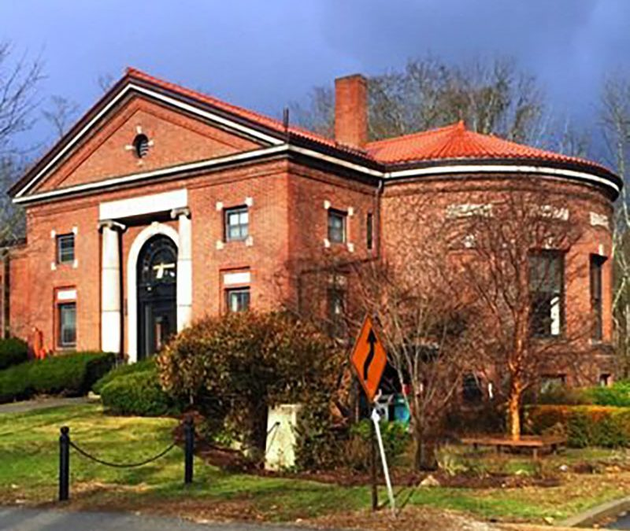
Libraries
Libraries are the heart of every community; libraries are welcoming spaces that bring communities together to enjoy a variety of activities for all ages.
https://georgialibraries.org/nlw2024/

Slide 4
Agenda
Adult literacy in the United States: Program for the International Assessment of Adult Competencies (PIAAC)
  Activity: Examples from Georgia
Adult education in the United States: Federal, state, and community level programming
  Activity: Programs in Georgia communities
Library services for adults with foundational skill needs
  Examples from the District of Columbia
  Activity: Examples and possibilities in Georgia

Slide 5
Literacy Skill Levels of U.S. Adults
More than half (54 percent) of adults in the United States function with literacy skills at or below the equivalent of the sixth grade level.
Nearly one in five adults (approximately 43 million) function with literacy skills at or below the equivalent of the third grade level.

Slide 6
The Program for the International Assessment of Adult Competencies (PIAAC)
PIAAC is an international large-scale assessment administered in 2011-12 in 24 countries including the United States
Organized by the Organization for Economic Cooperation & Development (OECD)
It assessed 16 - to 65-year-olds residing in each country, irrespective of nationality, citizenship, or language status
Administered to a sample of about 5,000 adults on either laptop computer or paper-and-pencil
In 2013-14, the U.S. supplemented its original sample with 3,660 more adults, oversampling unemployed adults (ages 16-65), young adults (ages 16-34), and older adults (ages 66-74)
In 2017, the U.S. conducted a third round of data collection
New data coming at end of 2024
Sources: https://www.piaacgateway.com/what-is-piaacupdated; https://nces.ed.gov/surveys/piaac/national_results.asp

Slide 7
PIAAC Data Collection
Background Questionnaire
  Education and training, present and past
  Work experience
  Literacy, numeracy and ICT skill use at work and at home
  Other 21st century skills used at work
  Personal traits and background information
Module on skill use: cognitive skills, interaction and social skills, learning skills, physical skills
Assessment of skills: literacy, numeracy, digital problem solving
Sources: https://www.piaacgateway.com/what-is-piaacupdated; https://nces.ed.gov/surveys/piaac/national_results.asp

Slide 8
Definitions of PIAAC Direct Assessment Subjects
Literacy is understanding, evaluating, using and engaging with written texts to participate in society, to achieve one’s goals, and to develop one’s knowledge and potential.
Numeracy is the ability to access, use, interpret, and communicate mathematical information and ideas, in order to engage in and manage the mathematical demands of a range of situations in adult life.
Problem solving in technology-rich environments involves using digital technology, communication tools and networks to acquire and evaluate information, communicate with others and perform practical tasks.
Sources: https://www.piaacgateway.com/what-is-piaacupdated; https://nces.ed.gov/surveys/piaac/national_results.asp

Slide 9
PIAAC Reporting for Literacy
500 point scale with 6 levels, from Below Level 1 to Level 5
Test items at all levels drawn from real-world materials and tasks
For full descriptions of the task types at each level, see https://nces.ed.gov/surveys/piaac/measure.asp
For sample items at each level, see https://nces.ed.gov/surveys/ piaac/measure.asp?section=1&sub_section=5
For research reports, see https://www.piaacgateway.com/researchpapers
Source: https://nces.ed.gov/surveys/piaac/measure.asp

Slide 10
Both more books growing up and education of the parents are associated with higher literacy skills.
500
//
//
0
NOTE: All differences between parental education levels within a category of number of books in the home are significant (p < .05).
Notes:
NOTE: All differences between parental education levels within a category of number of books in the home are significant (p < .05).
Below 1: 0=175
Level 1: 176-225
Level 2: 226-275

Slide 11
PIAAC Literacy – Below Level 1
Below Level 1: The tasks at this level require the respondent to read brief texts on familiar topics to locate a single piece of specific information. There is seldom any competing information in the text, and the requested information is identical in form to information in the question or directive. ... Only basic vocabulary knowledge is required, and the reader is not required to understand the structure of sentences or paragraphs or make use of other text features.
Source: https://nces.ed.gov/surveys/piaac/measure.asp

Slide 12
PIAAC Literacy – Level 1
Level 1: Most of the tasks at this level require the respondent to read relatively short continuous, noncontinuous, or mixed texts in digital or print format to locate a single piece of information that is identical to or synonymous with the information given in the question or directive. ... Little, if any, competing information is present. Some tasks may require simply cycling through more than one piece of information. The respondent is expected to have knowledge and skill in recognizing basic vocabulary, determining the meaning of sentences, and reading paragraphs of text.
Source: https://nces.ed.gov/surveys/piaac/measure.asp

Slide 13
PIAAC Literacy – Level 2
Level 2: At this level, texts may be presented in a digital or print medium and may comprise continuous, noncontinuous, or mixed types. Tasks at this level require respondents to make matches between the text and information and may require paraphrasing or low-level inferences. Some competing pieces of information may be present.
Source: https://nces.ed.gov/surveys/piaac/measure.asp

Slide 14
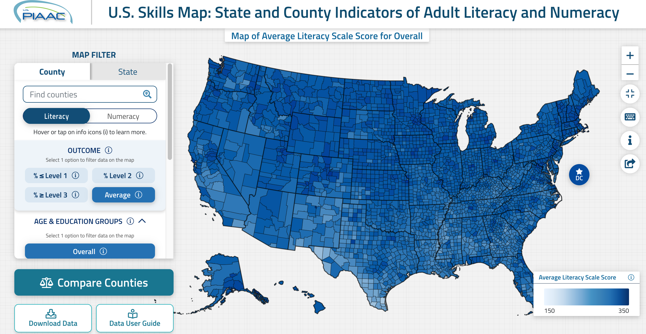
The PIAAC Skills Map – Average Literacy
Source: https://nces.ed.gov/surveys/piaac/skillsmap/

Slide 15
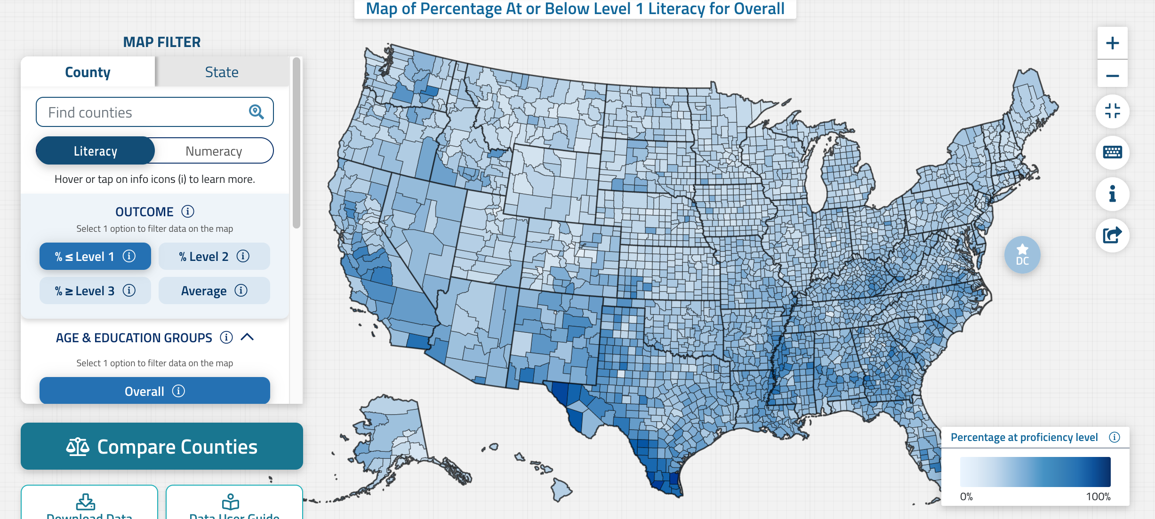
The PIAAC Skills Map – Literacy Level 1
Source: https://nces.ed.gov/surveys/piaac/skillsmap/

Slide 16
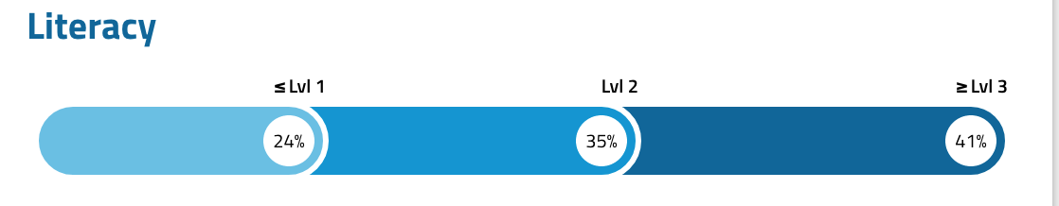
PIAAC Literacy: Georgia
Population: 11,029,227 as of July 1, 2023
24% = 2,647,014 35% = 3,860,229 41% = 4,521,983
Sources: https://www.census.gov/quickfacts/fact/table/GA; https://nces.ed.gov/surveys/piaac/skillsmap/

Slide 17
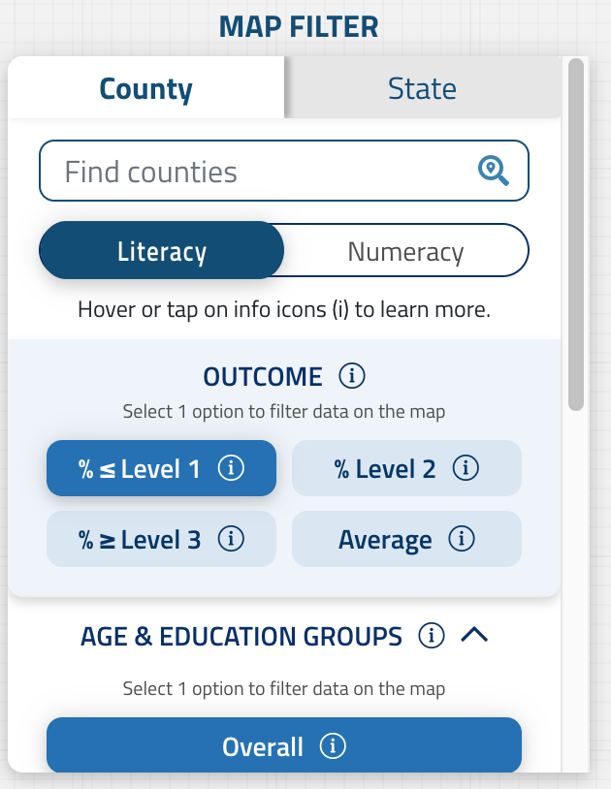
Using the PIAAC Skills Map – Georgia
Go to https://nces.ed.gov/surveys/piaac/skillsmap/
In the map filter on the left, select County, Literacy, and Level 1
In the “Find Counties” box, type in the name of your county
Mouse over the highlighted county to see what percentage of people have this literacy level
Enter your county name and the percent in the chat
Source: https://nces.ed.gov/surveys/piaac/skillsmap/

Slide 18
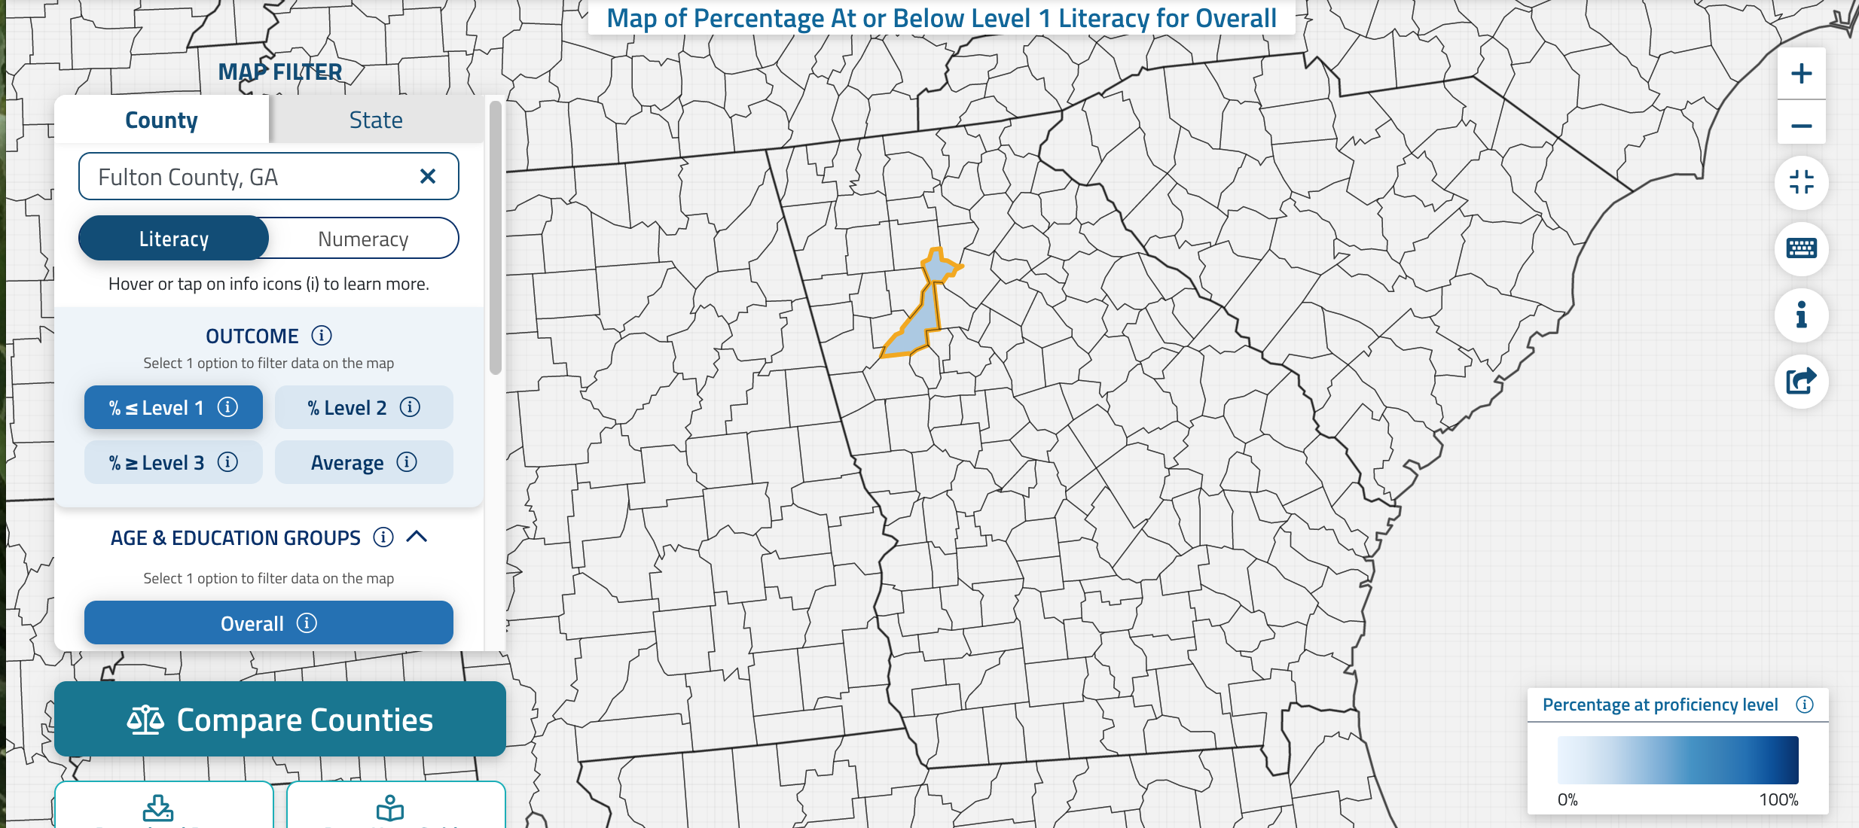
PIAAC Skills Map – Example for Fulton County
Source: https://nces.ed.gov/surveys/piaac/skillsmap/

Slide 19
Questions for Consideration
Why do so many adults have low literacy levels?
Why is ongoing educational opportunity important for these individuals?
What kinds of opportunities are available for them?
What kinds of opportunities work best for them?
Put your answers in the chat.

Slide 20
The Federal Adult Education System
Adult Education and Family Literacy Act (AEFLA), Title II of the Workforce Innovation and Opportunity Act of 2014 (WIOA)
Administered by Department of Education, Office of Career, Technical, and Adult Education (OCTAE), Division of Adult Education and Literacy (DAEL)
“Supports programs that help adults get the basic skills they need including reading, writing, math, English language proficiency, and problem-solving to be productive workers, family members, and citizens.”
Outcomes measured in terms of progress toward college and career objectives through the National Reporting System (NRS).
  Sources: https://aefla.ed.gov/; https://www2.ed.gov/about/offices/list/ovae/pi/AdultEd/index.htm

Slide 21

The Federal Adult Education System
Types of programming:
Adult education
Literacy
English language acquisition
Workplace literacy
Family literacy
Integrated Education & Training (IET)
Integrated English Literacy and Civics Education (IELCE)
  Sources: https://aefla.ed.gov/; https://www2.ed.gov/about/offices/list/ovae/pi/AdultEd/index.htm

Slide 22
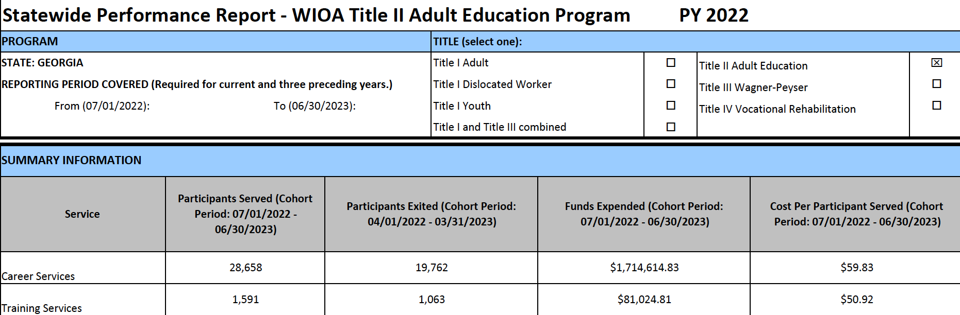
Participation in Federally Funded Programs: Georgia
Source: https://www2.ed.gov/about/offices/list/ovae/pi/AdultEd/accountability-reporting.html

Slide 23
Need v. Participation in Georgia
24% = 2,647,014 35% = 3,860,229 41% = 4,521,983
Participants per National Reporting System
Career Services: 28,658
Training Services: 1,591

Slide 24
Adult Literacy in Georgia
From the Georgia Council on Literacy Speakers’ Bureau Talking Points:
A 2017 Deloitte study found that over 1 million adults are low literate.
Low literacy is a generational cycle. If these adults have children, they are less likely to read to their children and those children will not receive the language nutrition they need as developing young learners. And the cycle continues.
The Deloitte study also found that low literacy costs Georgia $1.3 billion annually in lost revenue and social services.
As Georgia’s hospitality and restaurant business is replaced with AI and robotics, we have increased needs for literate adults for the workforce.
Source: https://gosa.georgia.gov/georgia-council-literacy

Slide 25
Adult Education in Georgia
Provided through the Technical College System of Georgia
  If you didn’t finish high school, we offer free classes to help you prepare to take the GED test or HiSET exam. We also offer free English as a Second Language (ESL) classes. These free classes help thousands of Georgians each year learn the skills needed to complete their high school equivalency (GED/HiSET), attain citizenship, go to college, or find a job. There are multiple options to earn your high school equivalency at one of our programs across Georgia. GED and HiSET testing scholarships are available for those who qualify.
Source: https://www.tcsg.edu/adult-education/

Slide 26
Certified Literate Community Program
CLCPs are under the administration of the Office of Adult Education at the Technical College System of Georgia (TCSG). Georgia is an educational innovator with its utilization of CLCPs to improve adult literacy rates.
CLCPs bring together stakeholders across the community to form a network of volunteers, local governments, school districts, faith-based organizations, business, and industry leaders to improve literacy rates in their shared community. Most CLCPs are non-profit organizations whose mission is to improve adult literacy. The Technical College System of Georgia approves CLCPs on a 4-year cycle.
Source: https://www.tcsg.edu/adult-education/adult-education-certified-literate-community-program/

Slide 27
Adult Education in Georgia
Find an adult education provider in your area or county:
Adult Education Program Directory https://www.tcsg.edu/adult-education/adult-education-students-test-takers/adult-education-program-directory/ [online]
CLCP directory https://www.tcsg.edu/adult-education/adult-education-certified-literate-community-program/clcp-directory/ [downloadable pdf]
Note what services it provides and list them in the chat.

Slide 28

Adult Learners: Challenges
Prior negative experience with the educational system
Low sense of self-efficacy
Fixed mindset (vs. growth mindset)
Unrecognized/undiagnosed reading or learning issues
Time, access, and financial obstacles
Conflicting priorities

Slide 29

Adult Education in Georgia Libraries
Fulton County: https://www.fulcolibrary.org/resources/adultlearn/
Cobb County: https://www.cobbcounty.org/library/learning-programs/adults
DeKalb County: https://dekalblibrary.org/using-the-library/literacy/adult-basic-education
Fayette County: https://fayettecountyga.gov/public_library/adult-programs

Slide 30
Example: Adult Education in DC Libraries
Digital Certifications: Free digital certifications in Microsoft, Northstar, Google modules
GED Prep: Individualized GED and high school skills tutoring for adult learners, and the GED Ready Practice Test
Adult Literacy: Book discussions and information about DC adult literacy programs
Tutoring: GED and CASAS tutoring in person
ESL Groups: English Conversation Circles for those looking to improve their speaking and listening skills; Citizenship Classes for those looking to pass the US Citizenship Exam
Computer Classes: A wide range of computer classes
Digital navigators: One-on-one tech support at DC Public Library
Source: https://www.dclibrary.org/using-the-library

Slide 31
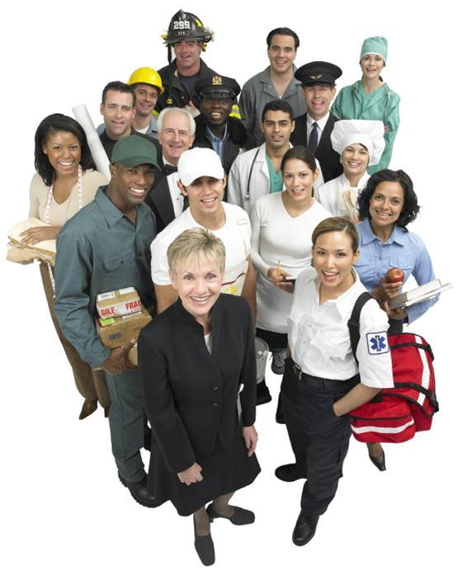
Adult Learners: Strengths and Assets
Experience: family, work, life
Knowledge: how to do things, how the world works
Social capital and community connections
Motivation: extrinsic, intrinsic
Reference: Norma Gonzalez, Luis C. Moll, and Cathy Armanti. Funds of Knowledge. Routledge, 2005.

Slide 32
Challenge and Potential
Libraries provide an environment that encourages adults to explore options and possibilities in their own ways.
They can pursue specific objectives related to their education and their participation in the workforce
They can broaden and deepen their understanding in areas central to success in everyday life, such as health literacy, financial literacy, and civic participation
They can discover areas of knowledge and experience that will increase their quality of life

Slide 33

Thank You!
Deborah Kennedy
Deborah.kennedy@key-words.us
https://www.nationalcoalitionforliteracy.org

