Slide 1
Introduction to GALILEO
Getting to know Georgia’s Virtual Library
Russell Palmer
Assistant Director, GALILEO Support Services
russell.palmer@usg.edu

Slide 3
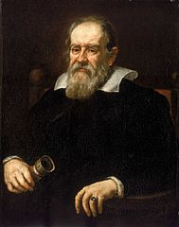
Pulling back the curtain
GALILEO is part of the Library Services division of the Board of Regents of the University System of Georgia
Staffed by library and technology professionals who coordinate:
Direction, vision, content
Programming and development
Support and training
Outreach and assessment

Slide 4
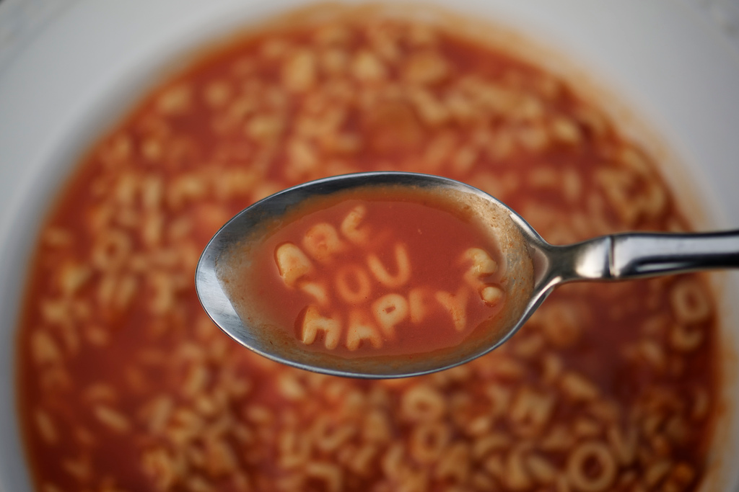
Stirring up the alphabet soup
Affordable Learning Georgia (ALG)
GALILEO Knowledge Repository (GKR)
New Georgia Encyclopedia (NGE)
Digital Library of Georgia (DLG)
GALILEO Interconnected Libraries (GIL)

Slide 5
Today’s focus: GALILEO basics
Go to: galileo.usg.edu

Slide 6
Navigation basics
Discover Search (Search lots of resources at once)
Discover Search Resource linking (Find full text)
A-Z Lists (Databases, Publications)
Browse by subject
Browse by Type of resource (Almanac, Encyclopedia, etc.)
Help!? & Support Services

Slide 7
Discover Search, browsing options

Slide 8
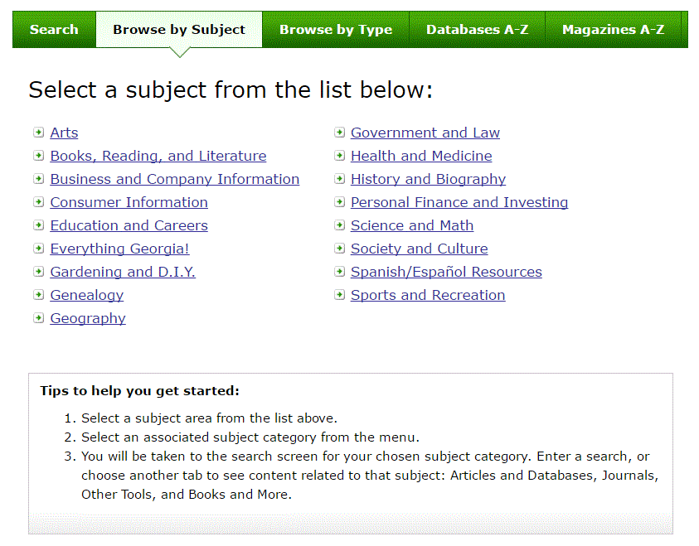

Slide 10
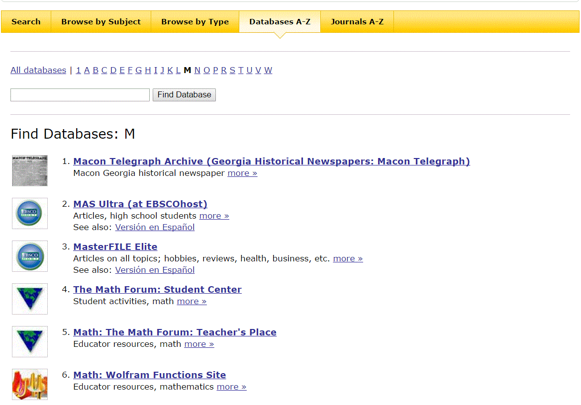
Databases A-Z

Slide 11
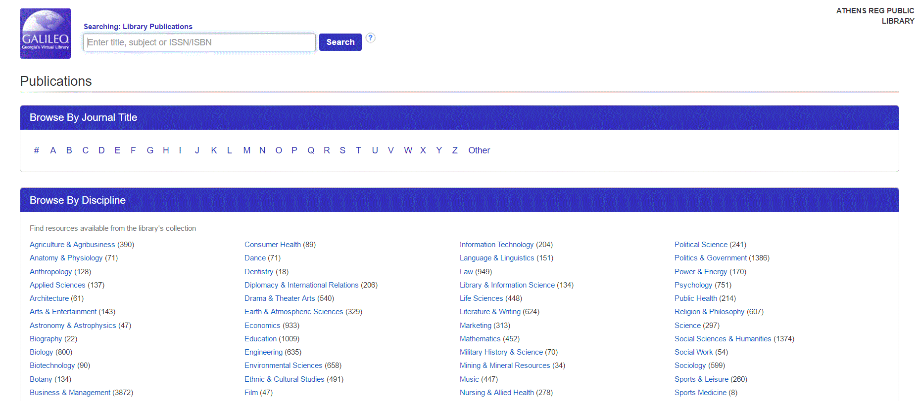
Magazines A-Z

Slide 12
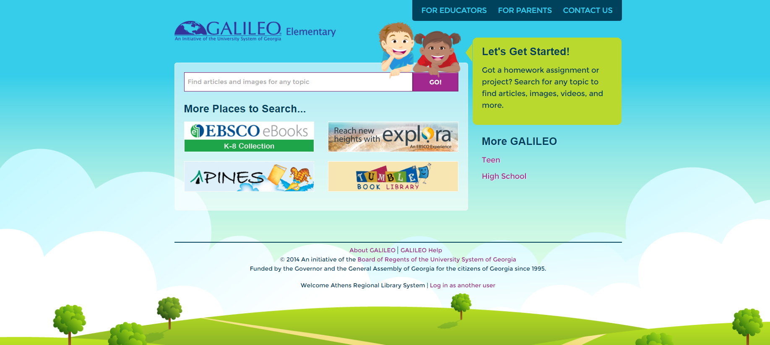
GALILEO Interfaces
Scholar
Kids
Book Collection: Nonfiction
Britannica School Elementary
Funk and Wagnall’s New World Encyclopedia
History Reference Center
Primary Search
High School
15 databases (ebooks, articles, encyclopedias and more)
Teen (Middle School)
20+ databases (ebooks, articles, encyclopedias, and more)

Slide 13
Database suggestions: general content
Magazines, research articles (scholarly), photographs and more:
Academic Search Complete (Academic, Public)
Explora (K12)

Slide 14
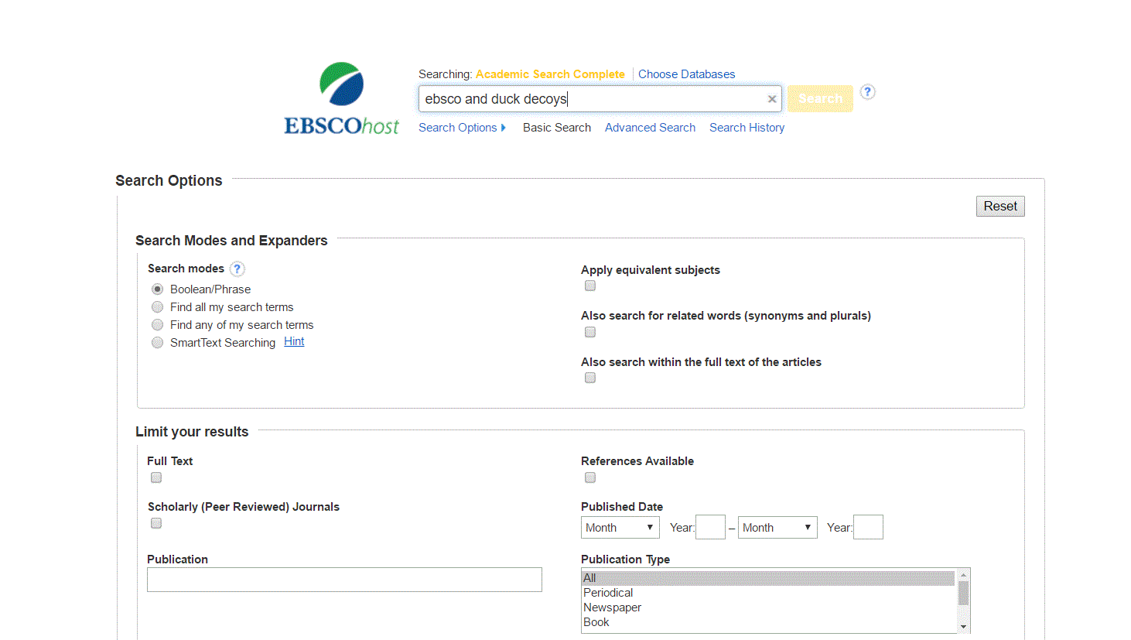
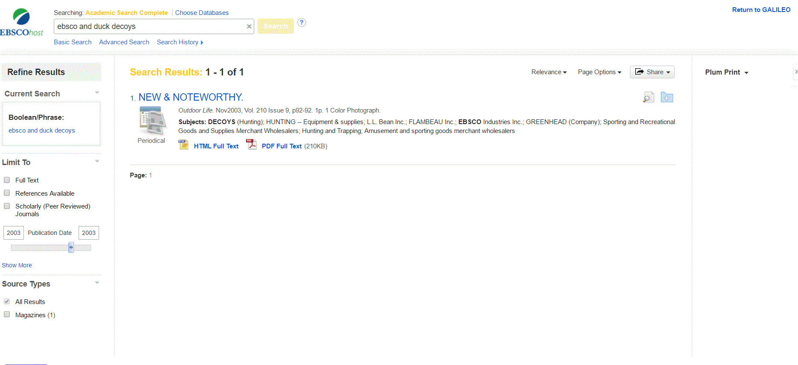

Slide 15
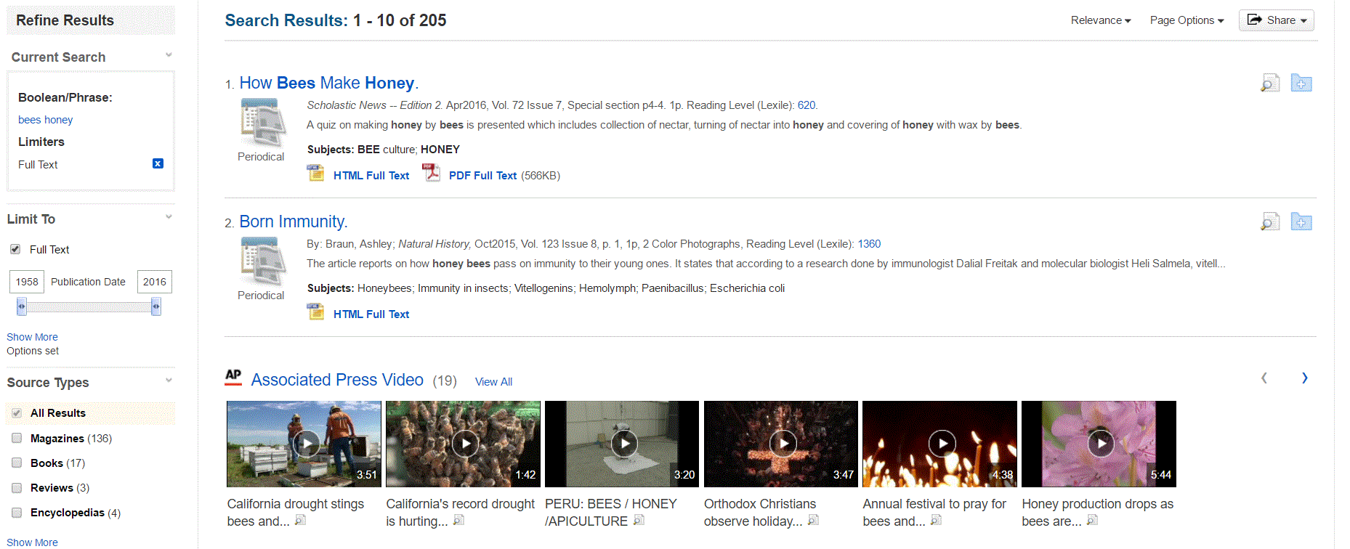

Slide 16
GALILEO offers eBooks!
Collections for all ages
EBSCO e-book Library (A variety of collections)
Ebrary (focus is on academic non-fiction)
Tumblebooks (Children’s books, Public Libraries)
Use on desktop or mobile devices

Slide 17
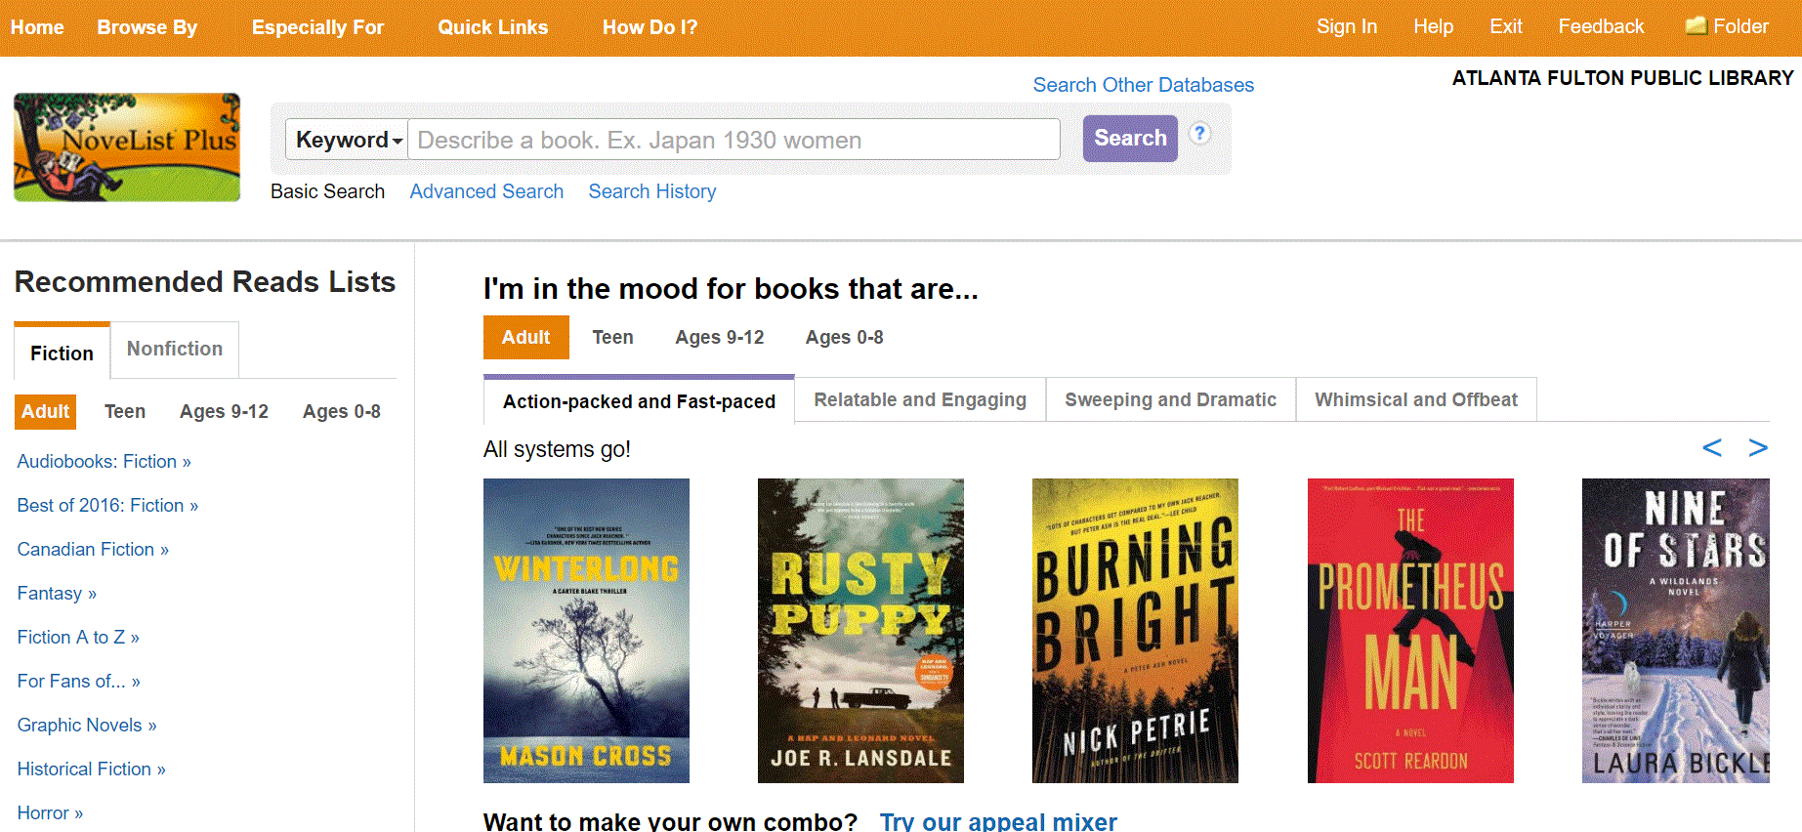
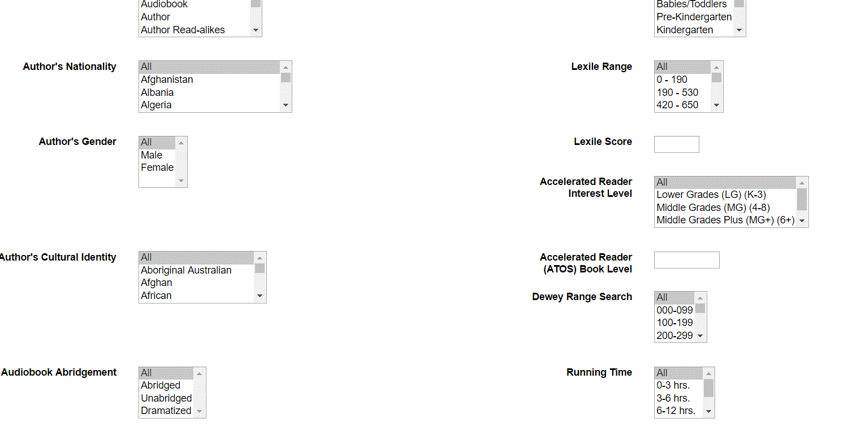
Reader’s advisory

Slide 18
Primary documents and genealogy
Digital Library of Georgia
Ancestry
Heritage Quest

Slide 19
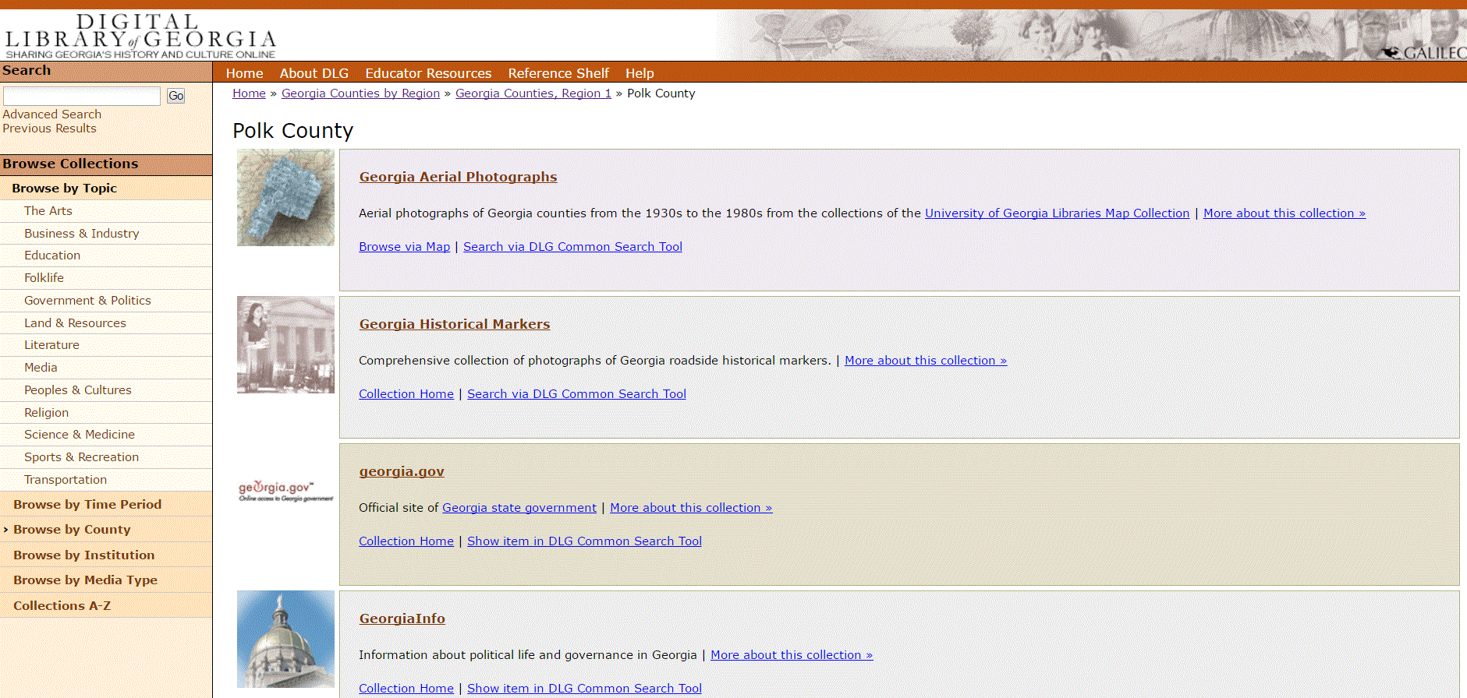

Slide 20
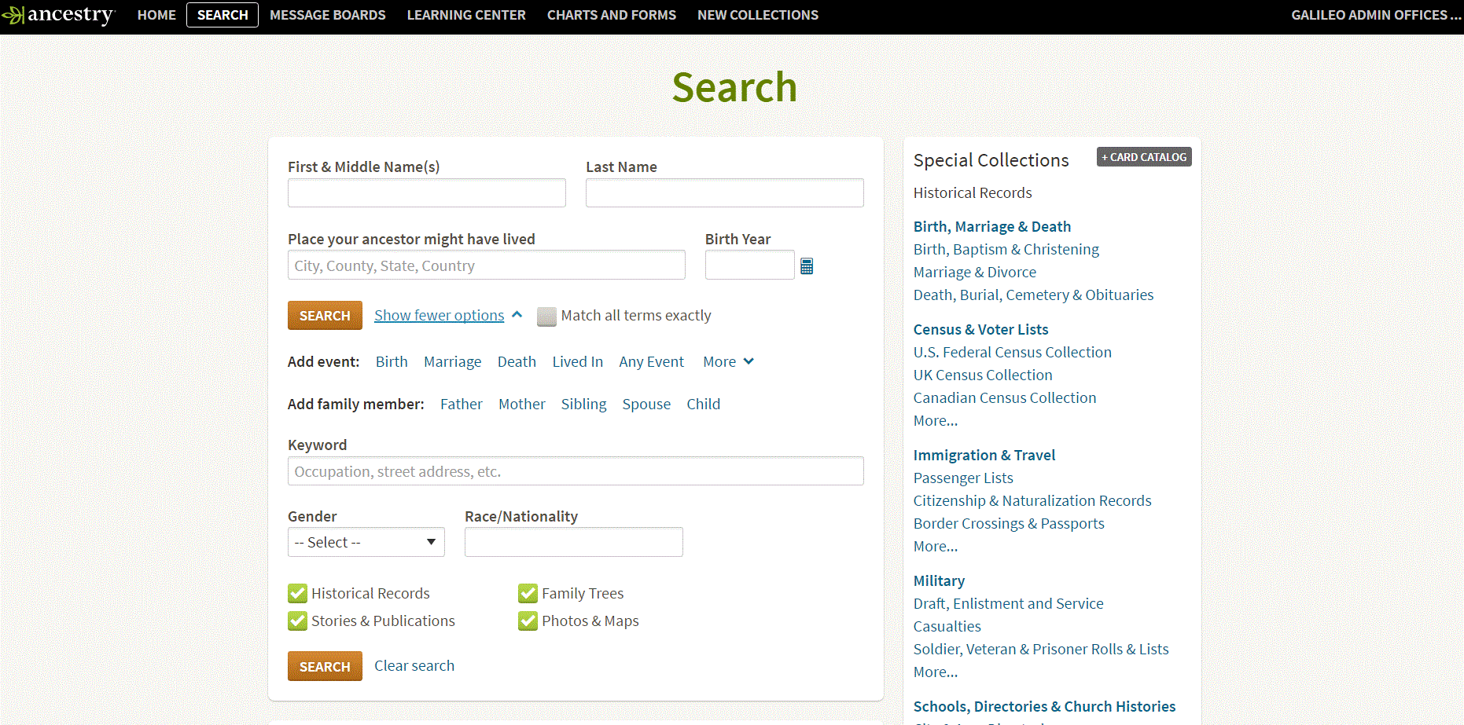

Slide 21
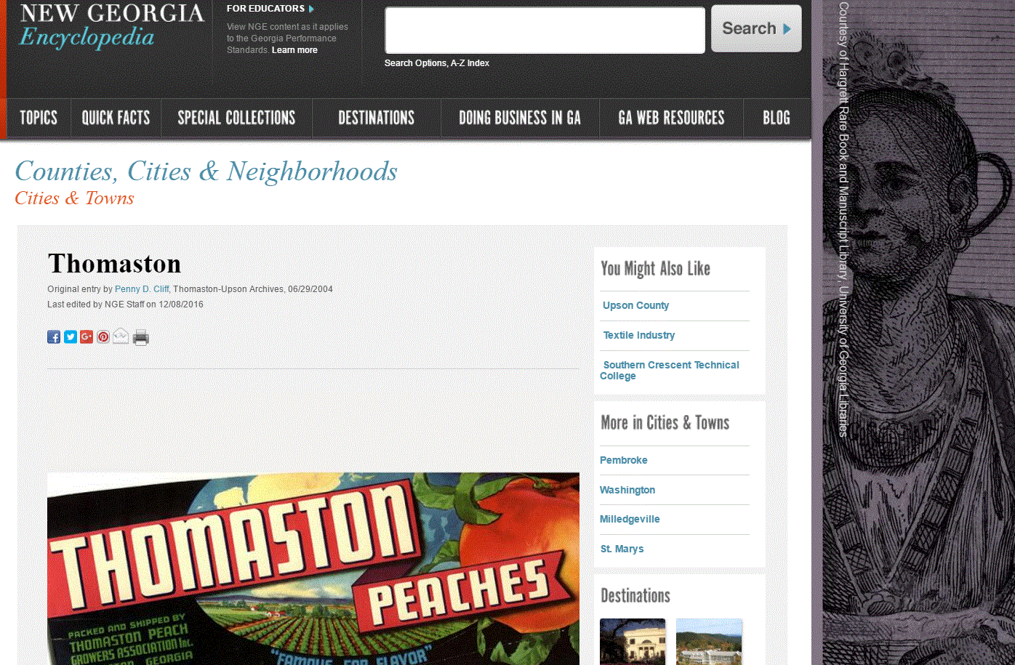

Slide 22
New This Year
GALE Legal Forms
Tumblebooks
EBSCO Learning Express Placards
Research Starters

Slide 23
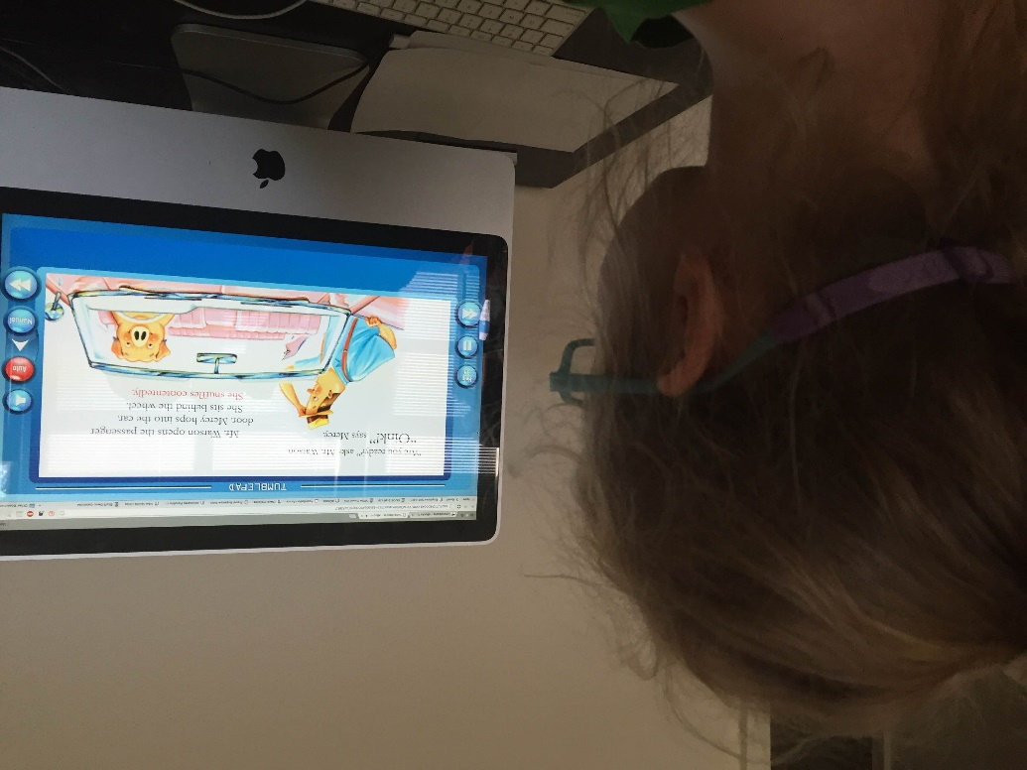
TumbleBooks
TumbleBooks (Public Libraries)
Over 1,000 titles for grades K-6
Animated talking picture books
Chapter books
Books in other languages
Videos
TumbleBooks app*

Slide 24
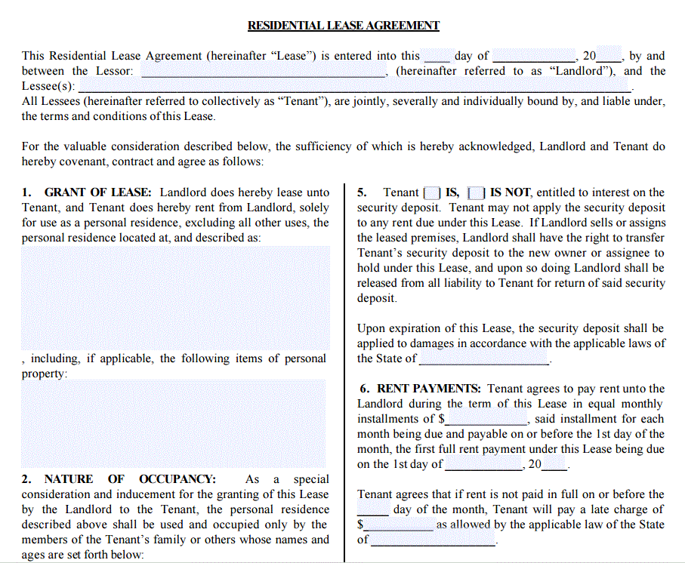
Gale Legal Forms

Slide 25
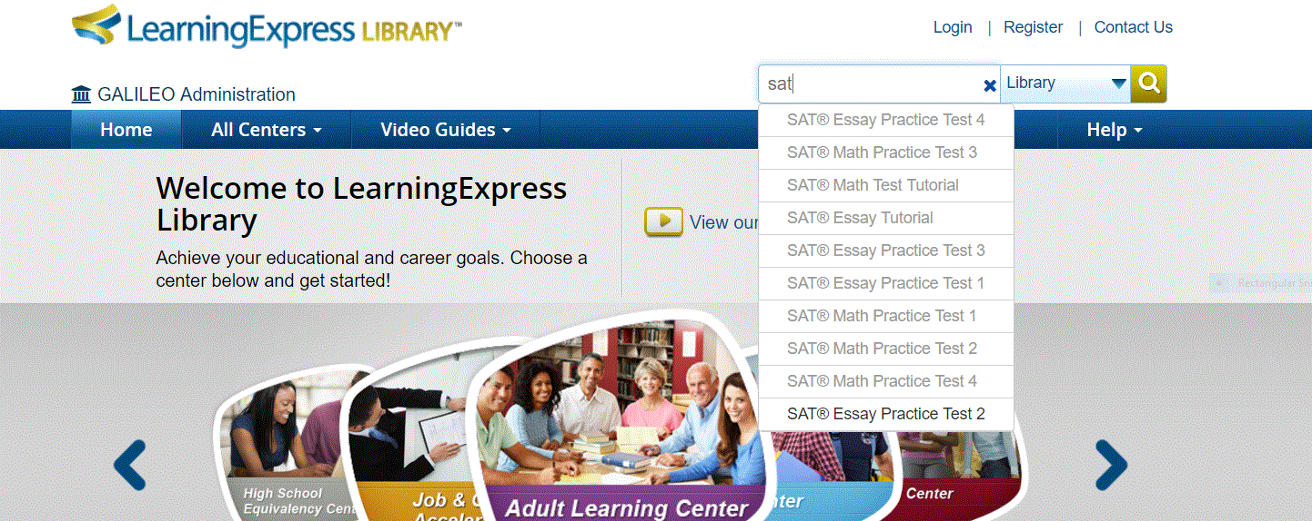
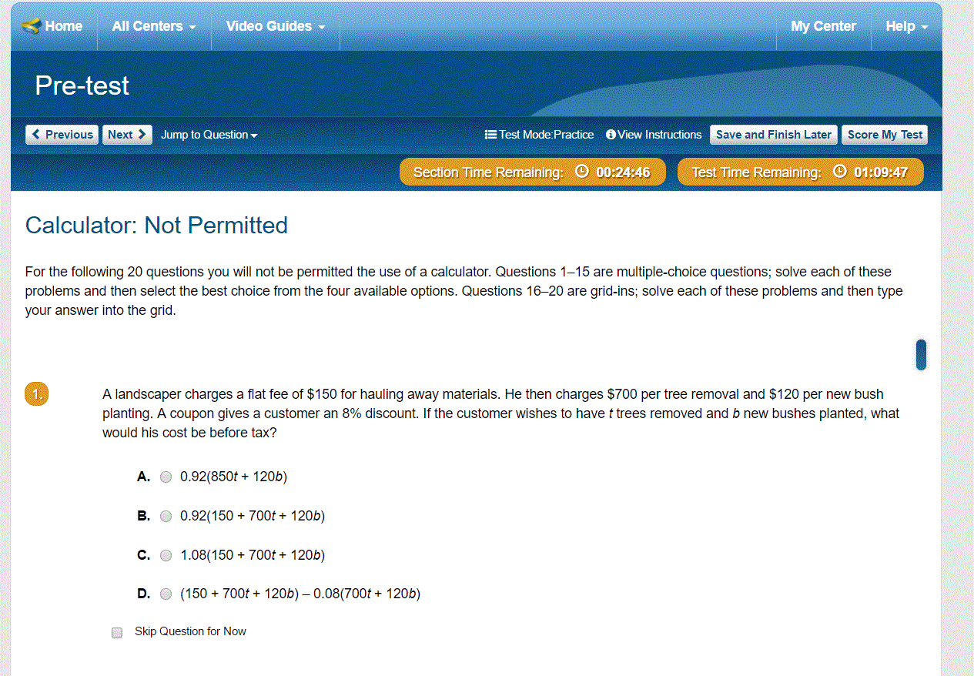
LearningExpress Library placards in EBSCO Discover Search

Slide 26
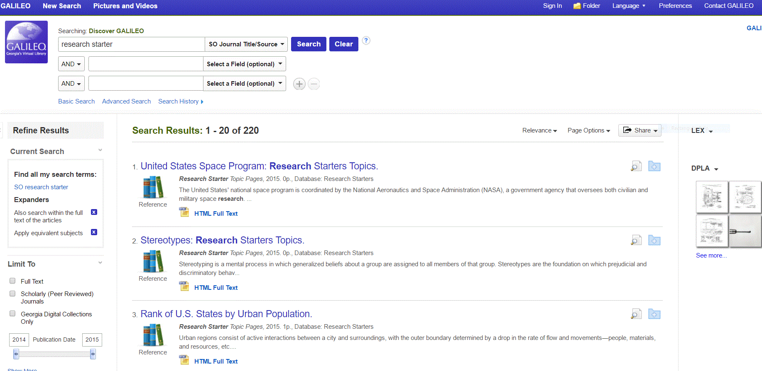
Research Starters

Slide 27
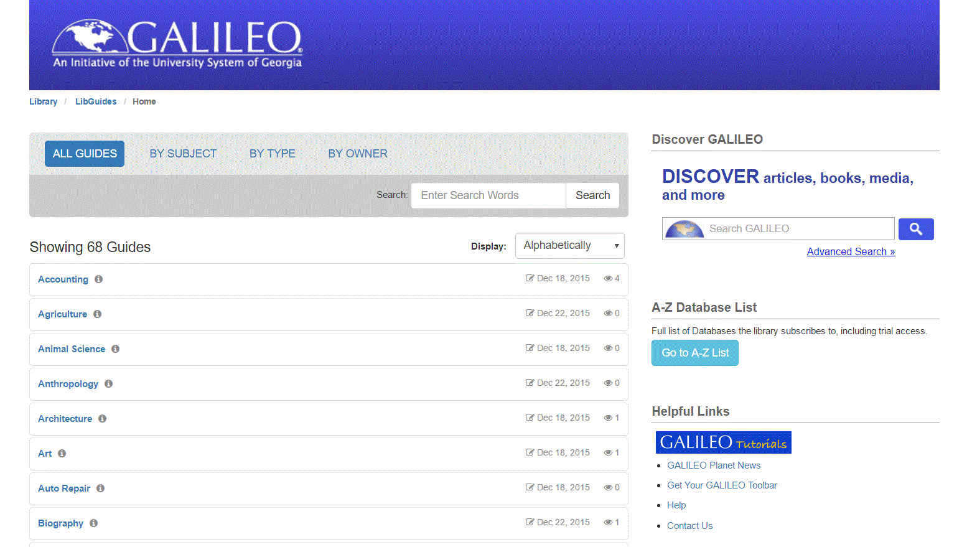
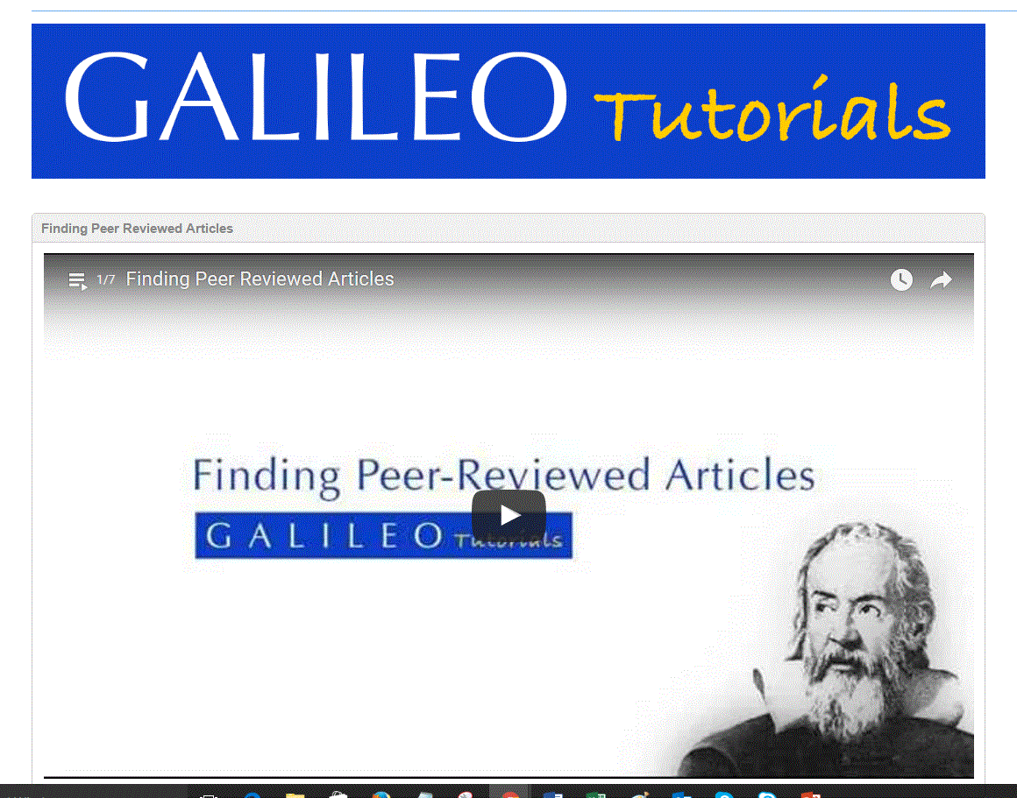
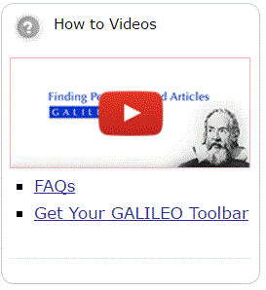
Need help? We have upgraded LibGuides (2.0) and added video tutorials
libguides.galileo.usg.edu

Slide 28
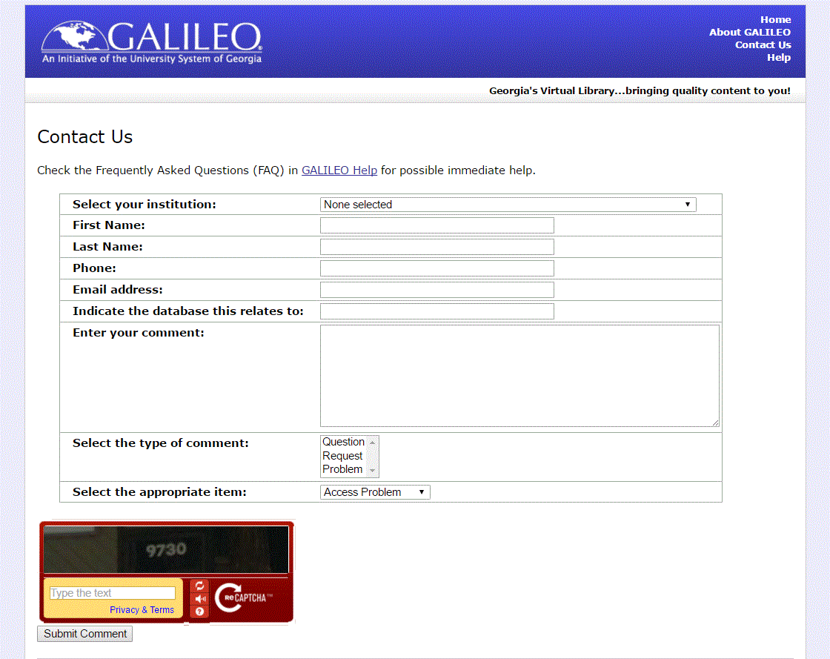
We are here for you!
GALILEO Support Services

Slide 29
Marketing GALILEO
GALILEO Library Marketing Tool Kit
Facts and Figures
Handouts and Fliers
Templates for press releases
Available here:
http://about.galileo.usg.edu/site/library_marketing_toolkit

Slide 30
General marketing strategy
Message: resources + services
Audience and partnerships: Friends, schools, local clubs and organizations
Focus less on “what is it?” and more on “what can it do?” and “What’s in it?”

Slide 31
Use marketing materials provided by vendors
Examples:
LearningExpress materials at: http://www.learningexpresshub.com/librarian-resources/library-resources
Tumblebooks materials: From Tumblebooks in GALILEO, click on the green Tumble Admin button on the bottom right of the page
Mango Languages:
http://www.promotemango.com/RetailSite.asp
Mango Marketplace-order materials, but we need to create an admin account for you (let us know)
GALILEO ebooks: http://about.galileo.usg.edu/docs/materials_docs/eBookHandout.pdf

Slide 32
GALILEO marketing materials
Forthcoming: “Marketplace” to order handouts, forms, bookmarks, etc.
For now:
Karen Minton, karen.minton@usg.edu

Slide 33
More GALILEO training is available
Our training schedule is updated often
http://help.galileo.usg.edu/librarians/training
Face to face training?
russell.palmer@usg.edu

Slide 34
Thank you!
Q&A Time

