Slide 1
GALILEO Update: GPALS
October 28, 2016

Slide 2
Agenda
Visioning and Strategic Planning: A Partnership Begins
Lucy Harrison, Assistant Vice Chancellor for Academic Library Services and Executive Director of GALILEO
GALILEO’s 21st Year
Russell Palmer, Assistant Director, GALILEO Support Services

Slide 3
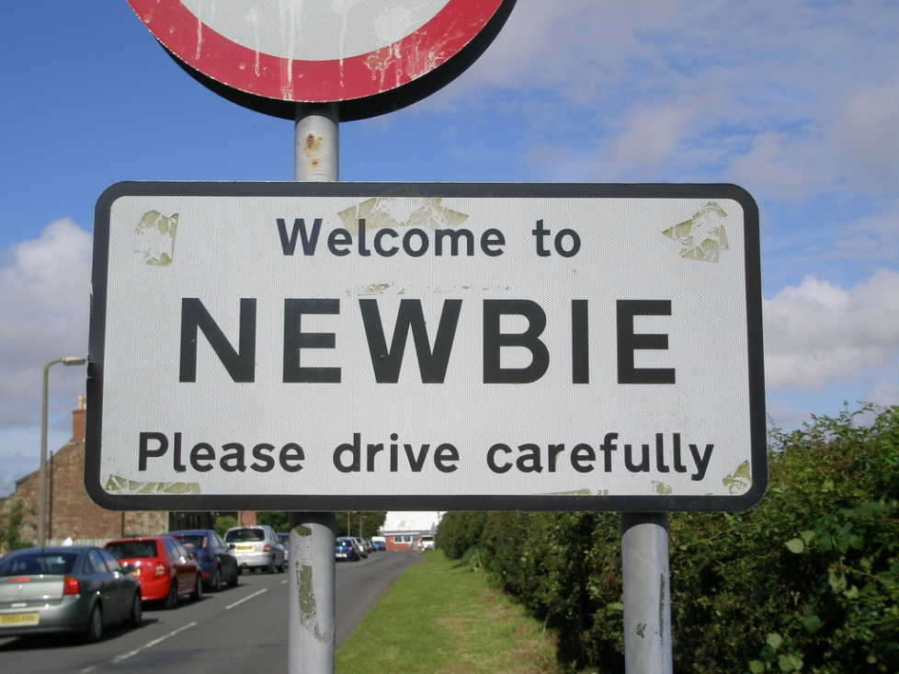
New GALILEO Staff
Lucy Harrison, Assistant Vice Chancellor for Academic Library Services and Executive Director of GALILEO
Jeff Gallant, Program Manager, Affordable Learning Georgia
Russell Palmer, Assistant Director, GALILEO Support Services

Slide 4
Visioning and Strategic Planning: A Partnership Begins
October 5, 2016

Slide 5
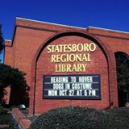
Listening & Learning

Slide 6
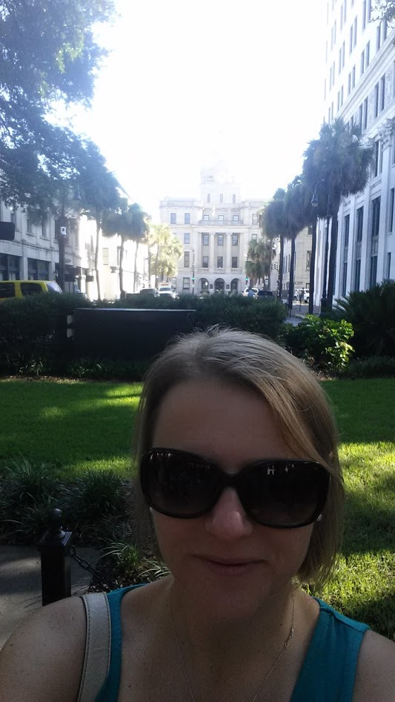
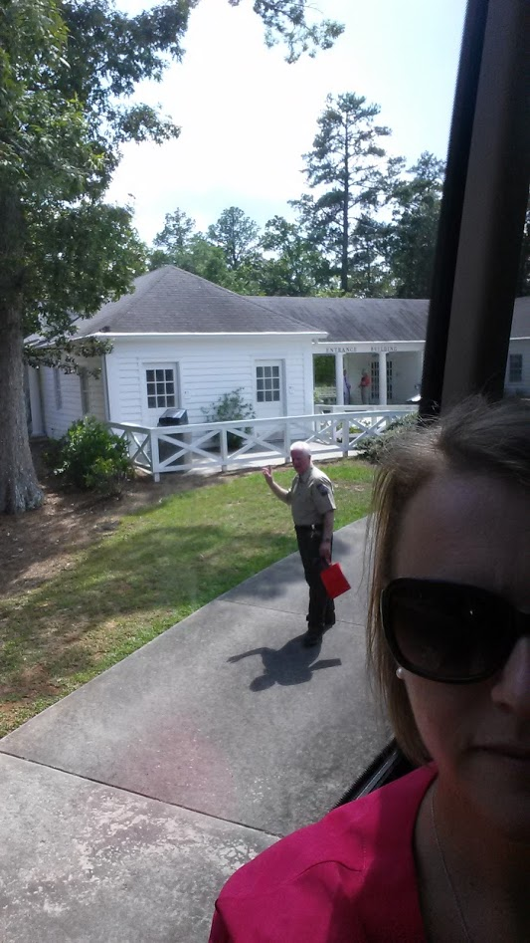

Slide 7
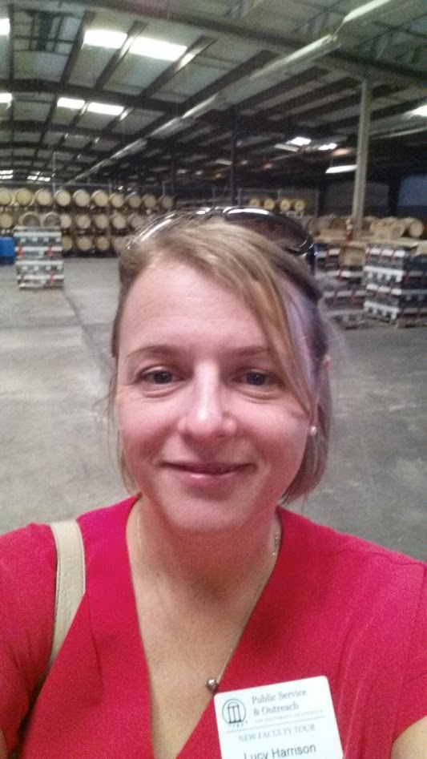
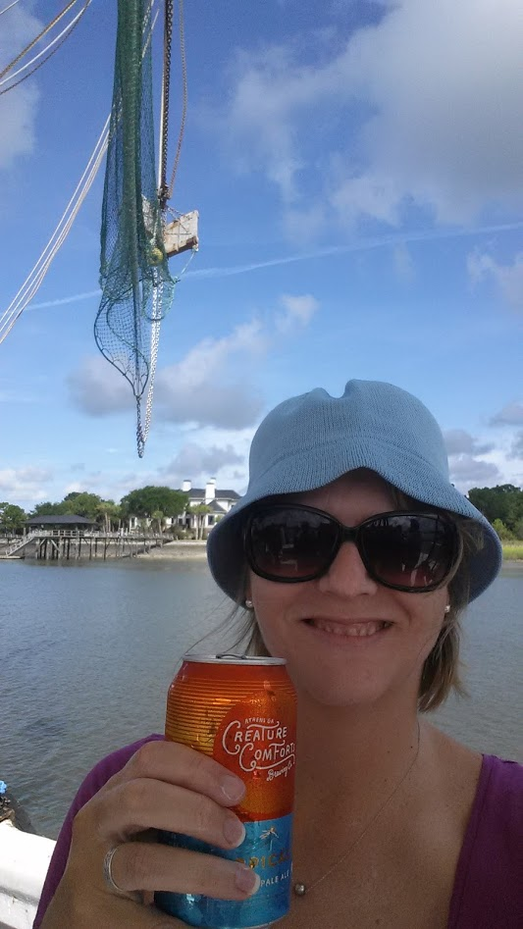

Slide 8
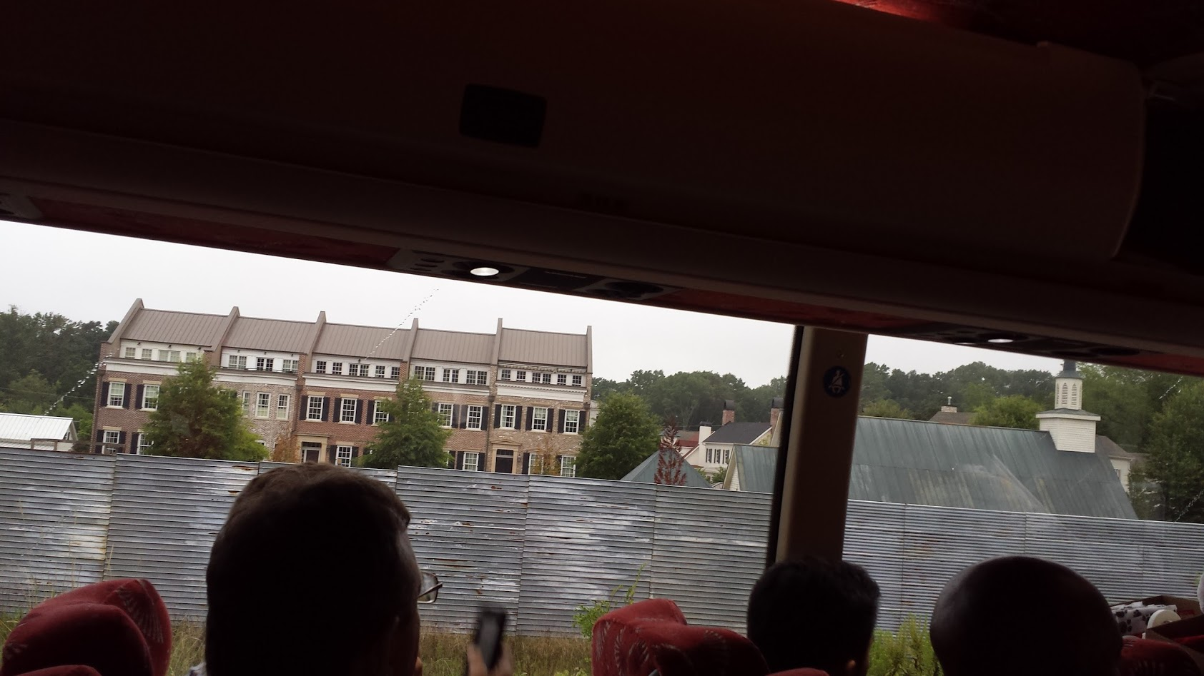

Slide 9
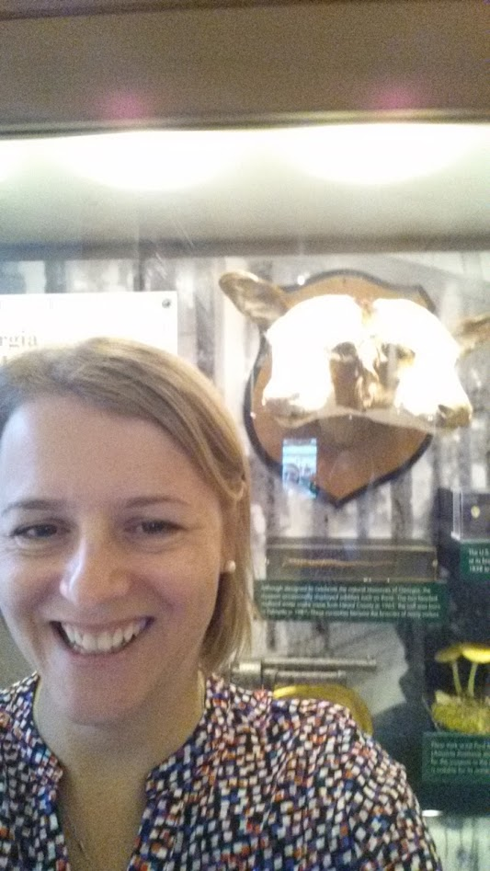
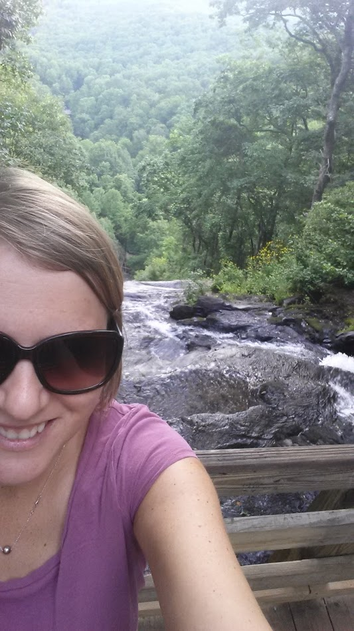

Slide 10
Listening and Learning
Touring libraries
GALILEO Annual Survey
User Group Meeting
124 attendees
Very positive feedback
Save the date: June 15 (GUGM) and June 16, 2017
GALILEO Newsletter

Slide 11
Future Plans
Listen and learn
Vision for GALILEO

Slide 12
Vision Framework
Core Ideology
Purpose / Mission
Values

Slide 13
Excellence
Passion
Funding

Slide 14
Vision Framework
Core Ideology
Purpose / Mission
Values
Envisioned Future
10 - 25 year “BHAG”
Vivid Description
Exciting, Clear, Compelling, and Easy to Grasp
Supported by all

Slide 19
Year of Visioning
Kickoff at RACL November 15
Up to 7 “listening sessions” (USG, TCSG, GPLS, K-12, AMPALS, GPALS, GISA, GALILEO staff)
Visioning session
Strategic planning session
Operational planning session
GALILEO User Group Meeting
Develop a new strategic plan to address the need for a big, audacious goal(s) that can guide GALILEO into the next generation and that can serve as a guiding plan towards another incredible vision like the one created in 1994.

Slide 20
Future Plans
Listen and learn
Vision for GALILEO
Might include:
Statewide shared services
Leveraging partnerships and strengths
User-centered
Demonstrating indispensable value
Big, Hairy, Audacious Goal
Additional funding?

Slide 21
Ongoing Work
New Resources
Alma implementation
Affordable Learning Georgia
Georgia Knowledge Repository
Digital Library of Georgia
Discover GALILEO
EBSCO Full Text Finder
LMS Integration
Data Reporting

Slide 22
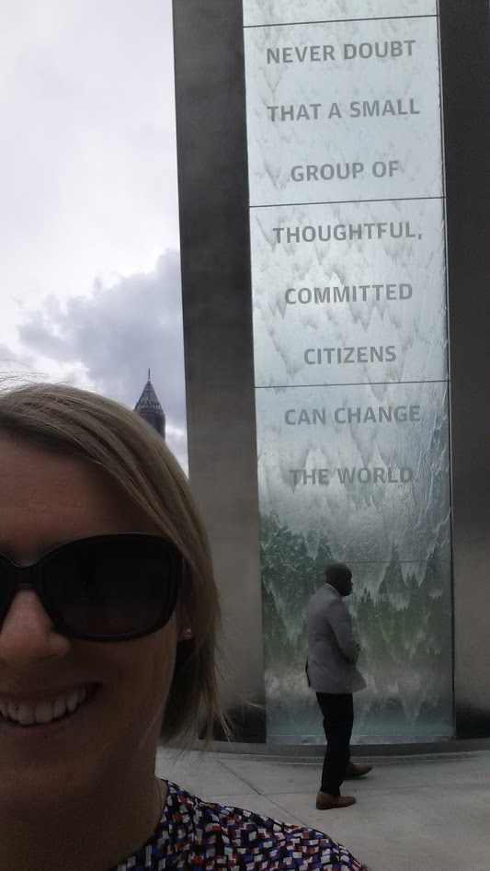

Slide 23
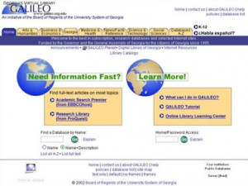
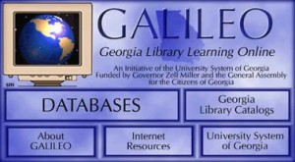
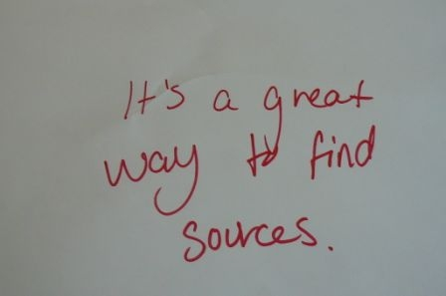
GALILEO’s 21st Year

Slide 24
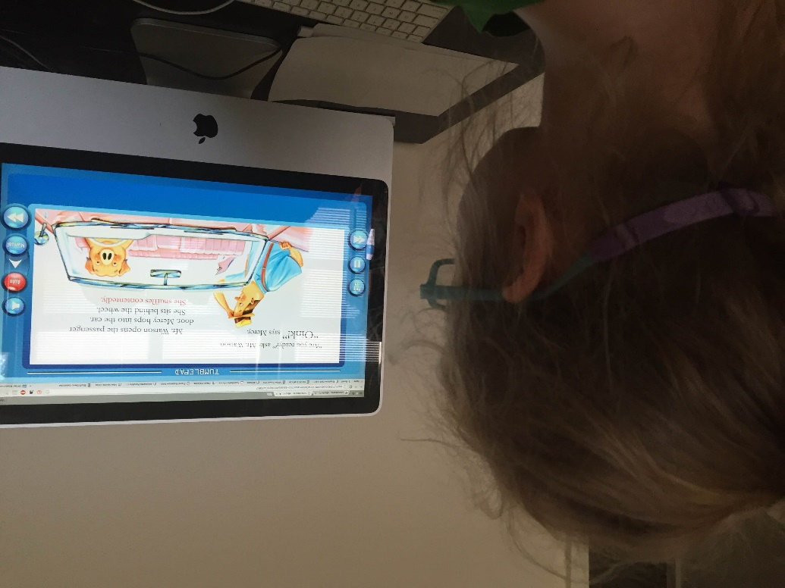
New content: Tumblebooks & ebrary
Tumblebooks (Public Libraries)
More ebrary collections (All GALILEO Users)
Academic Complete
College Complete
Public Library Complete

Slide 25
New content: EBSCO ebooks
More EBSCO ebook collections (ALL GALILEO Users)
eBook (NetLibrary Collections)
eBook Subscription Public Library Collection (North America)
eBook Subscription K-8 Collection
eBook Subscription High School Collection
eBook Community College Collection
Academic eBook Collection (North America)

Slide 26
Discovery improvements
Georgia Knowledge Repository can be added to any institution’s GALILEO discovery search
Learning Management System Integrations continue (BrightSpace/ D2L, Blackboard, MackinVIA)
GALILEO Auto-authentication: 23 institutions in production, 2 in process/testing
Films on Demand: 20 institutions in production, 2 in process/testing
Curriculum Builder 12 in production, 3 in process/testing
Transitioned K12, Private K12, Public, and Private Academic institutions to EBSCO Full Text Finder

Slide 27
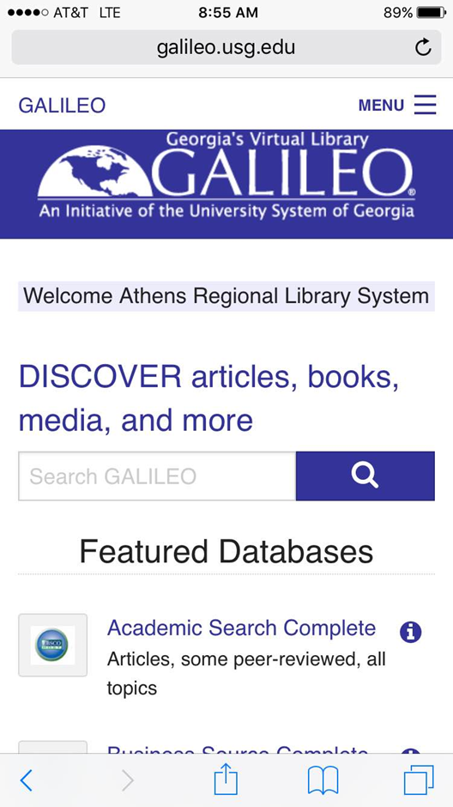
GALILEO for Mobile
Discover GALILEO Search
Provides a mobile friendly set of databases and
featuring:
Encyclopedia Britannica (K12)
EBSCO databases (All)
Tumblebooks (Public Libraries)

Slide 28
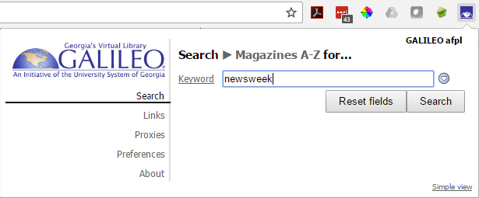
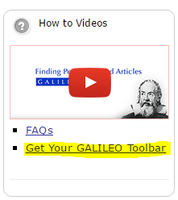
Introducing the new GALILEO Toolbar
An all new look based on the LibX 2.0 platform
Search Discovery, journals, and catalog directly from toolbar
Compatible with Chrome and Firefox browsers
Automatically generates a Find-It button when it detects an ISSN or ISBN on web pages you browse. Great for quickly being able to see if you have access through GALILEO
Download directly from the main GALILEO page.

Slide 29
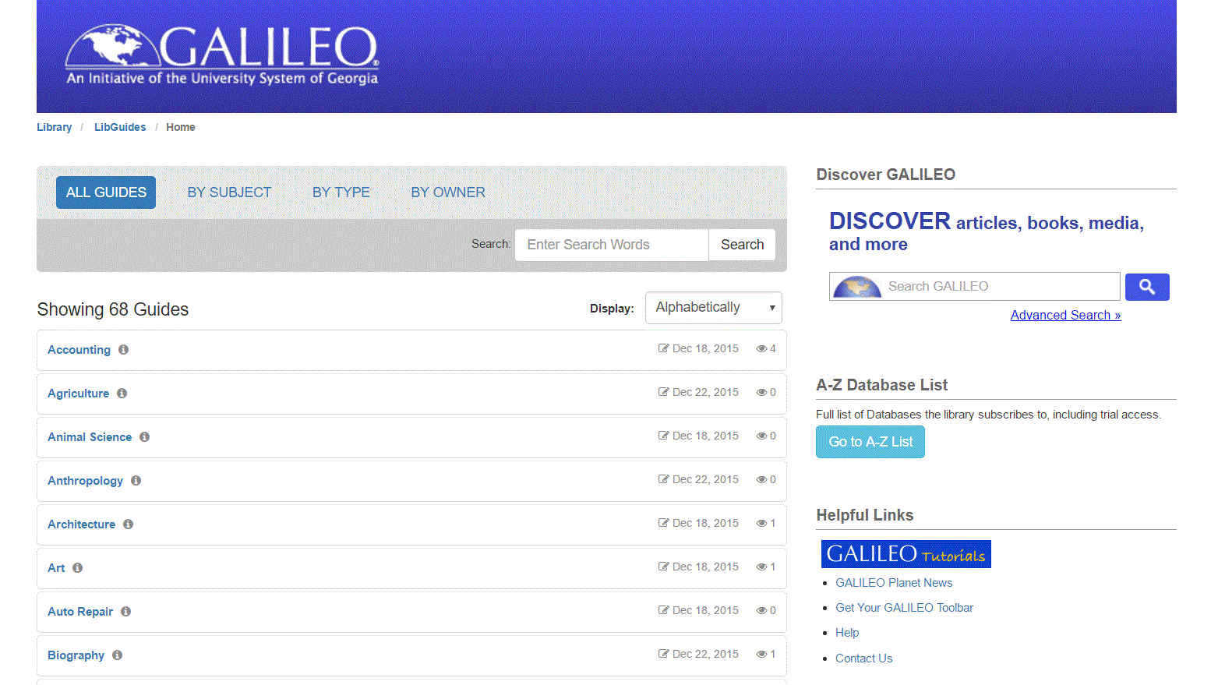
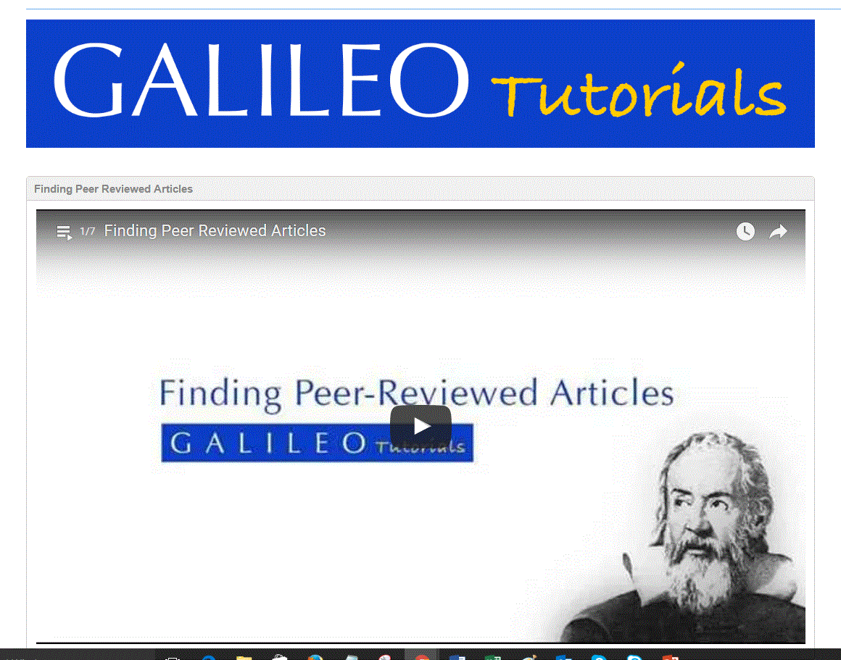
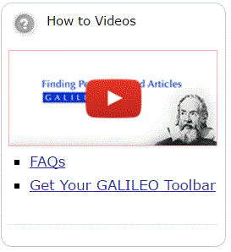
Upgraded LibGuides (2.0) and video tutorials
libguides.galileo.usg.edu

Slide 30
Improved access to usage data
GALILEO Usage Data Reporting Tool now available
http://about.galileo.usg.edu/statistics
GALILEO sessions can now be viewed by authentication method (IP, password)
New vendor data added
Films on Demand
Learning Express
GALILEO Usage Statistics Listserv
Email ken.henslee@usg.edu to be added to the list
Get notifications, updates, and corrections

Slide 32
A New Way to Share: GALILEO Open Learning Materials
GALILEO Open Learning Materials is a new digital repository focused on sharing free and open materials created by University System of Georgia faculty.
http://oer.galileo.usg.edu

Slide 33
Current Collections
22 USG Open Textbooks
57 Grants Collections
26 Ancillary Materials / Material Sets

Slide 34
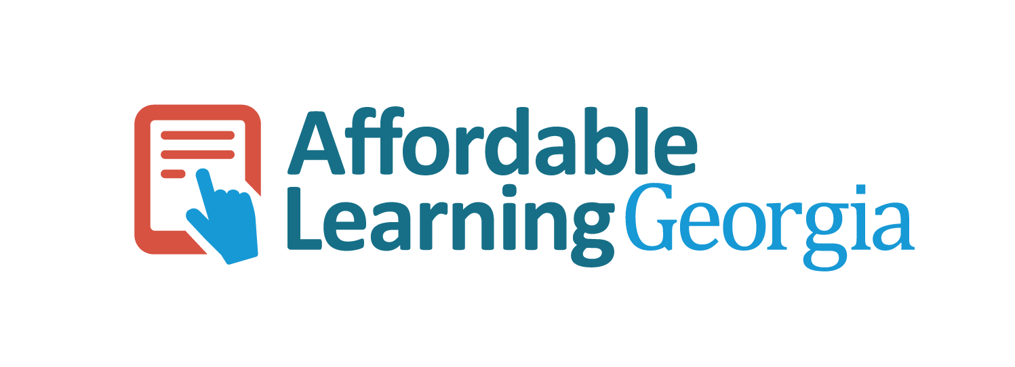
oer.galileo.usg.edu

Slide 35
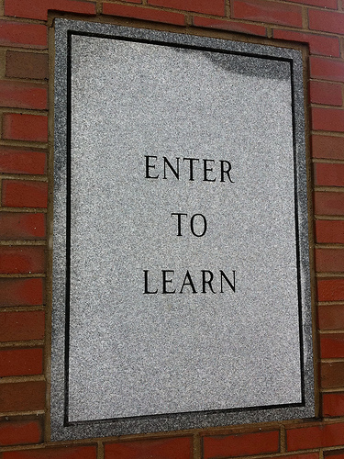
What’s next?
Updating systems to better serve the GALILEO community
New customer support and on call systems implementations
Streamlining e-resource licensing process (ALMA, other systems)
Exploring the future of the GALILEO platform and interface
Better understand how GALILEO is used for research
Innovate a better user experience
Continue to improve resources and services
Improve automation and eliminate “manual automation”

Slide 36
Thank you!
Questions?

