Slide 1
Getting the Most from GALILEO
The Media Center, the Classroom, and Beyond
Russell Palmer
Assistant Director, GALILEO Support Services
russell.palmer@usg.edu

Slide 2
Slides and handouts
Today’s presentation, and many GALILEO handouts are available for download here:
https://tinyurl.com/y7nntc9o
EBSCO ebooks mobile app set up guide:
https://tinyurl.com/ycn87v4a

Slide 3
GALILEO offers eBooks for K12!
Collections for all ages
EBSCO Non-fiction collection
EBSCO K8 Collection
EBSCO High School Collection
Ebrary (focus is on academic non-fiction)
Use on desktop or mobile devices

Slide 4
Tim Turner, EBSCO

Slide 5
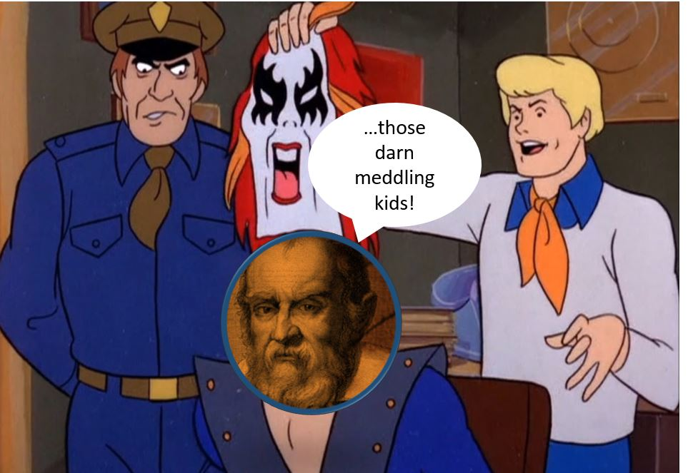
GALILEO Mysteries: Q&A Kickoff What would you like to know about us?

Slide 6
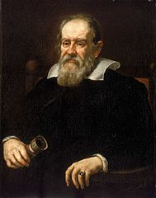
Pulling back the curtain
GALILEO is part of the Library Services division of the Board of Regents of the University System of Georgia
Staffed by library and technology professionals who coordinate:
Direction, vision, content
Programming and development
Support and training
Outreach and assessment

Slide 7
Discover search, browsing options

Slide 8
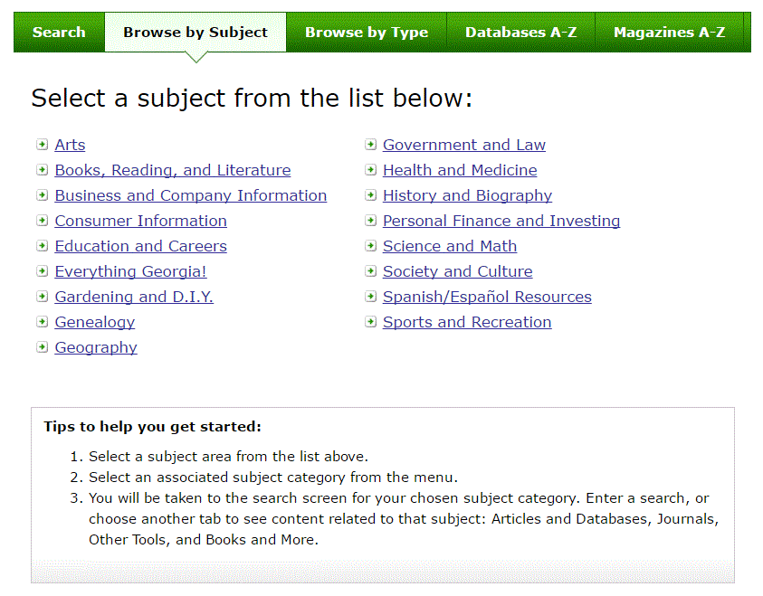

Slide 10
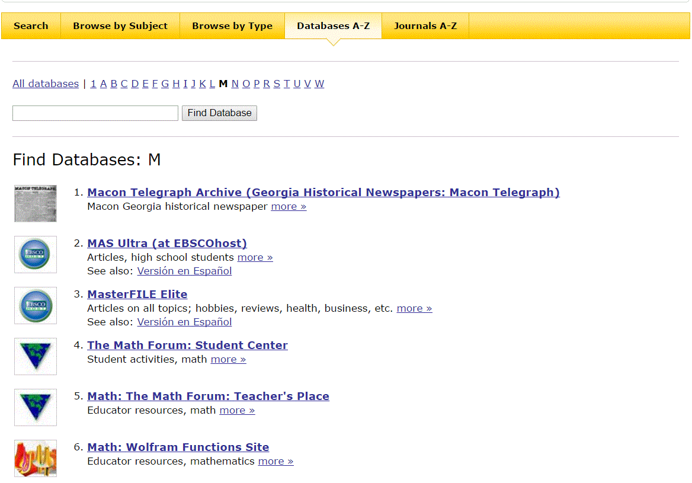
Databases A-Z

Slide 11
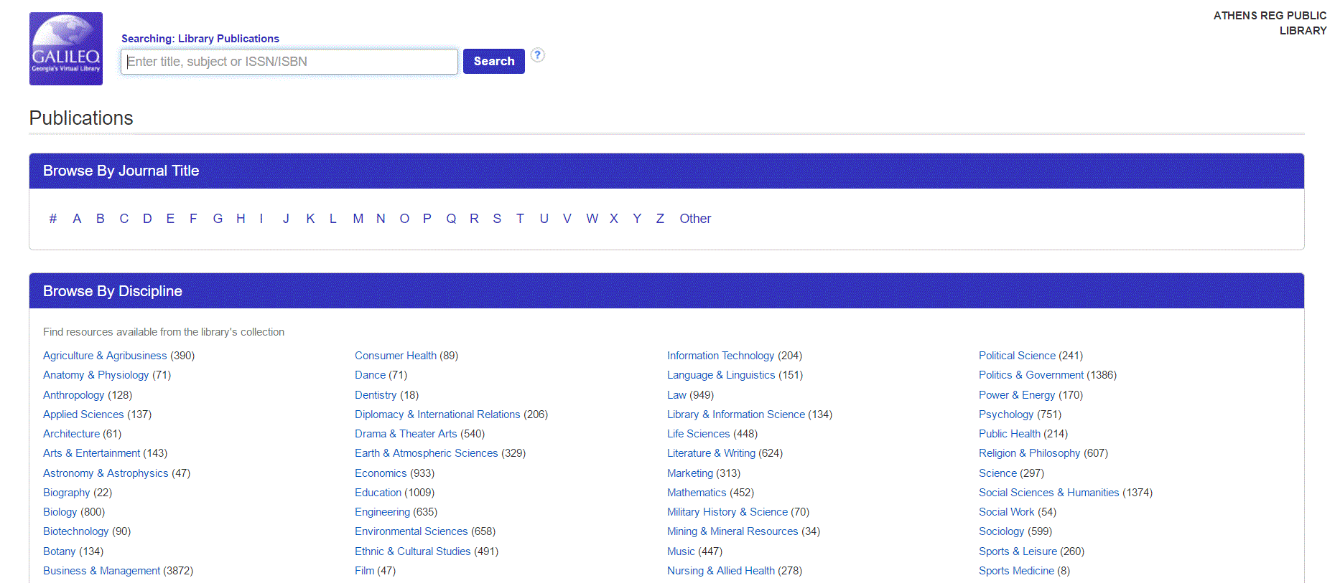
Magazines A-Z

Slide 12
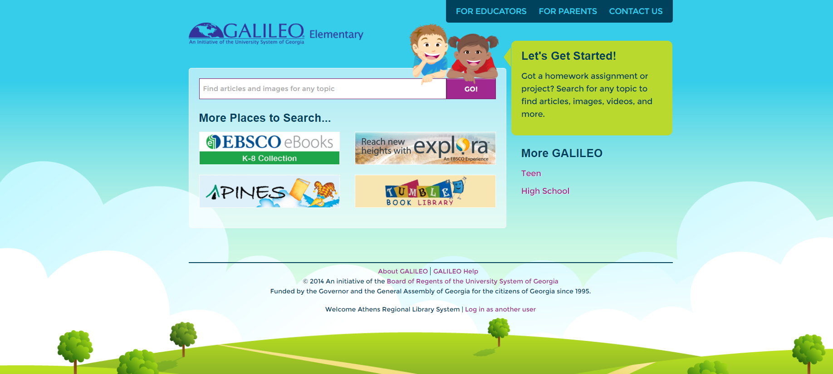
GALILEO Interfaces
Scholar
Kids
Book Collection: Nonfiction
Britannica School Elementary
Funk and Wagnall’s New World Encyclopedia
History Reference Center
Primary Search
High School
15 databases (ebooks, articles, encyclopedias and more)
Teen
20+ databases (ebooks, articles, encyclopedias, and more)

Slide 13
=Search by lexile level and/or grade level

Slide 14
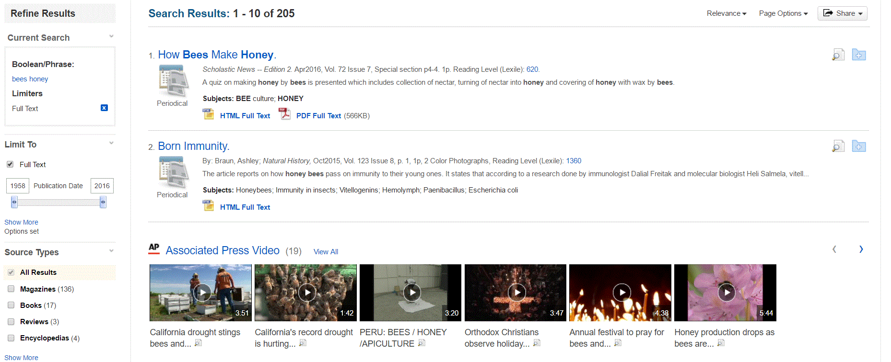

Slide 15
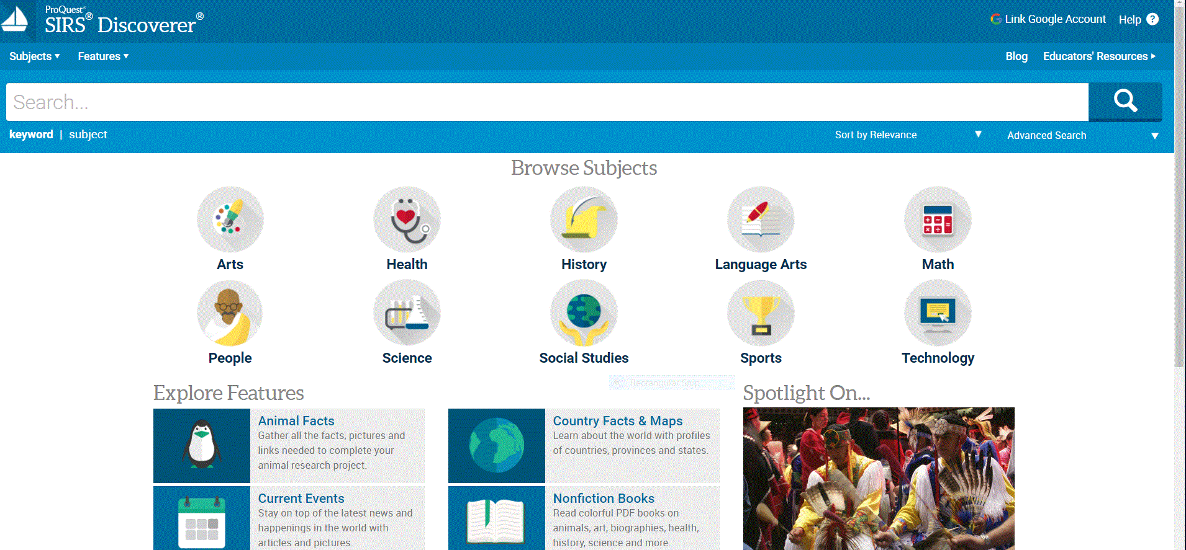
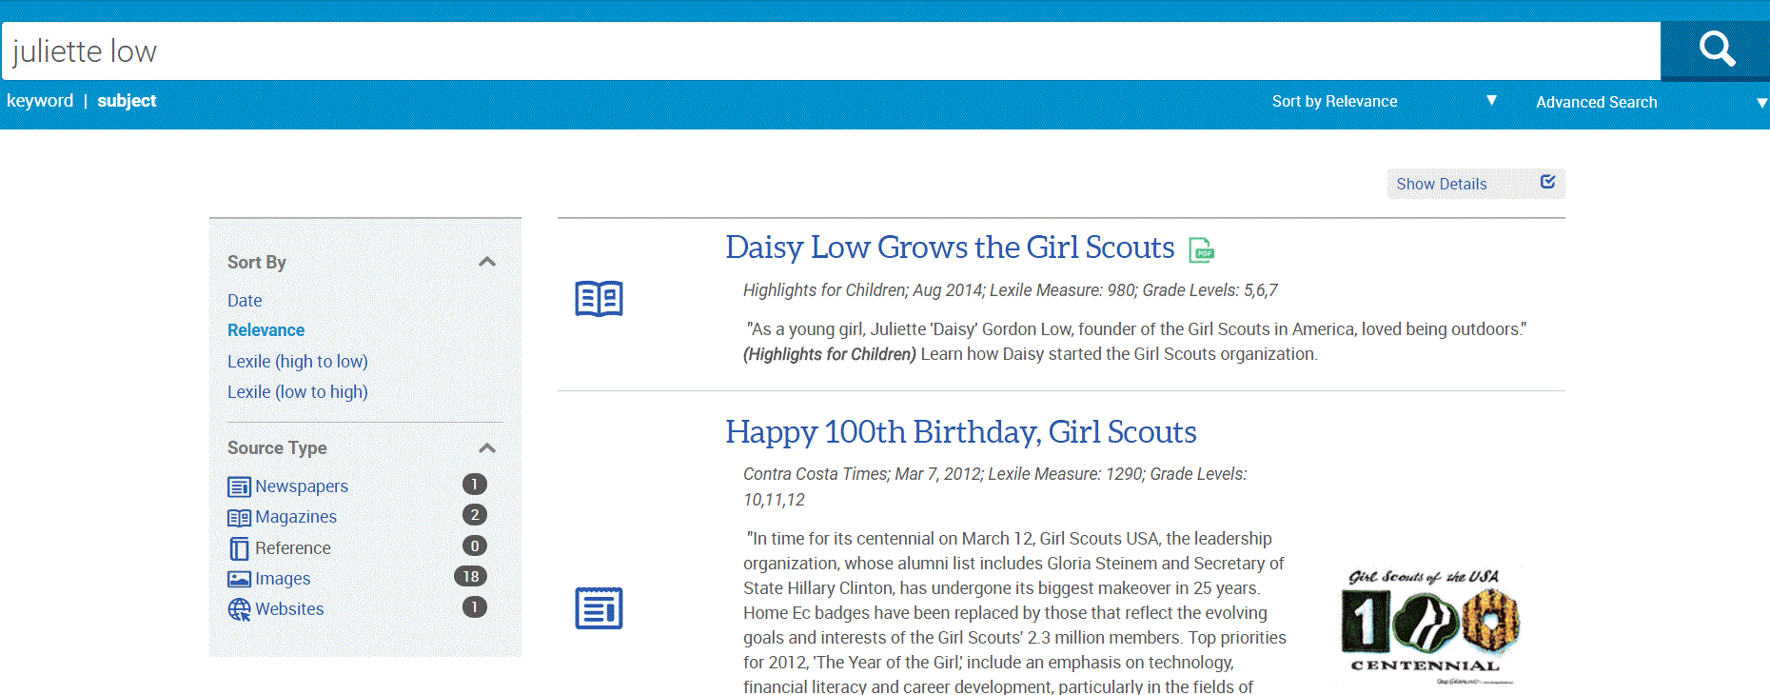

Slide 16
Note the levels: 1-3
(roughly, elementary, middle, high)

Slide 17
Primary documents
Digital Library of Georgia
Newspaper collections and more

Slide 18
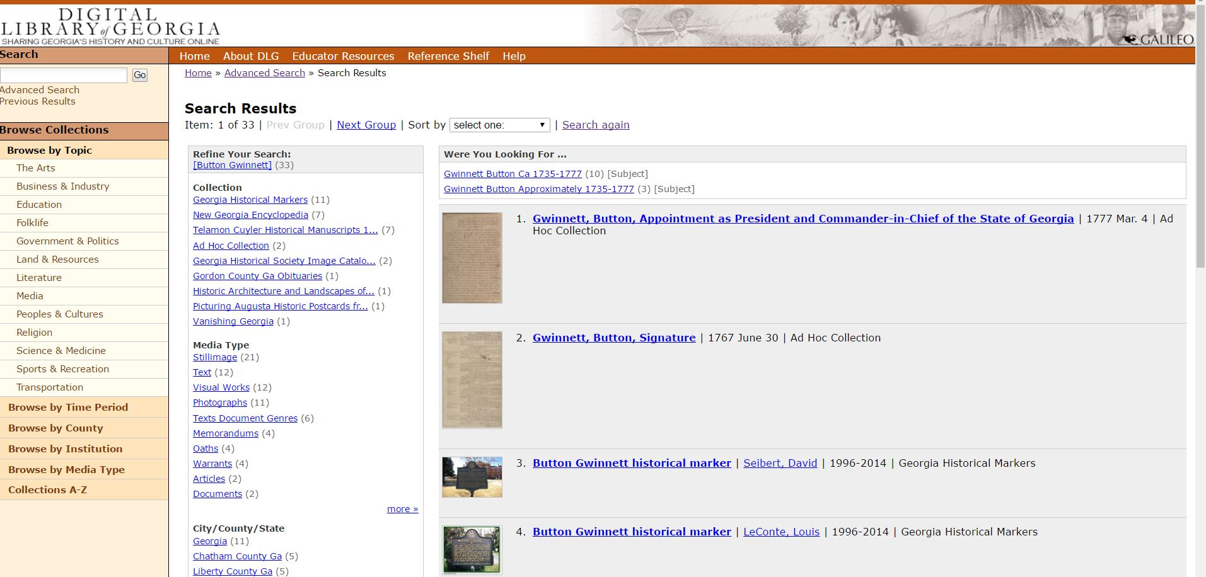

Slide 19
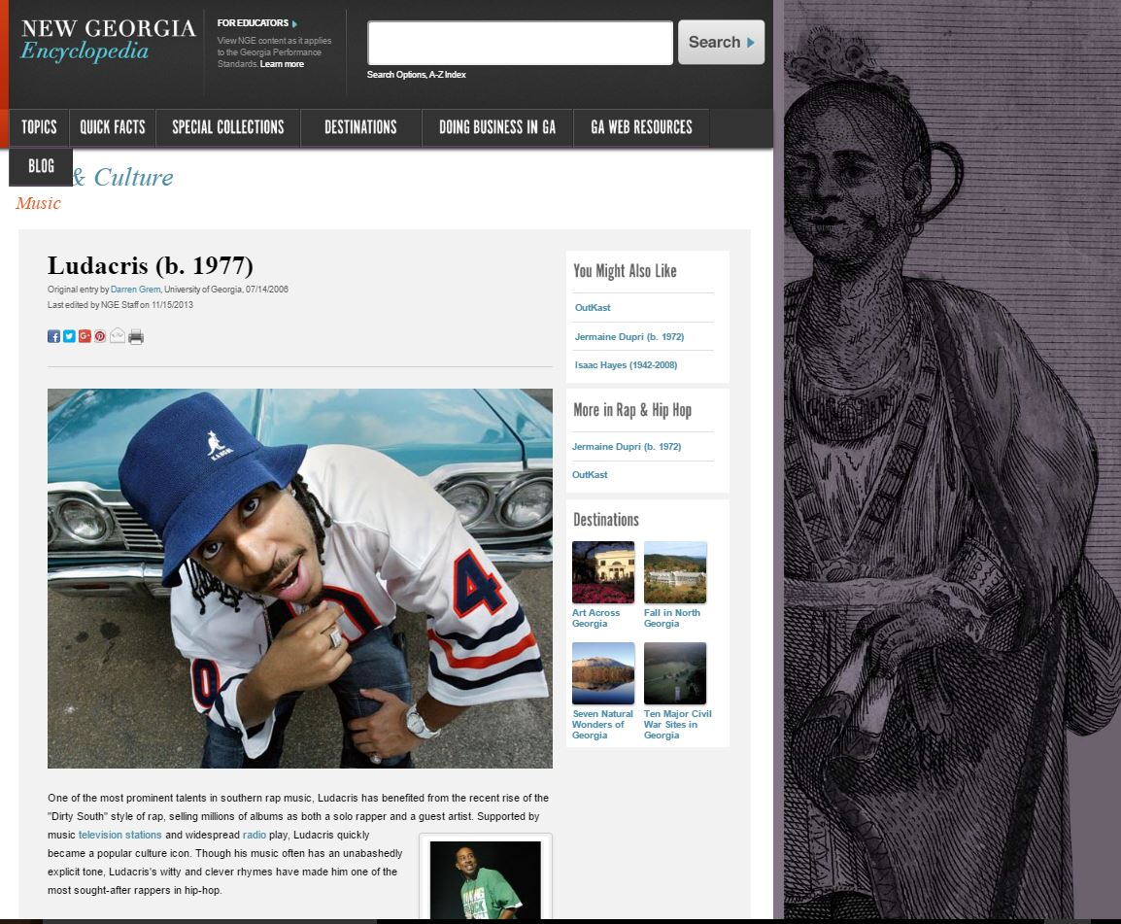

Slide 20
Discussion Time
GALILEO in the classroom and beyond
Form groups of four people
Answer two questions and be ready to share with everyone:
What is your favorite collaborative (teacher/librarian) in class activity that involves GALILEO resources?
How is GALILEO usage encouraged outside the classroom?

Slide 21
Resources for your professional development
Professional Development Collection
ERIC (at EBSCO with direct links to full text when available)
ebrary
EBSCO ebook Academic Collection

Slide 22
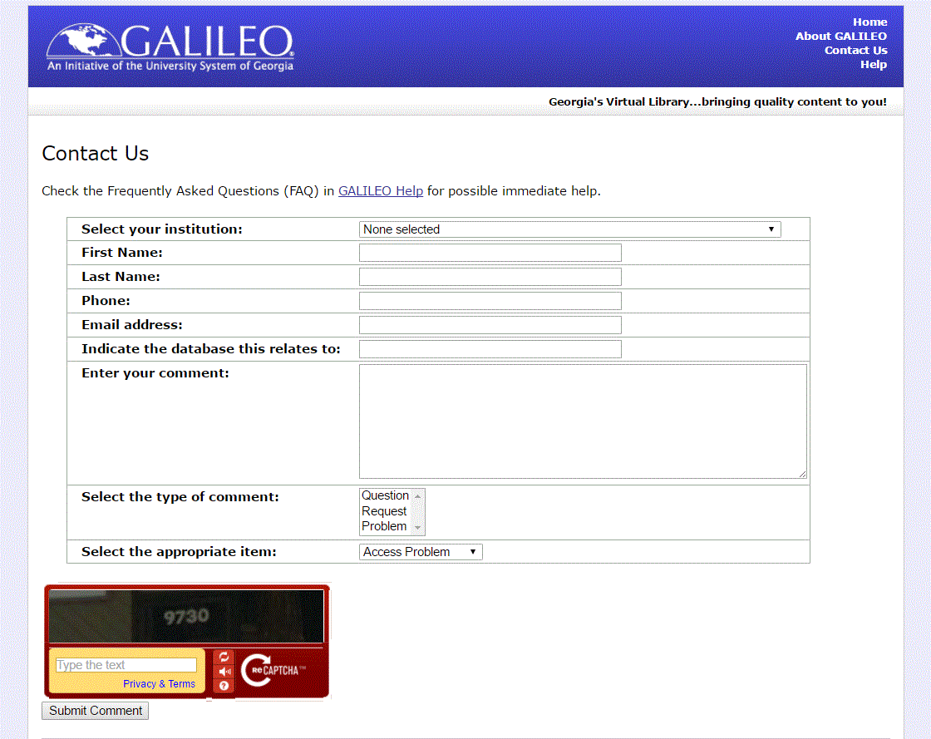
We are here for you!
GALILEO Support Services

Slide 23
GALILEO training is available
Our training schedule is updated often
http://help.galileo.usg.edu/librarians/training
Upcoming: Using lexile limits in EBSCO resources (January 5, 3 PM)
Face to face training?
russell.palmer@usg.edu

Slide 24
Final Discussion
Today, you’ve seen and heard about examples of GALILEO resources, and you’ve heard your colleagues discuss GALILEO in action.
Think creatively for a moment about “what’s next?” in terms of integrating research into the curriculum.
Raise your hand to share an idea. Conclude your thought with “GALILEO staff can help by….”

Slide 25
Thank you!
Q&A Time

