Slide 1
GALILEO for Genealogy - Georgia's Gateway to Databases
Laura W. Carter
Georgia Genealogical Society Webinar
16 September 2013

Slide 2
What is GALILEO?
GALILEO stands for GeorgiA LIbrary LEarning Online

Slide 3
What is GALILEO?
GALILEO stands for GeorgiA LIbrary LEarning Online
A gateway (or portal) to online information

Slide 4
What is GALILEO?
GALILEO stands for GeorgiA LIbrary LEarning Online
A gateway (or portal) to online information
Access to authoritative, subscription only information

Slide 5
What is GALILEO?
GALILEO stands for GeorgiA LIbrary LEarning Online
A gateway (or portal) to online information
Access to authoritative, subscription only information
More than 100 databases

Slide 6
What is GALILEO?
GALILEO stands for GeorgiA LIbrary LEarning Online
A gateway (or portal) to online information
Access to authoritative, subscription only information
More than 100 databases
More than 10,000 journal titles in full text

Slide 7
Who is Served by GALILEO?
2000 + Educational institutions in Georgia
University System of Georgia
Technical College System of Georgia
K-12 schools
public libraries
and a group of private academic colleges and universities

Slide 8
How can I find the information in GALILEO?
Go to any of the public libraries, academic libraries, or technical colleges in Georgia and use what is available onsite.
Go to http://galileo.usg.edu, sign in using the password you are eligible for and search

Slide 9
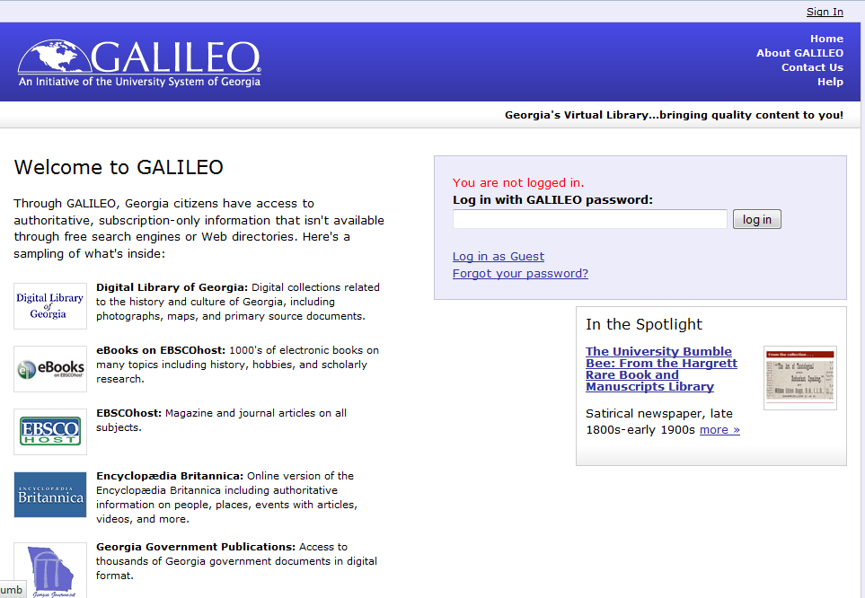

Slide 10
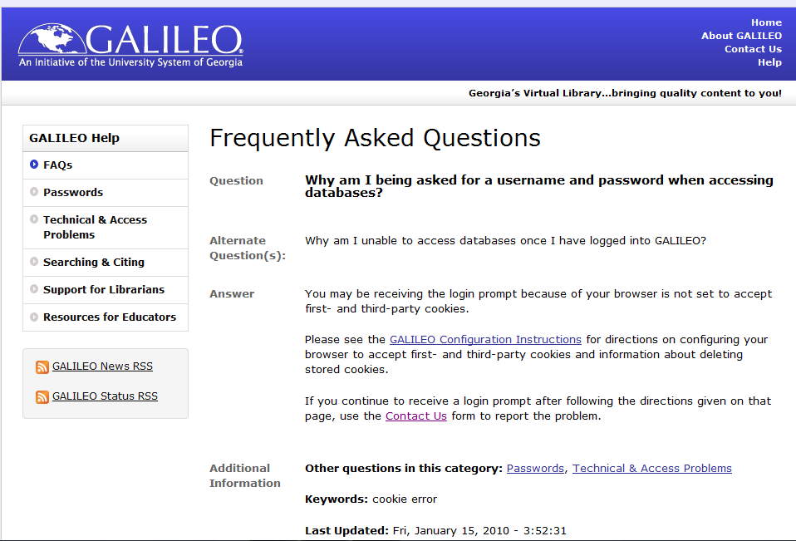

Slide 11
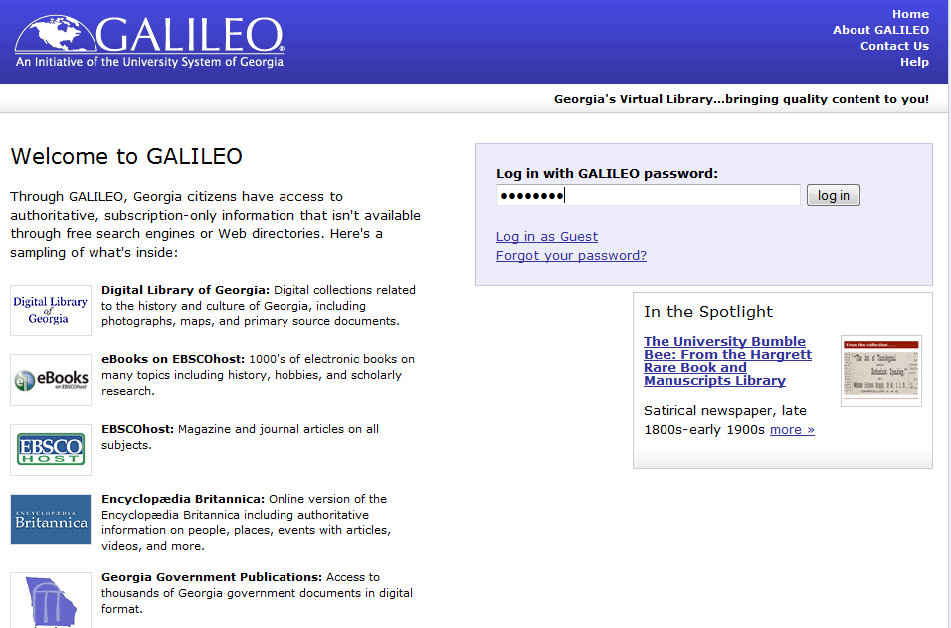

Slide 12
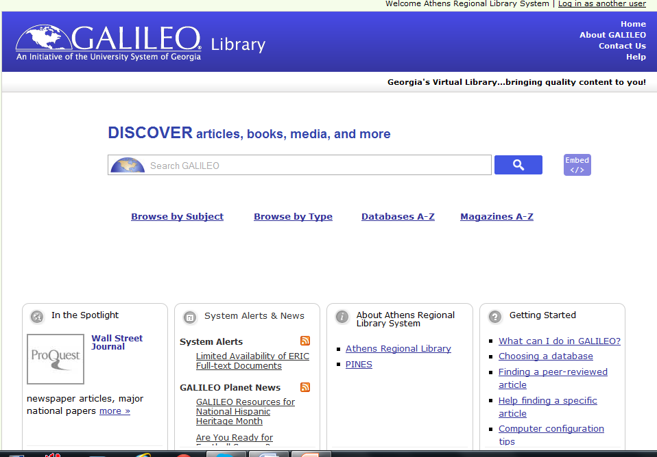

Slide 13
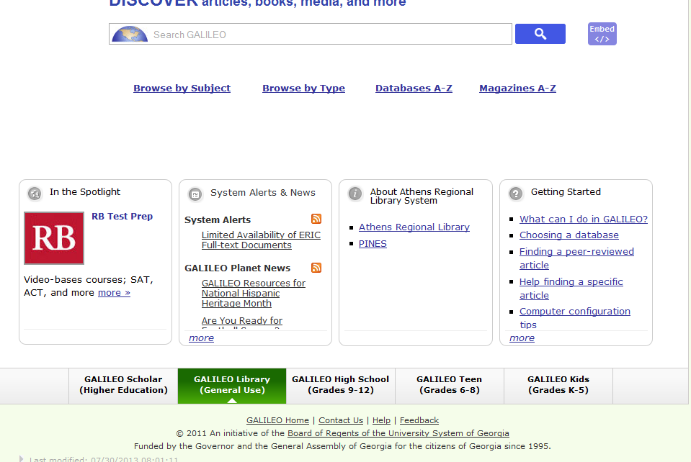

Slide 14
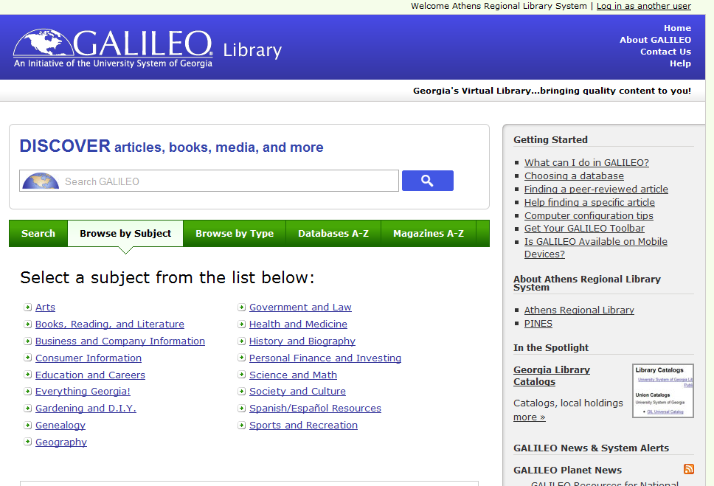

Slide 15
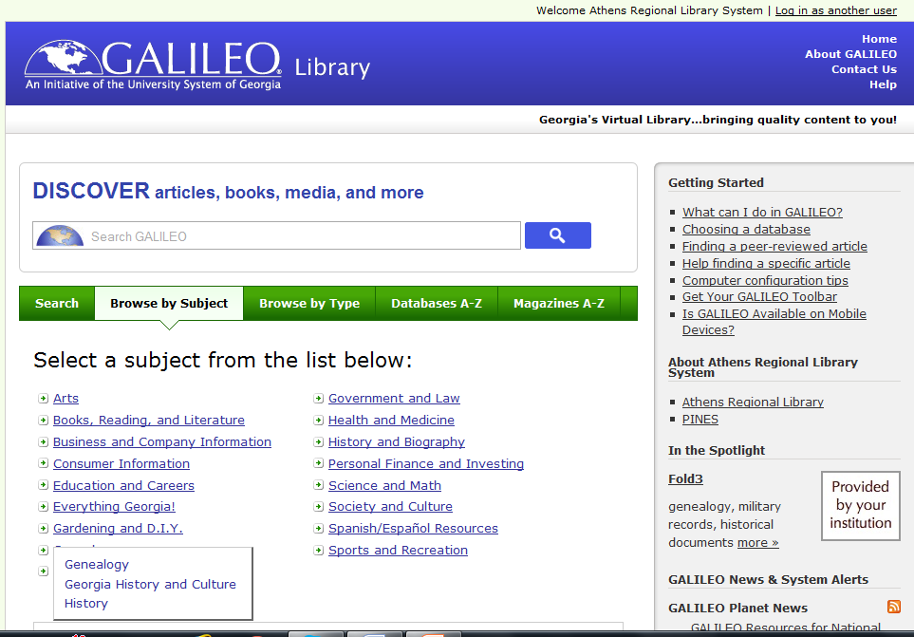

Slide 16
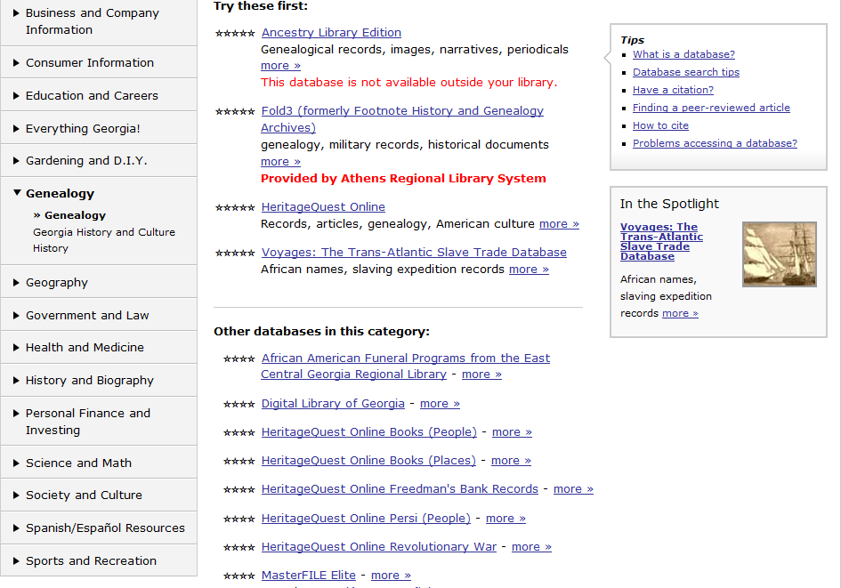
This page shows what appears after clicking on Genealogy under Browse Subjects

Slide 17
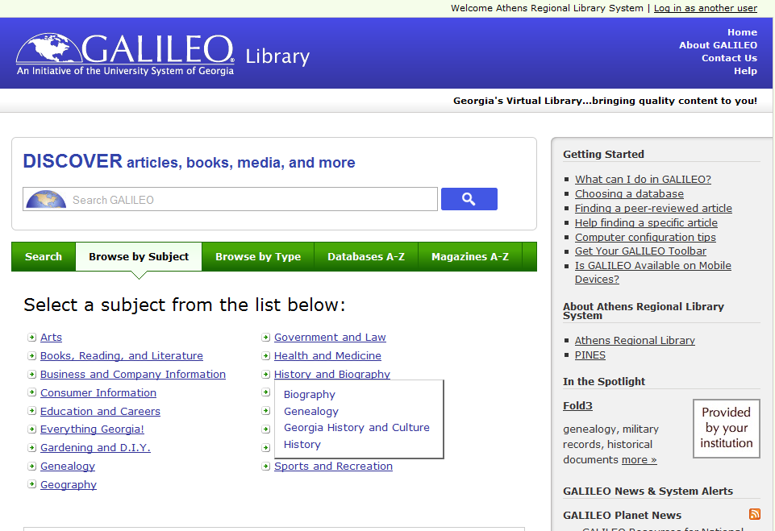

Slide 18
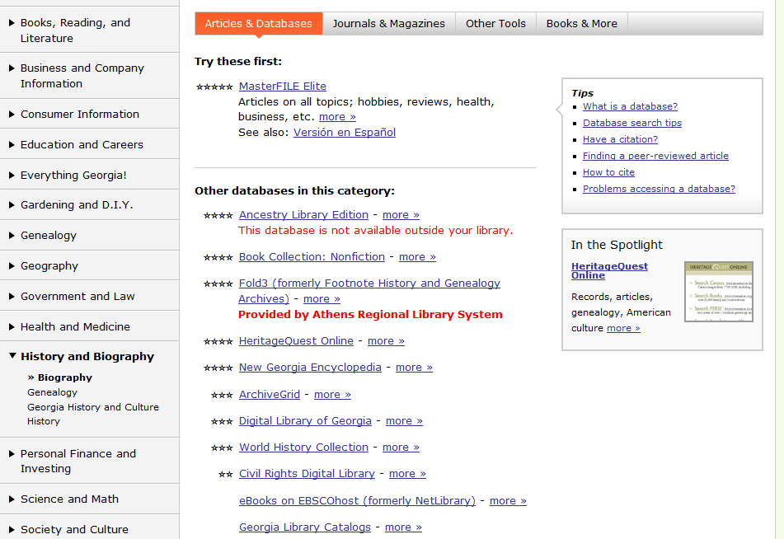

Slide 20
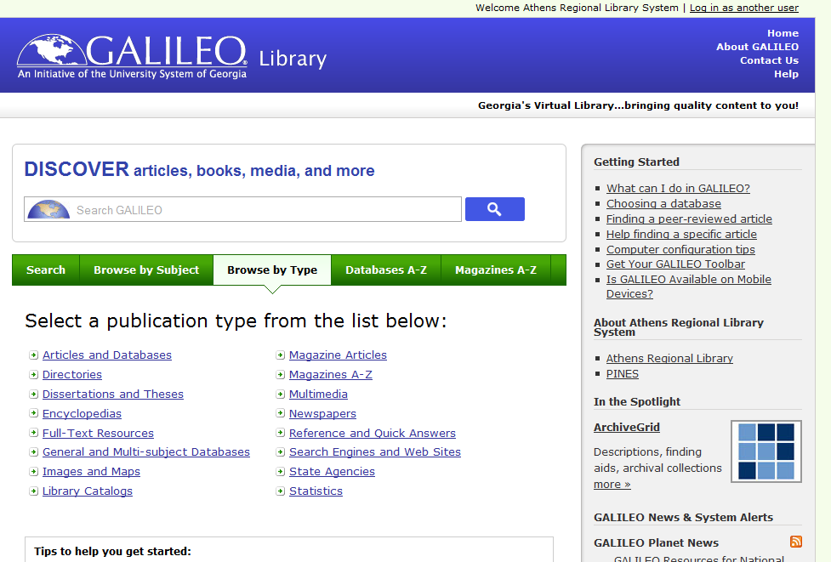

Slide 21
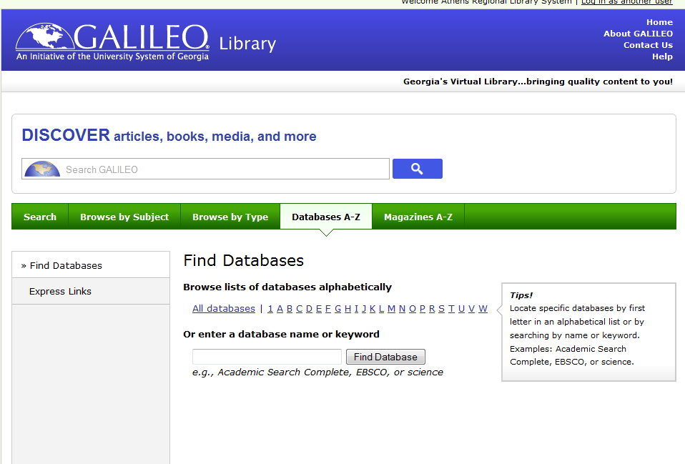

Slide 22
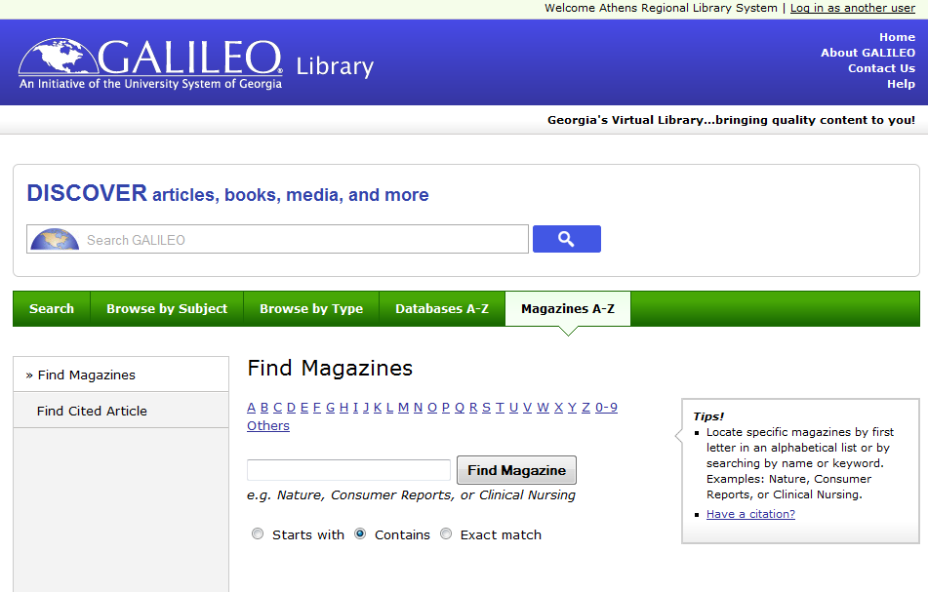

Slide 23
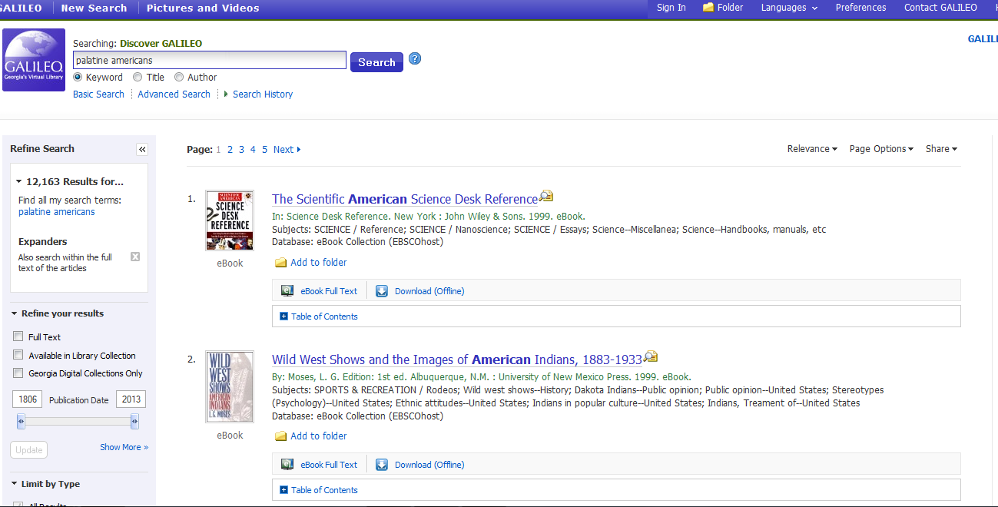
Notice how many results and how unrelated to what was needed the search results are. This is not the best way to search.
Instead, use Advanced Search and place limits, but it may be that for what you are working on, going to a specific database may be a better option.

Slide 24
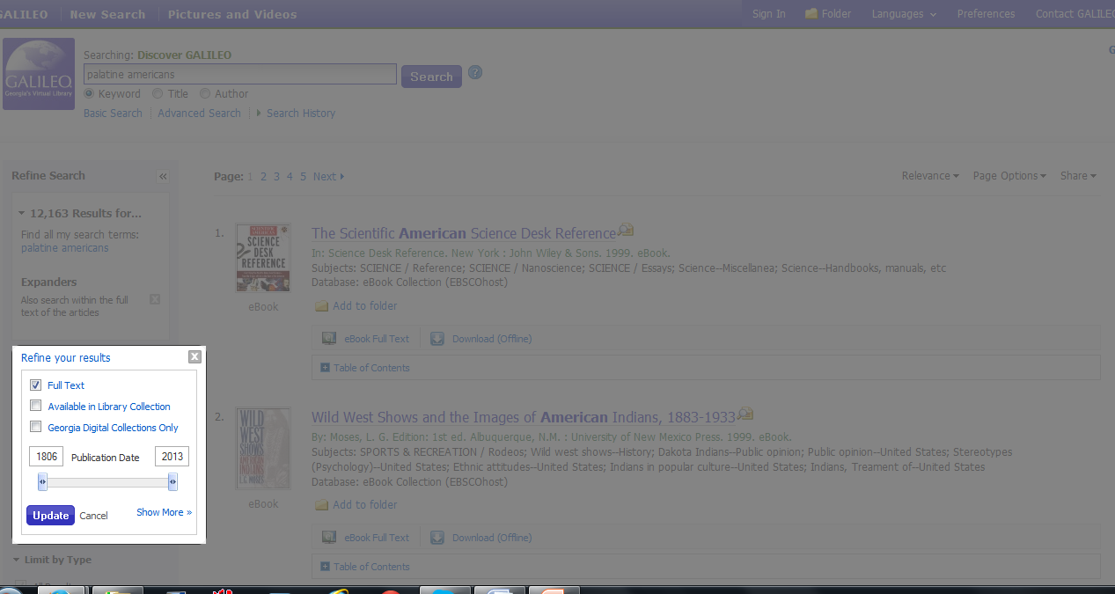
Insert additions like Full Text to get only results that are full text instead of just citations or abstracts.
Change dates with sliding bar, but remember the dates are publication dates, not dates of events.

Slide 25
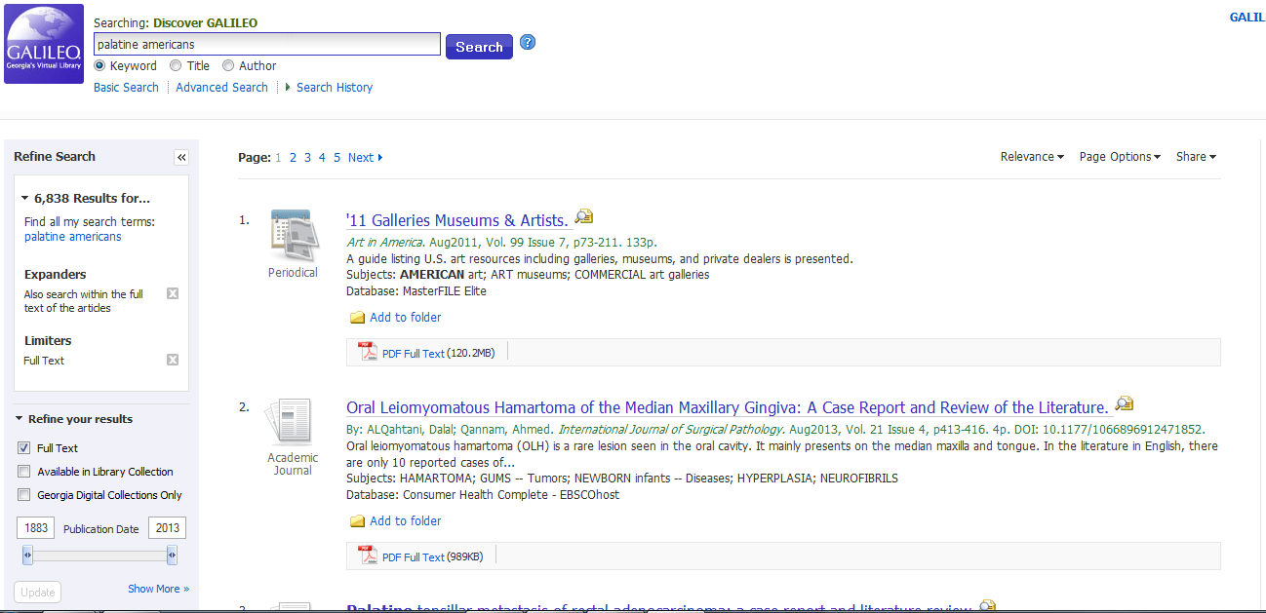

Slide 26
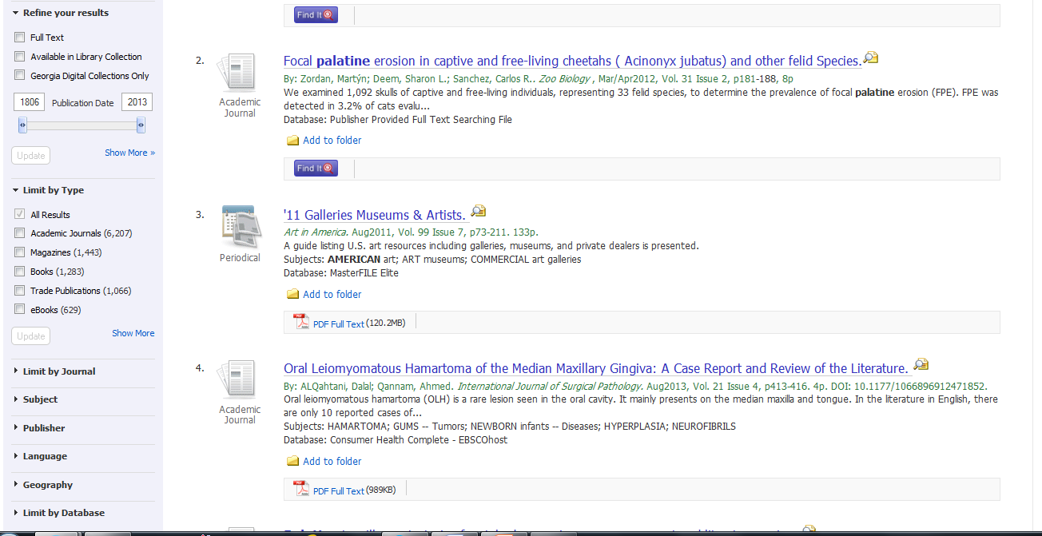

Slide 27
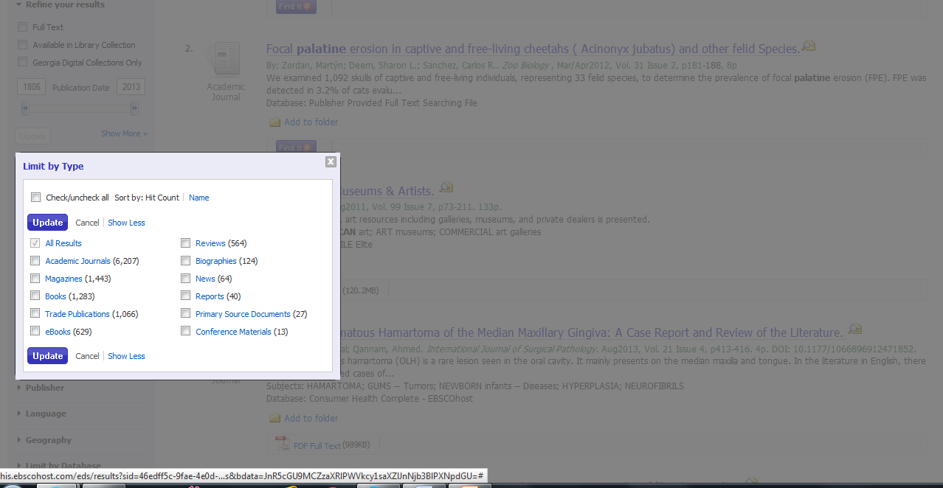
To see Types of materials included in database, click on Show More under Limit by Type.
Background grays out. Choose types of materials to limit search.

Slide 28
Improve search results by :
Working from a specific database
Academic Search Complete
MAS Ultra
MasterFILE Elite
Newspaper Source
World History Collection

Slide 30
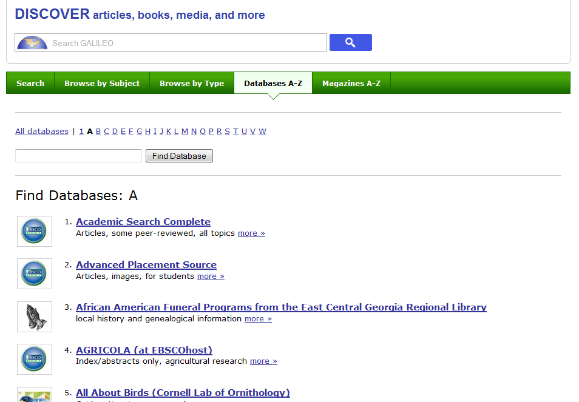

Slide 31
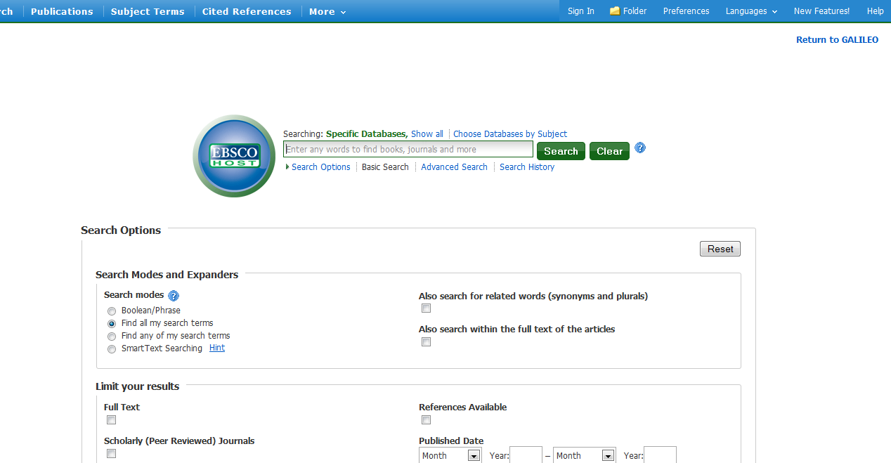
Notice we do not know which EBSCOHost database we are searching. Make notes so you do not repeat yourself.

Slide 32
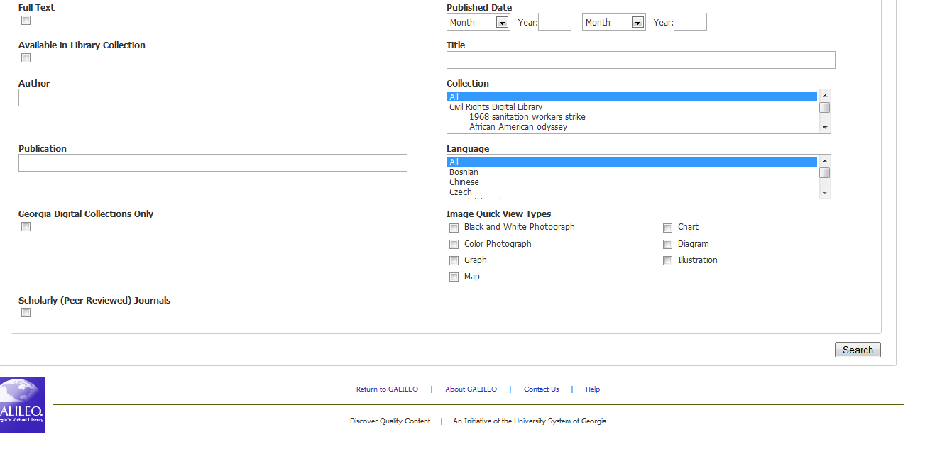
Notice the other limits you can put on searches. This is the rest of the page for a Search.

Slide 33
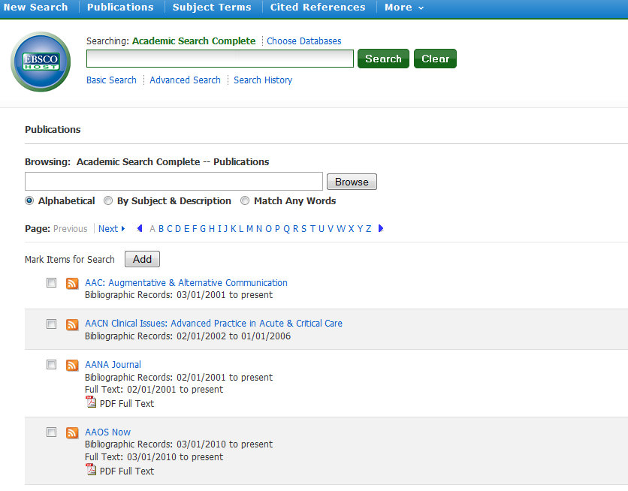
Page tells us what database and shows where we are.

Slide 34
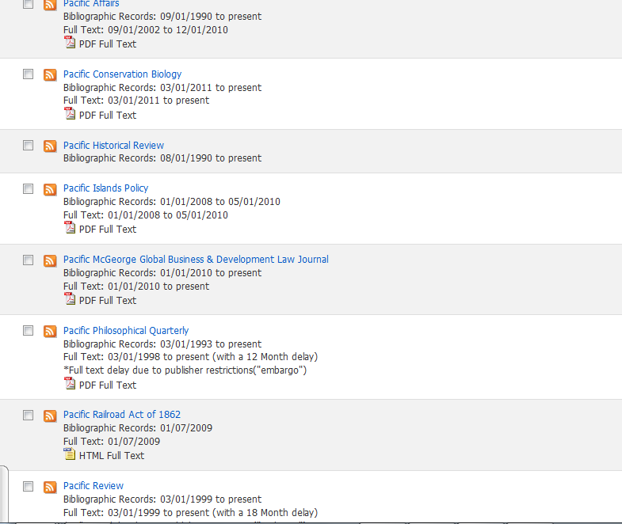

Slide 35
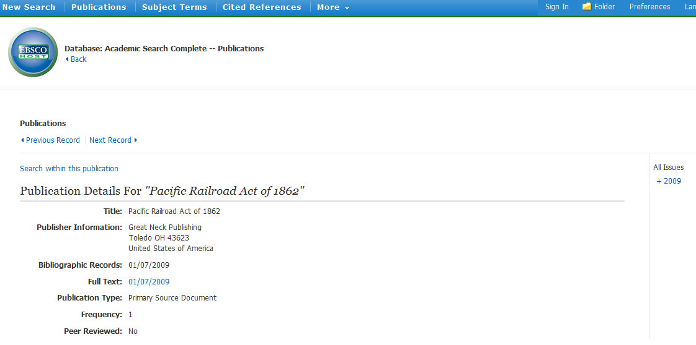

Slide 36
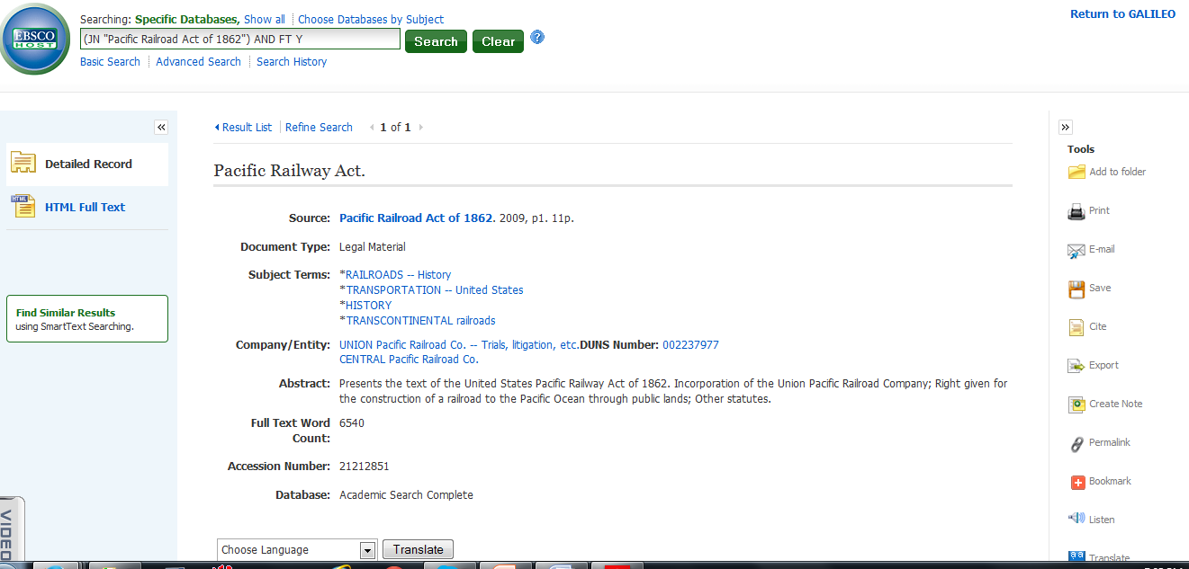

Slide 37
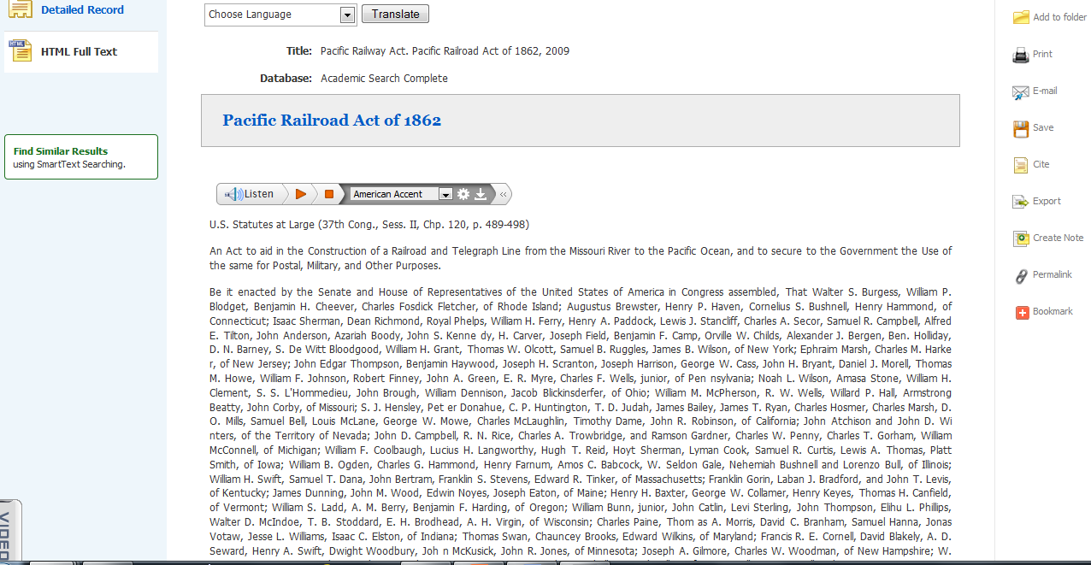

Slide 38
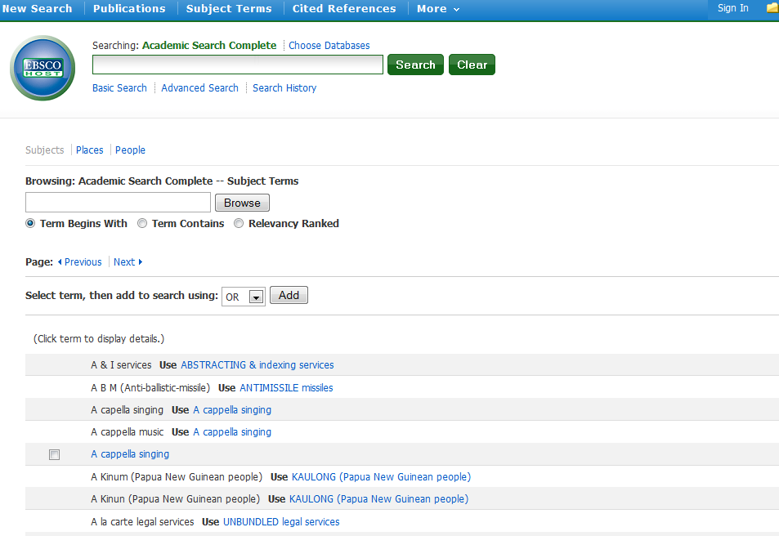

Slide 39
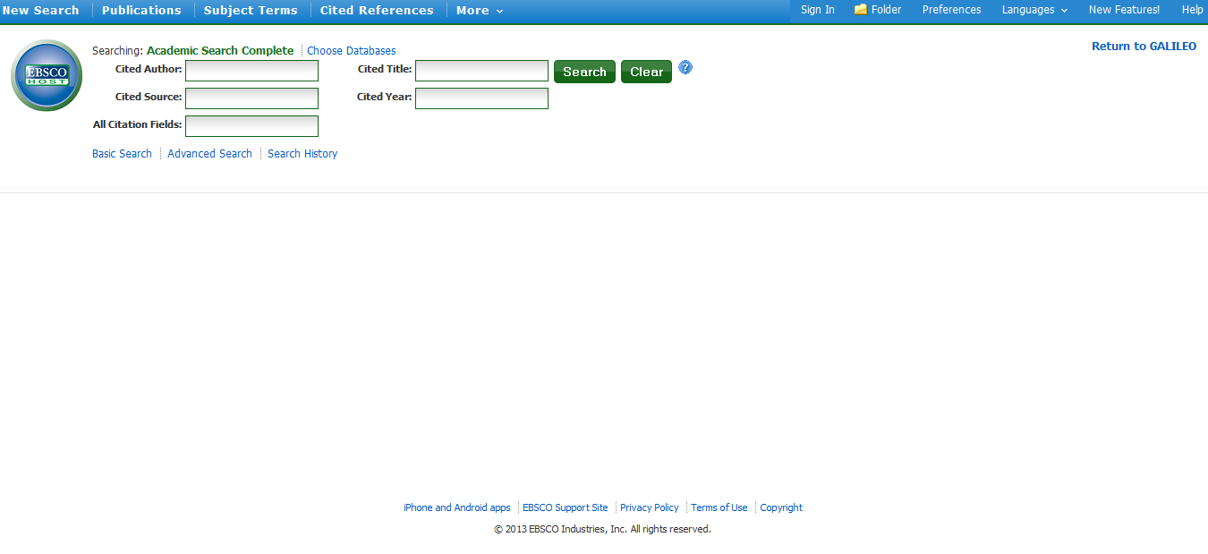

Slide 40
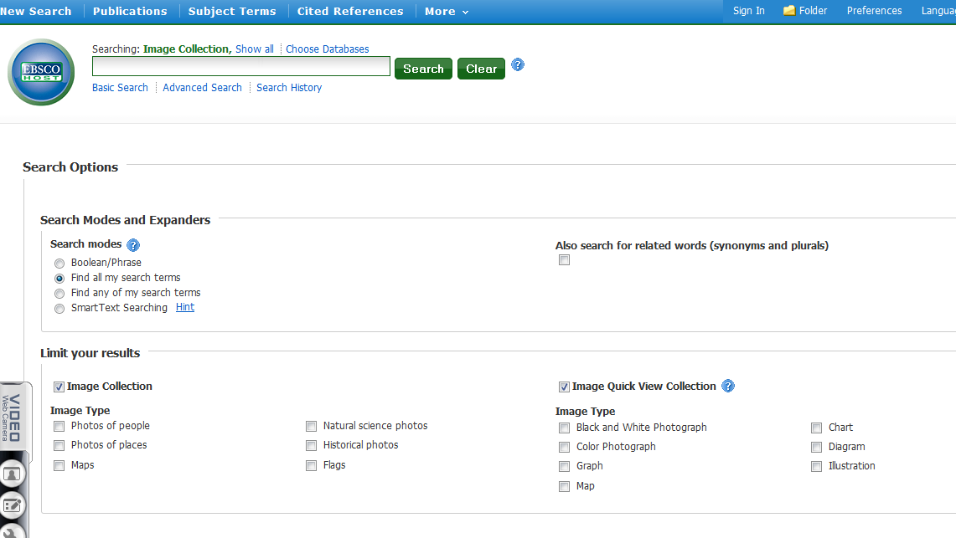
From More, there is a
drop down for Images
and another for Indexes

Slide 41
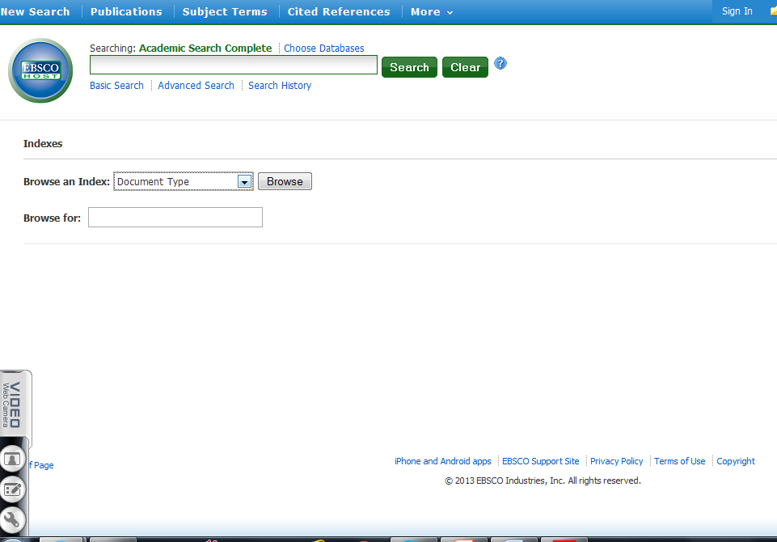
Browse indexes by various criteria
such as document type, language, headings, geographic terms, author-supplied keywords, etc.

Slide 42
Improve search results :
Work from a specific database
Use subject terms from database

Slide 43
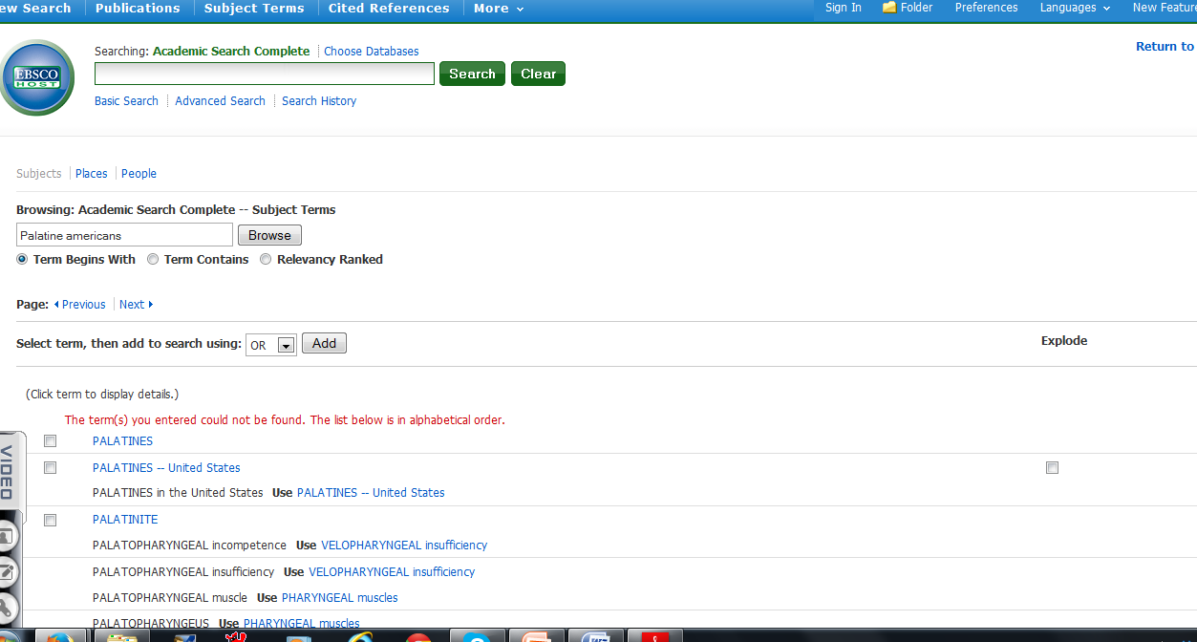
Enter palatine americans in Subject
Terms box. Now get valid subject terms to
use in search

Slide 44
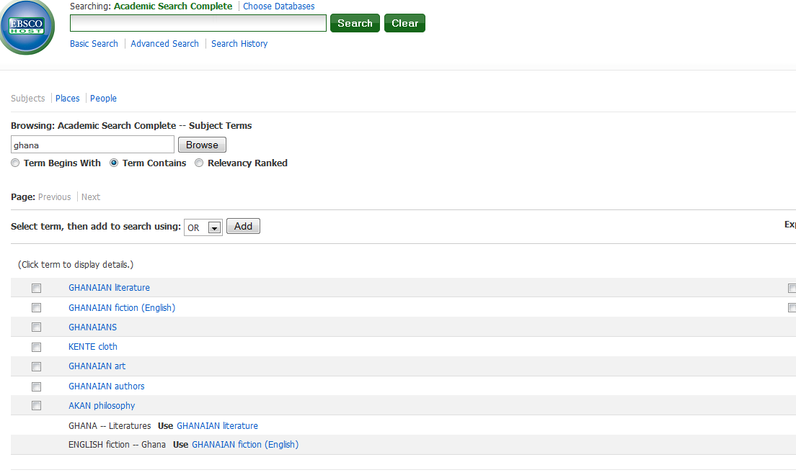
Entered search term Ghana, chose Term Contains. Not correct term in this database

Slide 45
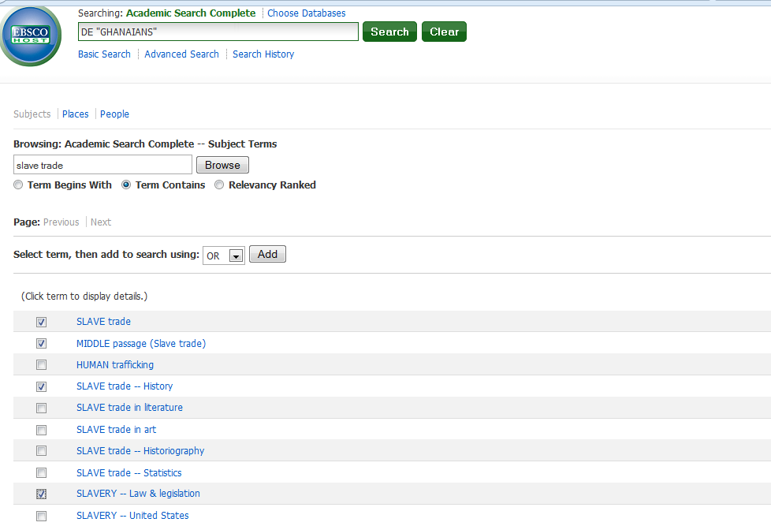
Clicked on Ghanaians and transferred to search box at top.
Entered Slave trade in Browse, chose subject terms wanted and added to search.

Slide 46
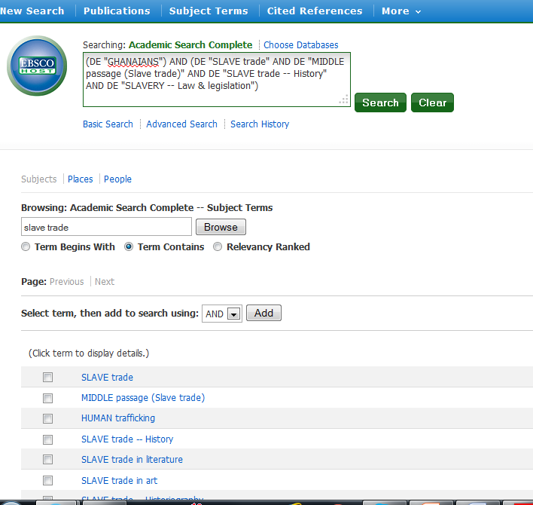
Search box now has
all terms.
Caution, choosing
Advanced Search now
Will lose search terms

Slide 47
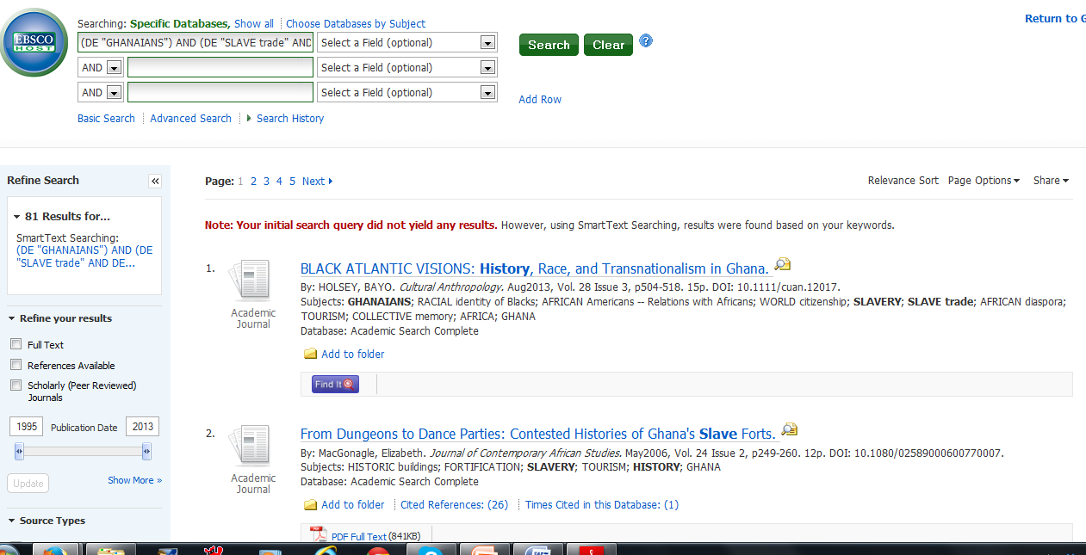
Results without Full text limit

Slide 48
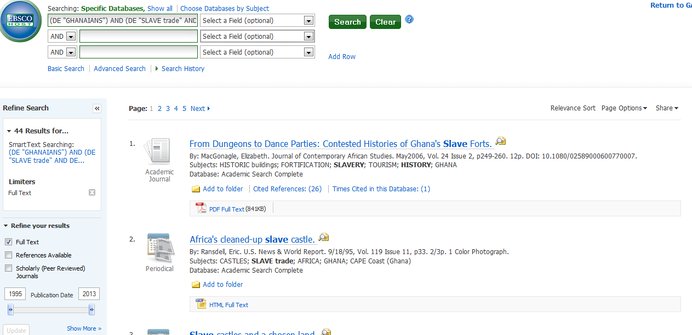
Down to 44 results and can decide if want to focus or expand more

Slide 49
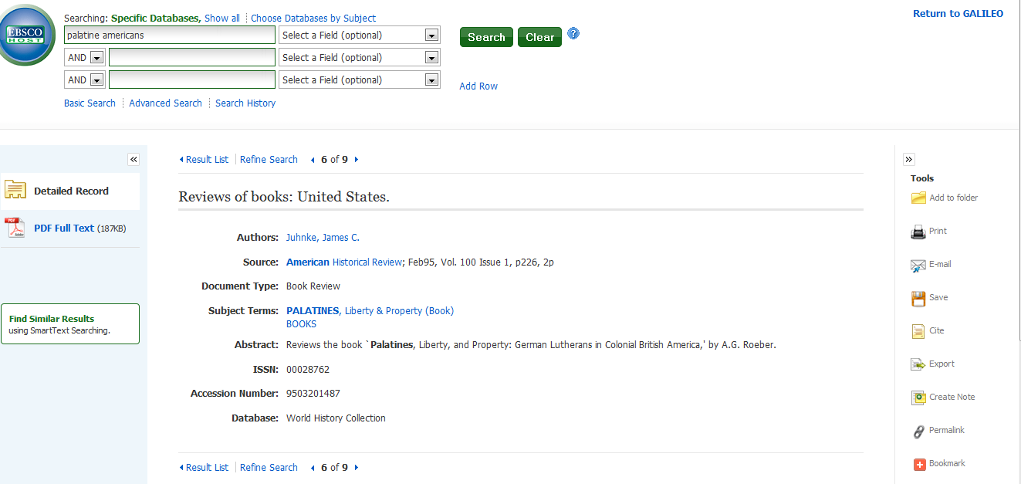

Slide 50
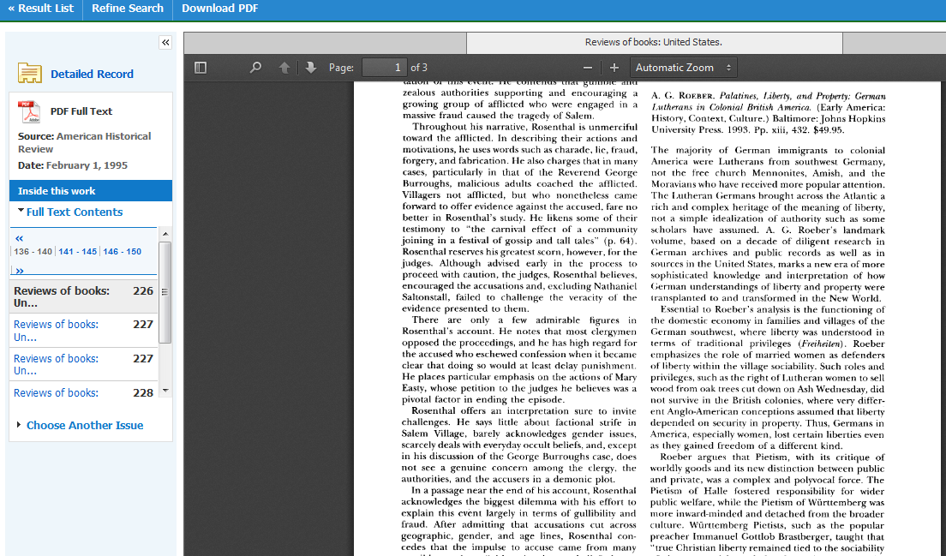

Slide 51
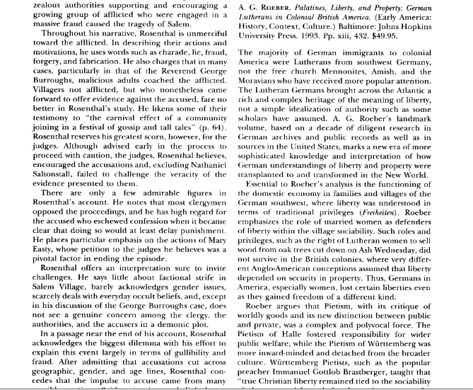

Slide 52
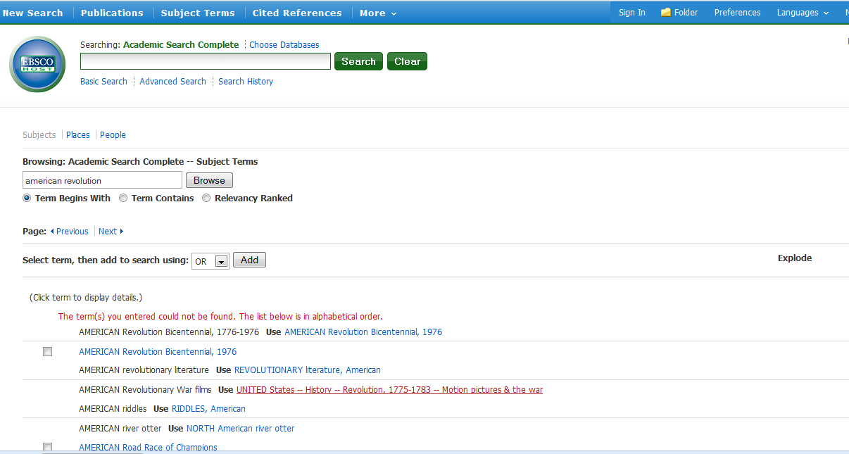
When creating a search, use the “controlled vocabulary” or thesaurus when possible
to narrow the search to be more precise. All databases do not have this feature, but look for it when searching most databases.

Slide 53
Wanted to find information about the American Revolution. Went to screen for this database Academic Search Complete and entered “american revolution” in Browsing subject terms. “american revolution” was not a correct subject search in this database. But, if I look down the list, I find a clue as to what the correct entry in Subject search might be.

Slide 54
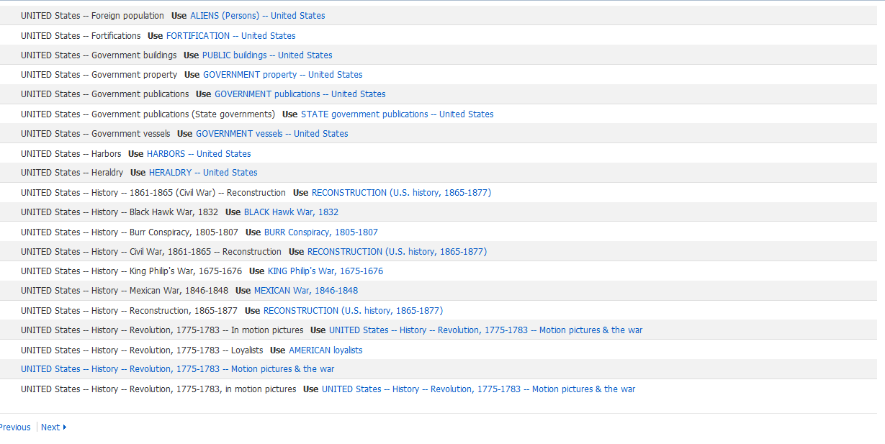
Notice the headings for topics aka (subjects)
on the left. There is little consistency in what database uses. Use the database vocabulary to improve your searches.

Slide 55
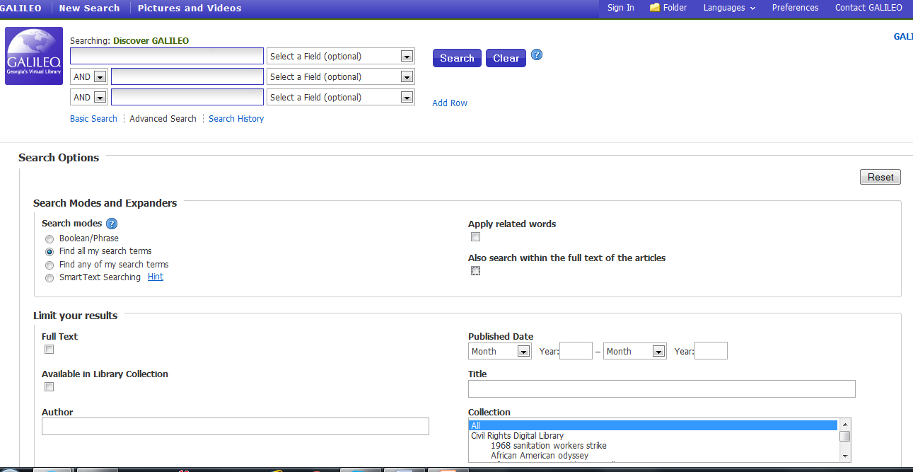
Check Full Text.
Often “search within full text” helps locate information that would otherwise be missed.

Slide 56
Questions?
Georgia Genealogical Society
http://gagensociety.org
To register for October 5 seminar with Maureen Taylor
http://gagensociety.org/calendar_ggs.htm

