Slide 1
Finding Informational Text and Primary Sources in GALILEO to Support Common Core Standards
Courtney McGough
GALILEO Support Services
Georgia Council for the Social Studies
2013

Slide 2
Agenda
Resources for research
On-level informational text
Primary sources
Multimedia
Citing
Curriculum Tools
Adding GALILEO to your website
Activities for research and writing

Slide 3
Informational Text ELACCXRI: Reading Informational Standards
Discover GALILEO offers a single search of resources with magazine, newspaper, and encyclopedia articles as well as book chapters
Search from the GALILEO High School, GALILEO Teen, or GALILEO Elementary home page for any topic
Notes:
*Tip: It may help to use quotes for a name (e.g., “Mary Musgrove”) to get results with the first and last name together, but may also need to check for several forms of the name (e.g., General Sherman, William Sherman, William T. Sherman).
*Tip: If getting too many academic journals in search, limit to Trade Publications, Magazines, and/or News in Limit by Type.
*Tip: Limit results by subject to get better results. This works especially well for a person, historical event, or well-known topic.
*Tip: When student see an article title, note the Cite feature on the right that provides pre-formatted citations for the article and note the Permalink, which is a persistent link to the article that can be used in bibliographies, classroom websites, learning management systems, etc.
*Tip: Note Relevance Sort at the top of the search results list can be changed to Date Descending to see articles for current events topics.

Slide 4
Informational Text ELACCXRI: Reading Informational Standards
Or, see individual resources
Britannica School Edition
Britannica School Elementary
Britannica School Middle
Britannica School High
SIRS Discoverer (elementary and middle school)
EBSCO resources
Kids Search (elementary)
Middle Search Plus (middle school)
MAS Ultra (high school)
Student Research Center (middle and high school)
History Reference Center (grades 5-12)
Book Collection: Nonfiction (all grade levels)
See more in your Databases A-Z list

Slide 5
Literary Text ELACCXRL: Reading Literary Standards
NoveList and NoveList K-8 (NOT in Discover GALILEO)
Book and author recommendations
Curriculum-based book lists (by grade and topic)
Picture Book Extenders
Literary Reference Center (also in Discover GALILEO)
Literary Criticism
Plot Summaries
Full-text classics – poems, stories, some books

Slide 6
Primary Sources LXRH: Literacy Standards for Reading in History and Social Studies
GALILEO offers resources with primary sources
Annals of American History (NOT in Discover GALILEO)
American Memory (from Library of Congress)
Digital Library of Georgia
History Reference Center (also in Discover GALILEO)
See more at
High School > Browse by Type > Primary Source Documents
Teen > By Type > Primary Source Documents

Slide 7
On-Level Text
Many GALILEO resources include Lexile scores
See Lexile Handout

Slide 8
Multimedia
GALILEO offers resources with images, videos, and/or audio
Britannica School Edition
Britannica School Elementary
Britannica School Middle
Britannica School High
SIRS Discoverer
Images @ EBSCO
Digital Library of Georgia
See more in
High School > Browse by Type > Images , Maps, and Flags
Teen > By Type > Pictures, Maps, and Flags

Slide 9
Citing Sources
Several GALILEO resources have pre-formatted citations for articles

Slide 10
Linking to Articles
Several GALILEO resources offer article-level linking

Slide 11
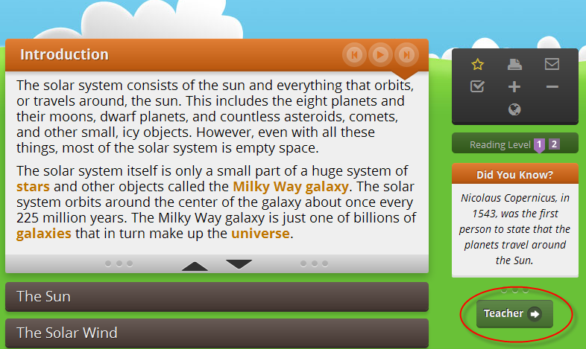
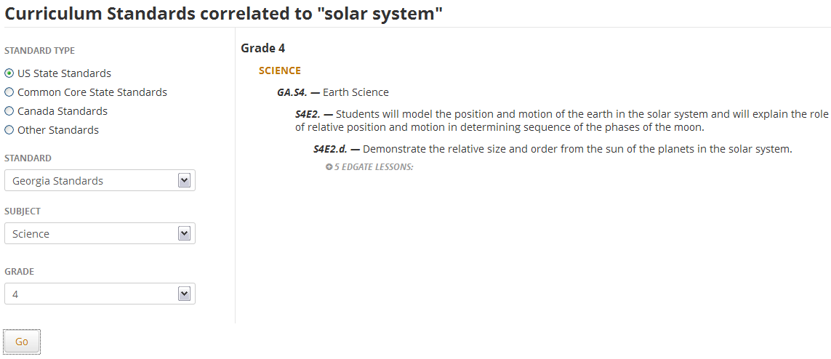
Britannica School Curriculum tool
In Britannica School Elementary, search for an article and then click the Teacher button

Slide 12
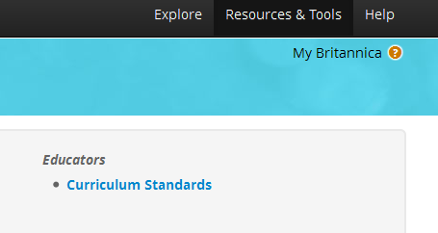
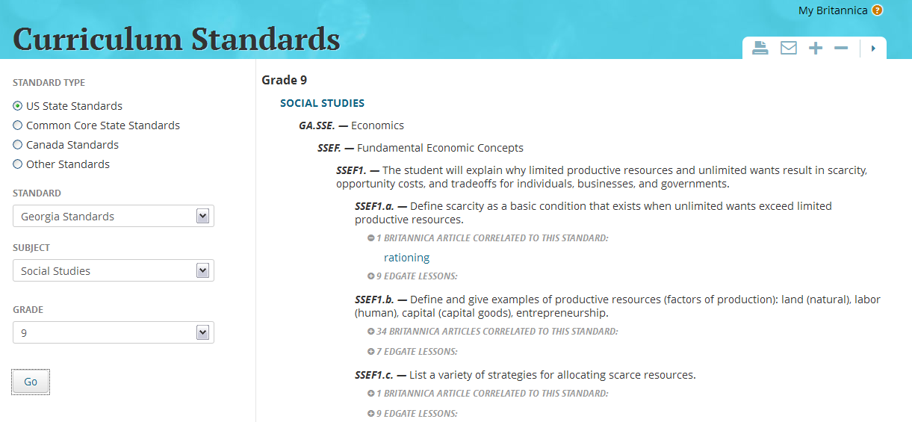
Britannica School Curriculum tool
In Britannica School, choose Middle or High school level, click

Slide 13
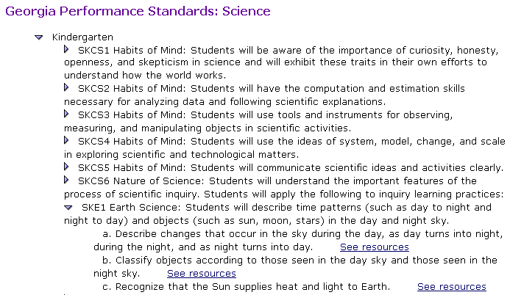
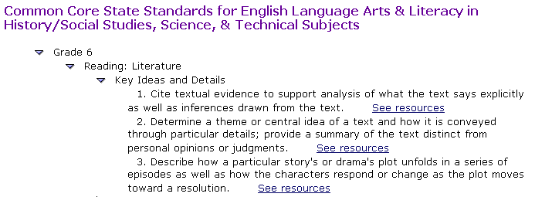
SIRS Curriculum tool
SIRS Discoverer (elementary or middle)
Look in Educators’ Resources or click the Common Core Correlations link

Slide 14
Linking to GALILEO Databases
Express Links
Link directly to one GALILEO resource from your classroom or media center site
Students at home are only asked for the GALILEO password
Find all of your Express Links at Databases A-Z > Express Links

Slide 15
Widgets and Buttons
Get icons/logos to create buttons
http://help.galileo.usg.edu/faqs/how_can_i_create_buttons_to_link_to_databases_on_my_library_site/
Britannica search box widget
http://help.galileo.usg.edu/faqs/how_do_i_create_a_search_box_for_britannica_for_my_library_site/

Slide 16
GALILEO Lesson Plans and Activities
Resources for Educators
Guided Research Activity – lesson plan and activities designed around the Big6 information literacy process; supports CCGPS, AASL Learning Standards, ACRL Information Literacy Standards
Lesson Plan
Activity for High School, Middle School, and Elementary
Where I’m From in GALILEO – create local history poem
Create Your Own Story – create a digital story

Slide 17
More GALILEO Resources
GALILEO email list – low traffic; announcements
GALILEO Training – watch for new K-12 sessions to be scheduled through the school year
GALILEO Training Archives
Presentations and Materials

Slide 18
Contact Us!
http://www.galileo.usg.edu/contact
Email: helpdesk@usg.edu

