Slide 1
GALILEO to the Core: Leveraging Digital Resources for Literacy in CCGPS Classes (Elementary)
Session will begin at 3:30PM
While you are waiting, please check your audio
(microphone and speakers)
Go to Tools > Audio > Audio Setup Wizard

Slide 2
Viewing Archived Webinar
ELA Georgiastandards.org: https://www.georgiastandards.org/Common-Core/Pages/ELA.aspx
Literacy Georgiastandards.org:
https://www.georgiastandards.org/Common-Core/Pages/CCGPS_Literacy.aspx

Slide 3
Common Core Shifts for ELA/Literacy
Building knowledge through content-rich nonfiction
Reading, writing, and speaking grounded in evidence from text, both literary and informational
Regular practice with complex text and its academic language

Slide 4
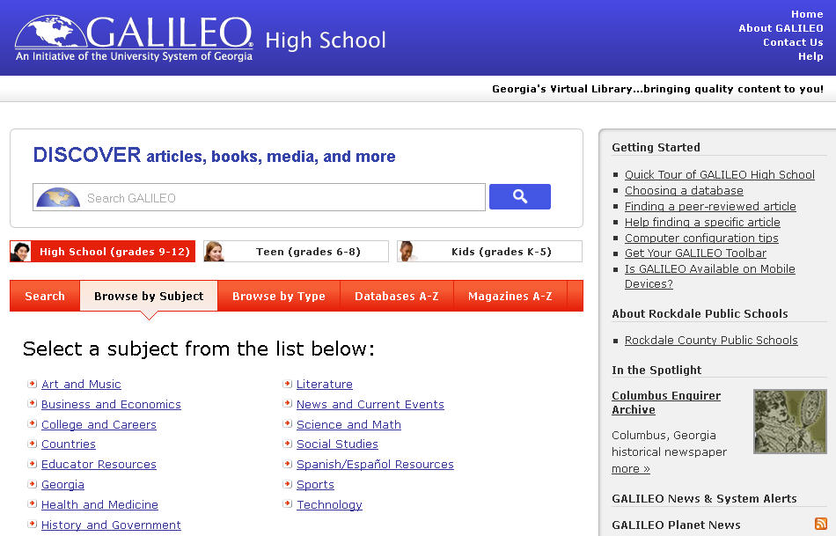
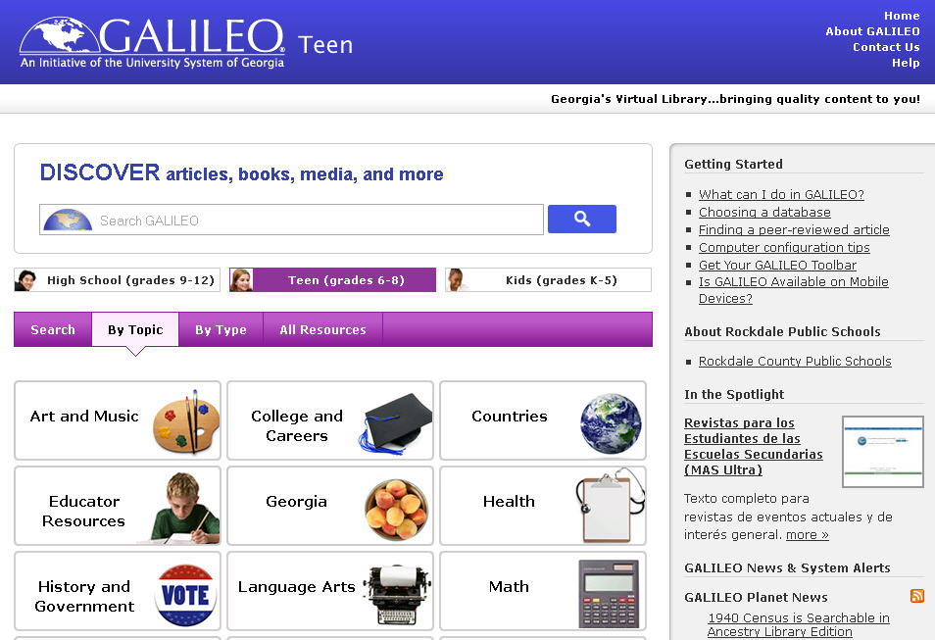
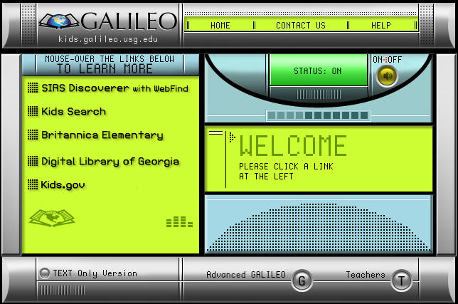
What is GALILEO?
GeorgiA LIbrary LEarning Online
Georgia’s Virtual Library
http://www.galileo.usg.edu
Notes:
What is GALILEO?
GALILEO stands for GeorgiA LIbrary LEarning Online.
It is Georgia's virtual library.
It can be found at http://www.galileo.usg.edu .

Slide 5
Who’s in GALILEO?
Public and Private Schools
Public Libraries
Public and Private Colleges and Universities

Slide 6
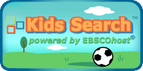
What’s in GALILEO?
Your portal to authoritative age-appropriate databases on multiple topics
Notes:
GALILEO is your portal to hundreds of databases that contain authoritative, subscription-only information that is not available in full text through Google and other search engines.

Slide 7
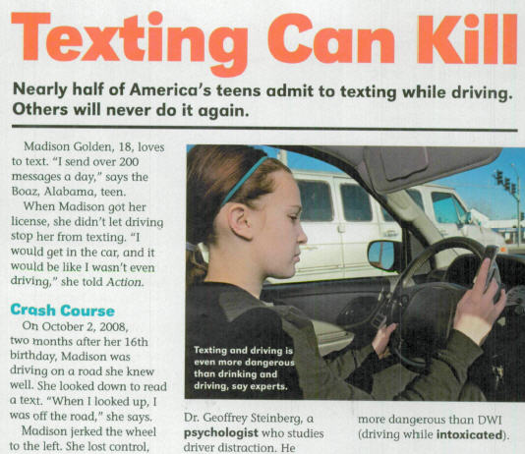
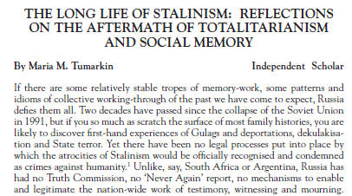
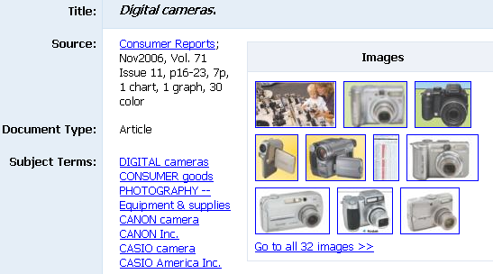
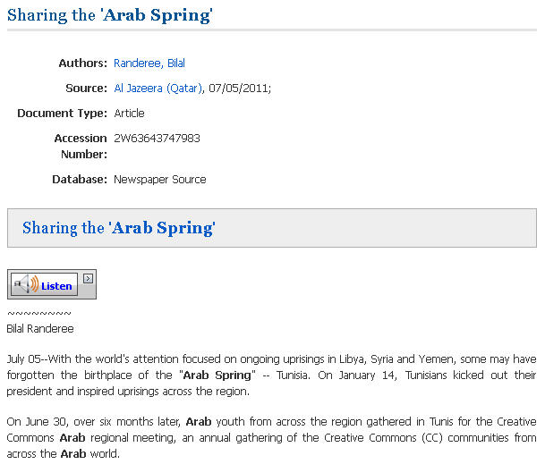
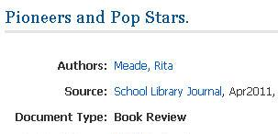
What’s in a database?
Databases can contain
magazine articles,
scholarly journal articles,
newspaper articles,
reviews,
and…
Notes:
So, what can you find in a database? A database can contain magazine articles, scholarly journal articles, newspaper articles, book and product reviews, and…

Slide 8
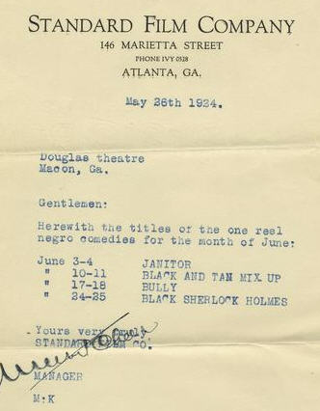
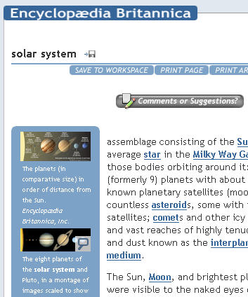
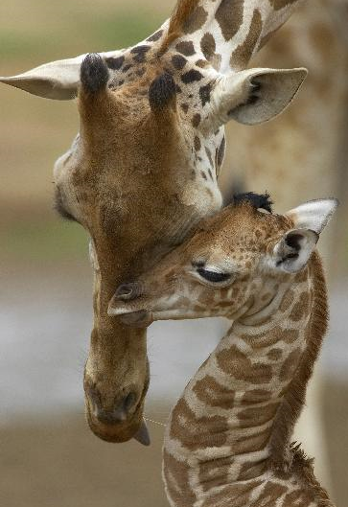
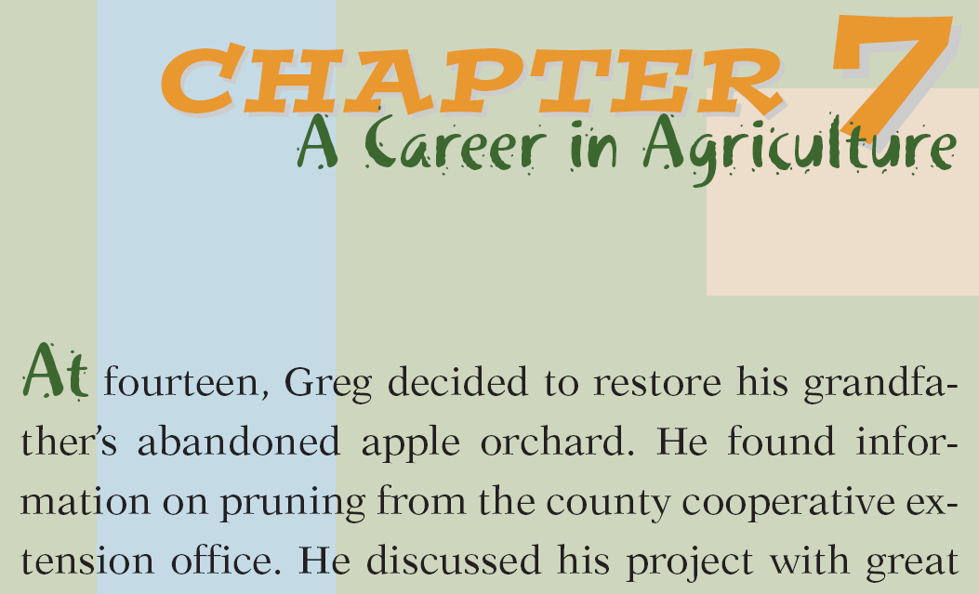
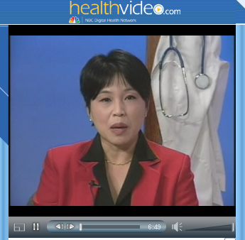
What’s in a database?
Databases can also contain
primary source documents,
encyclopedia entries,
book chapters,
images,
videos,
and much more
Notes:
They can also contain primary source documents, encyclopedia entries, book chapters, images, and videos.

Slide 9
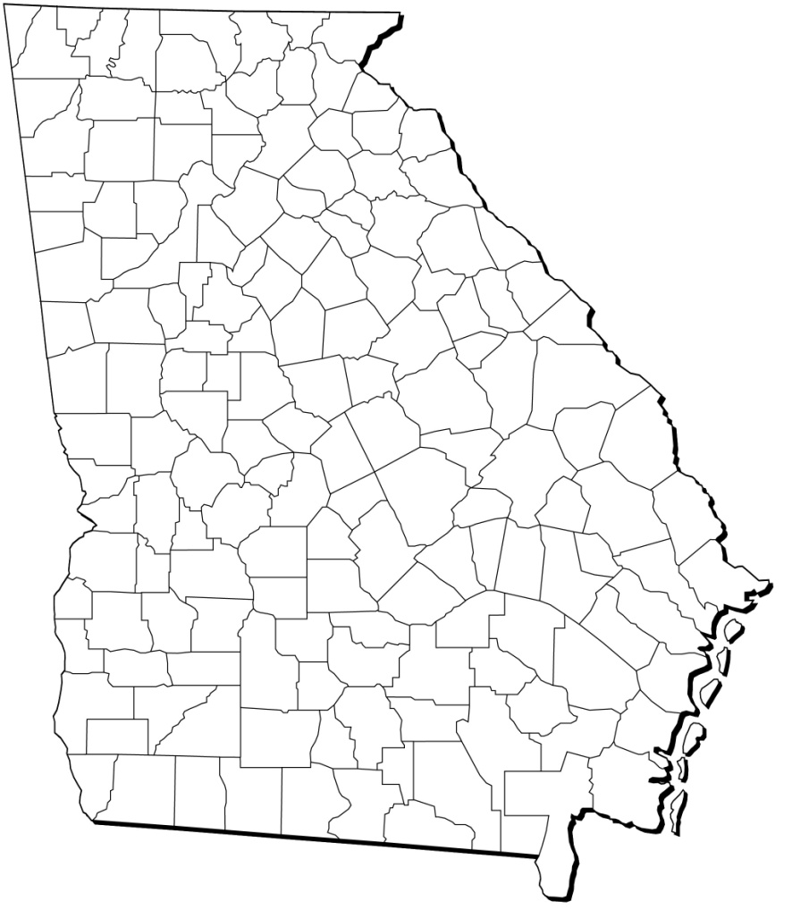
Georgia Resources in GALILEO
Notes:
GALILEO also includes several resources on the history and culture of Georgia, including the Digital Library of
Georgia, the New Georgia Encyclopedia, and GeorgiaInfo.

Slide 10
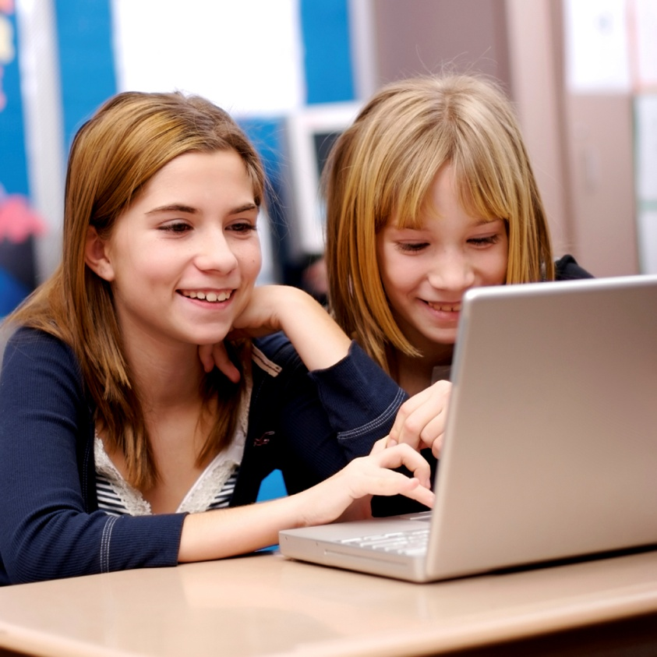
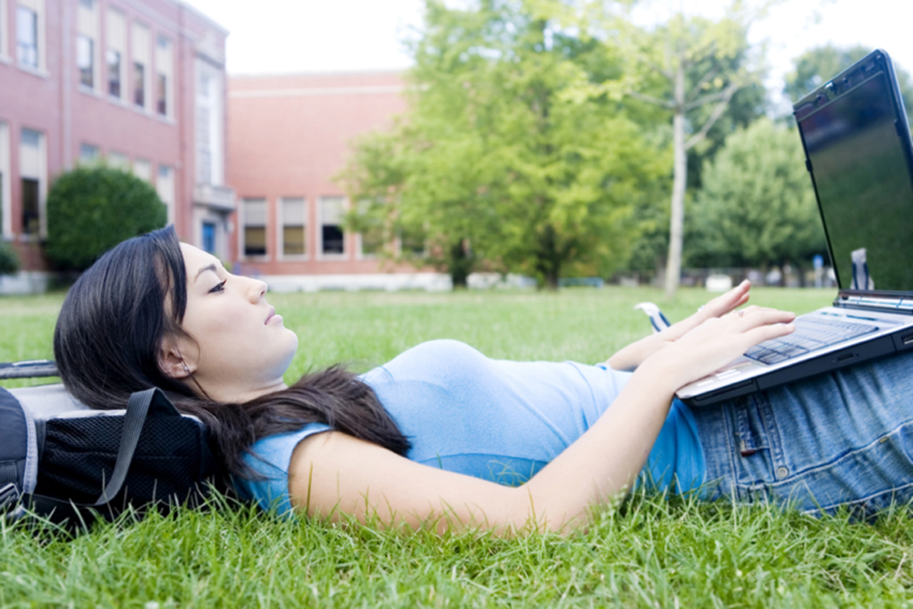
Get GALILEO Anytime, Anywhere
Seamless access on-campus via IP authentication
Log in off campus with GALILEO password
Notes:
GALILEO is available at any time of day and anywhere there is an internet connection, so your students can do research at school or at home.

Slide 11
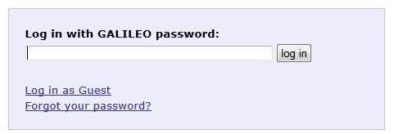
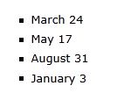
GALILEO Password
Each public school system, private school, public library system, and academic institution gets a unique password
Passwords change 4 times a year
Teachers: Get your password from your media specialist
Media specialists: Request to be added to the password list by contacting us.
Notes:
Any media specialist can be added to the password distribution list to receive a notice of a password change 30 days before it changes. If the password is problematic, let GALILEO staff know.

Slide 12
Up Next
A Tour of GALILEO
http://www.galileo.usg.edu
Notes:
http://www.galileo.usg.edu

Slide 13
Tour
Britannica Elementary
SIRS Discoverer
Kids Search
Digital Library of Georgia
Teen > Georgia
New Georgia Encyclopedia
Teen > NoveList K-8

Slide 14
GALILEO offers
On-level informational text
Primary sources
Multimedia
Citing
Curriculum Tools
Lesson Plans from GALILEO

Slide 15
Informational Text ELACCXRI: Reading Informational Standards
Britannica Elementary
Encyclopedia articles at an elementary reading level
Click speaker icons for articles to be read aloud
SIRS Discoverer
Magazine articles from children’s magazines
Newspaper articles
Kids Search
Magazine and newspaper articles

Slide 16
Literary Text ELACCXRL: Reading Literary Standards
NoveList K-8
Book and author recommendations
Curriculum-based book lists (by grade and topic)
Picture Book Extenders - activities to accompany picture books

Slide 17
On-Level Text
Many GALILEO resources include Lexile scores
See Lexile Handout

Slide 18
Primary Sources LXRH: Literacy Standards for Reading in History and Social Studies
Kids Search
Digital Library of Georgia
SIRS Discoverer
Maps – current, historical, and outline
See more at
Teen > By Type > Primary Source Documents
Annals of American History (from Britannica)
American Memory (from Library of Congress)
History Reference Center (grades 5-12)

Slide 19
Multimedia
GALILEO offers resources with images, videos, and/or audio
Britannica Elementary
Images and videos with preformatted citations
SIRS Discoverer
Images, diagrams, charts
Digital Library of Georgia
Historical images, some audio and video
See more in
Teen > By Type > Pictures, Maps, and Flags

Slide 20
Citing Sources
Several GALILEO resources have pre-formatted citations for articles

Slide 21
Citing Sources
Several GALILEO resources offer persistent links to articles

Slide 22
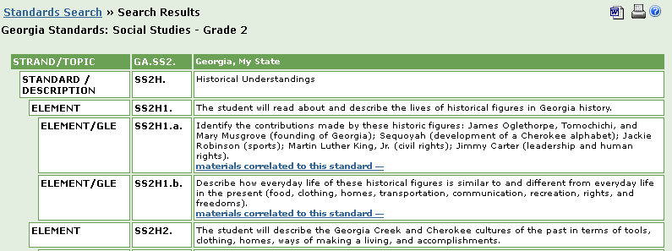
Encyclopædia Britannica
Look in Teachers’ Resources in Britannica Elementary
Click the orange buttons for Curriculum Standards tool

Slide 23
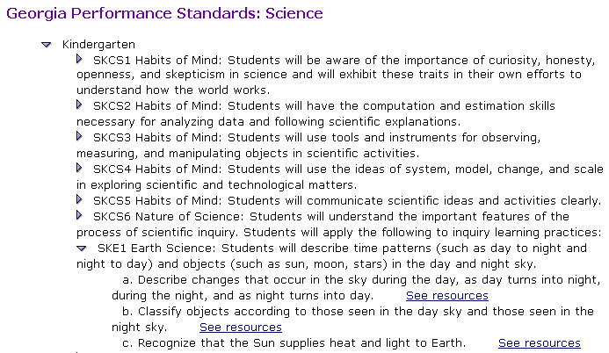
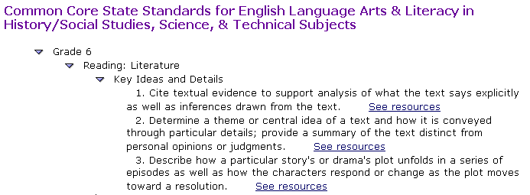
SIRS Resources Correlated to Standards
SIRS Discoverer
Look in Educators’ Resources or click the Common Core Correlations link

Slide 24
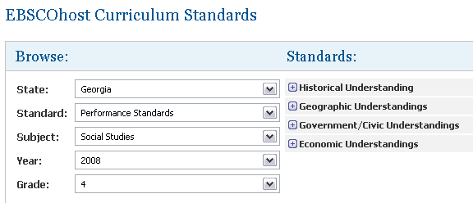
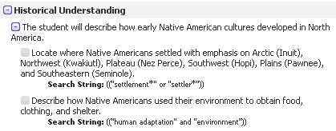
EBSCO Curriculum Standards
Appears in Kids Search and History Reference Center
Look in Teacher Resources or Curriculum Standards

Slide 25
Linking to GALILEO Databases Express Links!!
Link directly to one GALILEO resource from your website
Students at home are only asked for the GALILEO password
Find all of your Express Links at GALILEO High School > Databases A-Z > Express Links

Slide 26
GALILEO Lesson Plans
Where I’m From in GALILEO – create a local history poem
Create Your Own Story – create a digital story

Slide 27
Questions?
For assistance, contact your media specialist or
Contact Us
http://www.galileo.usg.edu/contact

